Slide 1

Chapter 2
Acids and Bases:
Central to Understanding Organic Chemistry
Paula Yurkanis Bruice
University of California,
Santa Barbara

Slide 2
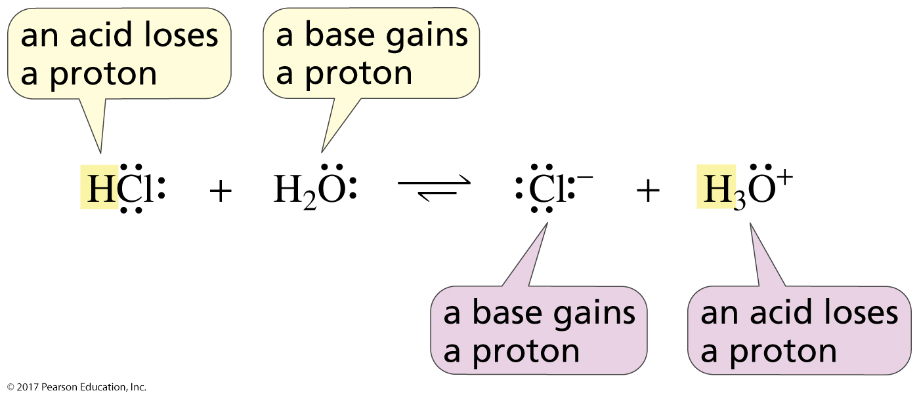
An Acid Loses a Proton
A Base Gains a Proton

Slide 3
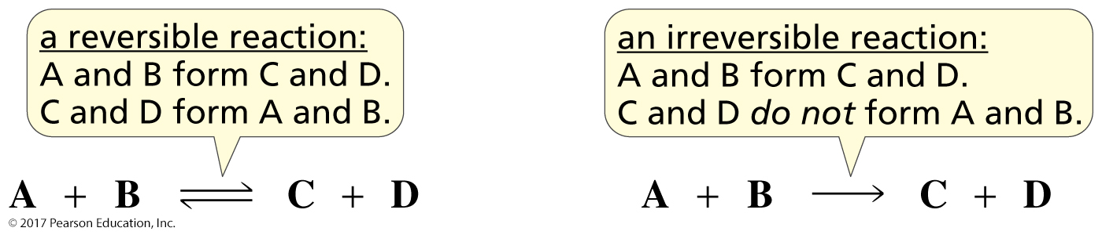
Most Acid–Base Reactions
Are Reversible

Slide 4
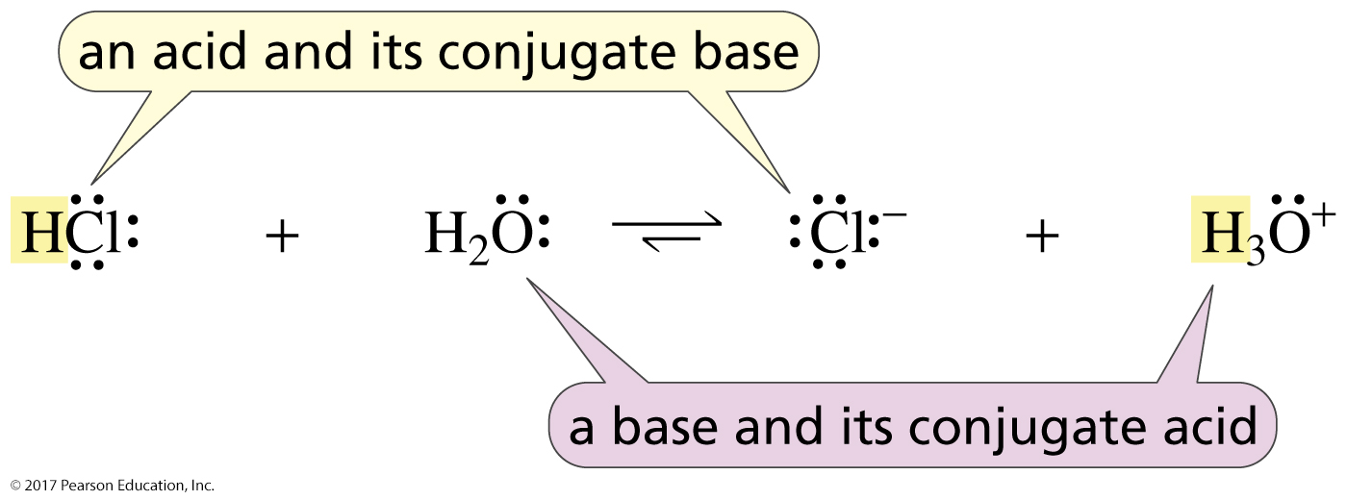
An Acid and Its Conjugate Base
A Base and Its Conjugate Acid
When an acid loses a proton, it forms its conjugate base.
When a base gains a proton, it forms its conjugate acid.

Slide 5
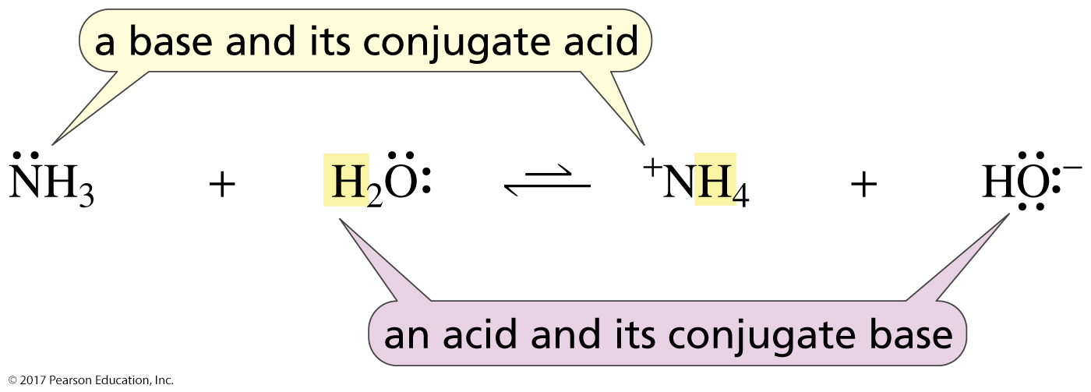
An Acid and Its Conjugate Base
A Base and Its Conjugate Acid
When an acid loses a proton, it forms its conjugate base.
When a base gains a proton, it forms its conjugate acid.
The stronger the acid,
the weaker its conjugate base.

Slide 6
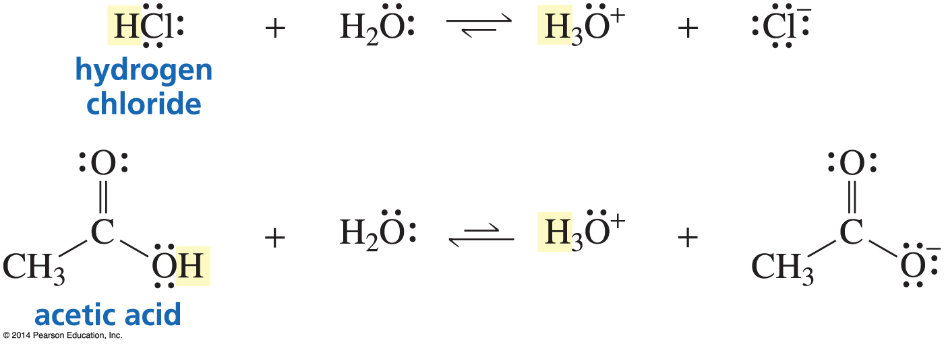
Acids Have Different Strengths
Strong acid: products are favored at equilibrium
Weak acid: reactants are favored at equilibrium

Slide 7
An Acid/Base Equilibrium
Acidity constant Ka
A measure of acid strength in water
For any weak acid HA, the acidity constant is given by the expression Ka
pH = -log [ H⁺]
[H⁺]
pK_{a} גדול יותר חומצה יותר חלשה
[HA]
K_{a} גדול יותר חומצה יותר חזקה
K_{a}: The acid dissociation constant

Slide 8
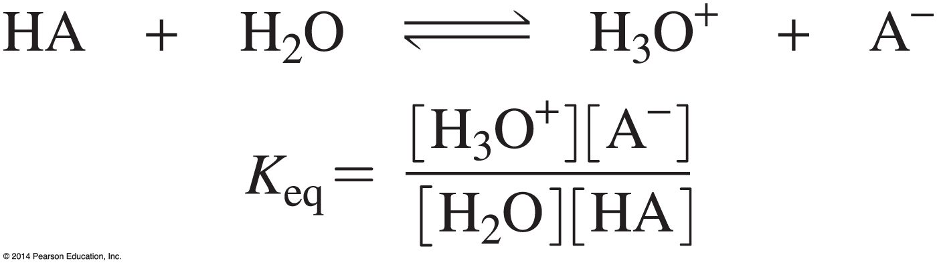
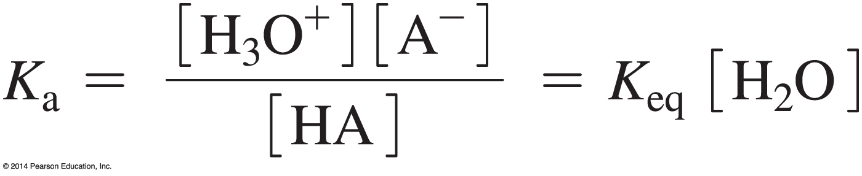
The Acid Dissociation Constant (K_{a}) is a
Measure of the Extent of Dissociation of an Acid
Put the constants on the same side of the equation.

Slide 9

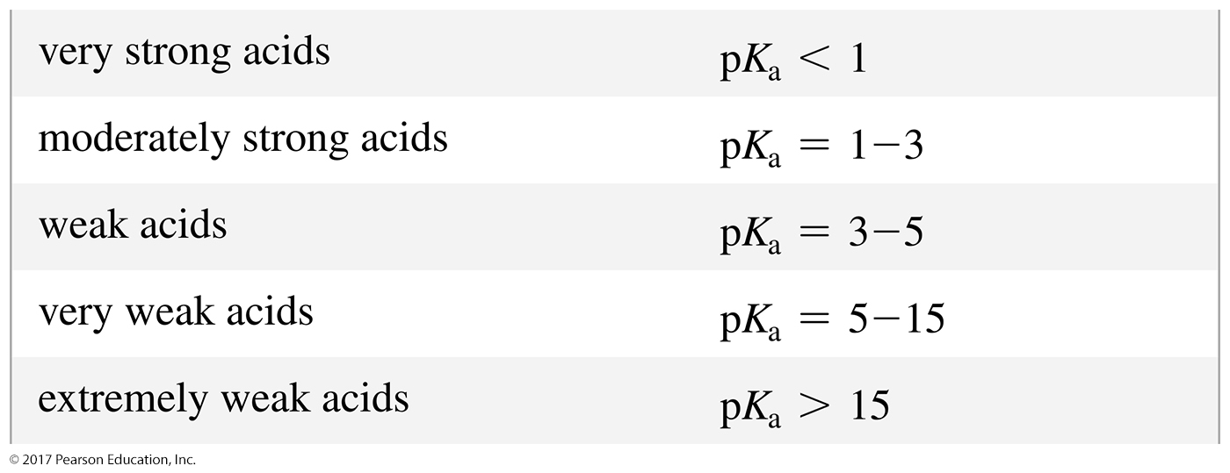
Acid Strength
The stronger the acid, the larger the K_{a}.
The stronger the acid, the smaller the pK_{a}.

Slide 10
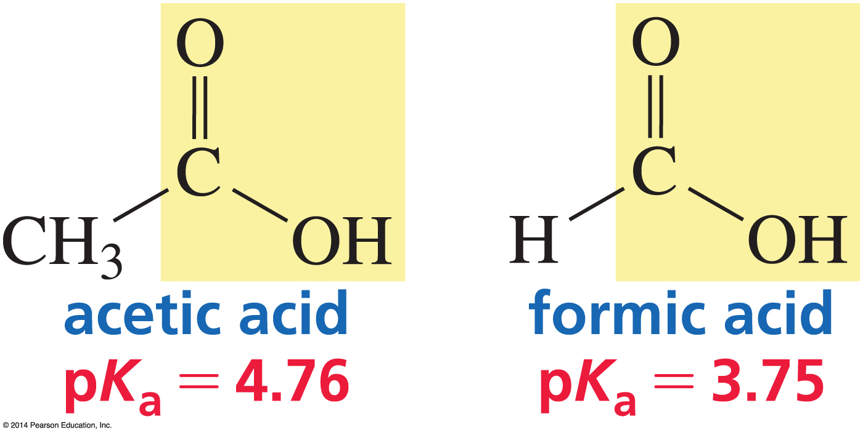
Carboxylic Acids are the Most
Common Organic Acids

Slide 11
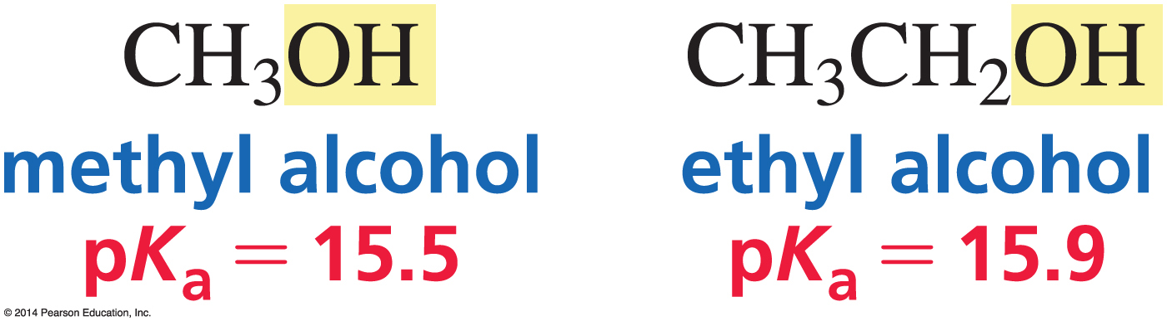
Alcohols

Slide 12
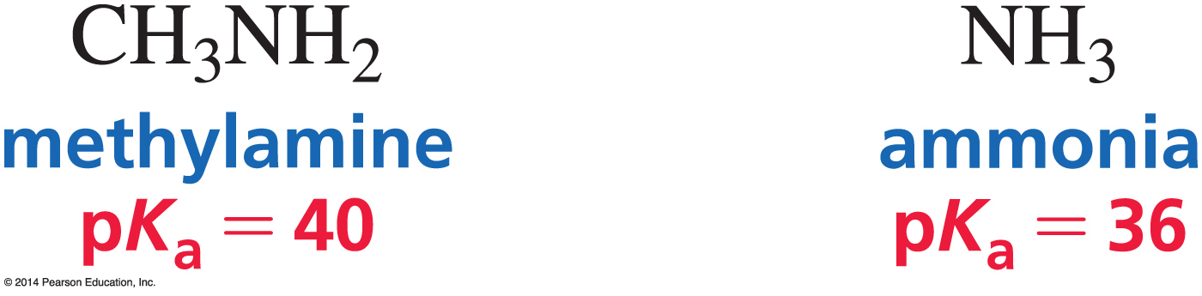
Amines

Slide 13
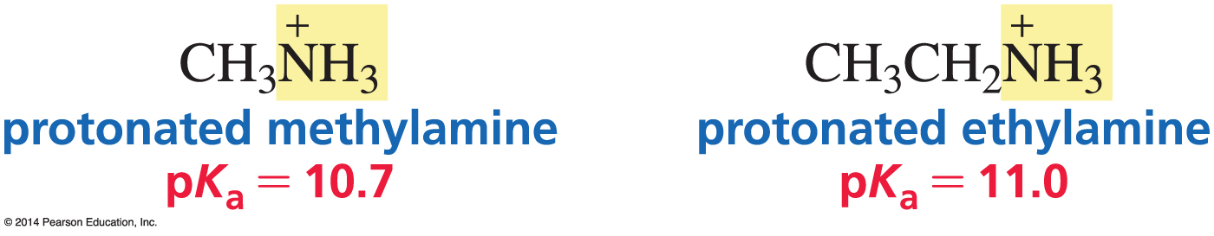
Protonated Amines

Slide 14
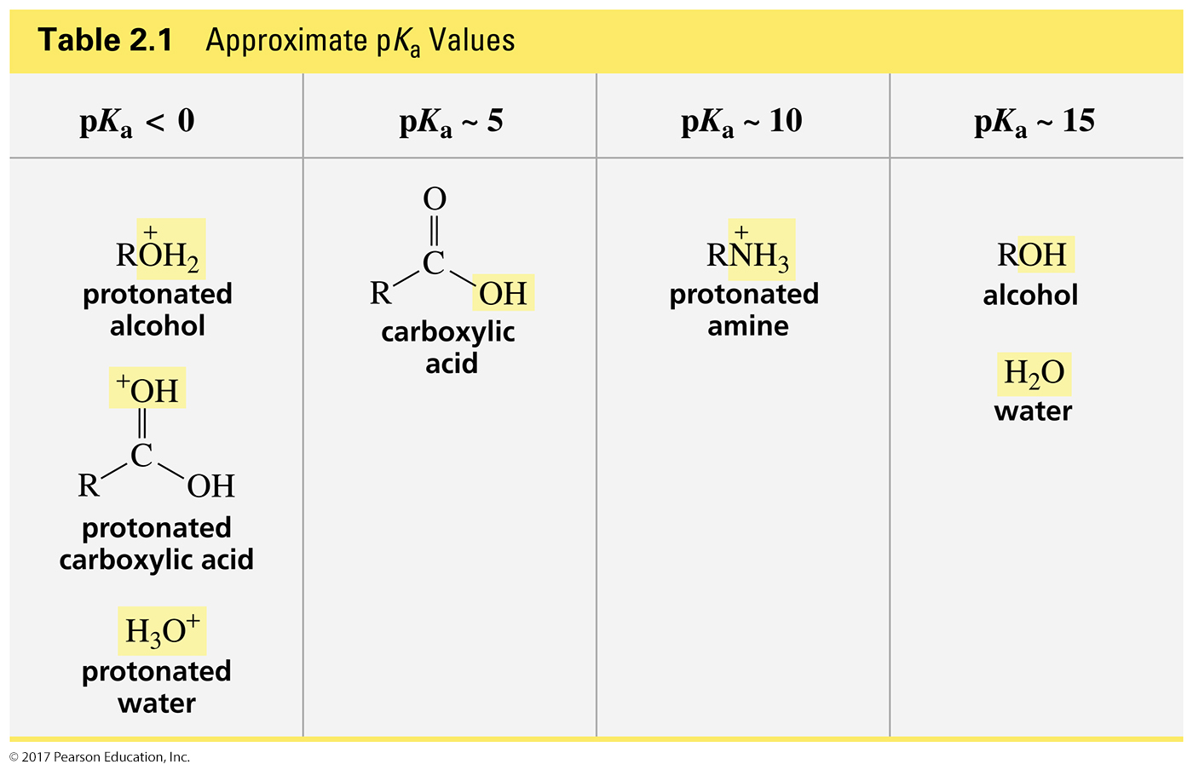
Approximate pK_{a} Values

Slide 15
RCO₂H חומצות קרבוקסיליות,
חומצות חלשות
חומצה חזקה יותר , בסיס מצומד חלש יותר
חומצות חזקות:
HCl (חומצת מלח) pK_{a}= -7
HBr ((pK_{a}= -9
HI ((pKa= -10
חומצה חנקתית (HNO₃, pKa= -1.3)
חומצה גופרתית (H₂SO₄, pKa= -5)
למימן הראשון

Slide 16
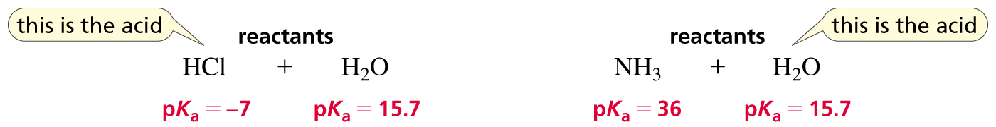
Which Reactant is the Acid?
The stronger acid behaves as the acid.
Water is the base.
Water is the acid.

Slide 17
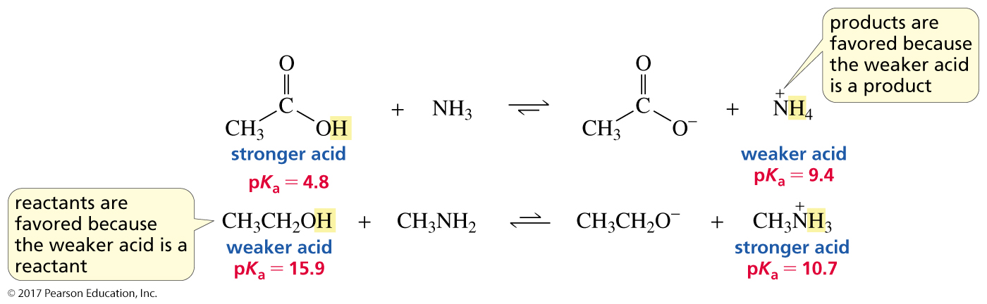
The Position of Equilibrium
The equilibrium favors formation of the weaker acid.

Slide 18
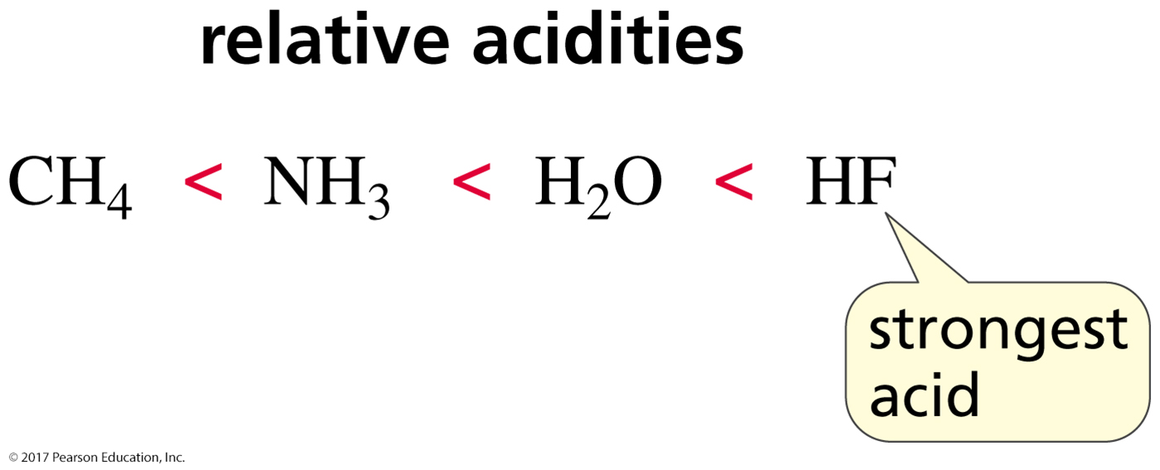
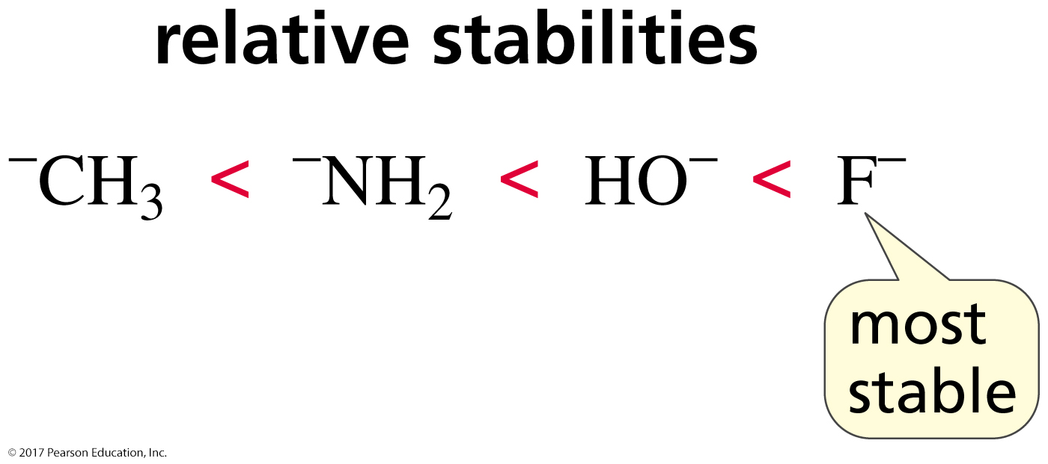
The Strength of an Acid is Determined by the Stability of Its Conjugate Base
The more stable the conjugate base, the stronger the acid.
Stable bases are weak bases.

Slide 19
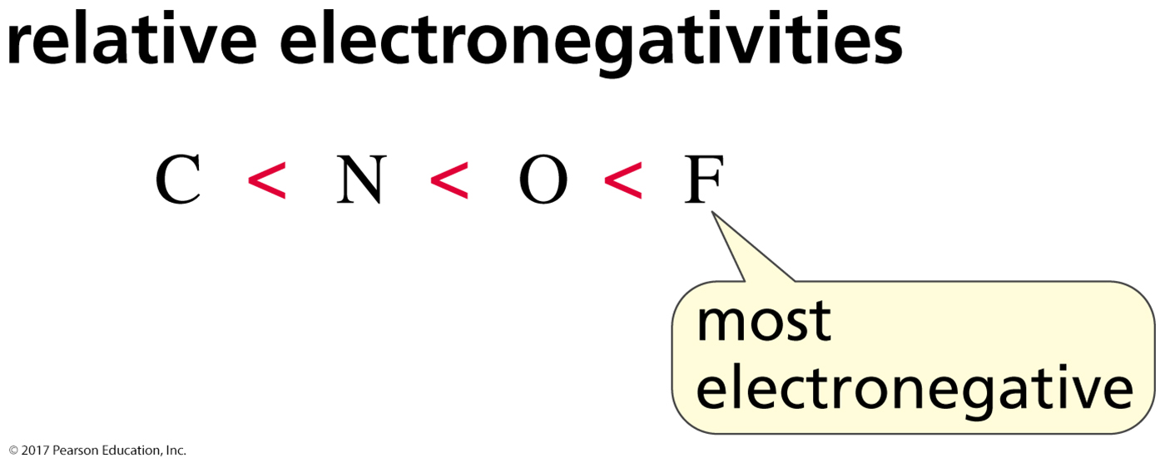
Electronegativity Affects pK_{a} Values
When atoms are the same size,
the strongest acid has its hydrogen attached
to the most electronegative atom.

Slide 20
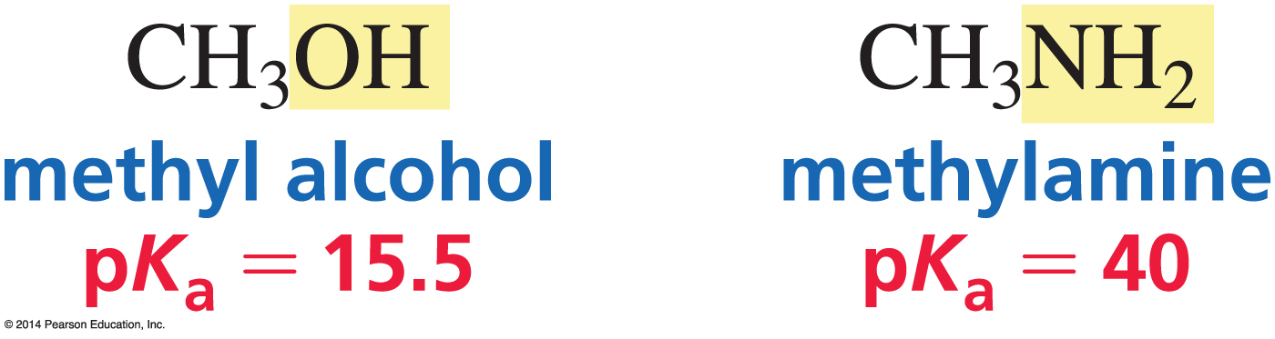
Why are Alcohols Stronger Acids
than Amines?
Oxygen is more electronegative than nitrogen.

Slide 21
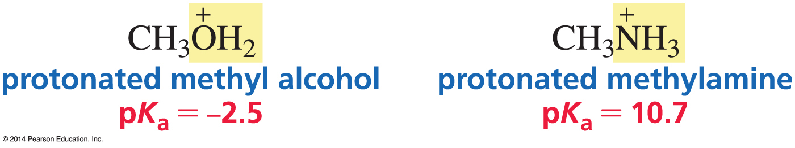
Why are Protonated Alcohols Stronger Acids than Protonated Amines?
Oxygen is more electronegative than nitrogen.

Slide 22
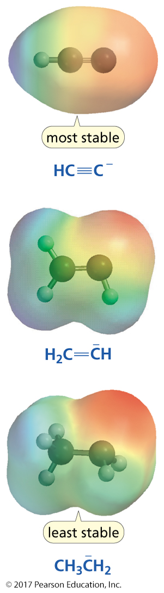
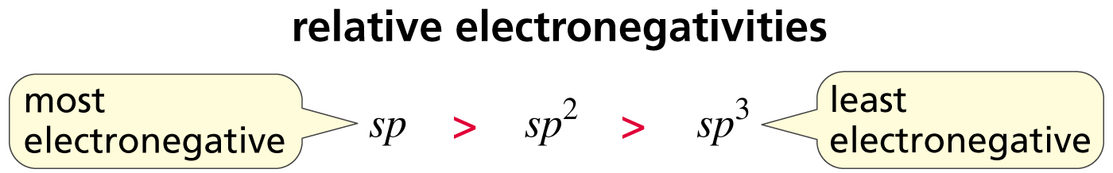
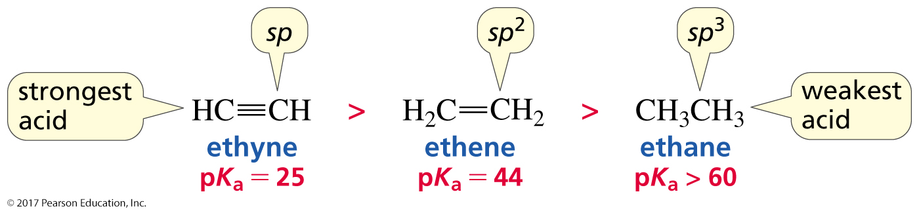
Hybridization Affects Electronegativity
The strongest acid has the
most stable (weakest) conjugate base.

Slide 23
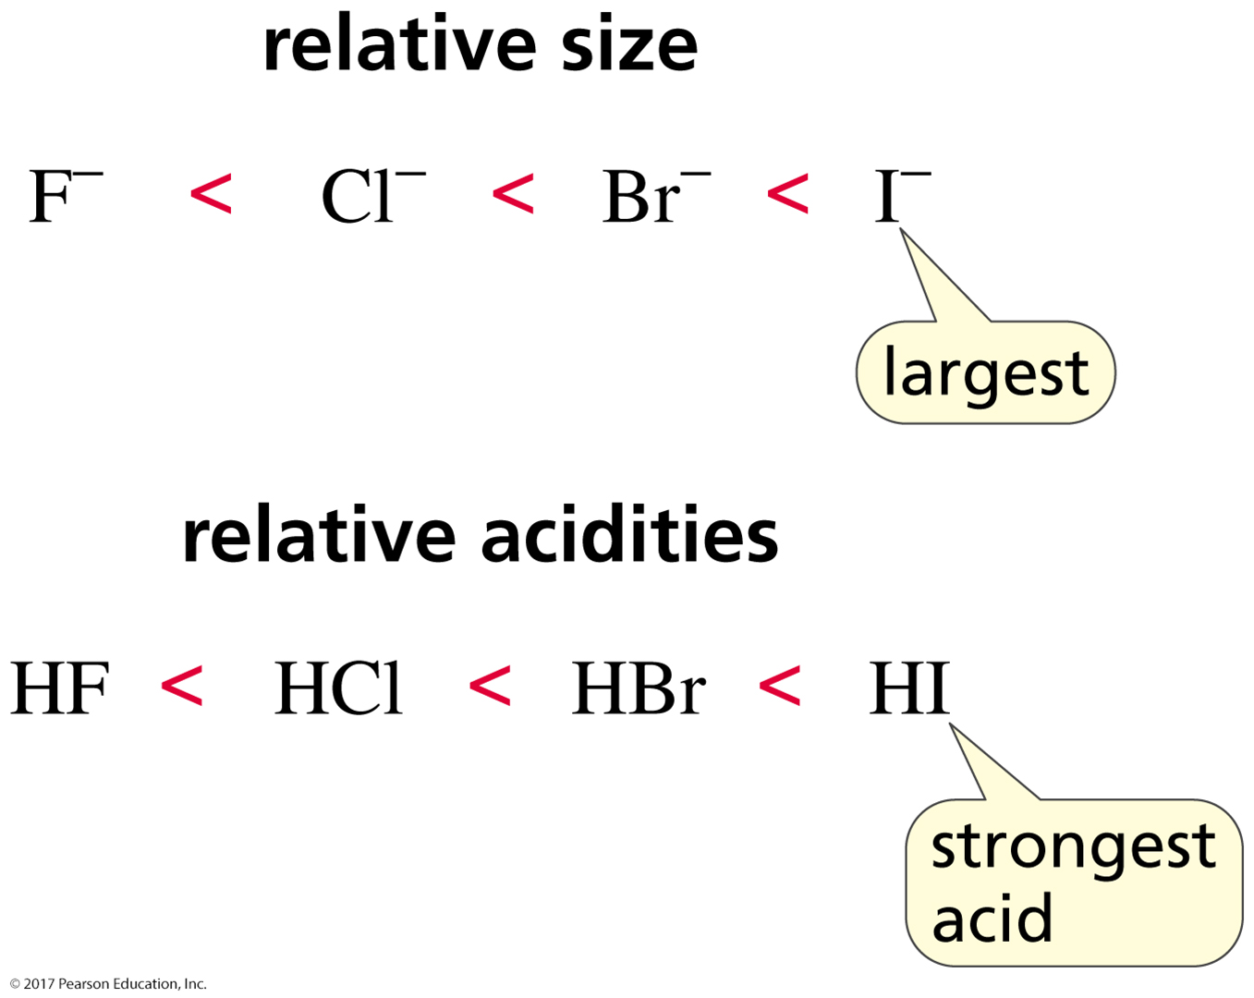
Size Affects pK_{a} Values
When atoms differ in size,
the strongest acid has its hydrogen bonded
to the largest atom.

Slide 24

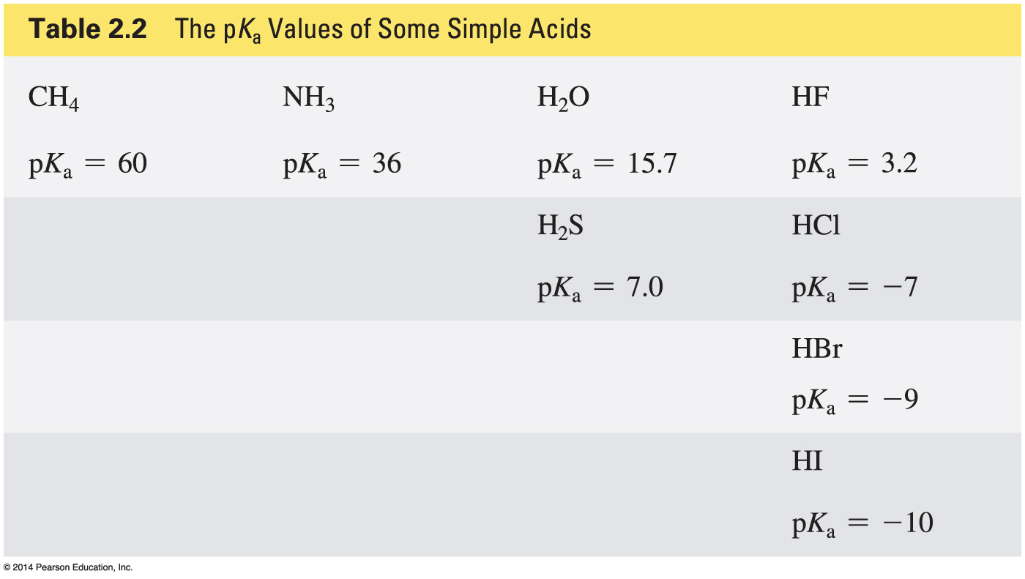
Some pK_{a} Values

Slide 25
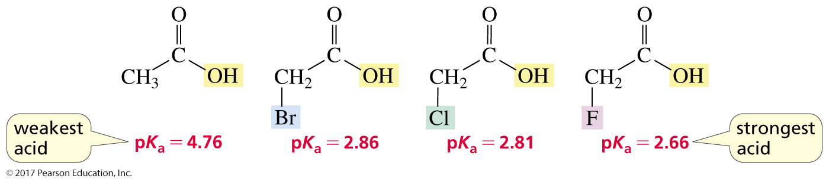
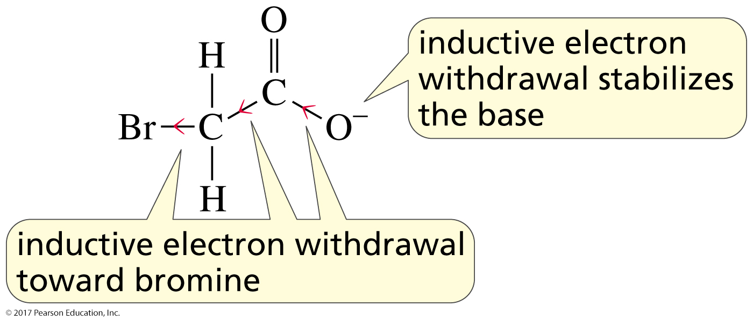
Substituents Affect the Strength of an Acid
inductive electron withdrawal

Slide 26
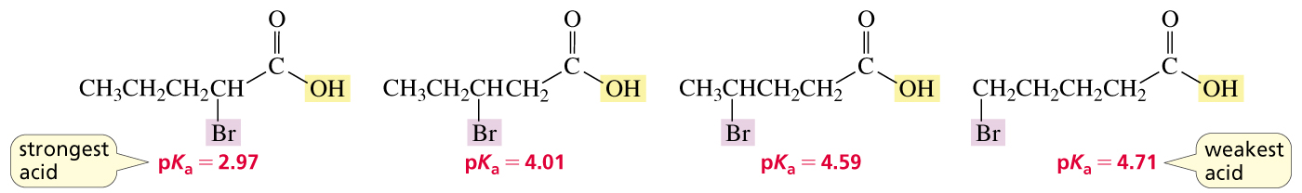
A Substituent’s Effect on pK_{a}
Depends on Distance

Slide 27
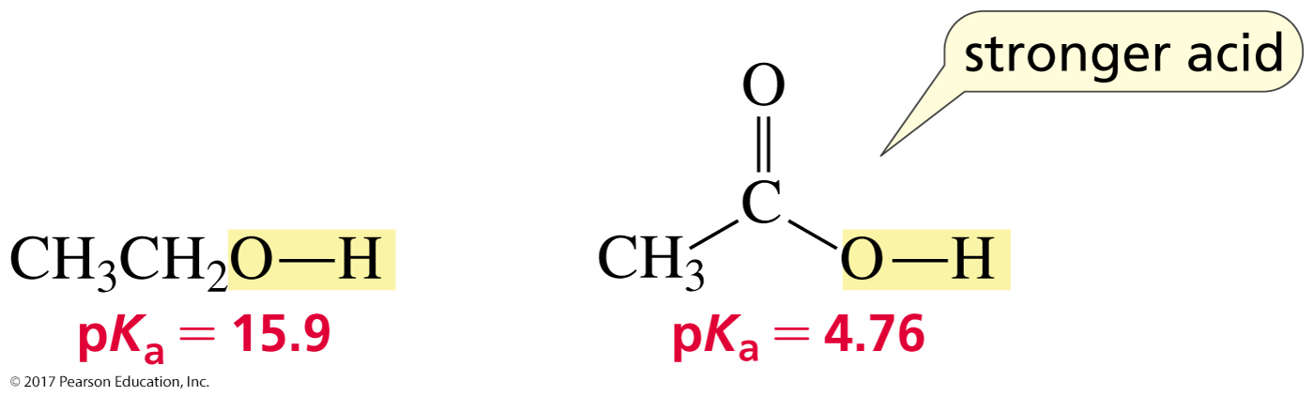
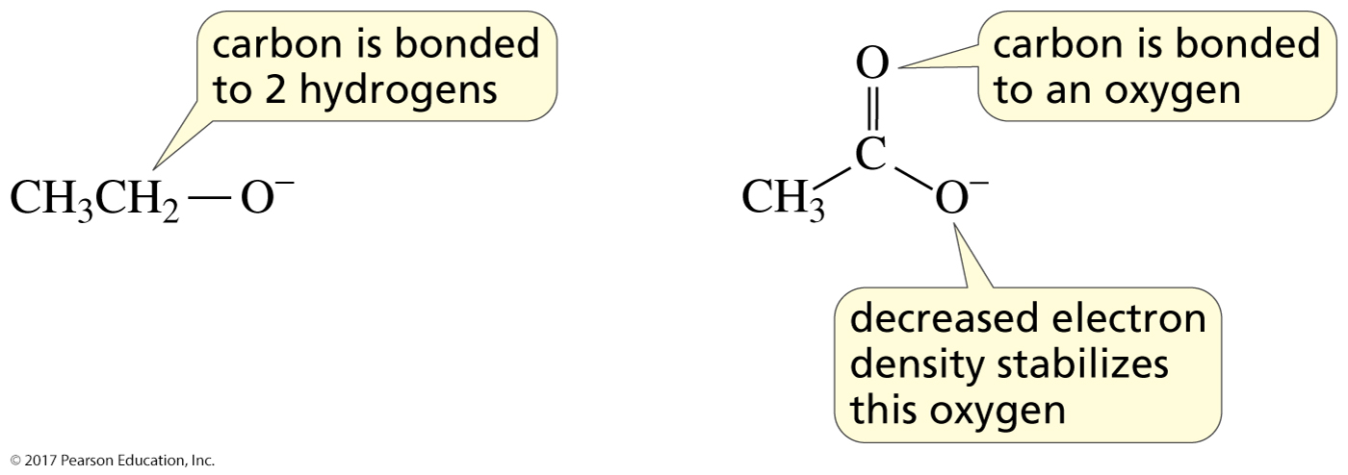
Why is a Carboxylic Acid a Stronger Acid than an Alcohol?
1. Inductive electron withdrawal

Slide 28
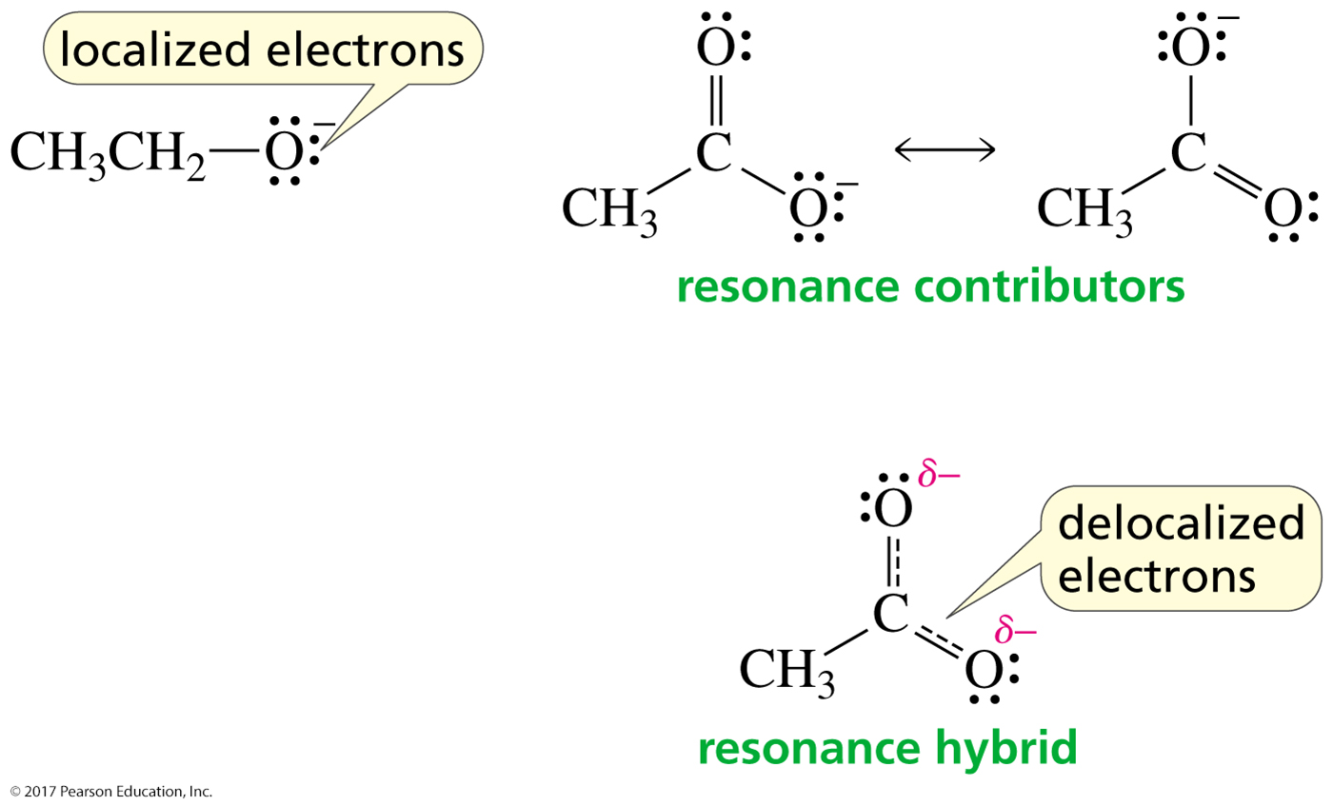
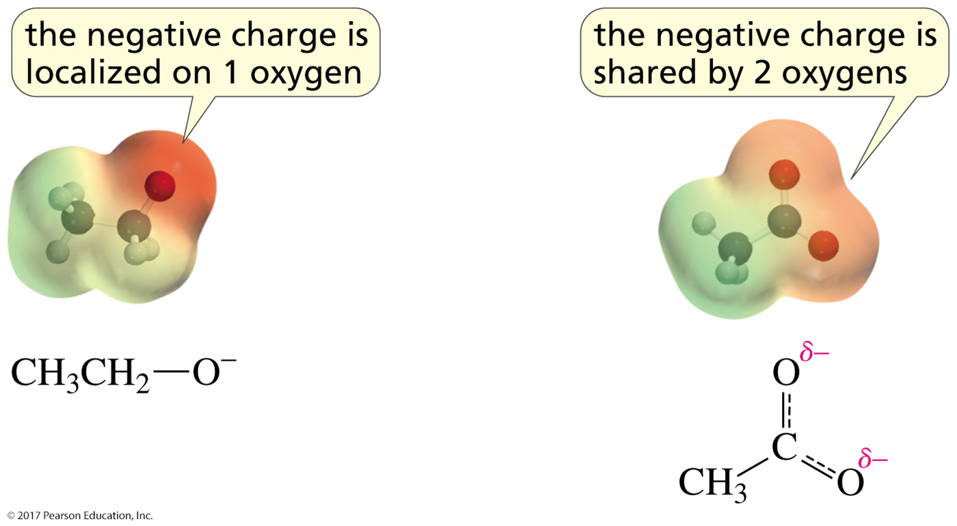
Why is a Carboxylic Acid a Stronger Acid than an Alcohol?
2. Delocalized electrons

Slide 29
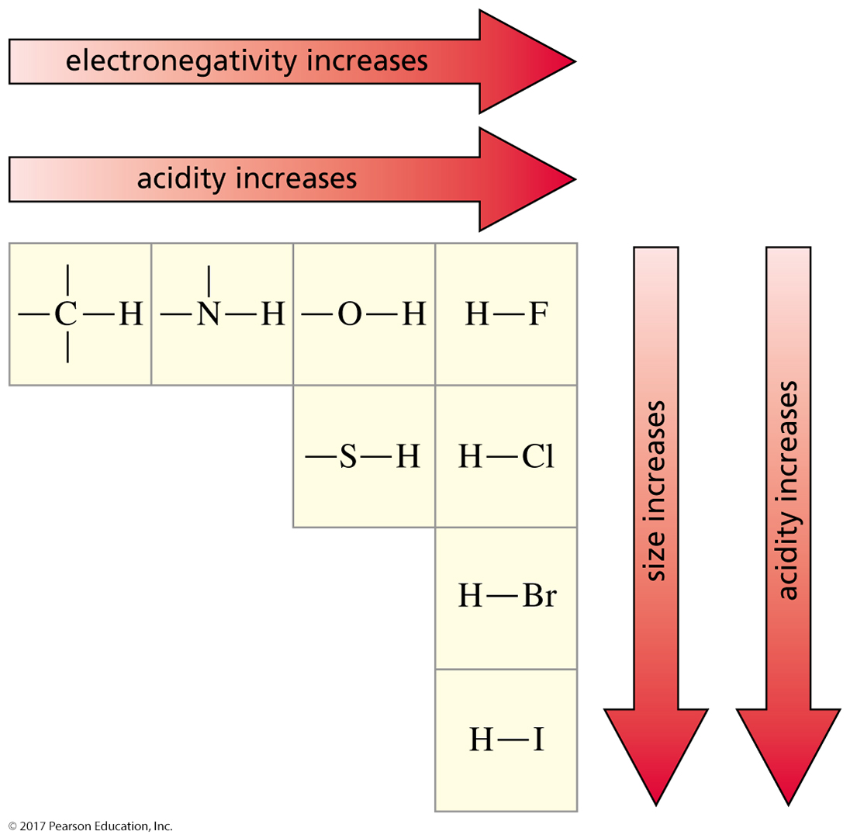
Summary of Factors
That Affect Acid Strength
electronegativity and size

Slide 30
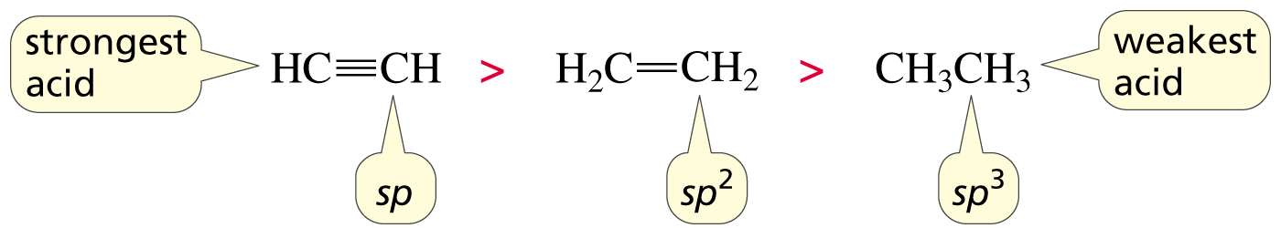
Summary of Factors
That Affect Acid Strength
hybridization

Slide 31
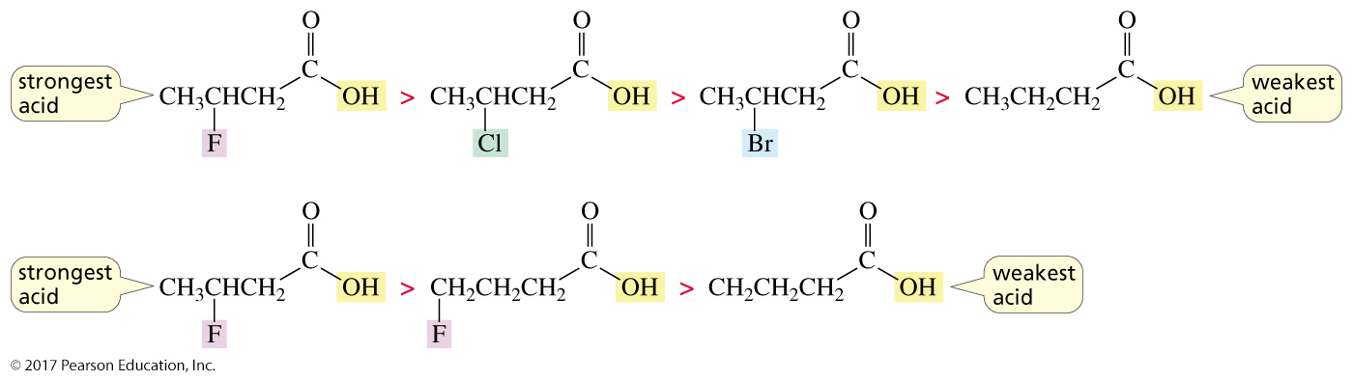
Summary of Factors
That Affect Acid Strength
inductive electron withdrawal

Slide 32
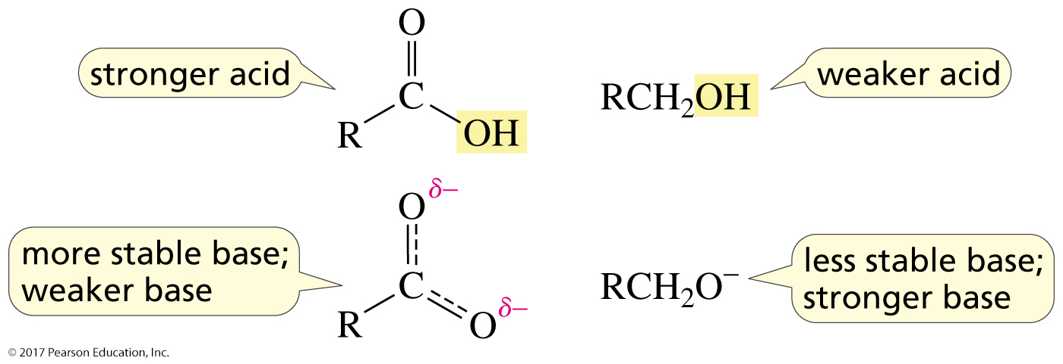
Summary of Factors
That Affect Acid Strength
electron delocalization

Slide 33
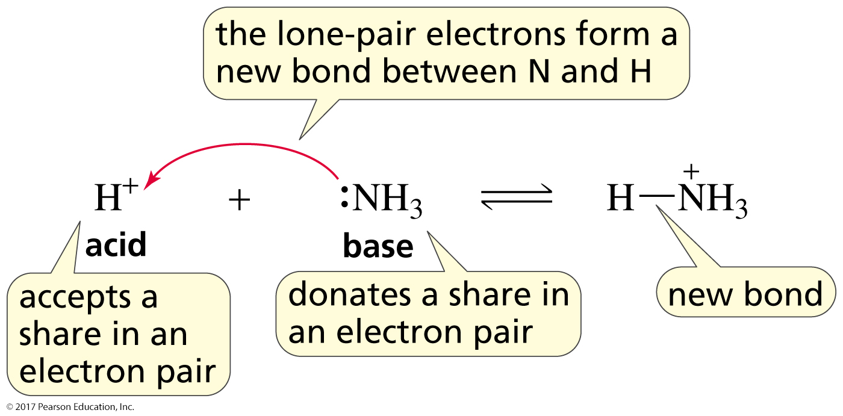
Lewis Acids and Bases
Lewis acid: a species that accepts a share in an electron pair
Lewis base: a species that donates a share in an electron pair
All Brønsted acids are Lewis acids.
All Brønsted bases are Lewis bases.

Slide 34
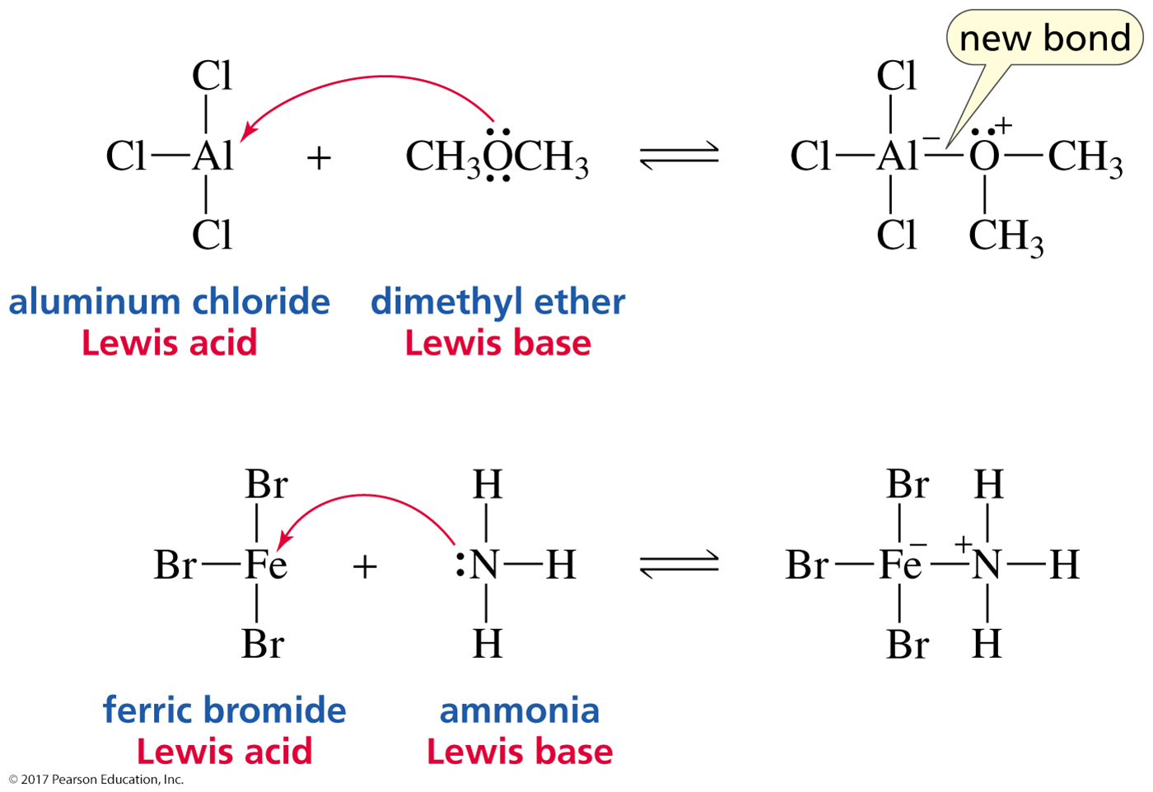
Lewis Acids and Bases

Slide 35
How Chemists Use the Terms
“acid” = a proton-donating acid
“Lewis acid” = a non-proton-donating acid
All bases are Lewis bases
because they have a pair of electrons they can share.

