Slide 1
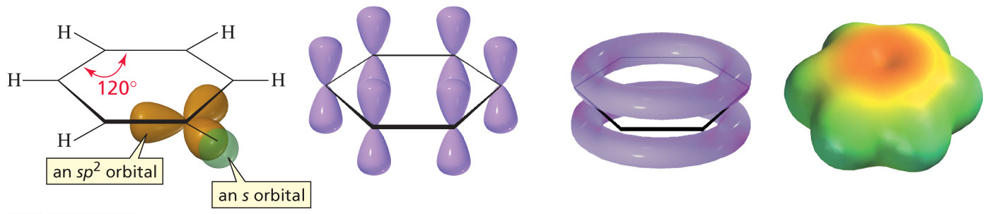
The Structure of Benzene
Compounds like benzene, which have relatively few hydrogens in relation to the
number of carbons, are typically found in oils produced by trees and other plants.
Early chemists called such compounds aromatic compounds because of their pleasing fragrances

Slide 2
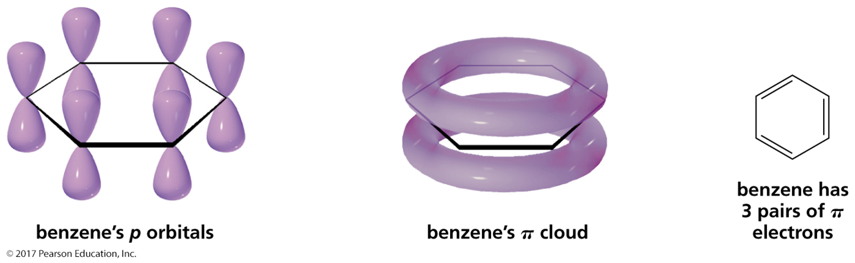
Criteria for a Compound to Be Aromatic
It must have an uninterrupted cloud of π electrons.
(cyclic, planar, and every ring atom must have a p orbital)
The π cloud must have an odd number of pairs of π electrons.

Slide 3
The Hückel 4n + 2 Rule
Developed by Erich Hückel in 1931
States that a molecule can be aromatic only if:
  It has a planar, monocyclic system of conjugation
  It contains a total of 4n + 2π electrons
    n = 0,1,2,3…
  4n π electrons are considered antiaromatic
(cyclic, planar, and every ring atom must have a p orbital)
Notes:
Aromaticity and the Hückel 4n + 2 rule

Slide 4
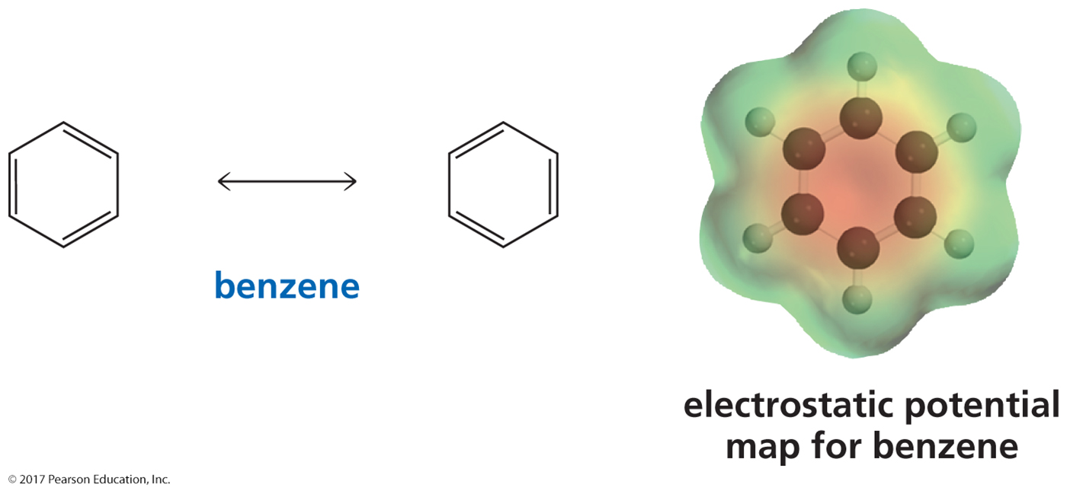
Benzene is an Aromatic Compound
Benzene is cyclic, is planar,
has an interrupted cloud of π electrons,
and has three pairs of electrons in the π cloud.
It is an unusually stable compound.
Benzene is aromatic.

Slide 5
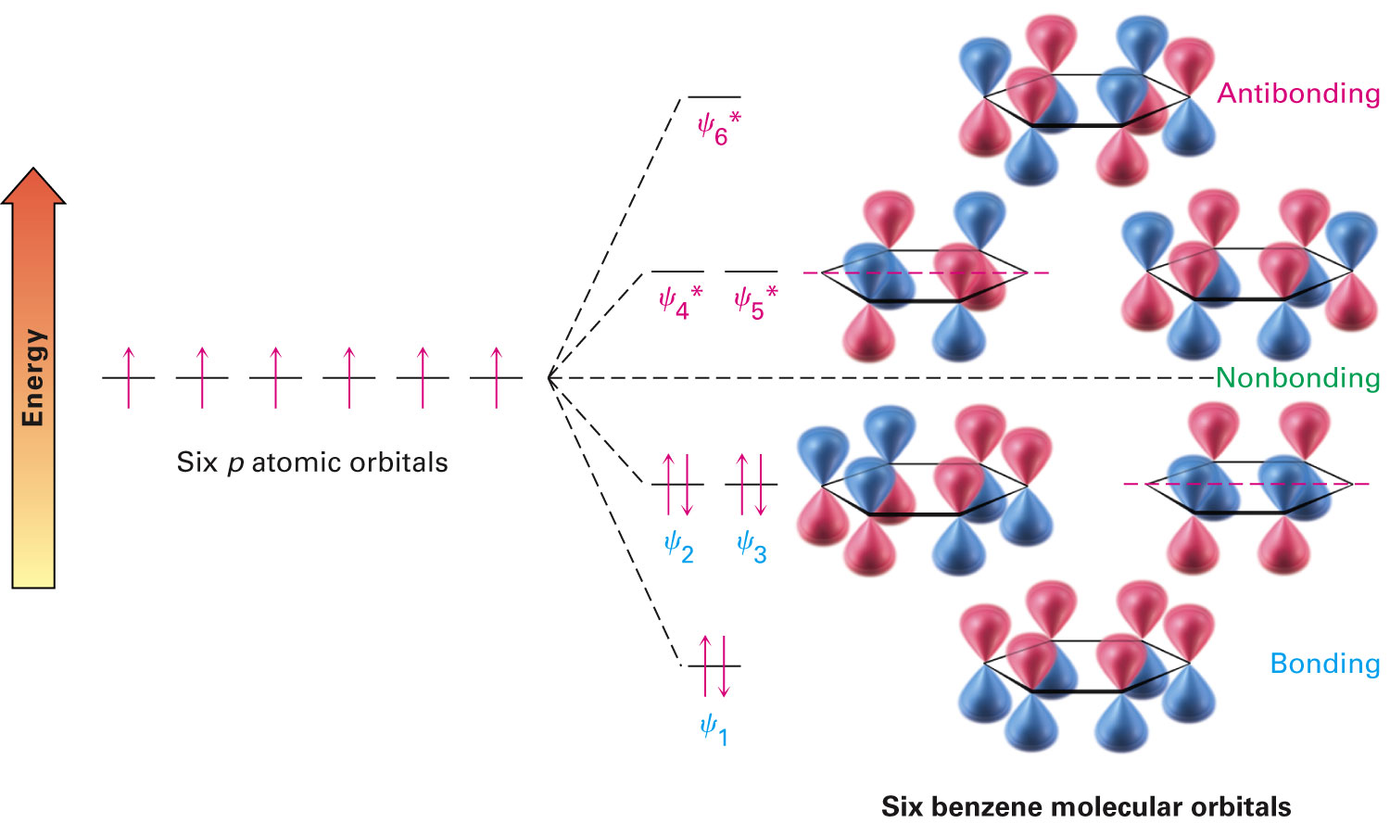
Molecular Orbital Description of Benzene
The 6 p-orbitals combine to give:
  Three bonding orbitals with 6 π electrons
  Three antibonding with no electrons
Orbitals with the same energy are degenerate
Notes:
Structure and stability of benzene

Slide 6
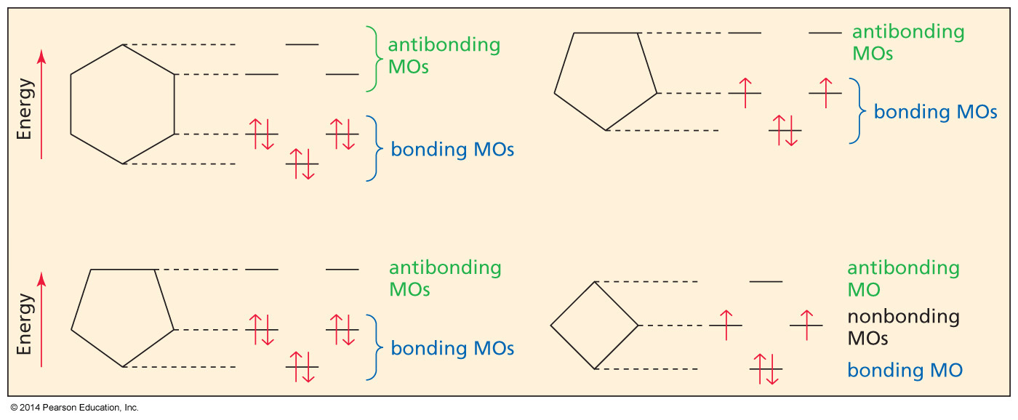
A Molecular Orbital Description
of Aromaticity
A compound with an odd number of pairs of π electrons
has completely filled bonding molecular orbitals.

Slide 7
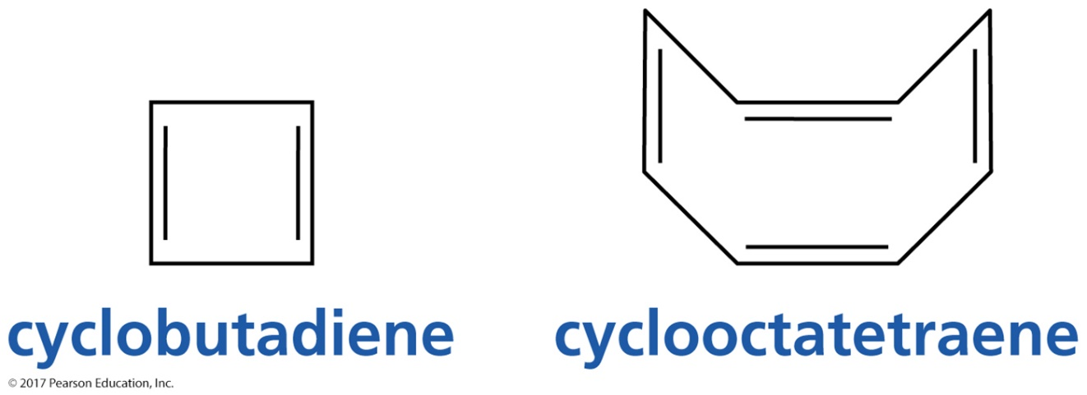
Examples of Compounds
That Are Not Aromatic
Cyclobutadiene has an even number of pairs of π electrons.
Cyclooctatetraene has an even number of pairs of π electrons, and it is not planar.

Slide 8
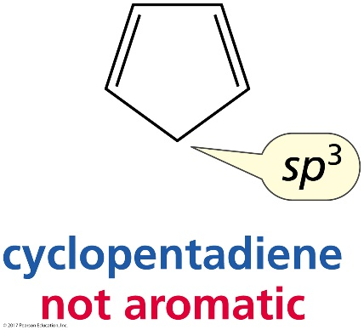
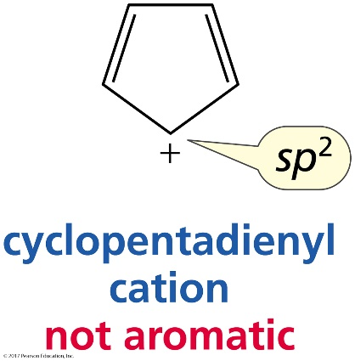
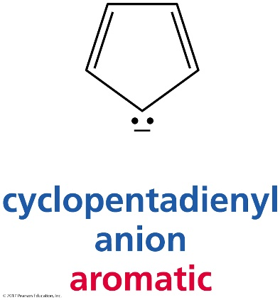
Nonaromatic and Aromatic Compounds
not aromatic because
it has an sp³ carbon
not aromatic because
it has an even number of pairs of π electrons
aromatic

Slide 9
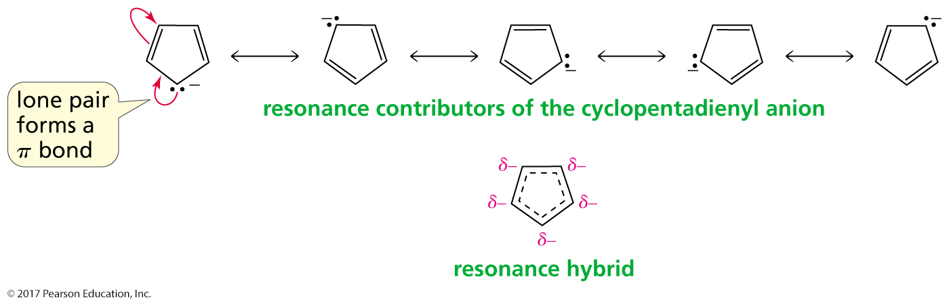
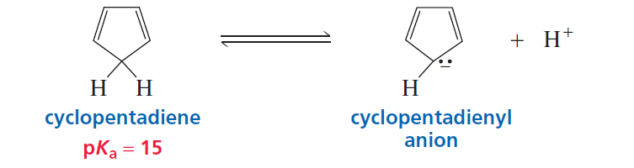
How Do We Know That Cyclopentadiene’s
Lone-Pair Electrons Are π Electrons?
If a lone pair can be used to form a π bond in a resonance contributor,
the lone-pair electrons are π electrons.
מימנים יחסית חומציים-נוצר אניון ארומטי-יציב

Slide 10
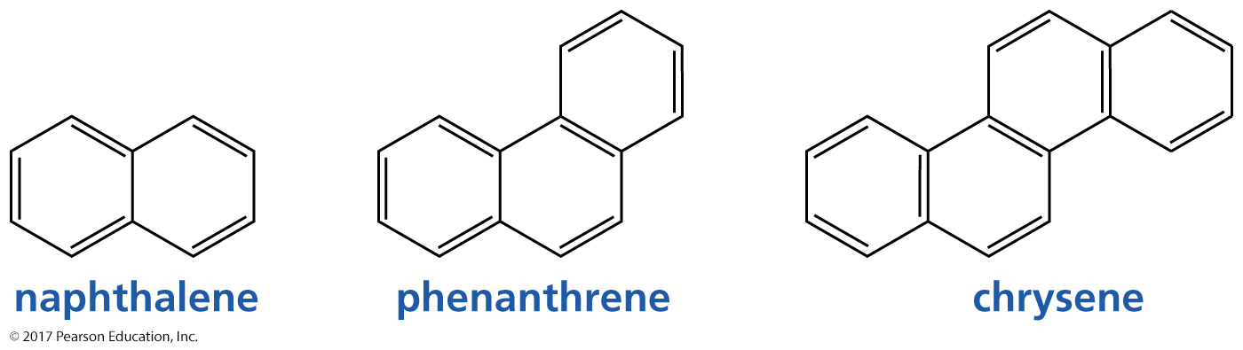
Aromatic Compounds

Slide 11
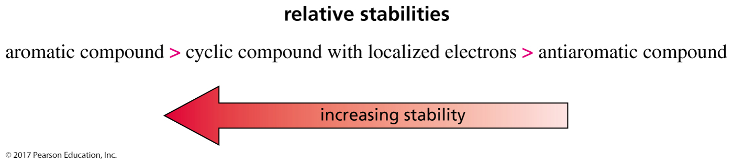
Antiaromatic Compounds
An antiaromatic compound fulfills the first criterion for aromaticity
but has an even number of π electrons.

Slide 12
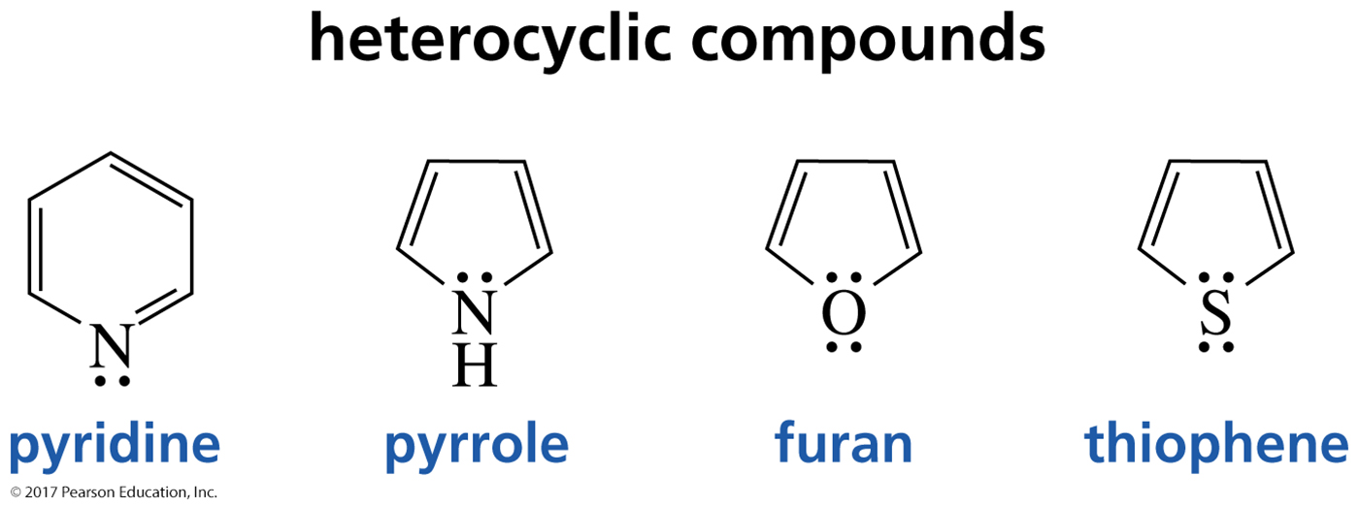
Heterocyclic Aromatic Compounds
A heterocyclic compound is a cyclic compound in which one or more of the ring atoms is an atom other than carbon ( N,O,S)

Slide 13
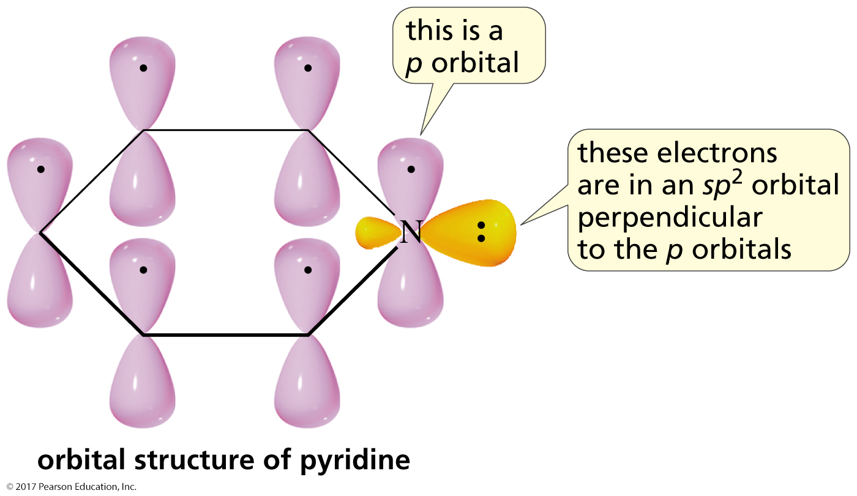
Orbital Structure of Pyridine

Slide 14
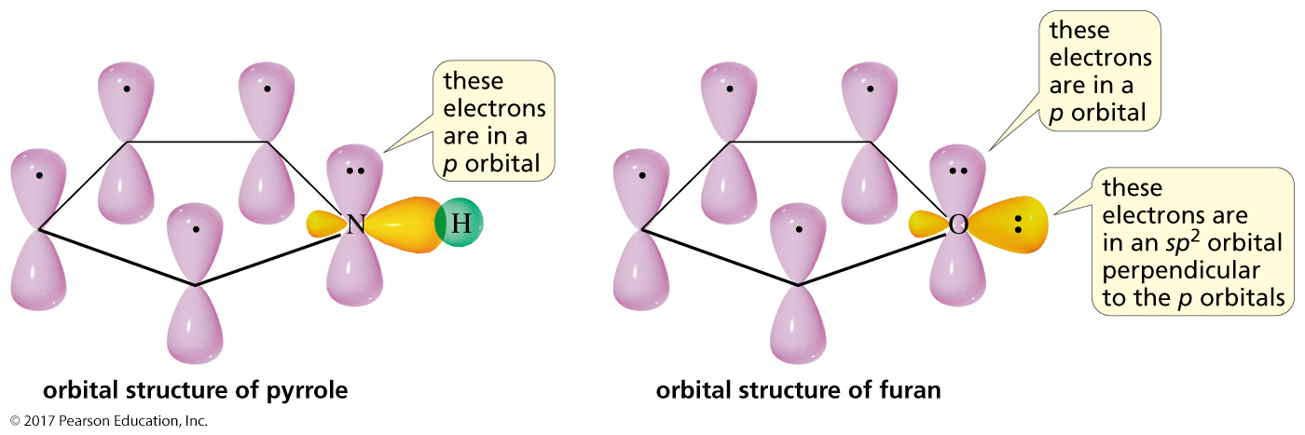
Orbital Structure of Pyrrole and Furan

Slide 15
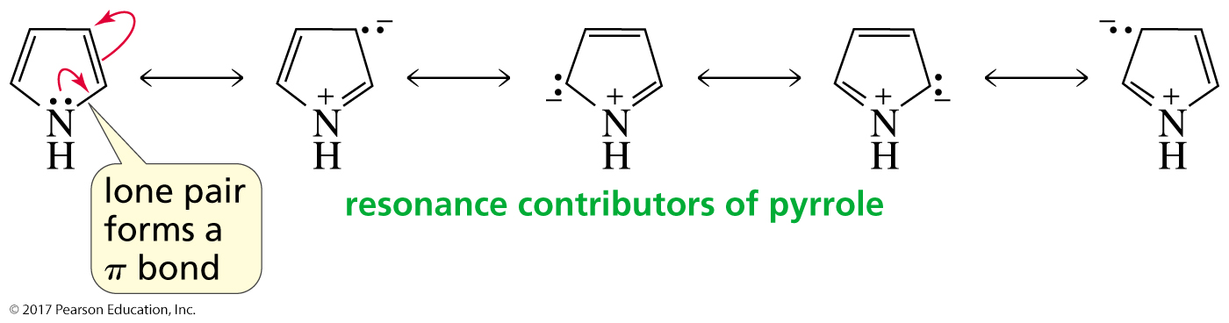
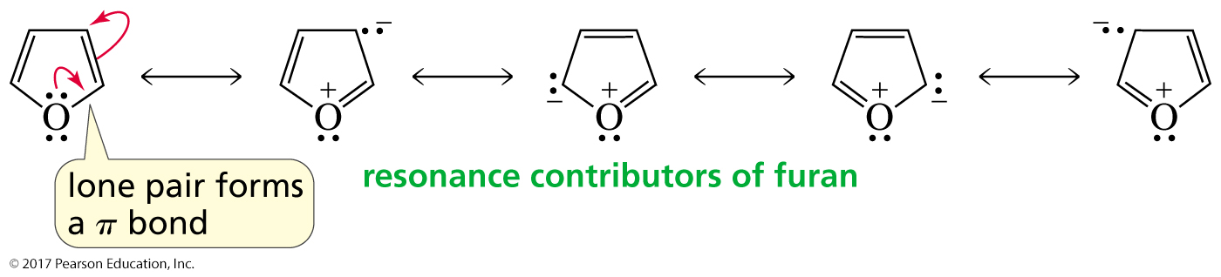
Resonance Contributors of Pyrrole and Furan

Slide 16
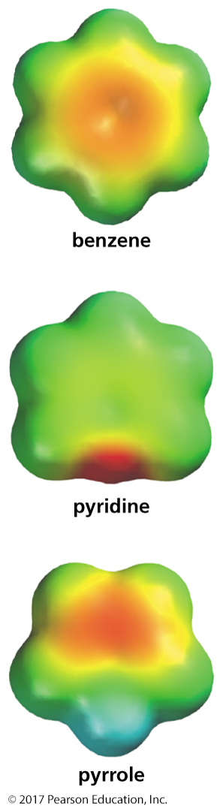
Benzene, Pyridine, and Pyrrole
The aromatic ring of pyridine is less electron-dense
than benzene because
the nitrogen withdraws electrons from the ring.
The aromatic ring of pyrrole is more electron-dense
than benzene because
the nitrogen donates electrons into the ring.

Slide 17
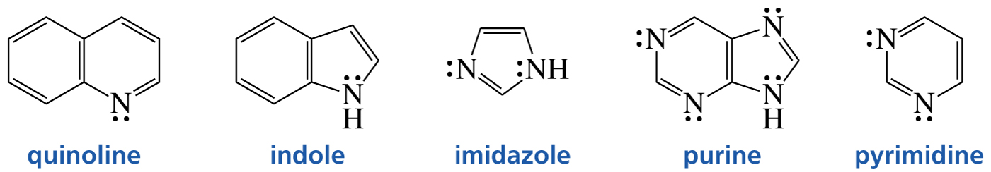
More Examples of
Aromatic Heterocyclic Compounds

Slide 18
π-π Interactions
Aromatic π-π interactions (sometimes called π-π stacking interactions) occur between aromatic rings, often in situations where one is relatively electron rich, and one is electron poor.
There are two general types of π -interactions:
face-to-face and edge-to-face, although a wide variety of intermediate geometries are known.
X-ray crystal structure of benzene showing
edge-to-face interactions.

Slide 19
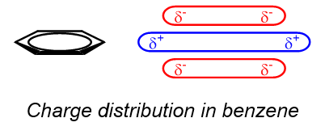
π-π Interactions
Edge-to-face interactions may be regarded as weak forms of hydrogen bonds between the slightly electron deficient hydrogen atoms of one aromatic ring and the electron rich π cloud of another. Strictly they should not be referred to as π -stacking since there is no stacking of the π -electron surfaces.
Arene Charge Distribution: The ability of pi systems to induce non-covalent interactions with other partially charged species is understood via examination of the charge distribution within an arene. Negatively charged electrons in the p-orbitals that comprise the molecular orbitals of the pi system are localized above and below the arene plane. Consequently, the arene plane bears partial positive charge. This charge distribution gives rise to interactions of arenes through electrostatic attraction.

Slide 20
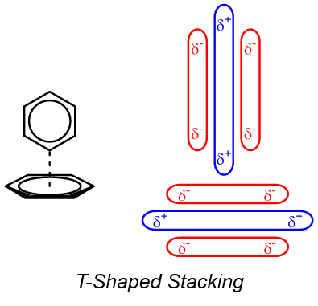
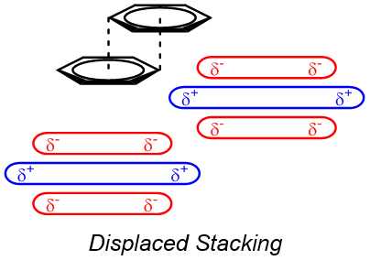
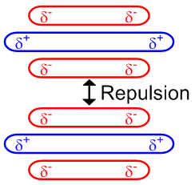
π-π Interactions
Face-centered stacking of arenes is not energetically favorable
Face-Centered Stacking

Slide 21
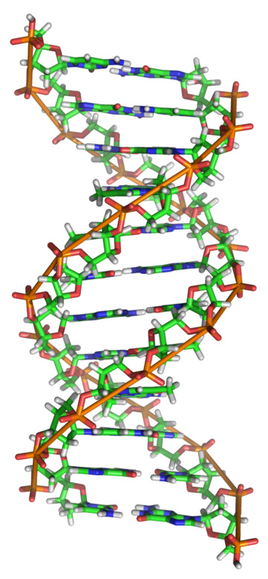
DNA Helix
DNA Helix: Pi stacking interactions are a key, potentially dominant, stabilizing feature of DNA’s helical structure. As the aromatic nucleobases orient to engage in favorable pi-pi interactions, this influences a second stabilization event: interstrand hydrogen bonding between base pairs.
DNA Bases
Adenine
Cytosine
Guanine
Thymine
Designates base stacking

Slide 22
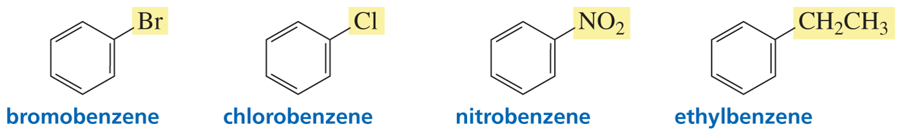
Naming Monosubstituted Benzenes
Some monosubstituted benzenes are named
by adding the name of the substituent to “benzene.”

Slide 23
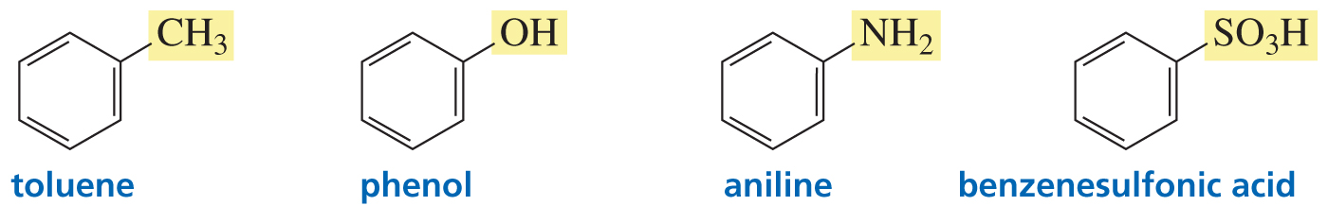
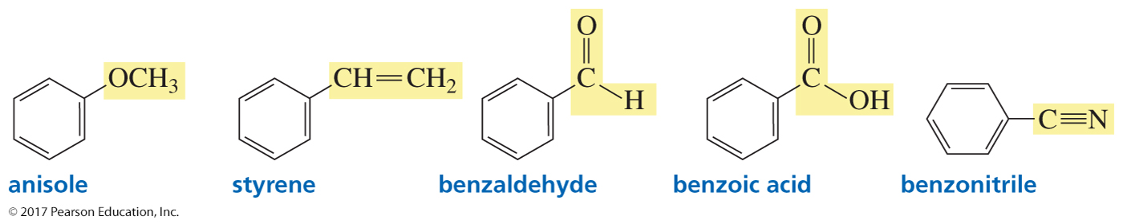
Naming Monosubstituted Benzenes
Some monosubstituted benzenes have names
that incorporate the substituent.

Slide 24
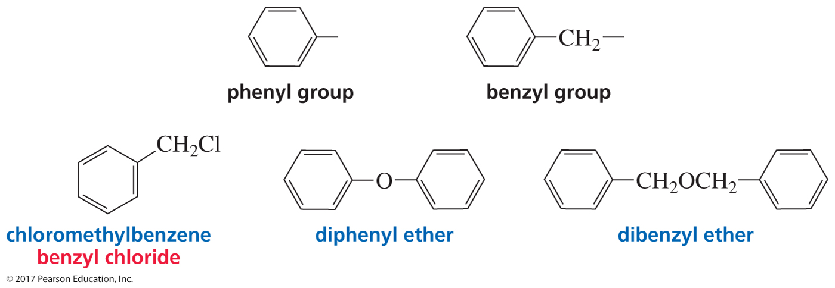
Phenyl and Benzyl Substituents

Slide 25
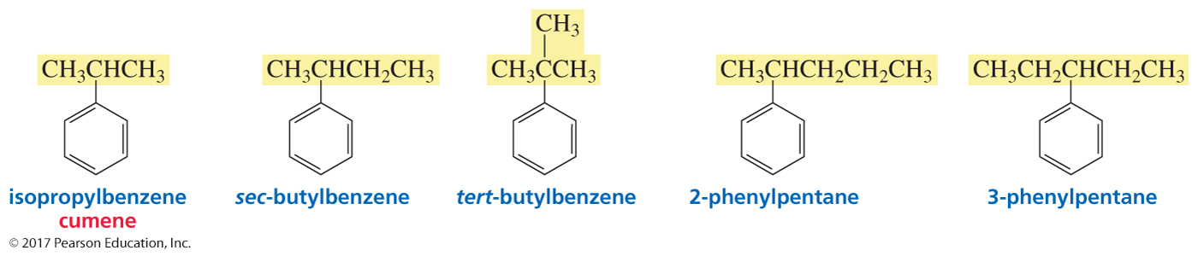
Alkyl-Substituted Benzenes
Name as an alkyl-substituted benzene
when the alkyl group has a name.
Otherwise, name as a phenyl-substituted alkane.
Toluene (methyl substituent on benzene) is an exception.

Slide 26
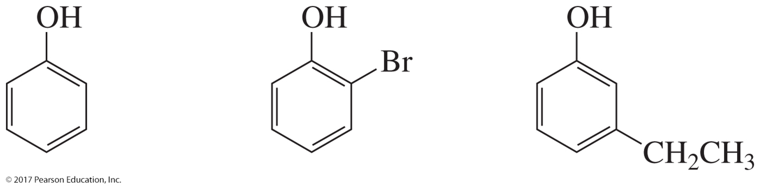
Aryl Means “Benzene” or
“Substituted Benzene”
Each of these structures could be abbreviated as ArOH.

Slide 27
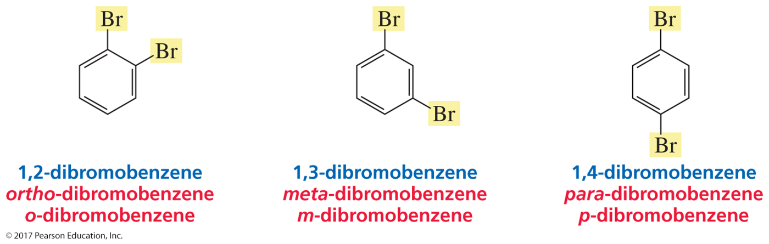
Naming Disubstituted Benzenes
The relative positions of two substituents can be indicated
by numbers or by prefixes.
ortho = adjacent
meta = separated by one carbon
para = opposite each other

Slide 28
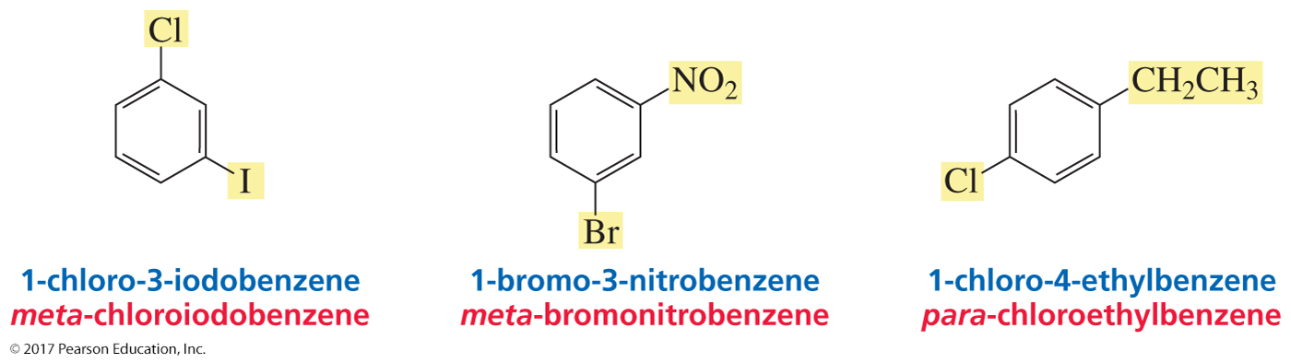
Naming Disubstituted Benzenes
The substituents are listed in alphabetical order.
The first-mentioned substituent is given the 1-position.
The ring is numbered to give the second substituent the lowest possible number.

Slide 29
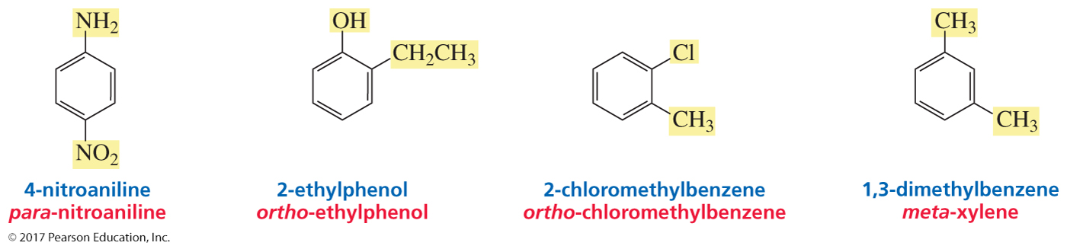
Naming Disubstituted Benzenes
Some substituents can be incorporated into a name.
An incorporated substituent is given the 1-position.
(With a second substituent, “methylbenzene” is used rather than “toluene.”)

Slide 30
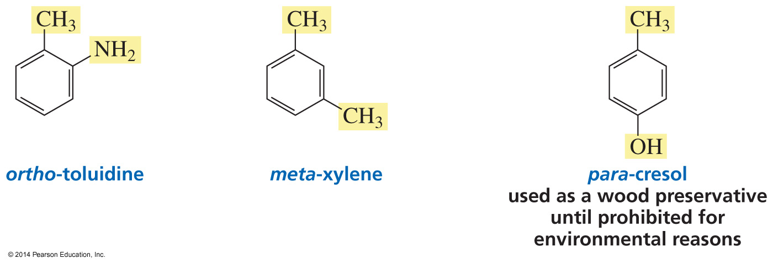
Naming Disubstituted Benzenes
Some disubstituted benzenes have both substituents incorporated into the name.

Slide 31
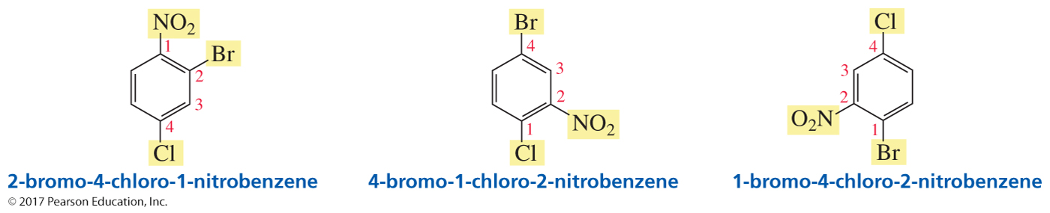
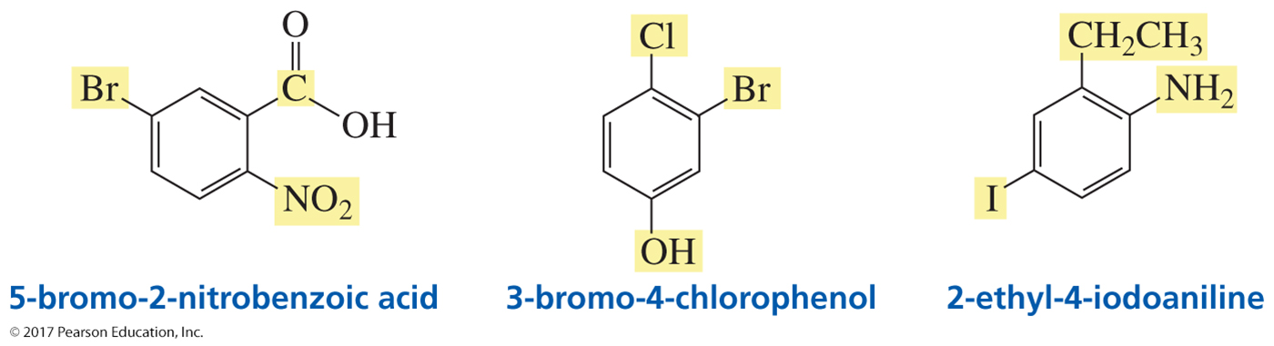
Naming Polysubstituted Benzenes
List substituents alphabetically and number so that
“1” and the next lowest possible number are in the name.
An incorporated substituent is given the 1-position.

