Slide 1
Aldehydes and Ketones
פורמלין משמש לשימור רקמות
formaldehyde: two hydrogens
aldehyde: a hydrogen and an alkyl group
ketone: two alkyl groups

Slide 2
Some Aldehydes and Ketones Found in Nature
Aldehydes have pungent odors.
לאלדהידים יש ריחות חריפים
Ketones have sweet odors.

Slide 3
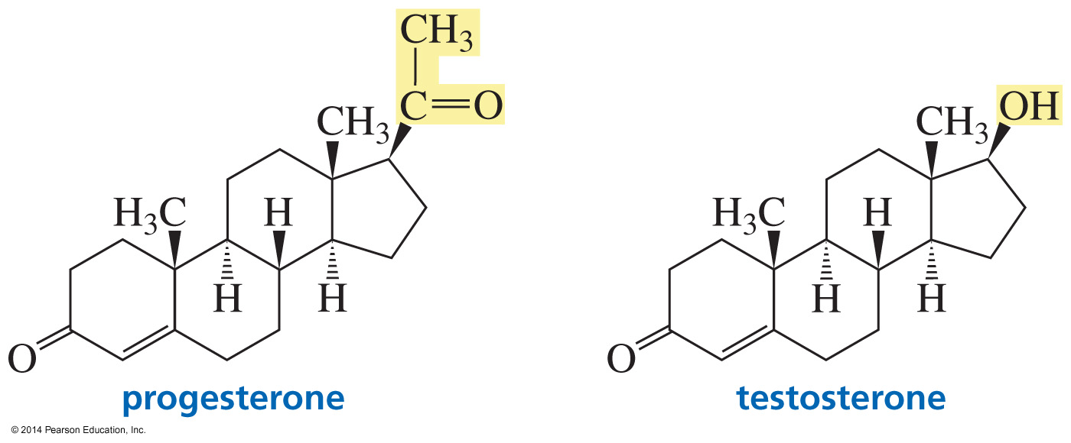
Biologically Important Ketones

Slide 4
Naming Aldehydes

Slide 5
Naming an Aldehyde on a Ring

Slide 6
Naming Ketones
The carbonyl is assumed to be at the 1-position in cyclic ketones.

Slide 7
Naming Ketones

Slide 8
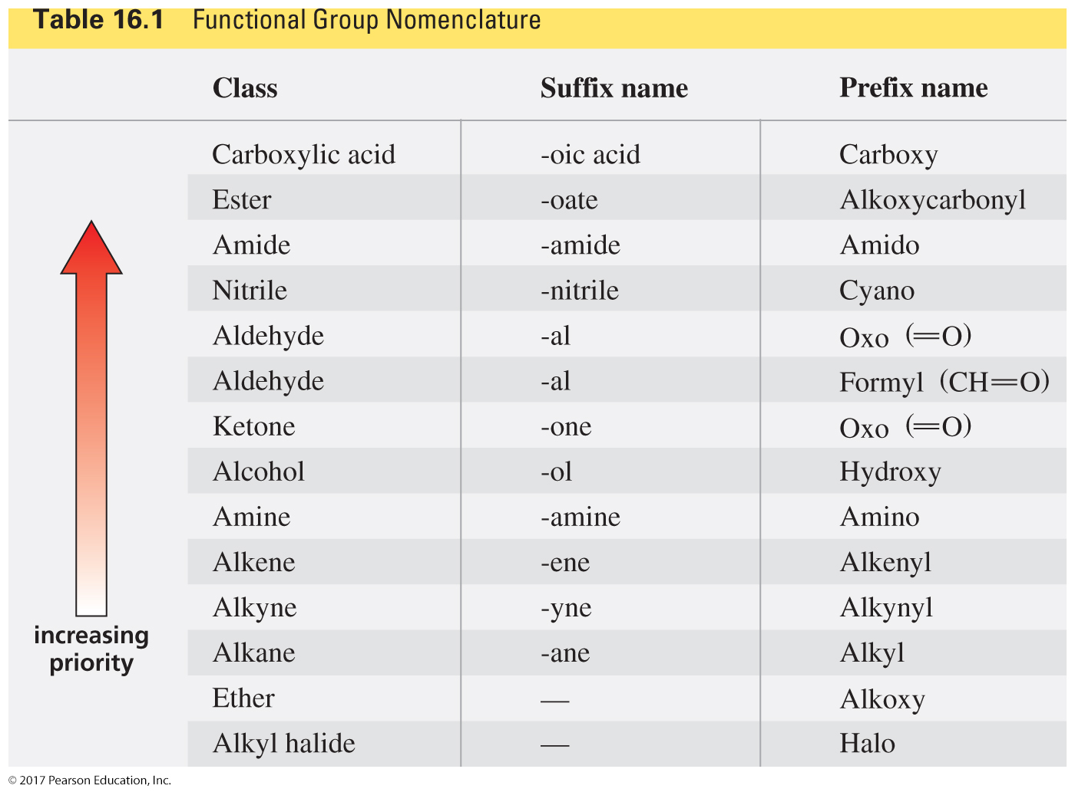
If a Compound Has Two Functional Groups,
the Lower Priority Group is Indicated by its Prefix Name

Slide 9
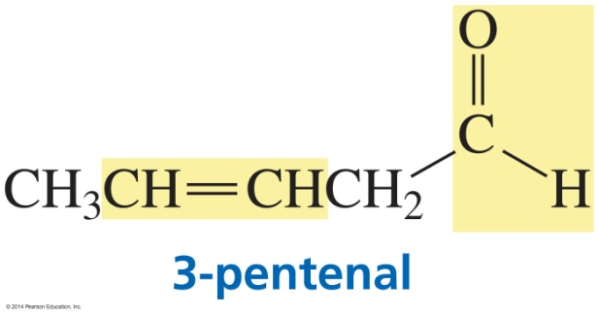
Naming Compounds with Two Functional Groups
When one group is an alkene,
suffix names are used for both;
“ene” is changed to “en” and stated first.

Slide 10
Naming Compounds with Two Functional Groups

Slide 11
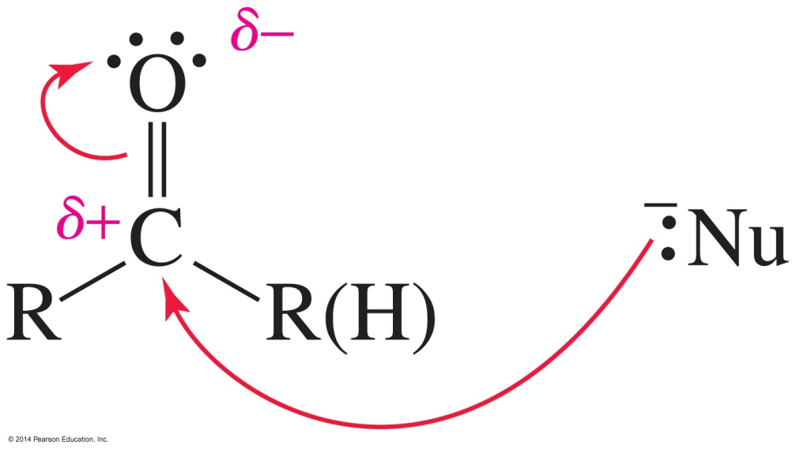
Aldehydes and Ketones (Electrophiles) React with Nucleophiles
The partial positive charge on the carbonyl carbon
causes it to be an electrophile, so it reacts with nucleophiles.

Slide 12
Aldehydes are More Reactive Than Ketones
An aldehyde has a greater partial positive charge
on its carbonyl carbon than does a ketone.
(because a hydrogen is more electron withdrawing than an alkyl group).
The carbonyl carbon of an aldehyde
is more accessible to the nucleophile.

Slide 13
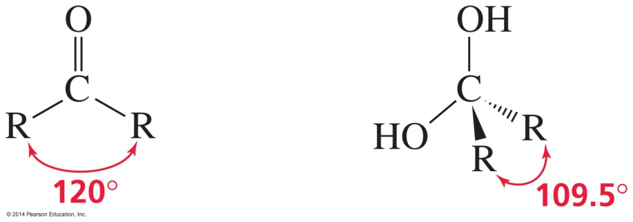
Aldehydes are More Reactive Than Ketones
Ketones have greater steric crowding in their transition states,
so their transition states are less stable than those of aldehydes.

Slide 14
Aldehydes and Ketones are Moderately Reactive Carbonyl Compounds
Aldehydes and ketones are less reactive
than acyl halides and acid anhydrides.
Aldehydes and ketones are more reactive
than esters, carboxylic acids, amides, and carboxylate ions.

Slide 15
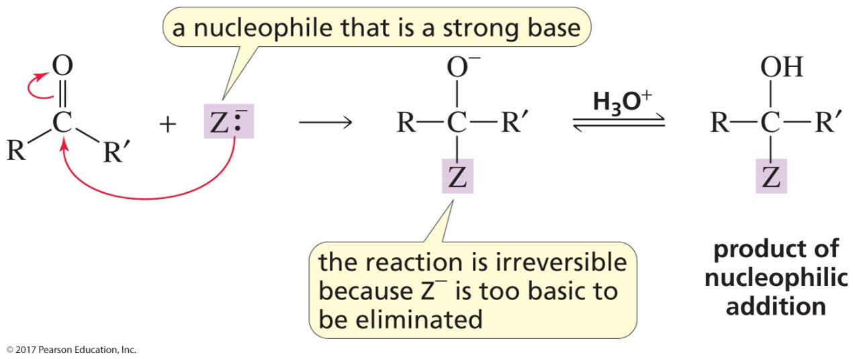
Aldehydes and Ketones React Differently than Carboxylic Acid Derivatives
Nucleophilic acyl substitution occurs when
Y is a group that can be replaced by another group.
Nucleophilic addition occurs when
Y is a group that cannot be replaced by another group.

Slide 16
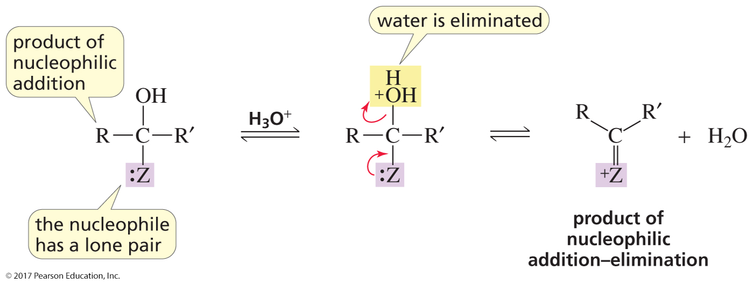
Some Additions of Nucleophiles to Aldehydes and Ketones Lead to an Addition–Elimination Product
Nucleophilic addition–elimination occurs
when the nucleophile has a lone pair on the attacking atom.
Water, rather than a group attached to the carbonyl group,
is eliminated.

Slide 17
Formation of a New Carbon–Carbon
Bond Using a Grignard Reagent

Slide 18
Reactions of Aldehyde and Ketones
with Grignard Reagents

Slide 19
A Grignard Reagent Reacts with
Carbon Dioxide to Form a Carboxylic Acid
The carboxylic acid has one more carbon
than the Grignard reagent.

Slide 20
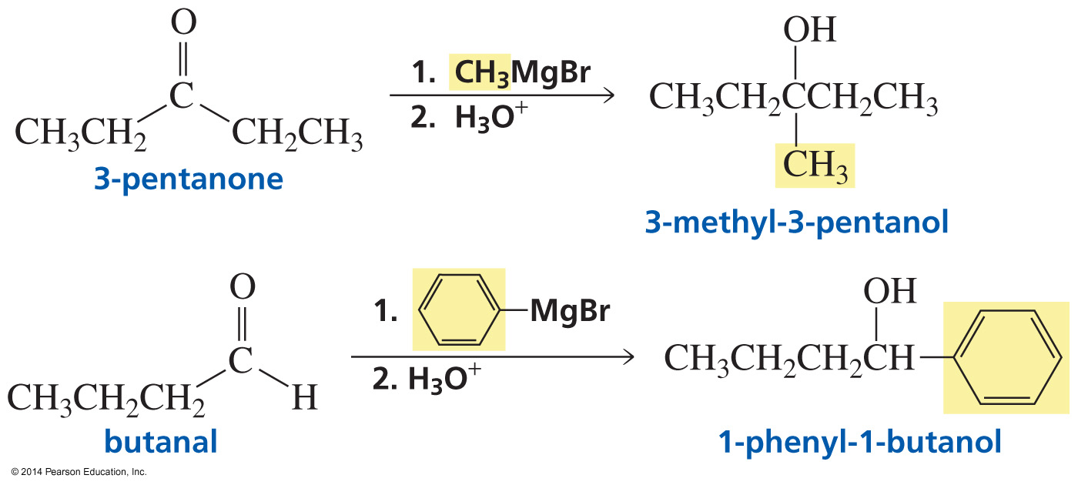
Examples of Reactions with Grignard Reagents
Numbers above and below arrows mean that the acid is not added
until the Grignard reagent has reacted with the carbonyl compound.
When a reaction creates an asymmetric center from a compound
without an asymmetric center, the product is a racemic mixture.

Slide 21
Reaction of Aldehydes and Ketones
with Acetylide Ions

Slide 22
Reaction of Aldehydes and Ketones with Cyanide Ion
The Mechanism

Slide 23
Reactions of Cyanohydrins
in base, decomposition to the carbonyl compound
in acid, hydrolysis to an α‑hydroxycarboxylic acid
reduction to a primary amine with an OH group on the β‑carbon

Slide 24
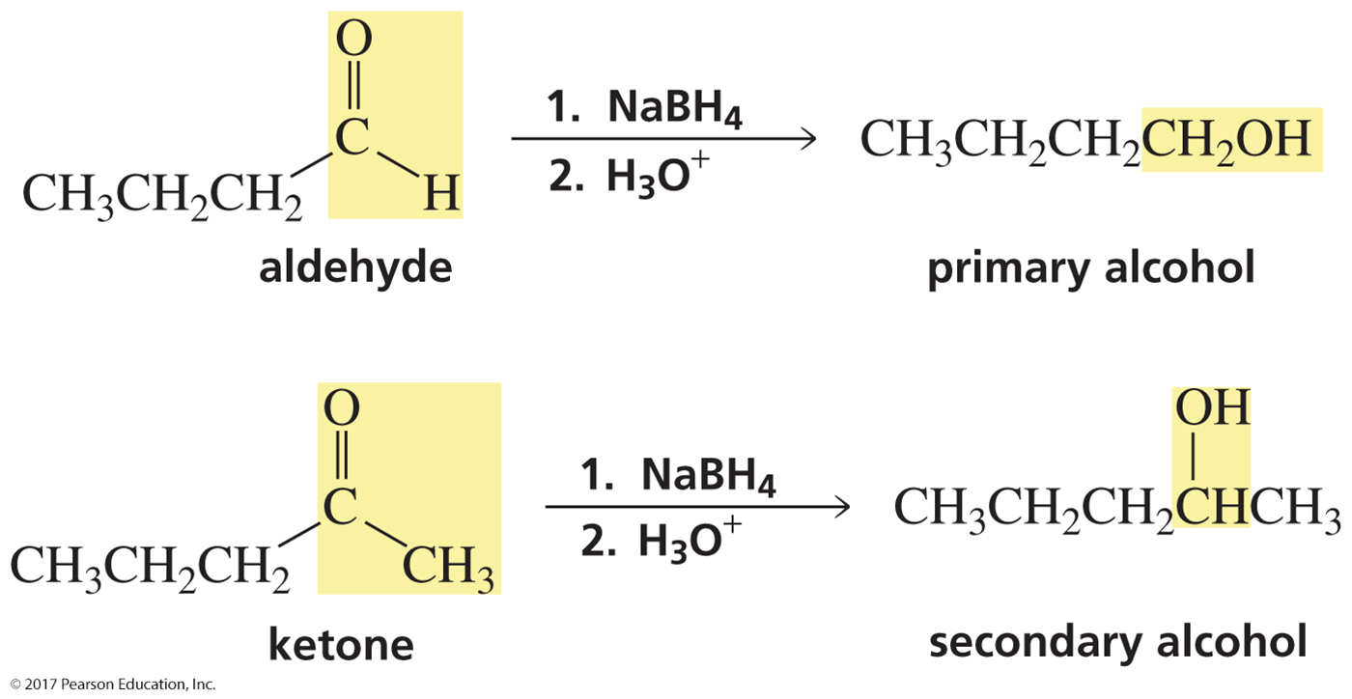
Reactions of Aldehydes and Ketones with Hydride Ion

Slide 25
The Mechanism

Slide 26
Reactions of Esters with Hydride Ion
The Mechanism

Slide 27
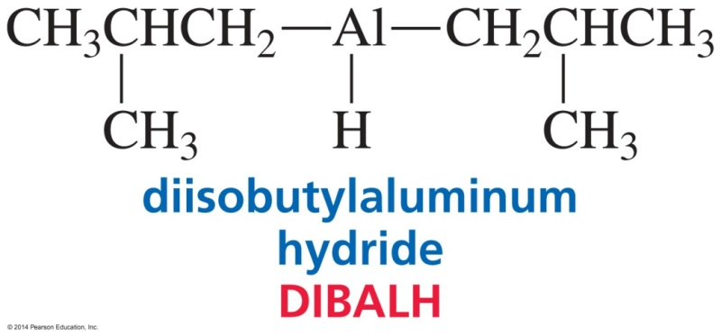
DIBALH Stops the Reaction
at the Aldehyde

Slide 28
Reactions of Carboxylic Acids with Hydride Ion

Slide 29
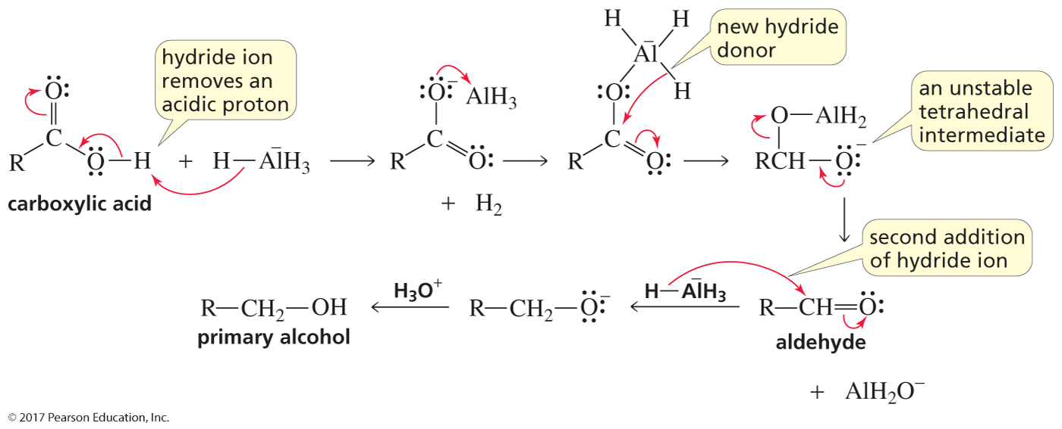
The Mechanism
המנגנון לא יהיה בבחינה

Slide 30
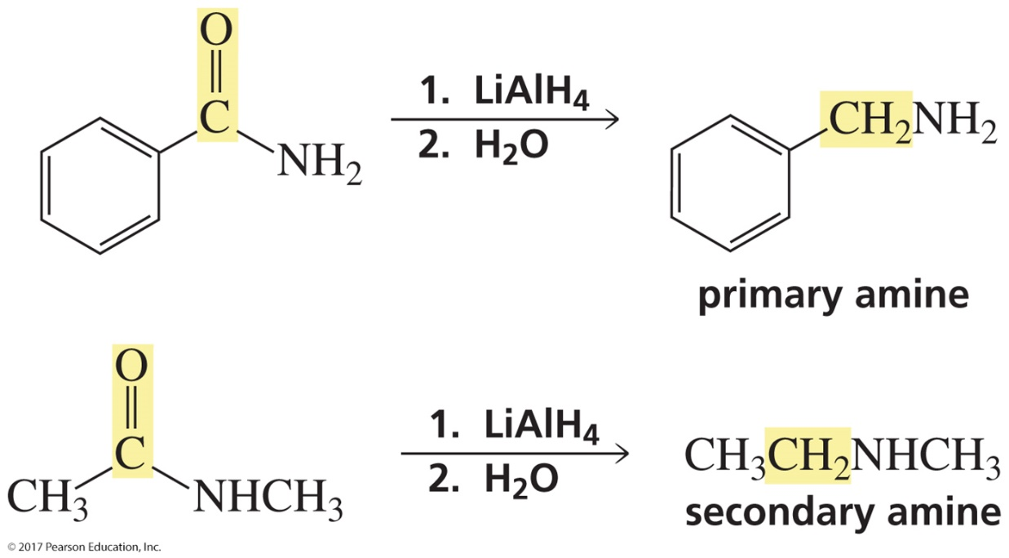
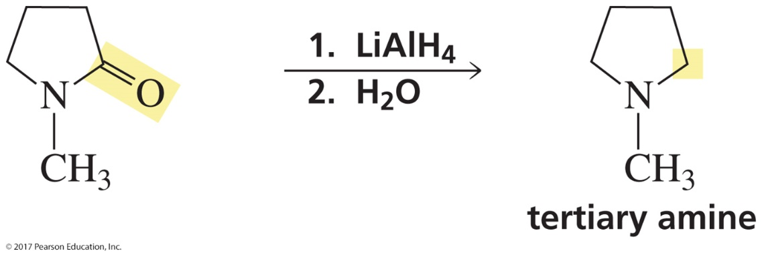
The Reactions of Amides with Hydride Ion
המנגנון לא יהיה בבחינה

Slide 31
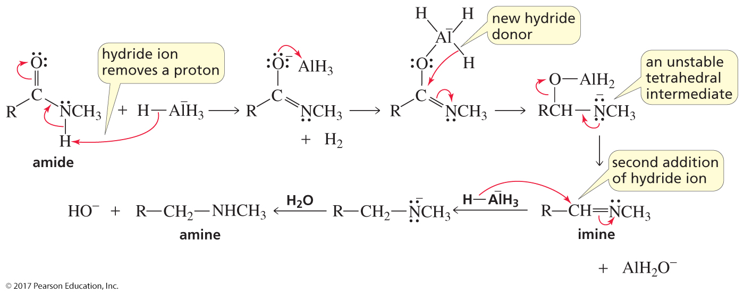
Mechanism for the Reaction of an N‑Substituted Amide with Hydride Ion
המנגנון לא יהיה בבחינה
חיזור ניטריל

Slide 32
Reduction Reactions
A compound is reduced when hydrogen (H₂) is added to it.
Hydrogen can be added in three ways:
addition of a hydride ion and a proton
addition of two hydrogen atoms
addition of two electrons and two protons

Slide 33
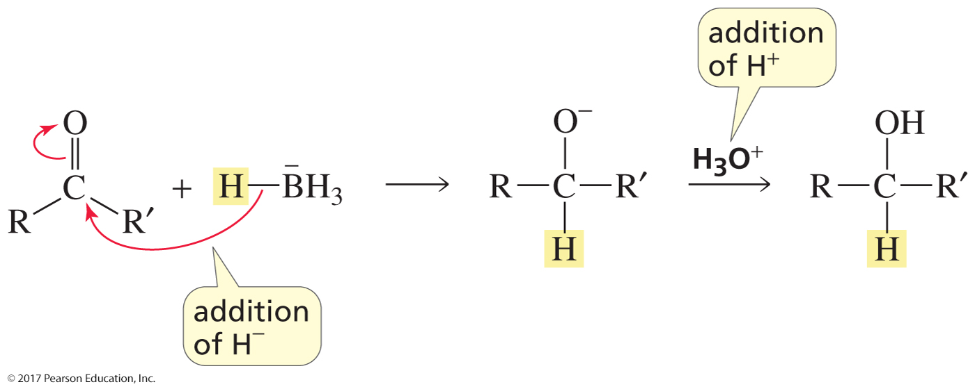
Addition of a Hydride Ion and a Proton

Slide 34
Addition of a Hydride Ion and a Proton Reduces Carbon–Nitrogen Double and Triple Bonds

Slide 35
Addition of a Hydride Ion and a Proton Cannot Reduce
Carbon–Carbon Double and Triple Bonds
None of the atoms have a partial positive charge,
so the compound will not react with hydride ion.

Slide 36
Catalytic Hydrogenation Reduces Carbon–Carbon Double and Triple Bonds

Slide 37
Catalytic Hydrogenation Reduces Carbon–Nitrogen Double and Triple Bonds
Raney nickel is the preferred metal for reducing carbon-nitrogen triple bonds.

Slide 38
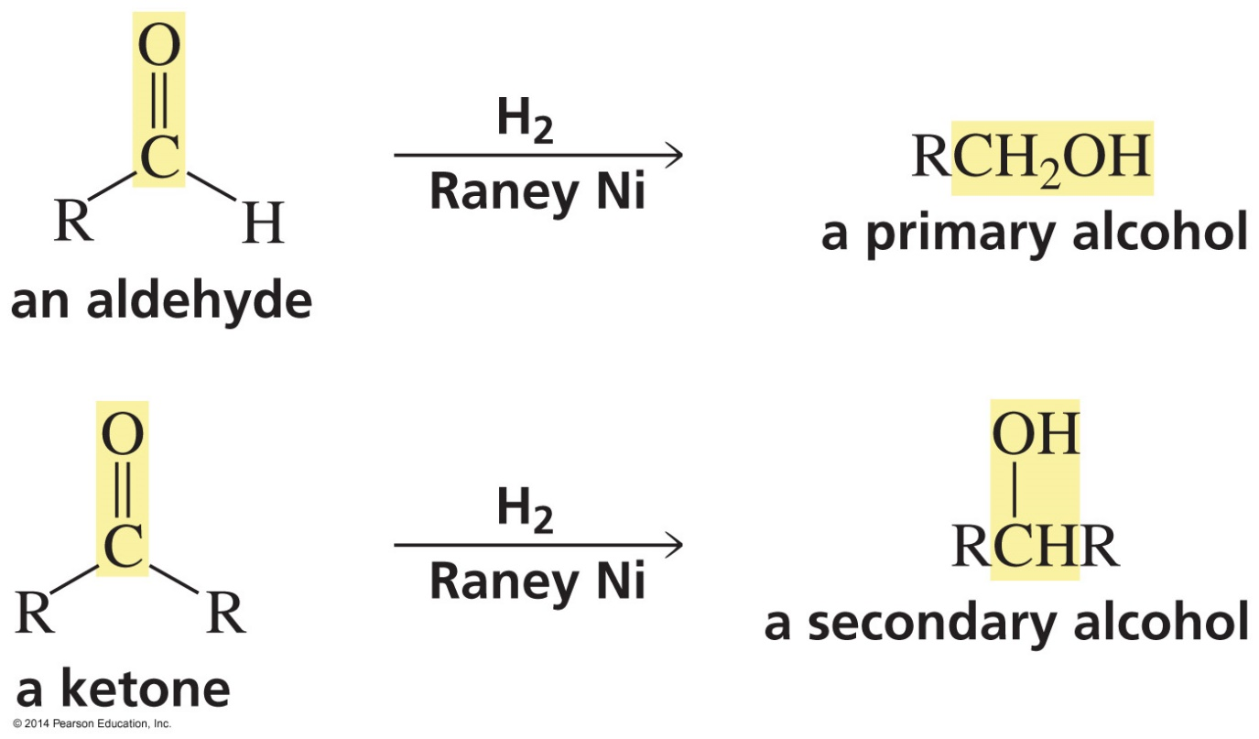
Catalytic Hydrogenation Reduces Carbon–Oxygen Double Bonds
Raney nickel is the preferred metal for reducing aldehydes and ketones.

Slide 39
Chemoselective Reactions
The reagent reacts with one functional group
in preference to another.

Slide 40
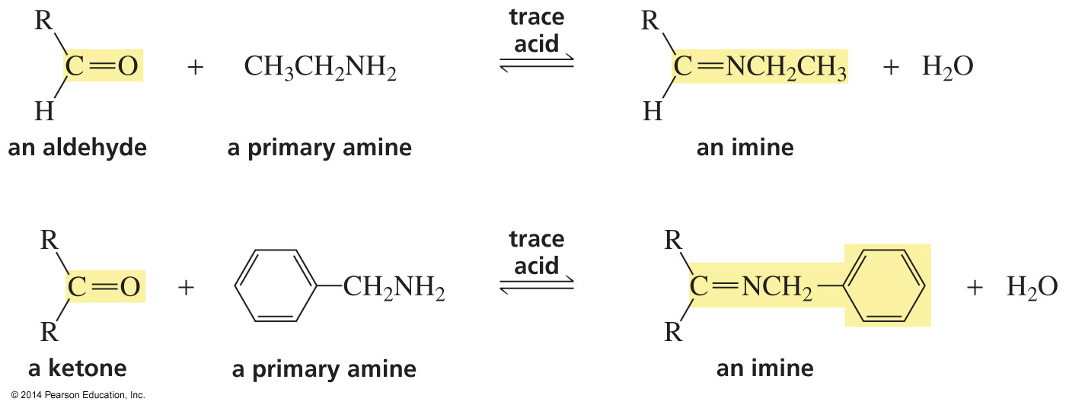
The Reaction of Aldehydes and Ketones
with Primary Amines
The product of the reaction is an imine.
Imine formation replaces C═O with C═NR.

Slide 41
Forming Imine Derivatives
Imine formation replaces C═O with C═NR.

Slide 42
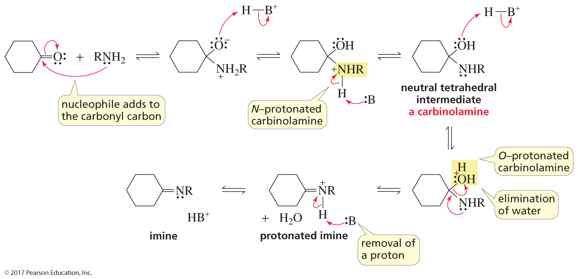
Mechanism for Imine Formation
Imine formation can be pushed to completion
by removing the water as it is formed.

Slide 43
Tetrahedral Compounds in Imine Formation are Unstable
The tetrahedral compound contains a group with a lone pair
that can eliminate water.

Slide 44
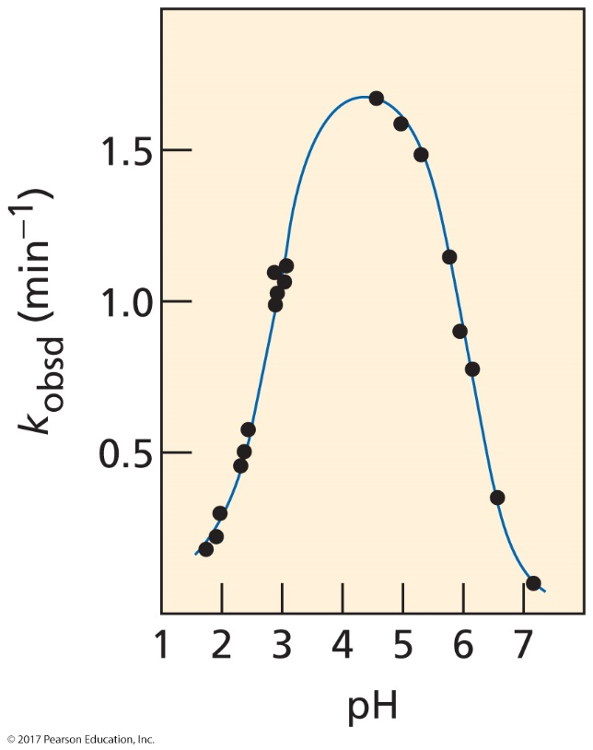
The pH Must Be Controlled
pK_{a} of the ammonium ion is 6.0.
maximum rate is at pH 4.5.
Therefore, the pH should be
1.5 units less than
the pK_{a} of the amine.
There must be enough acid to protonate the oxygen atom of the tetrahedral intermediate so that water can be expelled.
But if too much acid is present, the amine will be protonated and will not be a nucleophile.
For an amine with a pK_{a} = 10.5, the pH of the solution should be 9.0.

Slide 45
Imine Hydrolysis
Acid-catalyzed hydrolysis converts the imine
back to the carbonyl compound and the amine.
Imine hydrolysis is irreversible
because the protonated amine is not a nucleophile.

Slide 46
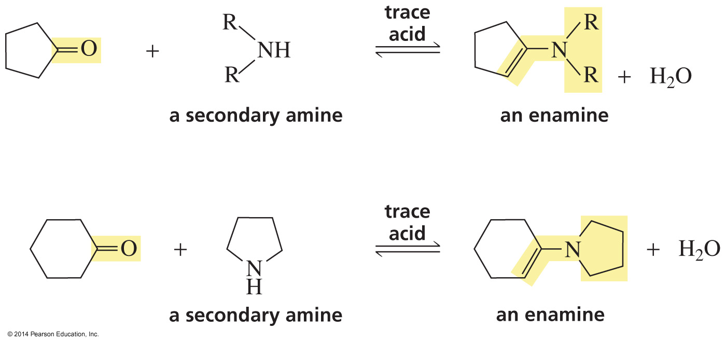
The Reaction of Aldehydes and Ketones with Secondary Amines

Slide 47
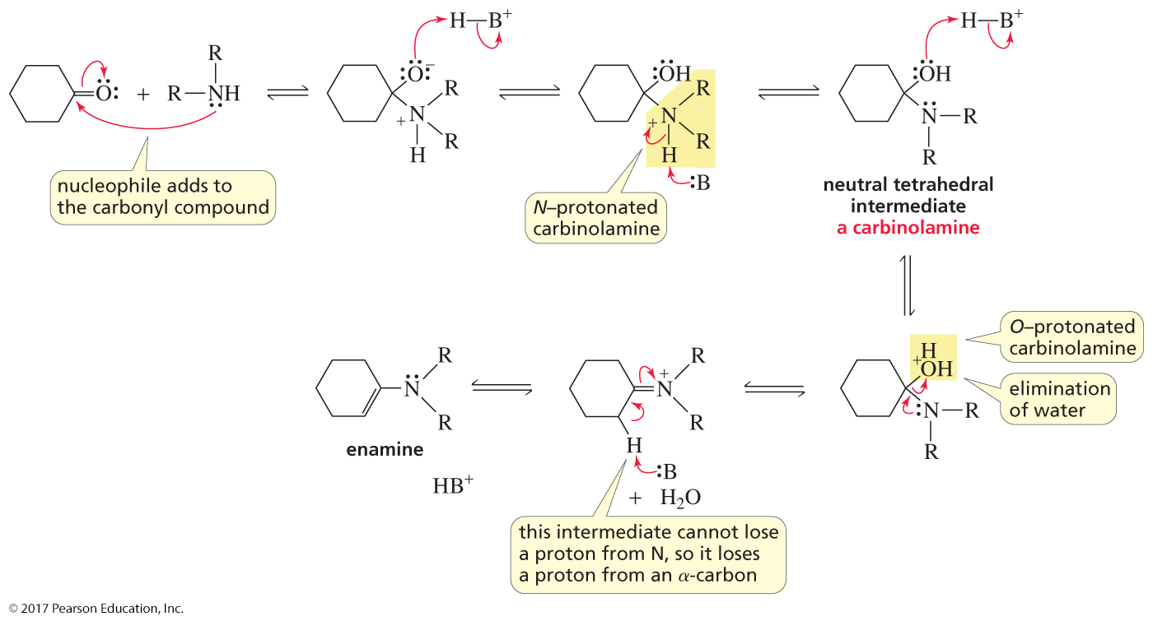
Mechanism for Enamine Formation

Slide 48
Enamine Hydrolysis
Acid-catalyzed hydrolysis converts the enamine
back to the carbonyl compound and the amine.
Enamine hydrolysis is irreversible
because the protonated amine is not a nucleophile.

Slide 49
Reductive Amination
Reaction with ammonia forms an unstable imine,
which can be reduced to a primary amine.

Slide 50
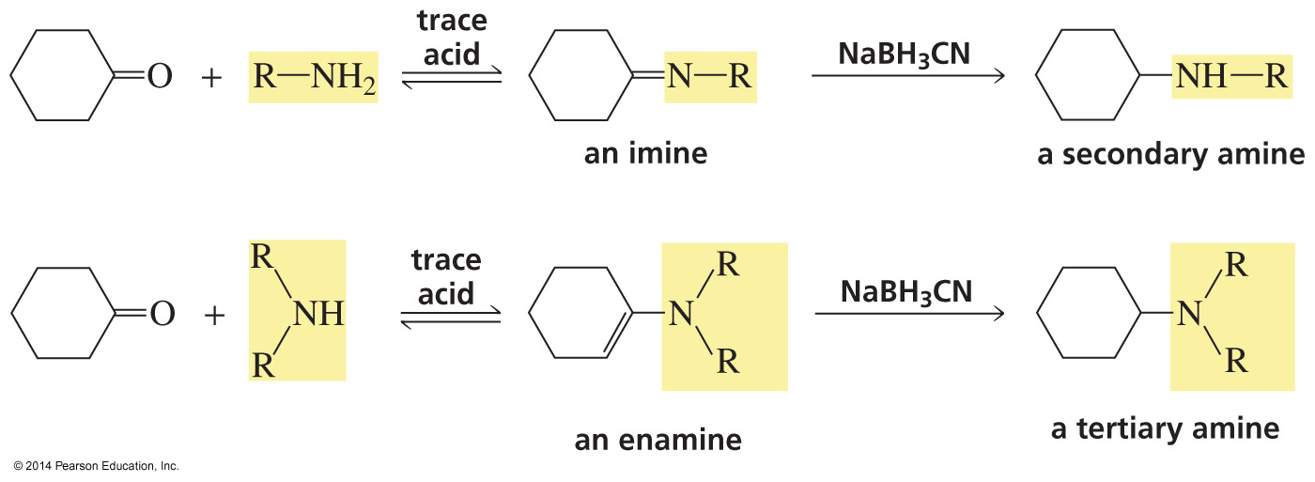
Reductive Amination
Imines and enamines are reduced to secondary and tertiary amines
with NaBH3CN.
(CN replaces an H of NaBH₄)

Slide 51
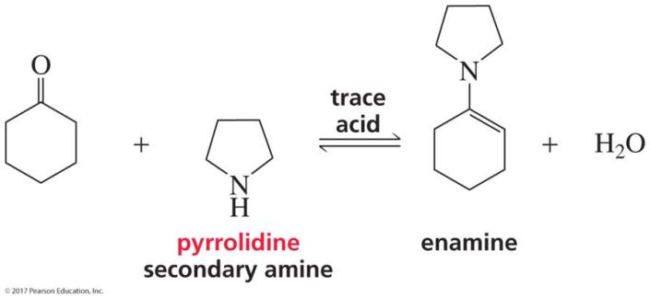
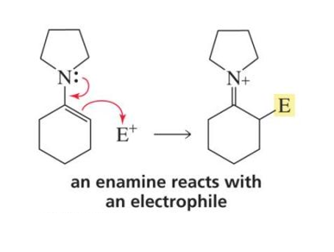
Synthesizing an Enamine

Slide 52
Alkylating the α-Carbon via an Enamine
This alkylation step is an S_{N}2 reaction.

Slide 53
Alkylating the α-Carbon via an Enamine

Slide 54
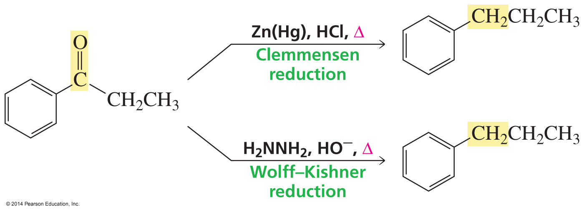
Other Ways to Convert a Carbonyl Group to a Methylene Group

Slide 55
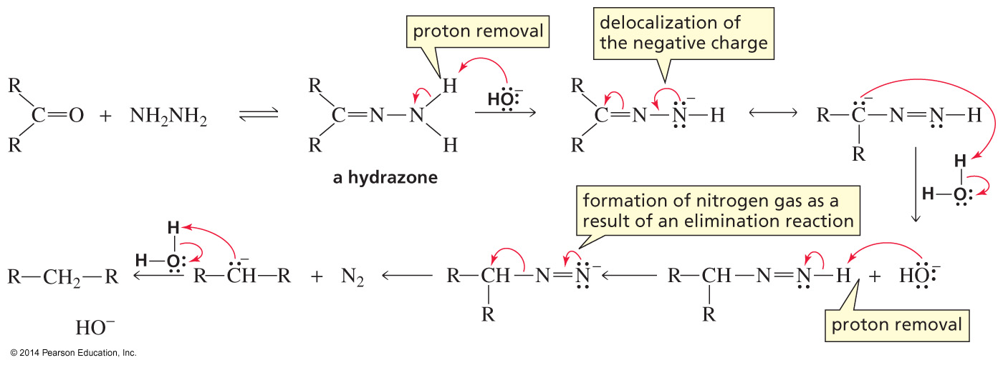
The Mechanism for the Wolff–Kishner Reduction
המנגנון לא יהיה בבחינה
The ketone forms a hydrazone following the mechanism for imine formation.
A hydroxide ion removes a proton from the weakly acidic NH₂ group.
Reprotonation occurs at carbon.
Another deprotonation, loss of N₂, and reprotonation forms the product.

Slide 56
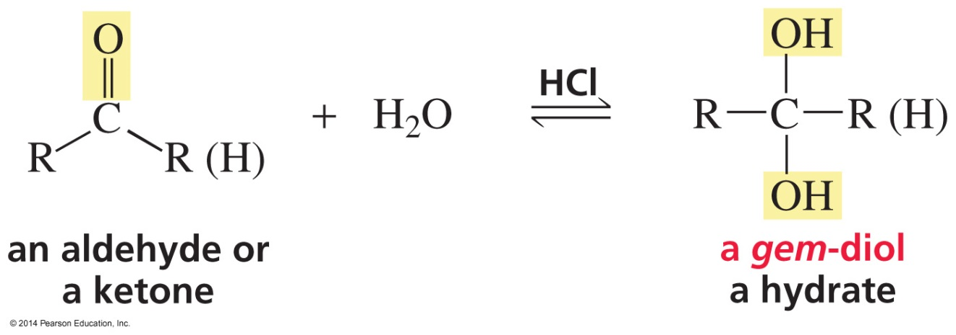
The Reaction of Aldehydes and Ketones
with Water
The Mechanism

Slide 57
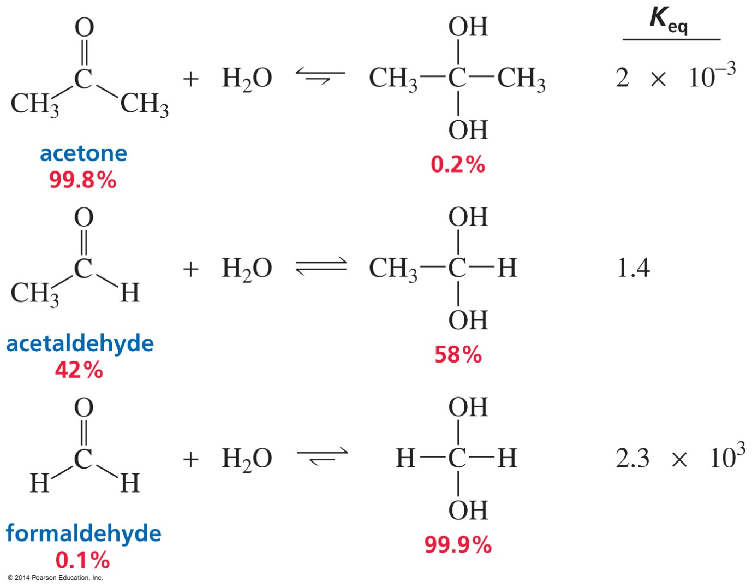
Why is There Such a Difference
in the Keq Values?

Slide 58
The Equilibrium Constant Depends on the
Relative Stabilities of the Reactants and Products

Slide 59
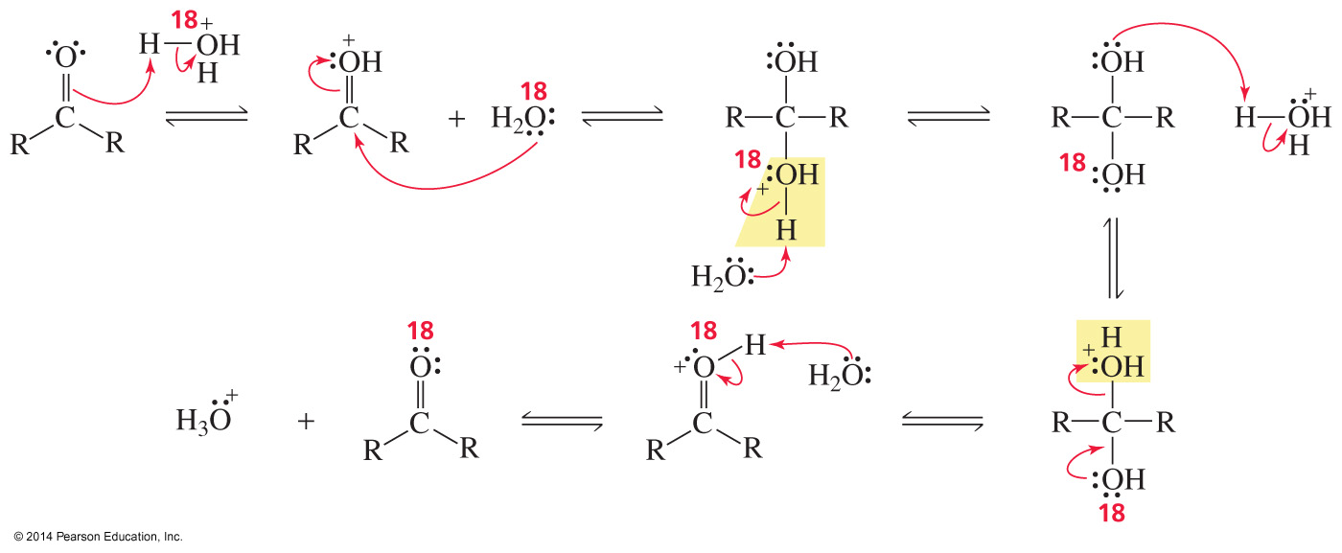
Proving the Mechanism for Hydrate Formation
Isotopically labeled oxygen from water is incorporated into the ketone.

Slide 60
The Reaction of Aldehydes and Ketones
with Alcohols
The reaction with one molecule of alcohol forms a hemiacetal.
The reaction with the second molecule of alcohol forms an acetal.

Slide 61
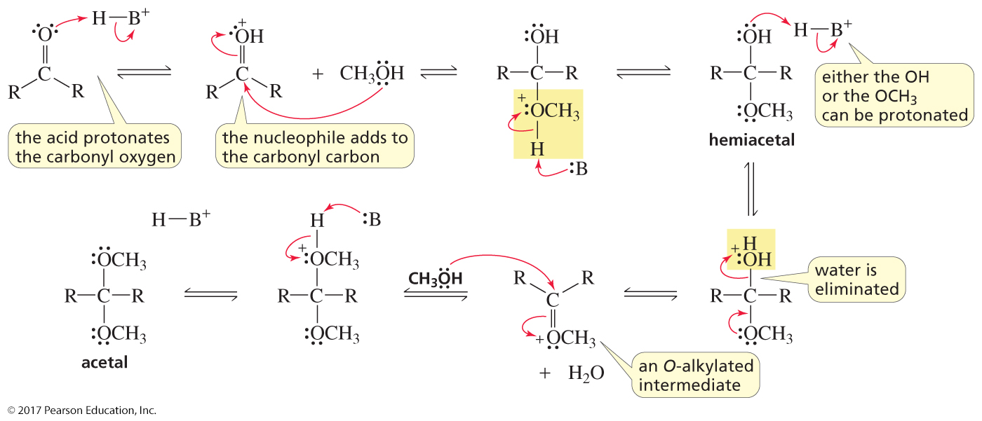
The Mechanism for Acetal Formation

Slide 62
Acid-Catalyzed Hydrolysis of an Acetal
Acid-catalyzed hydrolysis converts the acetal
back to the carbonyl compound and the amine.

Slide 63
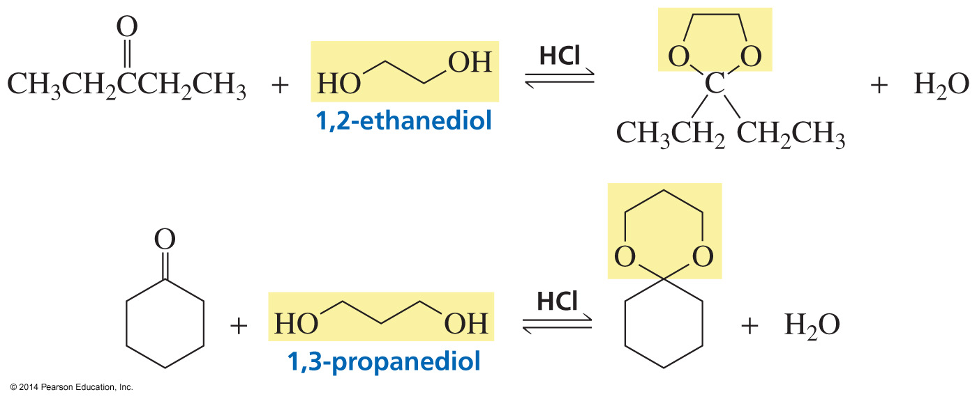
Cyclic Acetals Can Be Used as Protecting Groups

Slide 64
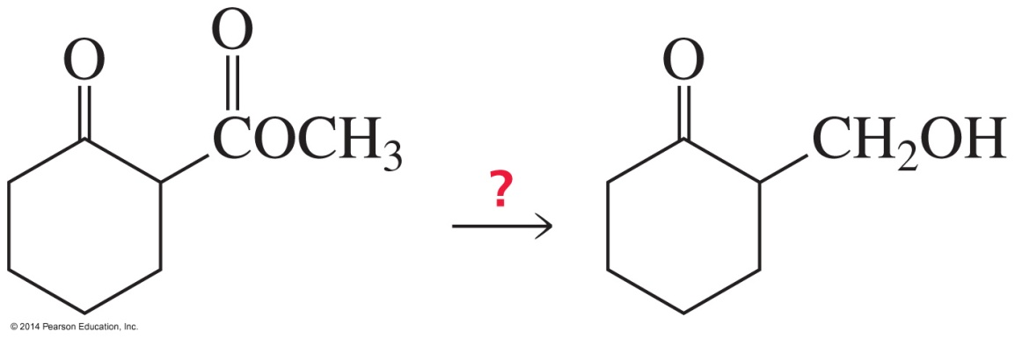
Using Protecting Groups in Synthesis
לא יהיה בבחינה
How can the ester be reduced without reducing the ketone?

Slide 65
α,β‑Unsaturated Aldehydes and Ketones Have Two Electrophilic Sites

Slide 66
Direct Addition to α,β‑Unsaturated Aldehydes and Ketones

Slide 67
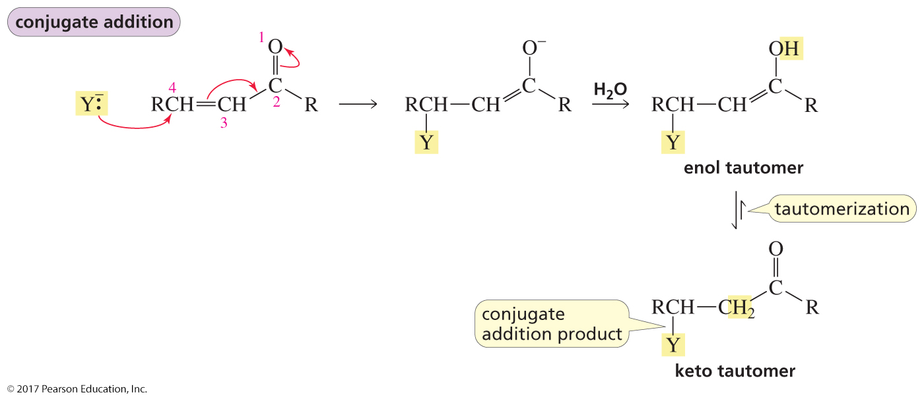
Conjugate Addition to α,β‑Unsaturated Aldehydes and Ketones

Slide 68
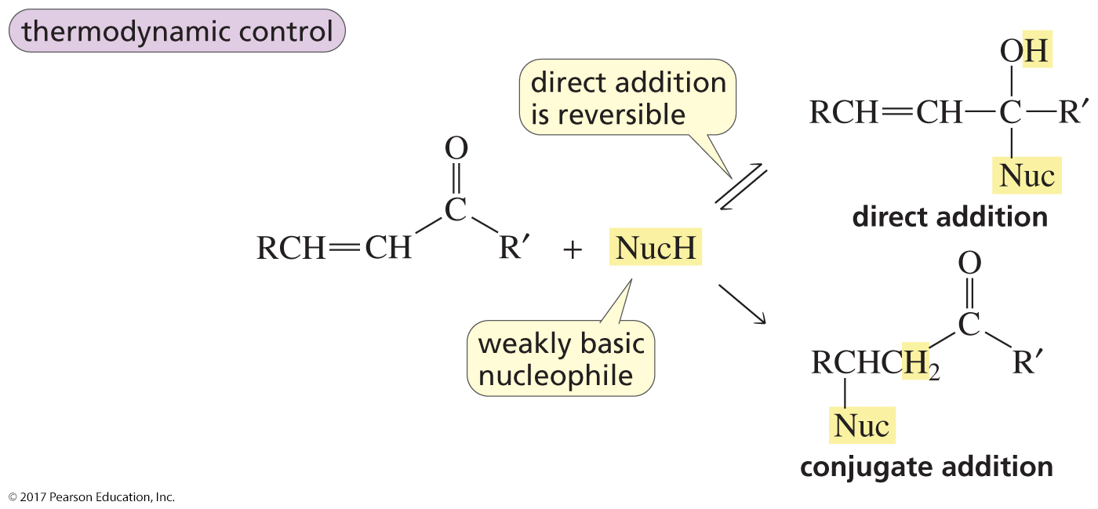
Thermodynamic Control
לא יהיה בבחינה
With a weakly basic nucleophile, direct addition is reversible,
so the reaction is under thermodynamic control.
The product with the carbonyl group is the more stable product.

Slide 69
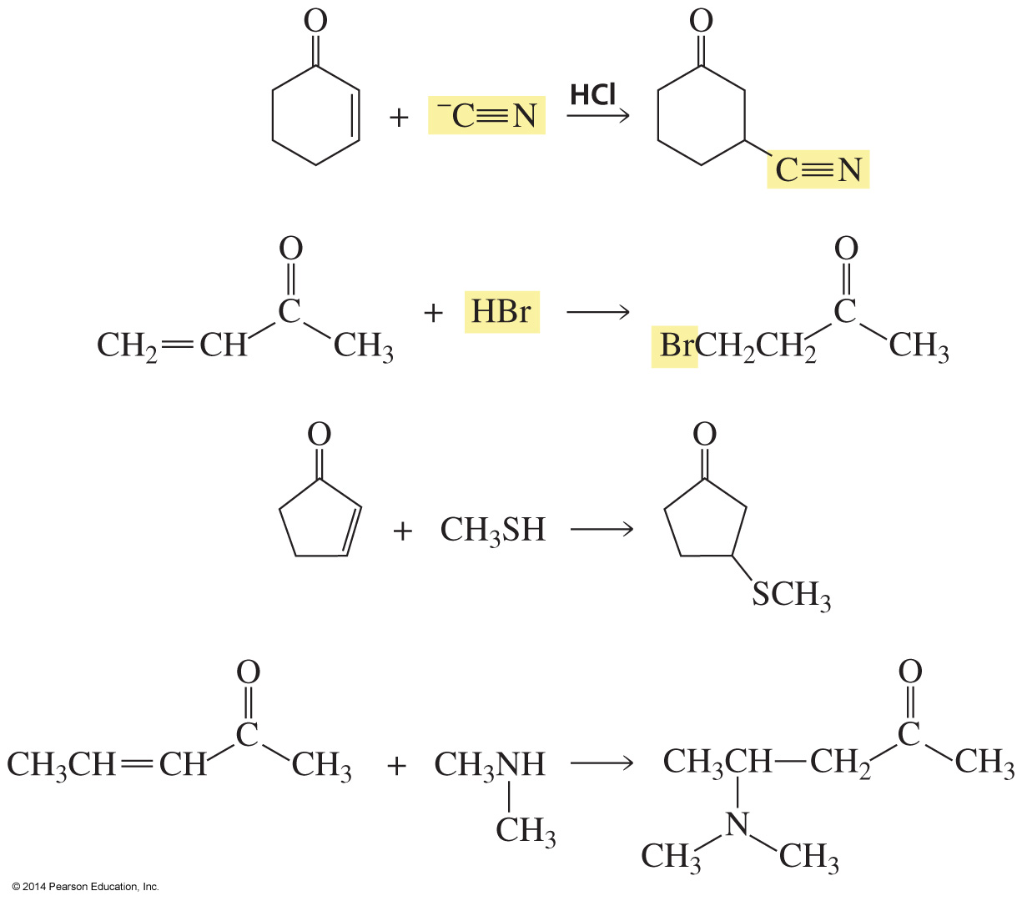
Therefore, Weak Bases Form Conjugate Addition Products

Slide 70
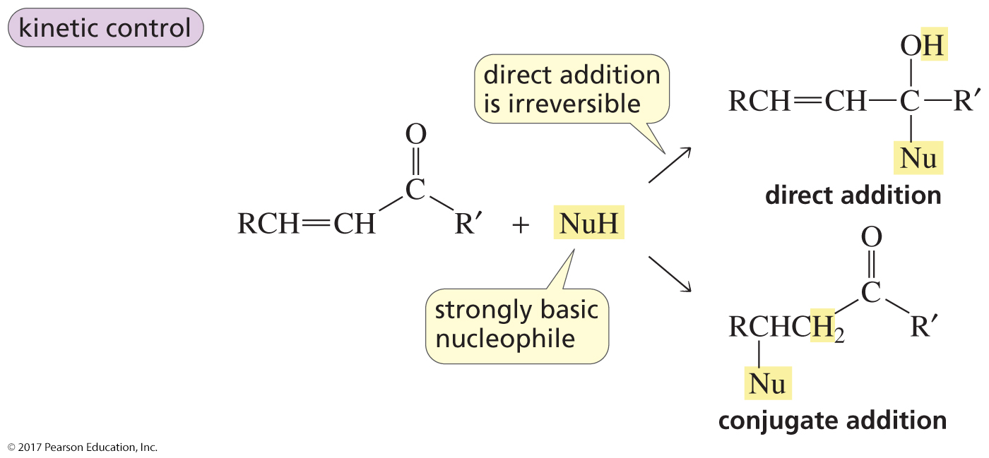
Kinetic Control
לא יהיה בבחינה
With a strongly basic nucleophile, both reactions are irreversible,
so the reaction is under kinetic control.
The product is the fastest formed product.

Slide 71
Direct Addition if the Carbonyl Group
is Not Sterically Hindered
לא יהיה בבחינה

Slide 72
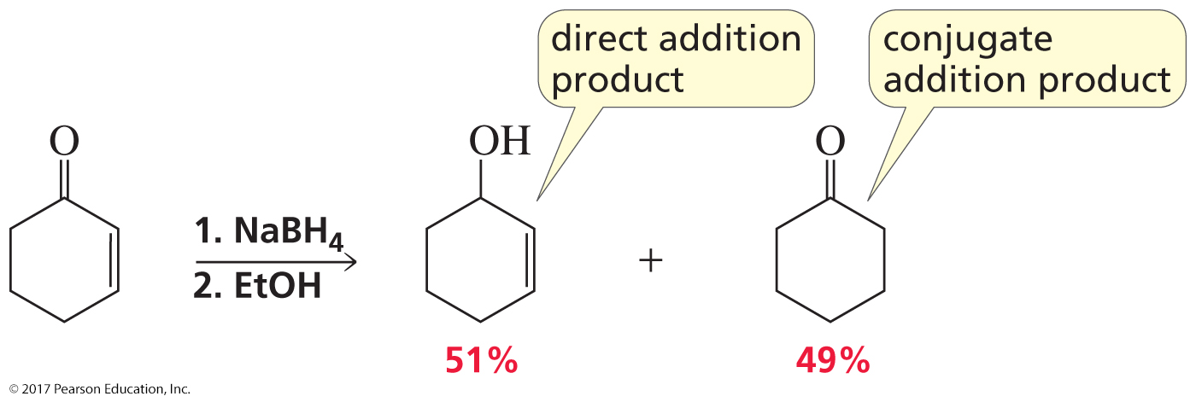
Direct Addition and Conjugate Addition
if the Carbonyl Group Has a Little Steric Hindrance
לא יהיה בבחינה

Slide 73
Conjugate Addition if the Carbonyl Group
is Sterically Hindered
לא יהיה בבחינה

Slide 74
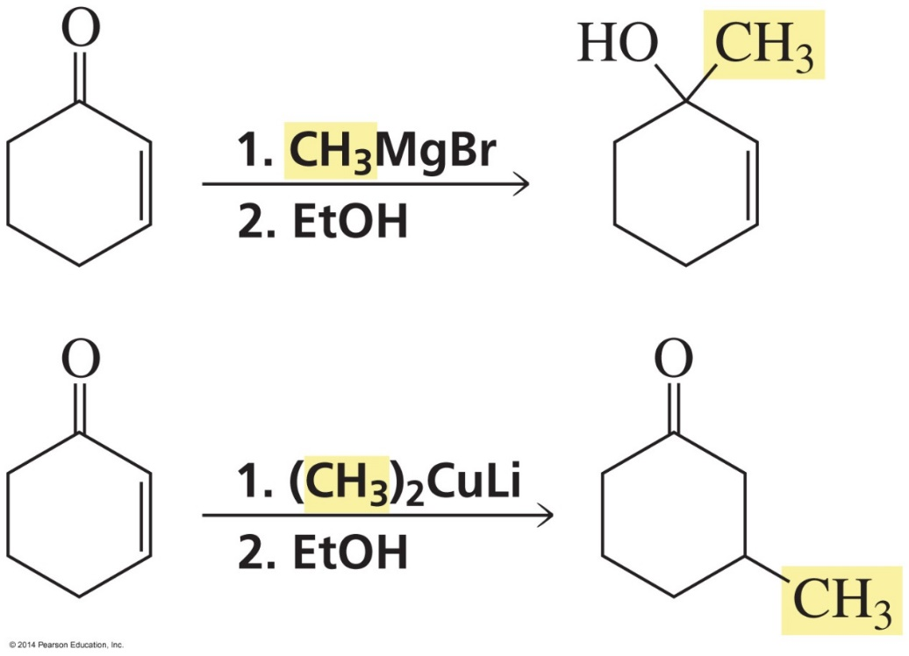
Grignard Reagents: Direct Addition
Organocuprates: Conjugate Addition
לא יהיה בבחינה

Slide 75
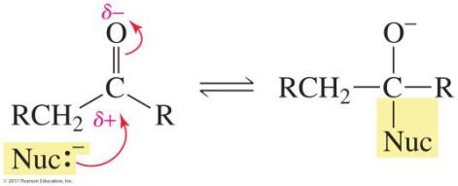
Many Carbonyl Compounds
Have Two Sites of Reactivity
A nucleophile can add to the carbonyl carbon.
A base can remove a proton from an α-carbon.

Slide 76
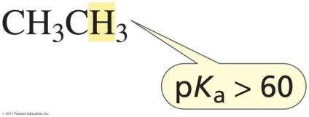
Hydrogens Attached to sp³ Carbons Have Very High pK_{a} Values

Slide 77
A Hydrogen Attached to an sp³ Carbon
Adjacent to a Carbonyl Carbon
Has a Much Lower pK_{a} Value
The sp³ carbon adjacent to carbonyl carbon is called an α-carbon.
A compound that contains a relatively acidic hydrogen
bonded to an sp³ carbon is called a carbon acid.
© 2017 Pearson Education, Inc.

Slide 78
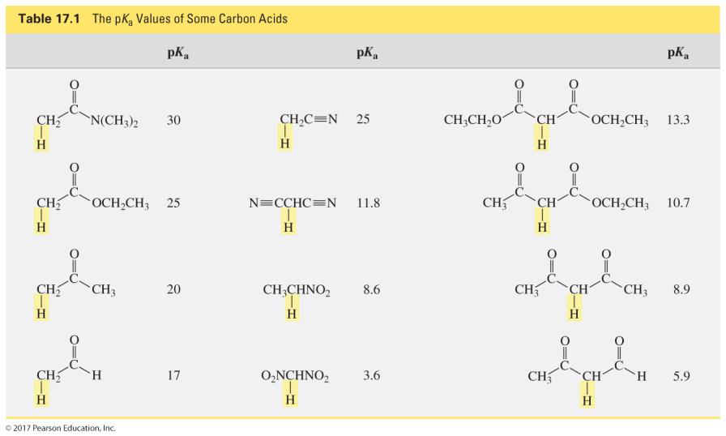
The pK_{a} Values of Some Carbon Acids

Slide 79
The Electrons Left Behind When a Proton is Removed
From an sp³ Carbon are Localized on the Carbon

Slide 80
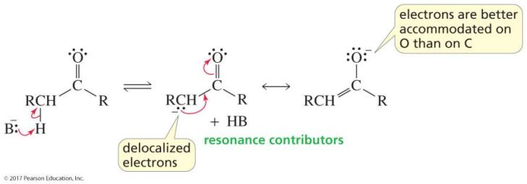
The Electrons Left Behind When a Proton is Removed
From an α-Carbon are Delocalized onto an Oxygen
Delocalization increases stability.
(The more stable the base, the stronger its conjugate acid.)
Oxygen is better able to accommodate the electrons than carbon.

Slide 81
A Proton on an α-Carbon of an Aldehyde or a Ketone
is More Acidic (pK_{a} = 16–20)
than a Proton on the α-Carbon of an Ester (pK_{a} = 25)
Esters are less acidic than aldehydes and ketones because
delocalization of the electrons left behind when the proton is removed
must compete with delocalization of the lone pair onto the carbonyl oxygen.
© 2017 Pearson Education, Inc.

Slide 82
pK_{a} Values
In each compound, the electrons left behind when the proton is removed can be delocalized onto an electronegative atom.
Only amides without a H on a N have “acidic” α-hydrogens.

Slide 83
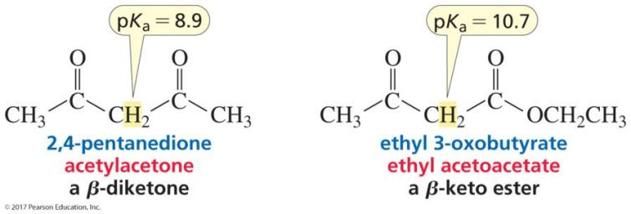
pK_{a} Values
The acidity of the α-hydrogen increases because the electrons left behind can be delocalized onto two oxygens.

Slide 84
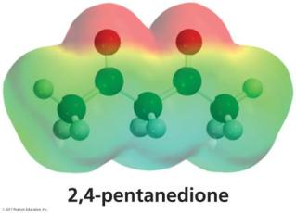
Delocalization onto Two Oxygens

Slide 85
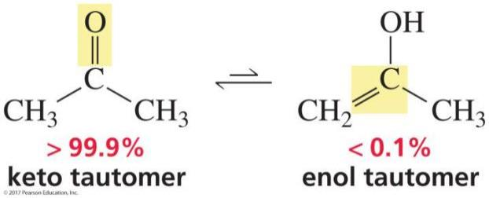
Keto–Enol Tautomers
Tautomers differ in the location of a double bond and a hydrogen.
For most ketones, the keto tautomer is more stable than the enol tautomer.

Slide 86
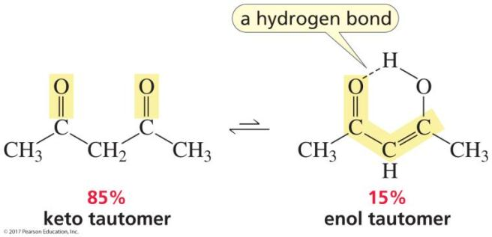
Keto–Enol Tautomers
The hydrogen bond stabilizes the enol tautomer
relative to the keto tautomer.
(But the keto tautomer is still more stable.)

Slide 87
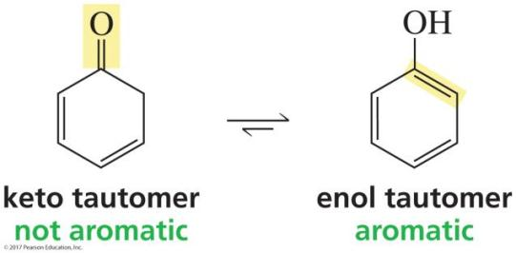
Keto–Enol Tautomers
The enol tautomer is more stable than the keto tautomer
because the enol tautomer is aromatic.

Slide 88
The Mechanism for Base-Catalyzed
Keto–Enol Interconversion

Slide 89
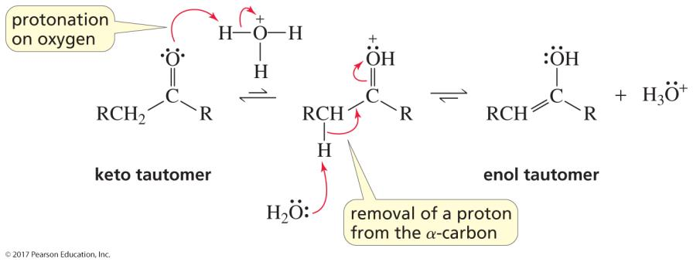
The Mechanism for Acid-Catalyzed
Keto–Enol Interconversion

Slide 90
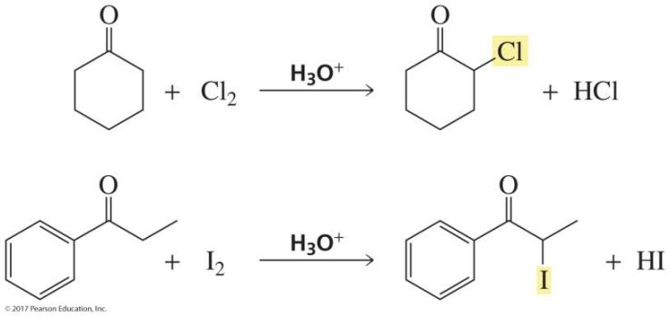
Acid-Catalyzed Halogenation
Only one α-hydrogen is replaced by a halogen.

Slide 91
Mechanism for Acid-Catalyzed Halogenation
This is the same as the mechanism for acid-catalyzed enolization
except that Br⁺ is the electrophile instead of H⁺.

Slide 92
Base-Promoted Halogenation
All the α-hydrogens are replaced by a halogen.

Slide 93
Mechanism for Base-Promoted Halogenation
This is the same as the mechanism for base-promoted enolization
except that Br⁺ is the electrophile instead of H⁺.

Slide 94
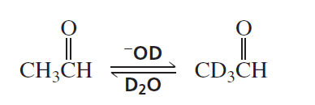
Enolization
רצימיזציה בעמדה אלפא

Slide 95
The Bromine on the α-Carbon Can Be Replaced Only by a Weak Base
Strong bases cannot be used for this reaction
because they will form elimination products.

Slide 96
Using LDA to Form an Enolate Ion
Only a small amount of enolate ion is formed. (The equilibrium lies to the left.)
All the ketone is converted to enolate ion.
(The equilibrium lies to the right.)

Slide 97
Synthesizing LDA

Slide 98
Alkylating an Enolate Ion
can also be shown as
This method can be used to alkylate the α-carbon of
ketones, esters, and nitriles.

Slide 99
Alkylating Esters and Nitriles

Slide 100
Kinetic and Thermodynamic Products
kinetic
enolate ion
thermodynamic enolate ion
לא יהיה בבחינה
2,6-Dimethylcyclohexanone is the major product
if the reaction is irreversible (LDA at −78 °C).
2,2-Dimethylcyclohexanone is the major product
if the reaction is reversible (LDA at 0 °C).

Slide 101
The Kinetic Enolate Ion is Formed Faster
The Thermodynamic Enolate Ion is More Stable
לא יהיה בבחינה
formed faster because the H is more accessible and more acidic
more stable because the double bond is more substituted

Slide 102
Alkylating the β-Carbon
The β-carbon of an α,β-unsaturated aldehyde or ketone
can be alkylated via conjugate addition.

Slide 103
Conjugate Addition
attaching the α-carbon to the β-carbon

Slide 104
Michael Reactions
When the nucleophile in conjugate addition is an enolate ion, the reaction is called a Michael reaction.

Slide 105
The Mechanism for a Michael Reaction
Michael reactions form 1,5-dicarbonyl compounds.

Slide 106
An Aldol Addition Reaction
One molecule of the aldehyde or ketone is an electrophile,
and the other is a nucleophile.

Slide 107
Aldol Addition Reactions
The product is a β-hydroxyaldehyde or a β-hydroxyketone.
It has twice as many carbons as the reactant.

Slide 108
The Mechanism for the Aldol Addition
The starting material is an aldehyde.

Slide 109
The Mechanism for the Aldol Addition
The starting material is a ketone.

Slide 110
A Retro−Aldol Addition

Slide 111
The Acid-Catalyzed Dehydration
of the Product of an Aldol Addition
The overall reaction is called an aldol condensation.
A condensation reaction combines two molecules
by forming a C—C bond while removing a small molecule (usually water or an alcohol).

Slide 112
The Base-Catalyzed Dehydration
of an Aldol Addition Product
The elimination reaction is an E1cb reaction.

Slide 113
The Mechanism for an E1cb Reaction
An E1cb reaction occurs only when the carbanion
can be stabilized by electron delocalization.

Slide 114
Dehydration Occurs without a Catalyst
as Soon as the Aldol Addition Product is Formed
Loses water without a catalyst (or ∆) because
the new double bond
is conjugate with the carbonyl group and the benzene ring.
(The more stable the double bond is, the easier it is to form.)

Slide 115
A Crossed Aldol Addition
(forms 4 products)

Slide 116
Obtaining One Product from
a Crossed Aldol Addition
If only one carbonyl compound has α-hydrogens.
a Claisen-Schmidt condensation
The carbonyl compound with α-hydrogens
is added slowly to a solution of
the carbonyl compound without α-hydrogens and a base.

Slide 117
Obtaining One Product from
a Crossed Aldol Addition
If both carbonyl compounds have α-hydrogens.
LDA is used to form the enolate ion, and the other carbonyl compound is added slowly.

Slide 118
Using Retrosynthetic Analysis
to Determine the Starting Materials
first do a retrosynthetic analysis
then do the synthesis
LDA is used to form the enolate ion,
and the other carbonyl compound is added slowly.

Slide 119
Retrosynthetic Analysis
synthesis

Slide 120
A Claisen Condensation
A Claisen condensation is a condensation reaction
of two molecules of an ester

Slide 121
The Nucleophile Should be Identical to the OR Group of the Ester

Slide 122
The Mechanism for the Claisen Condensation

Slide 123
The Claisen Condensation versus
the Aldol Addition

Slide 124
A Successful Claisen Condensation
Requires an Ester with Two α-Hydrogens
A second hydrogen is removed to prevent the reaction
from reversing to the starting material.

Slide 125
Obtaining One Product from
a Crossed Claisen
If only one carbonyl compound has α-hydrogens.
The carbonyl compound with α-hydrogens
is added slowly to a solution of
the carbonyl compound without α-hydrogens and a base.

Slide 126
Obtaining One Product from
a Crossed Claisen
If both carbonyl compounds have α-hydrogens.
LDA is used to form the enolate ion, and the other carbonyl compound is added slowly.

Slide 127
A Crossed Condensation between
a Ketone and an Ester
Only one carbonyl compound has α-hydrogens.
The carbonyl compound with α-hydrogens
is added slowly to a solution of
the carbonyl compound without α-hydrogens and a base.

Slide 128
A Crossed Condensation between
a Ketone and Diethyl Carbonate
Only one carbonyl compound has α-hydrogens.
The carbonyl compound with α-hydrogens
is added slowly to a solution of
the carbonyl compound without α-hydrogens and a base.

Slide 129
A Crossed Condensation Between
a Ketone and Diethyl Carbonate
The carbonyl compound with α-hydrogens
is added slowly to a solution of
the carbonyl compound without α-hydrogens and a base.

Slide 130
Summary of Crossed Condensations
If both carbonyl compounds have α-hydrogens:
Use LDA to form the desired enolate ion,
and the other carbonyl compound is added slowly.
If only one carbonyl compound has α-hydrogens:
The carbonyl compound with α-hydrogens
is added slowly to a solution of
the carbonyl compound without α-hydrogens and a base.

Slide 131
A Dieckmann Condensation
A Dieckman condensation is an
intramolecular Claisen condensation.

Slide 132
A Dieckmann Condensation

Slide 133
The Mechanism for a Dieckmann Condensation

Slide 134
Intramolecular Aldol Additions
Two different enolate ions can be formed.
A 5-membered ring is favored over a 3-membered ring.

Slide 135
Intramolecular Aldol Additions
Two different enolate ions can be formed.
A 5-membered ring is favored over a 7-membered ring.

Slide 136
Intramolecular Aldol Additions

Slide 137
Steps in the Robinson Annulation
לא יהיה בבחינה
A Robinson annulation forms a product with a 2-cyclohexenone ring.

Slide 138
Retrosynthetic Analysis
לא יהיה בבחינה

Slide 139
An Alkane Does Not Lose a Proton
A Carboxylic Acid Does Not Lose CO₂

Slide 140
A Proton Can Be Removed from an α-Carbon
CO₂ Can Be Removed from an α-Carbon
The electrons left behind when H⁺ is removed are
delocalized onto an oxygen.
The electrons left behind when CO₂ is removed are
delocalized onto an oxygen.

Slide 141
It is Easier to Remove a Proton
When the Carboxylic Acid is in Its Acidic Form

Slide 142
3-Oxocarboxylic Acids
Can Be Decarboxylated

Slide 143
3-Oxocarboxylic Acids
Can Be Decarboxylated

Slide 144
The Malonic Ester Synthesis
The starting material for the synthesis is malonic acid.
A malonic ester synthesis forms a carboxylic acid with two more carbons than the alkyl halide used in the synthesis.

Slide 145
The Steps in the Malonic Ester Synthesis

Slide 146
Synthesizing a Carboxylic Acid
With Two Substituents

Slide 147
Planning the Synthesis of a Carboxylic Acid

Slide 148
The Acetoacetic Ester Synthesis
The starting material for the synthesis is acetoacetic acid.
An acetoacetic ester synthesis forms a methyl ketone
with three more carbons than the alkyl halide used in the synthesis.

Slide 149
The Steps in the Acetoacetic Ester Synthesis

Slide 150
Planning the Synthesis of a Methyl Ketone

Slide 151
Designing a Synthesis
that Makes New Carbon–Carbon Bonds
Locate the new carbon–carbons bond that must be formed.

Slide 152
Designing a Synthesis
that Makes New Carbon–Carbon Bonds
Decide which end will be the nucleophile
and which end will be the electrophile.
synthesis

Slide 153
Designing a Synthesis
that Makes a New Carbon–Carbon Bond
Locate the new carbon–carbon bond that must be formed.
Then choose the nucleophile and the electrophile.
synthesis

