Slide 1
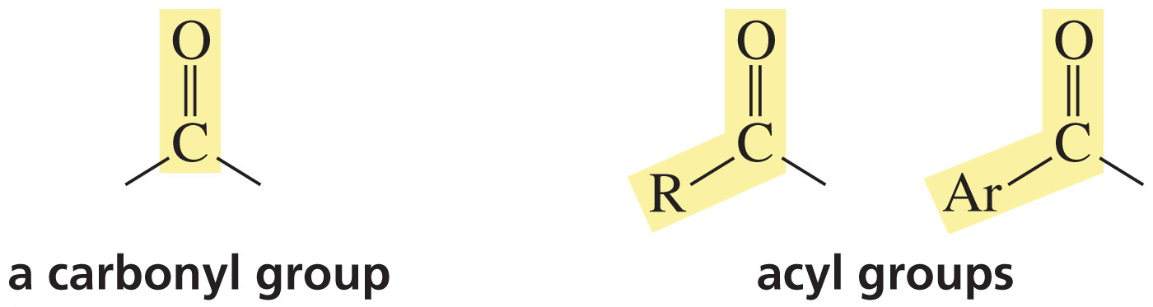
A Carbonyl Group
An Acyl Group

Slide 2
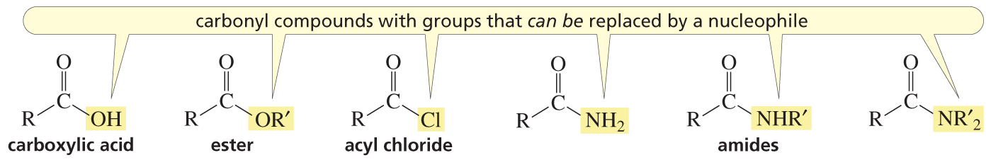
Two Classes of Carbonyl Compounds
These carbonyl compounds have a group
that can be substituted by another group.

Slide 3
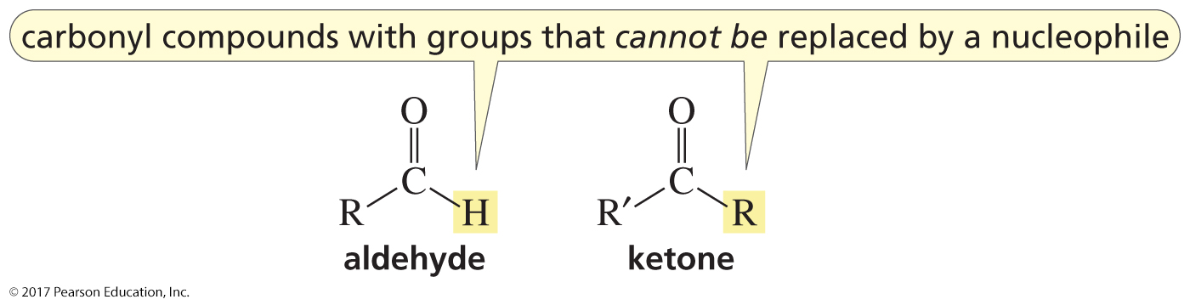
Two Classes of Carbonyl Compounds
These carbonyl compounds do not have a group
that can be substituted by another group.

Slide 4
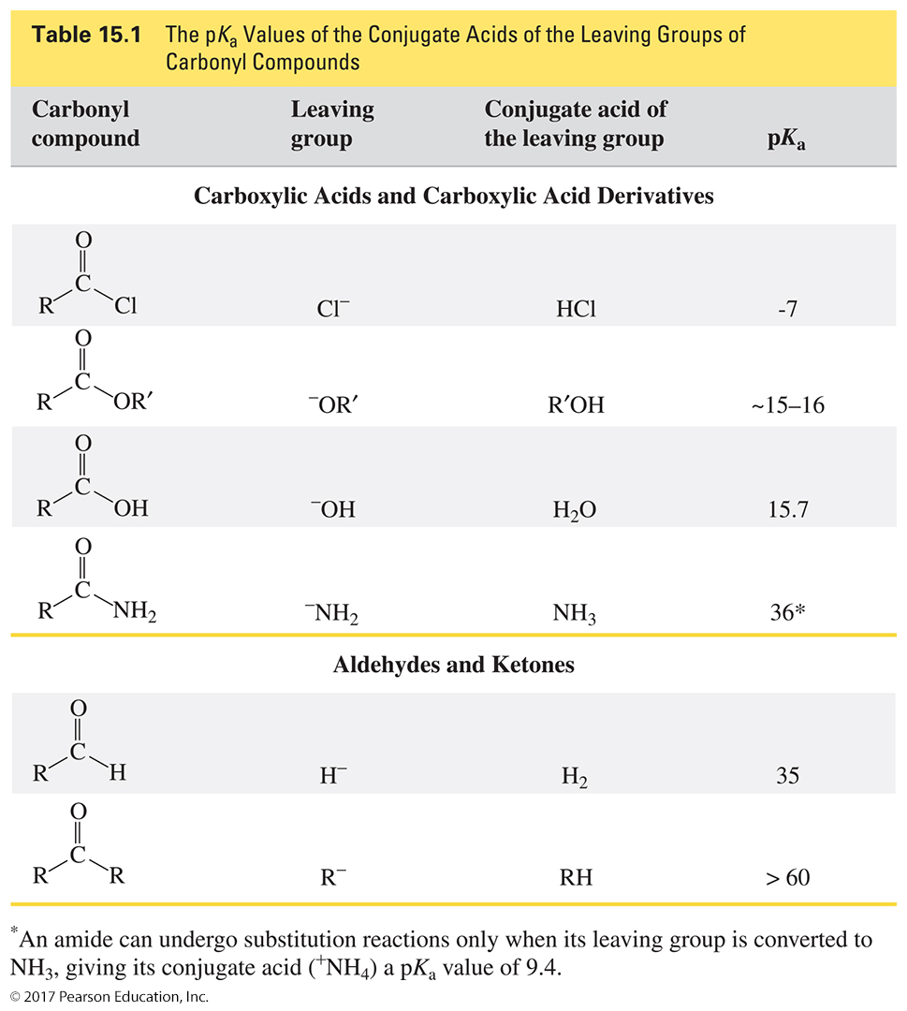
The Class to Which a Carbonyl Group Belongs Depends on the Basicity of the Group Attached to the Acyl Group

Slide 5
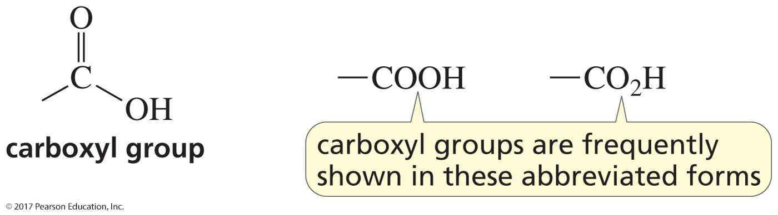
A Carboxyl Group

Slide 6
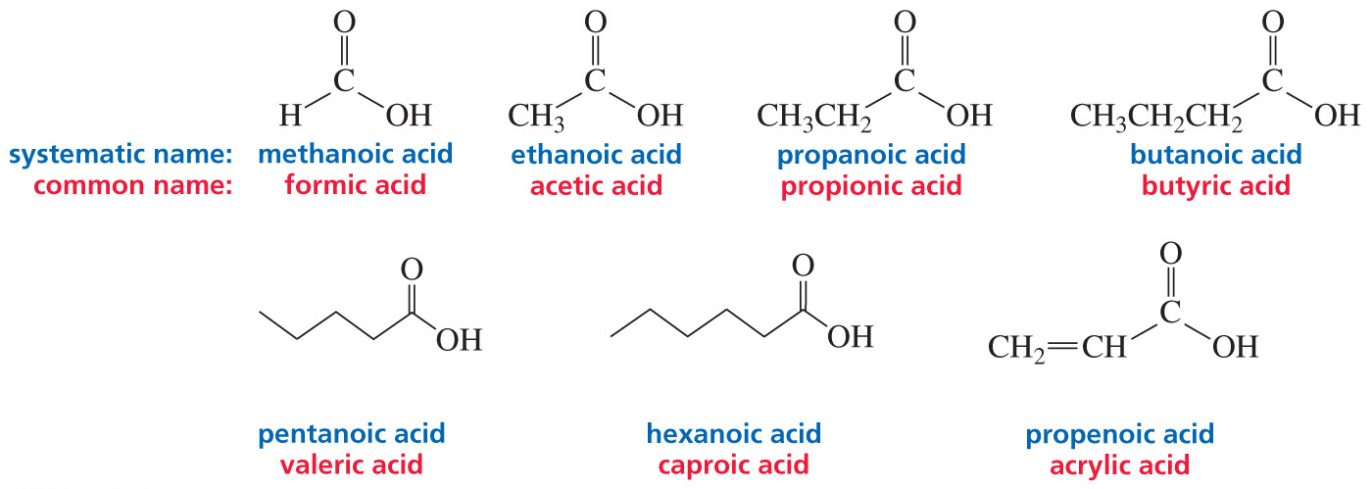
Naming Carboxylic Acids

Slide 7
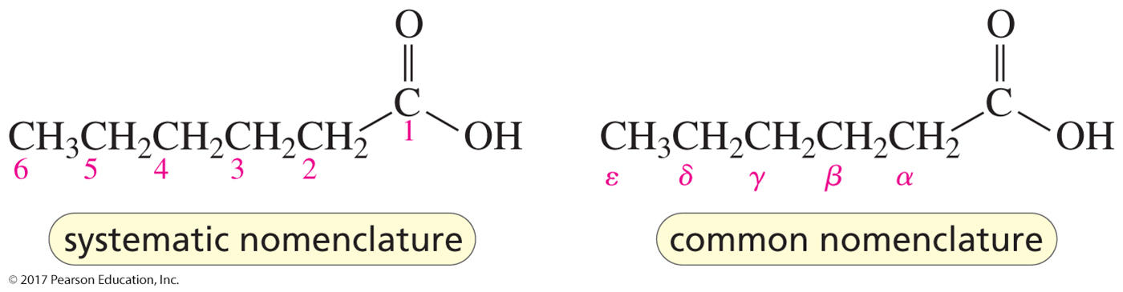
Naming Carboxylic Acids
In systematic nomenclature,
the carbonyl carbon is C-1.
In common nomenclature,
the carbon next to the carbonyl is the alpha carbon.

Slide 8
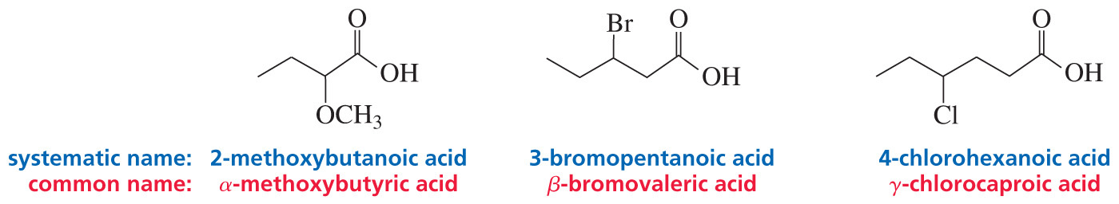
Naming Carboxylic Acids

Slide 9
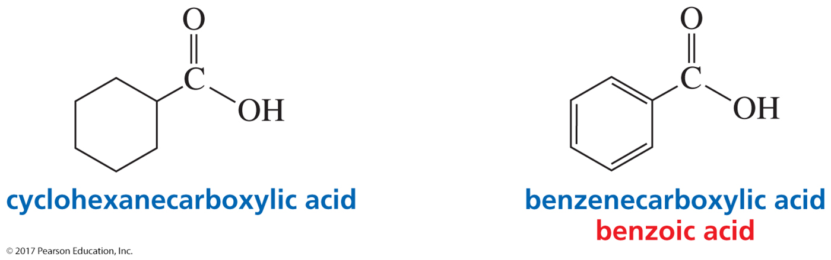
Naming Carboxylic Acids

Slide 10
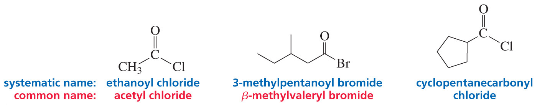
Naming Acyl Halides
(Acyl Chlorides and Acyl Bromides)

Slide 11
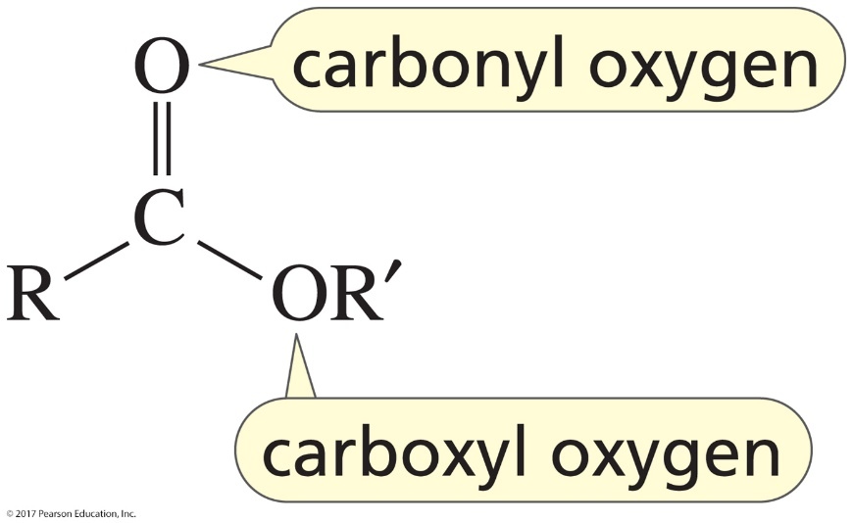
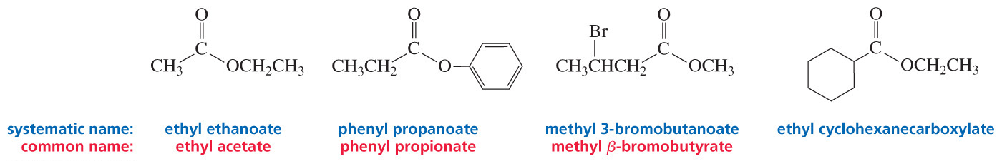
Naming Esters
The substituent attached to the O is stated first,
delete “ic acid,” add “ate”.

Slide 12
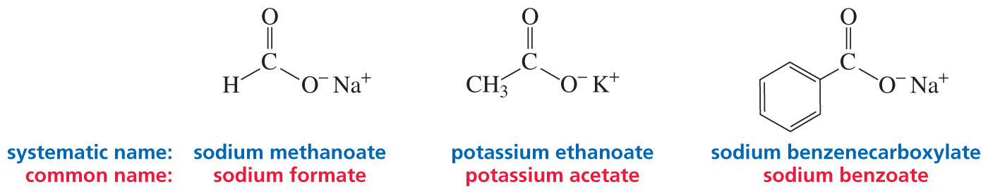
Naming Carboxylate Ion Salts

Slide 13
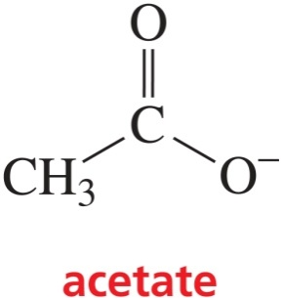
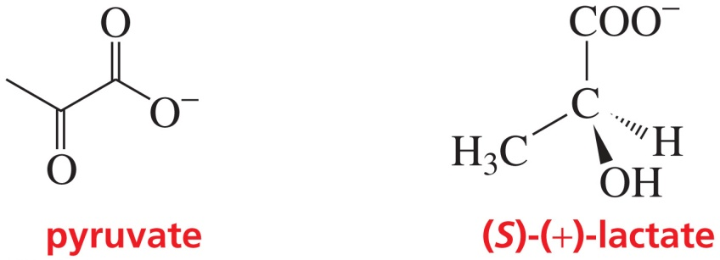
Naming Carboxylate Ions

Slide 14
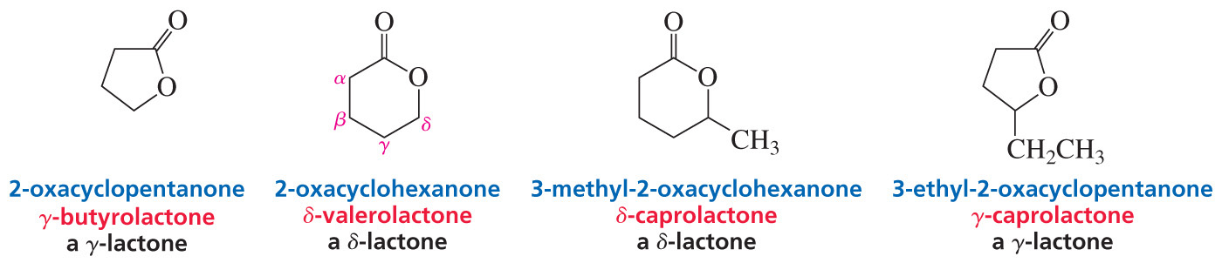
Naming Lactones
(Cyclic Esters)

Slide 15
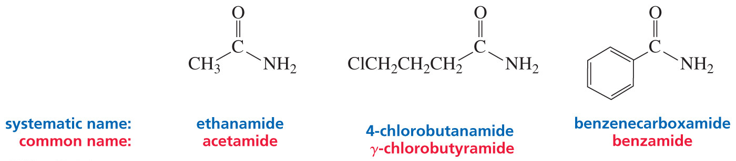
Naming Amides

Slide 16
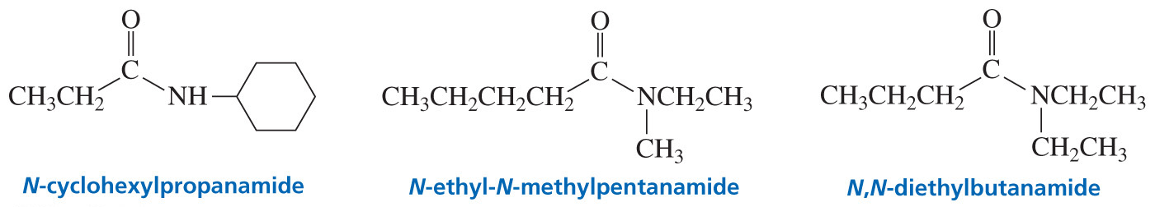
Naming Amides
The substituent attached to the nitrogen is stated first.

Slide 17
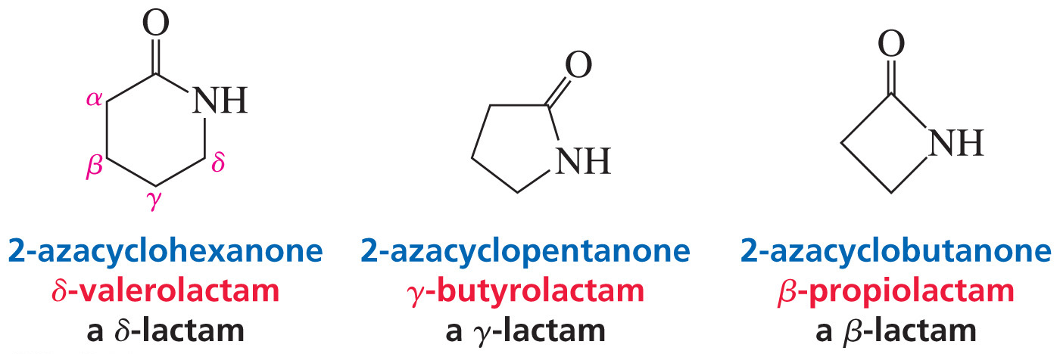
Naming Lactams
(Cyclic Amides)

Slide 18
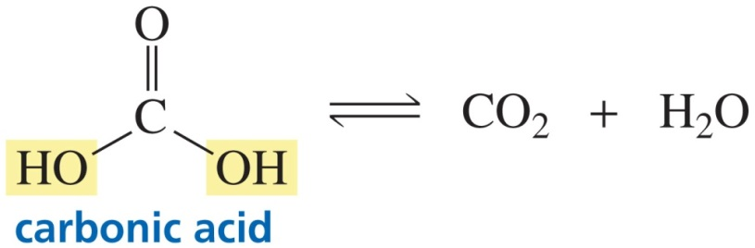
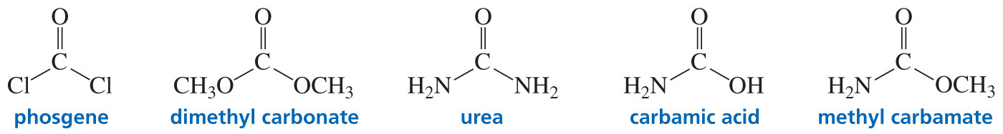
Derivatives of Carbonic Acid

Slide 19
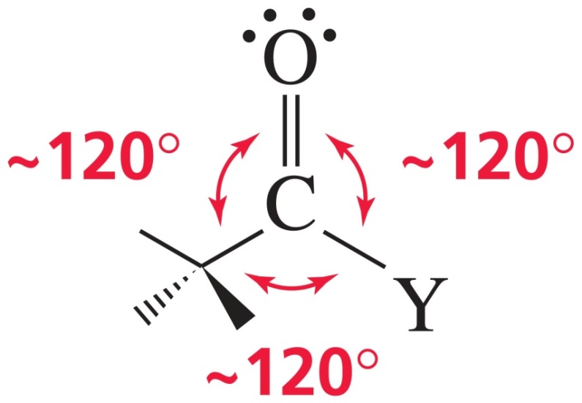
The Structure of a Carbonyl Compound

Slide 20
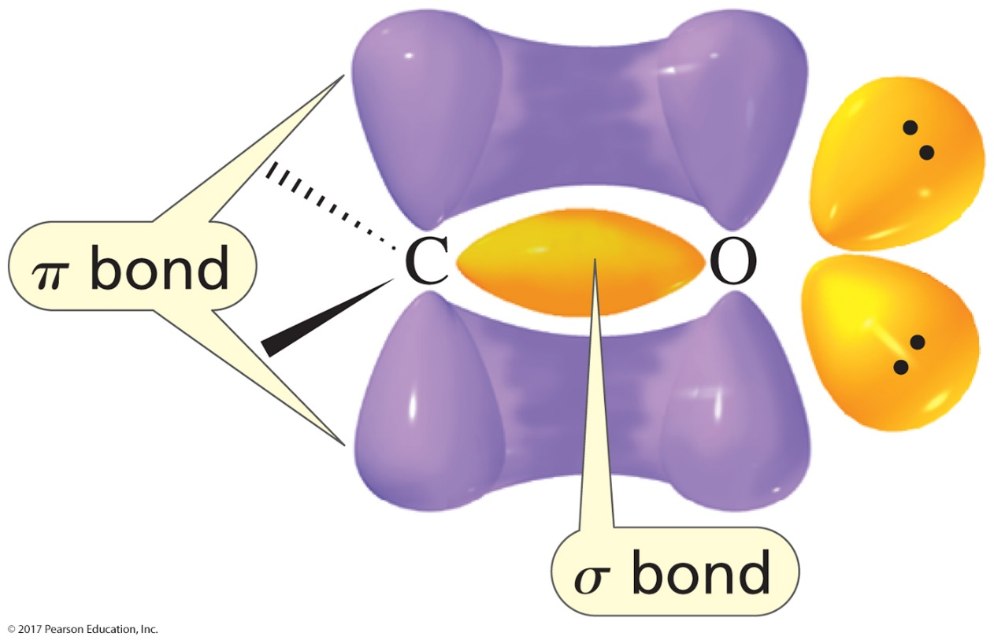
The Orbitals Used in
Carbonyl Group Formation

Slide 21
The Relative Reactivities Depend on the Basicity of the Substituent Attached to the Leaving Group
נגזרות של חומצות קרבוקסיליות
הקבוצות הממוסגרות מתחלפות בנוקלאופיל

Slide 22
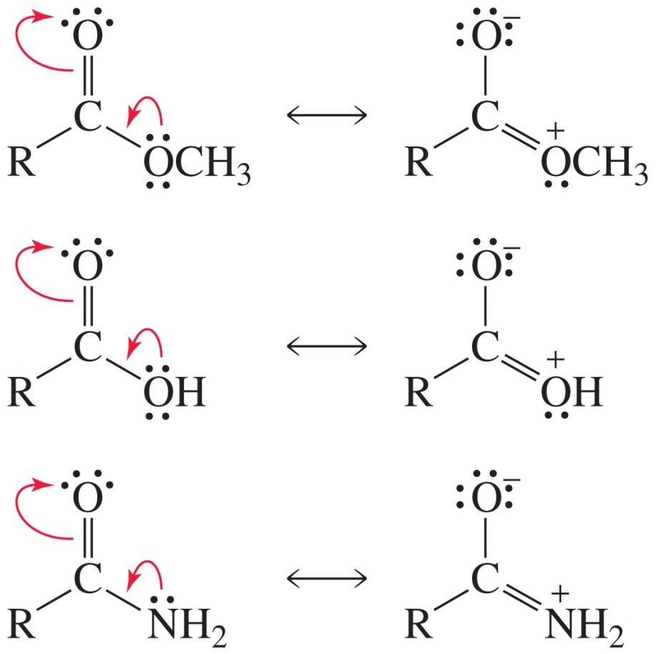
Resonance Contributors
Esters, carboxylic acids, and amides have
two resonance contributors.

Slide 23
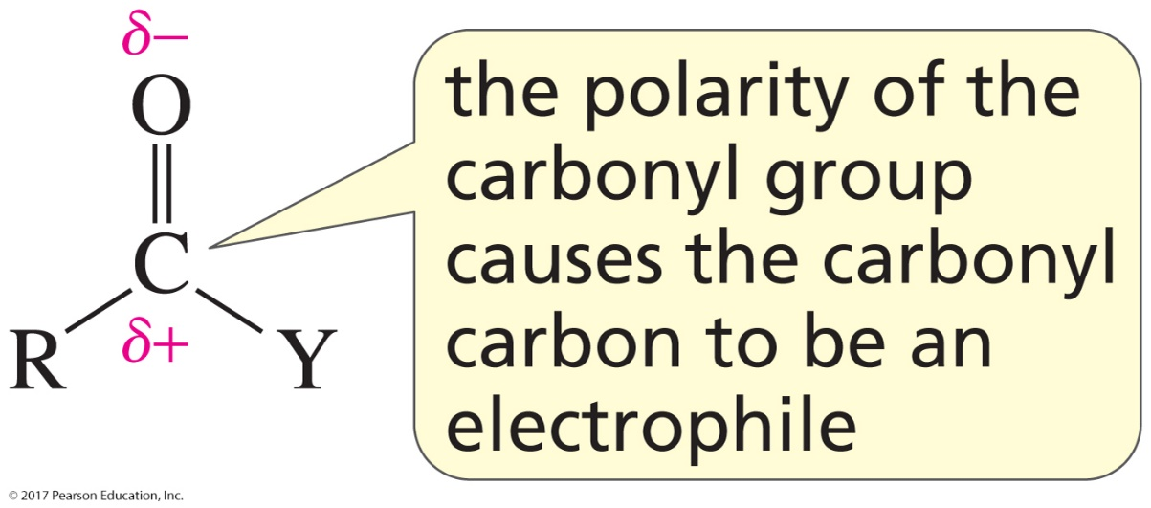
The Carbonyl Carbon is an Electrophile

Slide 24
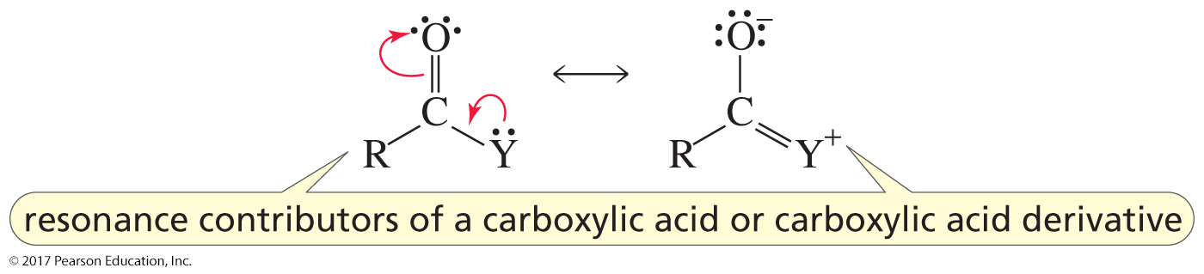
A Weak Base Makes Formation
of the Tetrahedral Intermediate Faster
The weaker the base,
the smaller the contribution from the resonance contributor with a positive charge on Y and
the more electrophilic the carbonyl carbon.

Slide 25
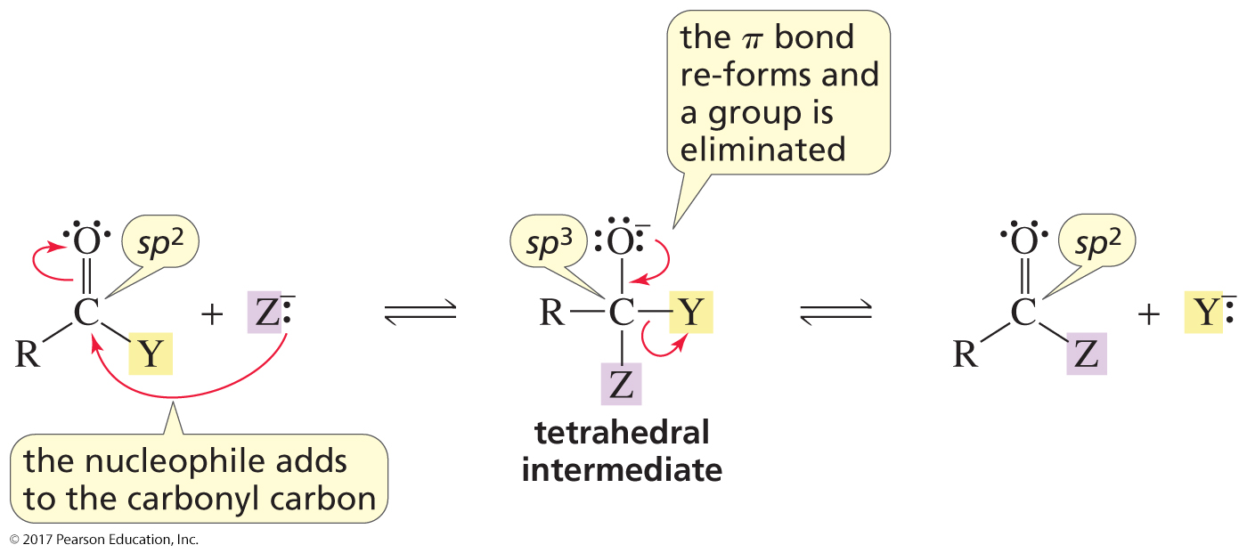
A Nucleophilic Acyl Substitution Reaction
Generally, a compound with an sp³ carbon bonded to an oxygen and to another electronegative atom is unstable.

Slide 26
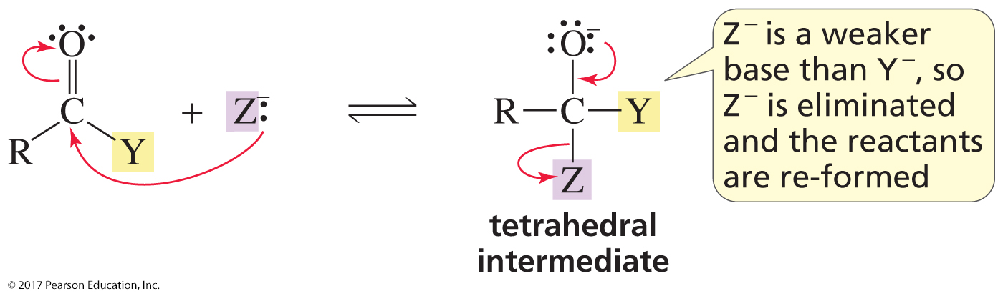
If the Incoming Nucleophile (Z) is a Weaker Base
Than the Base in the Reactant (Y)
The weakest base is eliminated from
the tetrahedral intermediate.
If the incoming nucleophile (Z) is a weaker base than the base
in the reactant (Y), the reactants will be reformed.

Slide 27
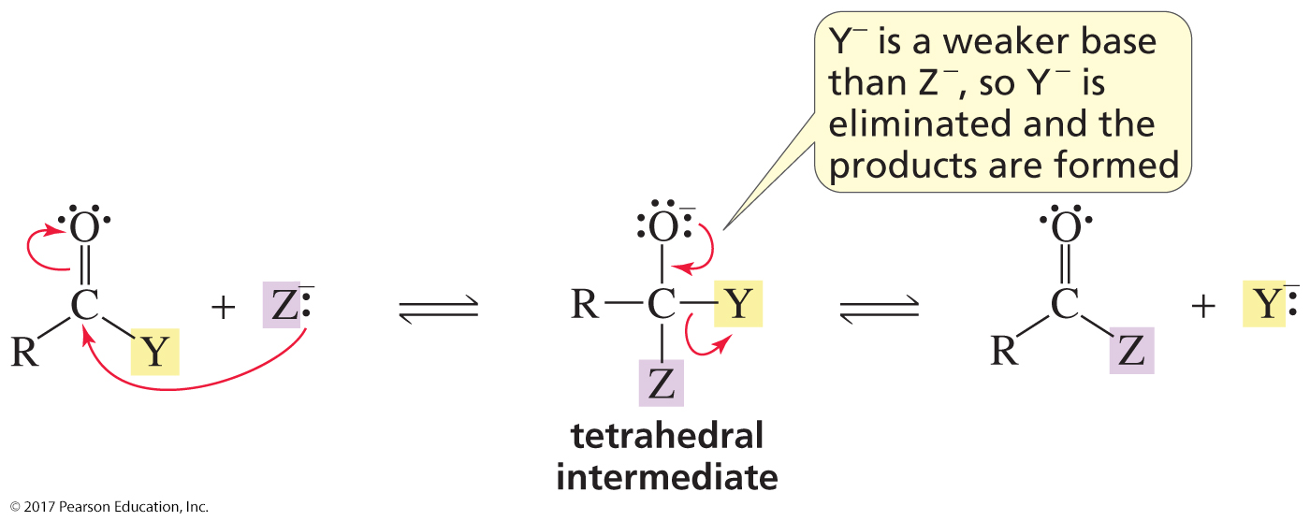
If the Incoming Nucleophile (Z) is a Stronger Base
Than the Base in the Reactant (Y)
The weakest base is eliminated from
the tetrahedral intermediate.
If the incoming nucleophile (Z) is a stronger base than
the base in the reactant (Y), a new product will be formed.

Slide 28
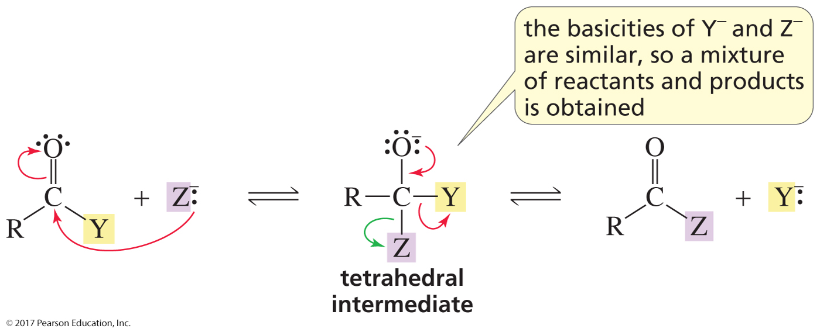
If the Two Groups Have
Similar Basicities
A mixture of reactants and products is obtained.

Slide 29
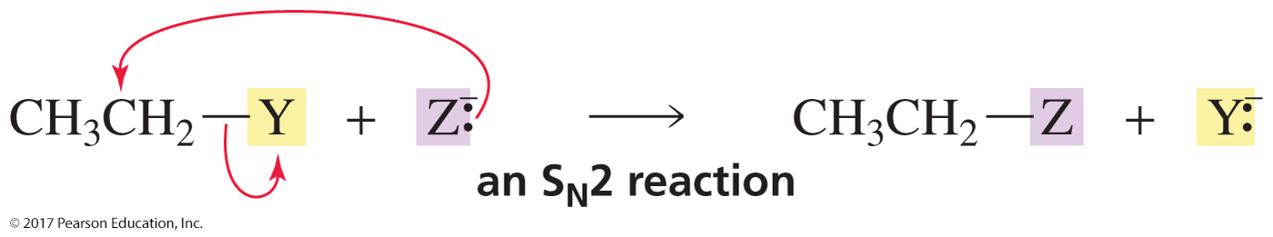
When a Nucleophile Attacks a Carbon,
the Weakest Bond Breaks
When a nucleophile attacks an alkyl halide,
the sigma bond breaks.
When a nucleophile attacks a carbonyl compound,
the π bond breaks.

Slide 30
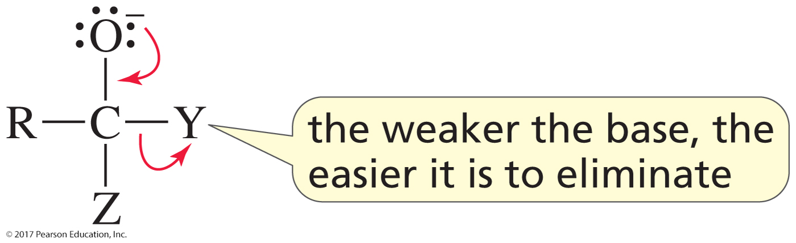
A Weak Base Makes Elimination
from the Tetrahedral Intermediate Faster

Slide 31
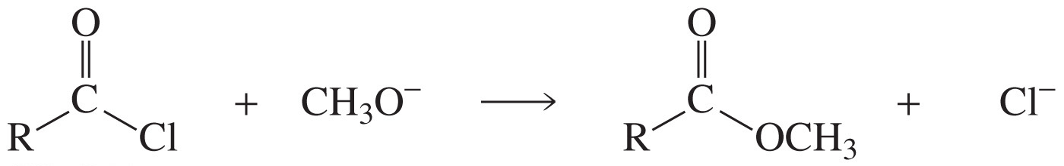
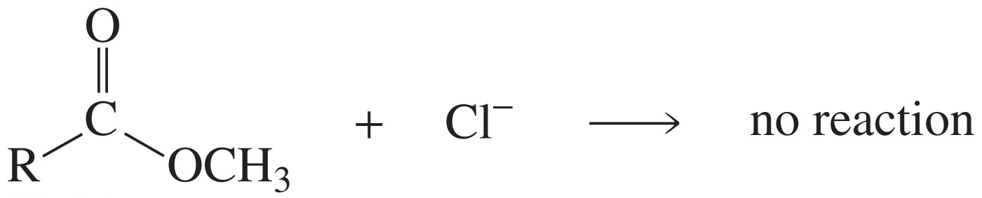
A Carboxylic Acid Derivative Can Be Converted
Only to a Less Reactive Carboxylic Acid Derivative

Slide 32
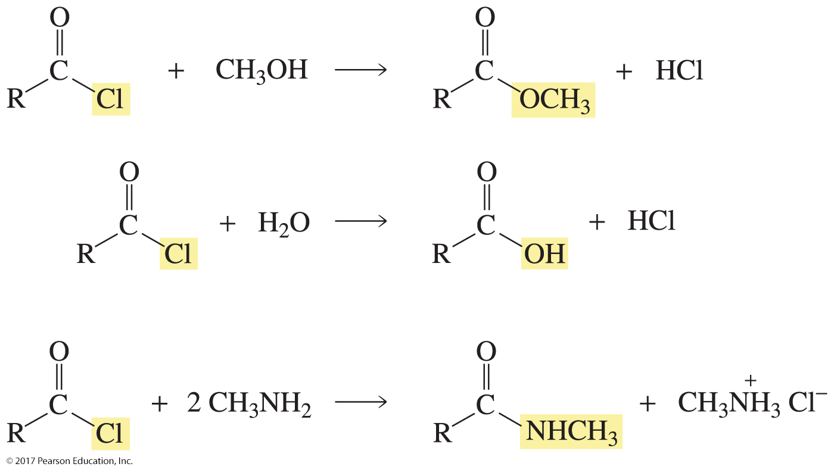
Reactions of Acyl Chlorides

Slide 33
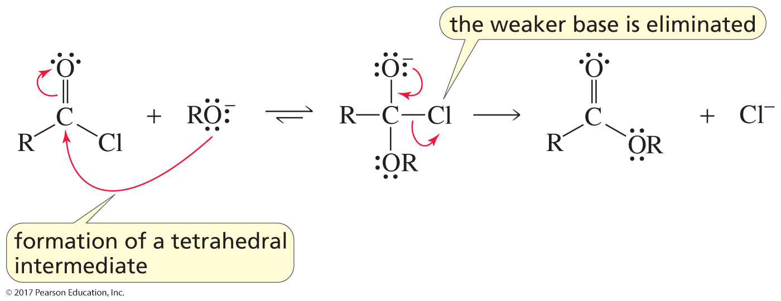
Mechanism of the Reaction
with a Negatively Charged Nucleophile

Slide 34
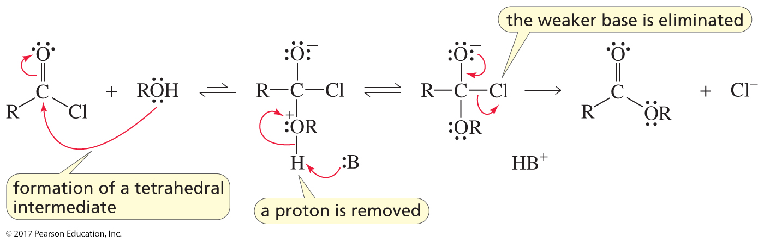
Mechanism of the Reaction
with a Neutral Nucleophile

Slide 35
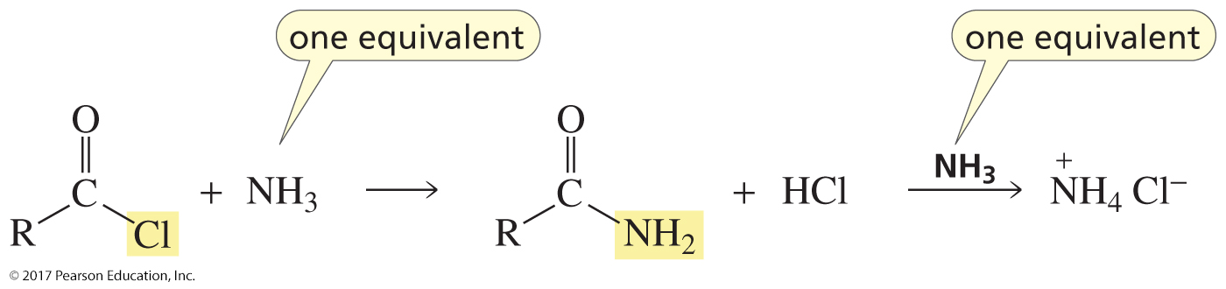
Two Equivalents of Amine (or Ammonia) are Required
One equivalent of amine (or ammonia) is the nucleophile;
the other picks up the proton produced in the reaction.

Slide 36
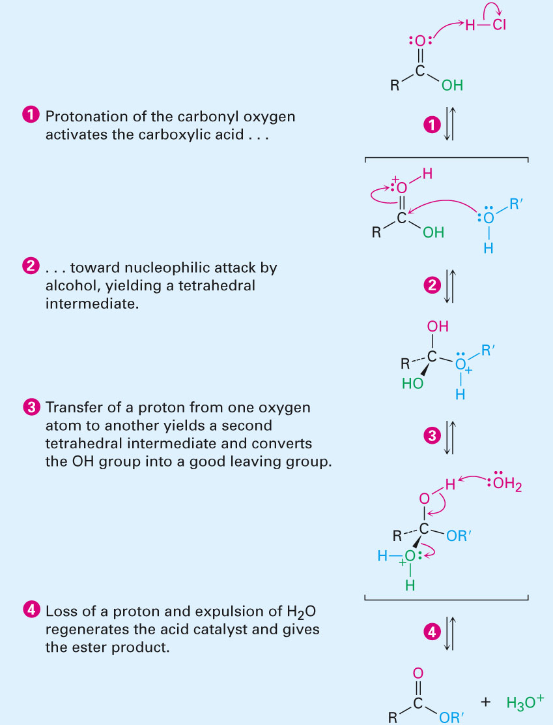
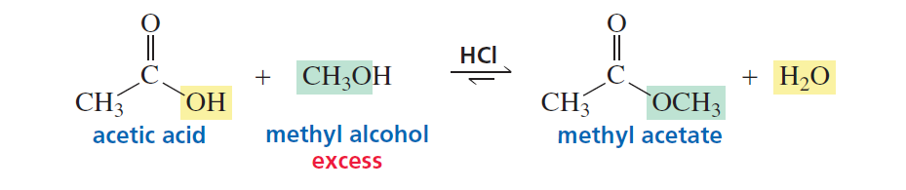
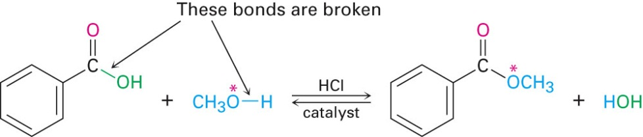
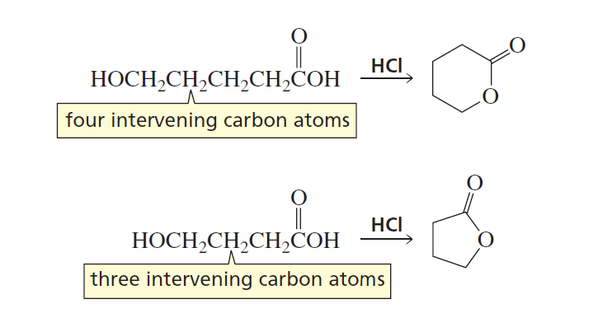
Fischer esterification

Slide 37
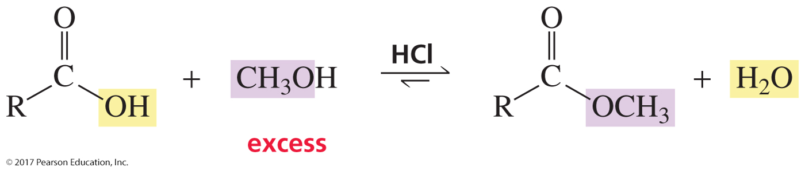
Reaction of a Carboxylic Acid with an Alcohol
a Fischer esterification
Excess alcohol drives the reaction to the right.

Slide 38
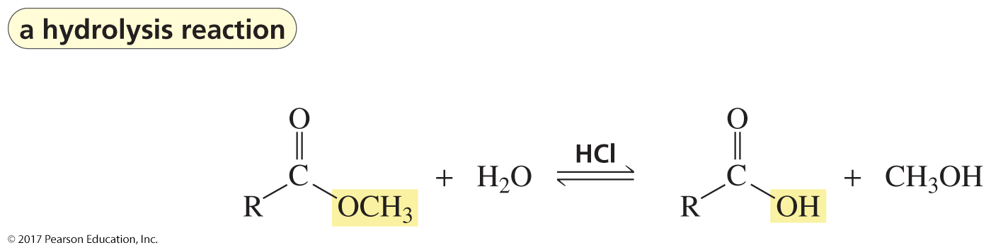
The Reaction of an Ester with Water
An ester is not very reactive, and water is a poor nucleophile,
so a catalyst is used.
A hydrolysis reaction is a reaction with water that converts
one compound into two compounds.

Slide 39
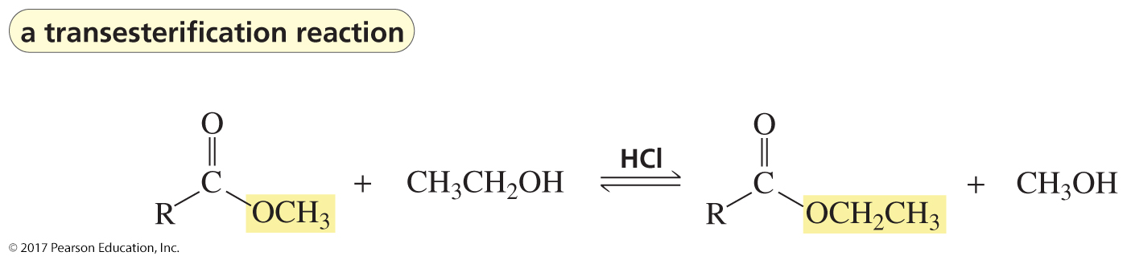
The Reaction of an Ester with an Alcohol
An alcoholysis reaction is a reaction with an alcohol
that converts one compound into two compounds.
This alcoholysis reaction is called a transesterification reaction
(one ester is converted to another ester).

Slide 40
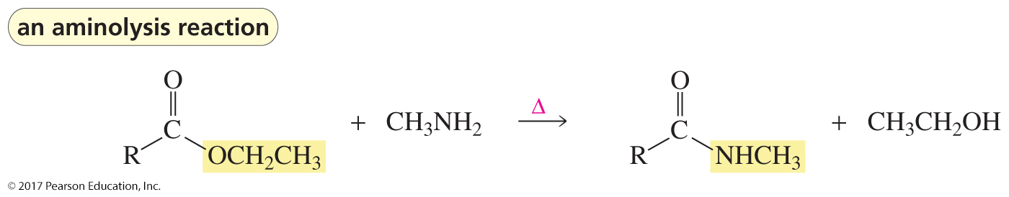
The Reaction of an Ester with an Amine
An aminolysis reaction is a reaction with an amine
that converts one compound into two compounds.

Slide 41
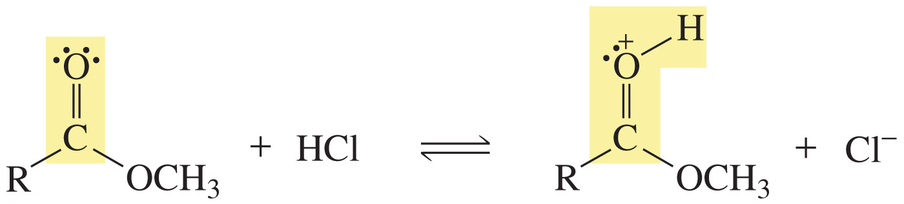
The Carbonyl Oxygen is Protonated
The acid protonates the atom with the greatest electron density.

Slide 42
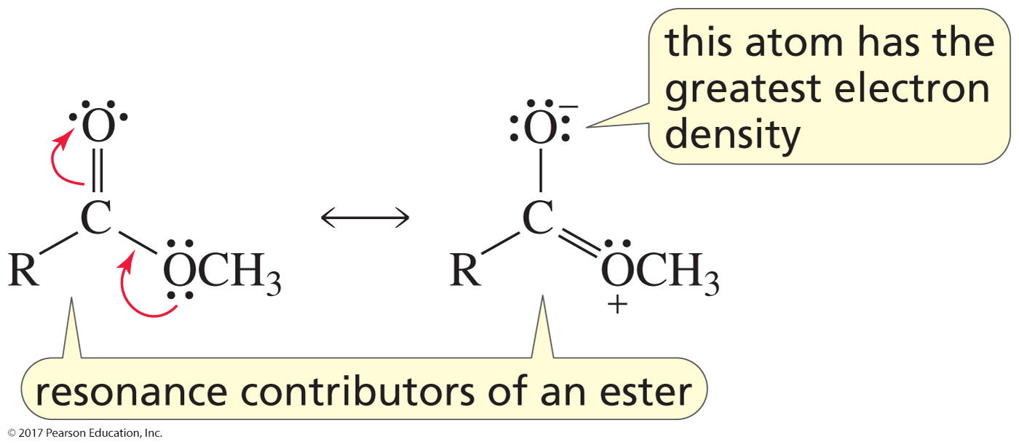
The Resonance Contributors Show That
the Carbonyl Oxygen Has the Greatest Electron Density

Slide 43
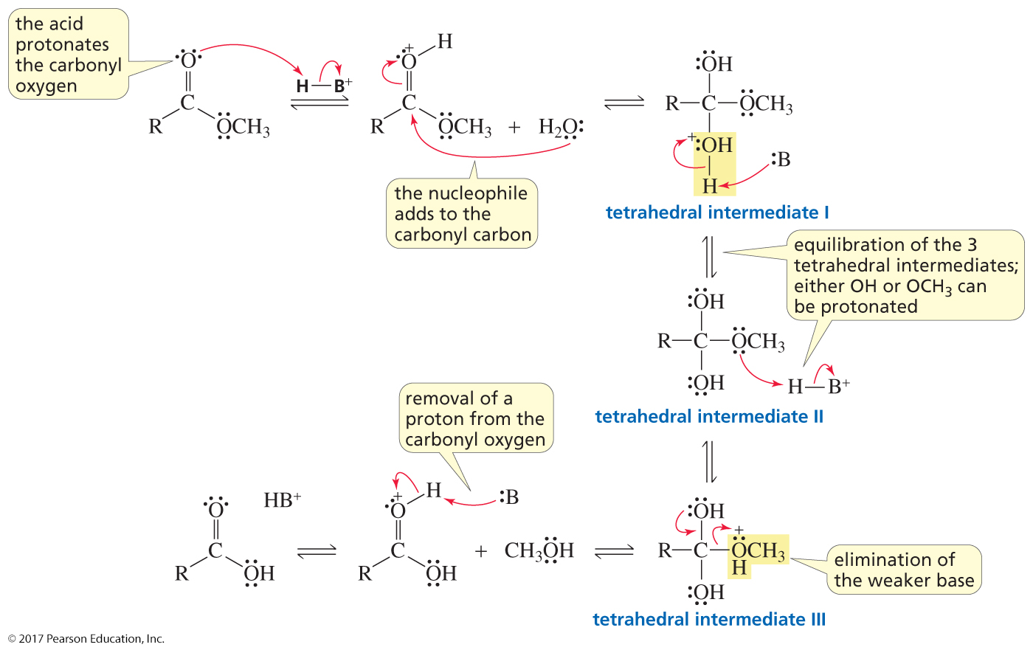
The Mechanism for the
Acid-Catalyzed Hydrolysis of an Ester

Slide 44
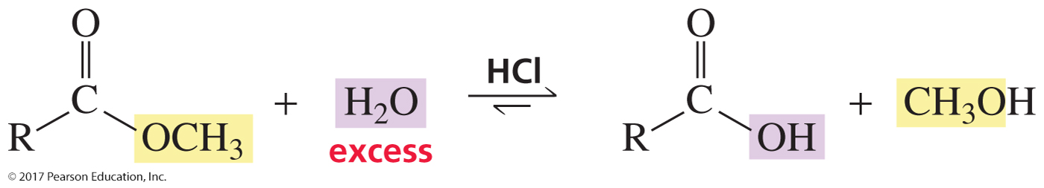
Use Excess Water
to Drive the Reaction to the Right

Slide 45

Protonation Makes the Carbonyl Group
More Susceptible to Nucleophilic Addition

Slide 46

Protonation Makes the Leaving Group
a Better Leaving Group

Slide 47

Transesterification
Transesterification is the reaction of an ester with an alcohol.
An ester is not very reactive and an alcohol is a poor nucleophile,
so a catalyst is used.

Slide 48

The Mechanism for Hydroxide-Ion-Promoted Hydrolysis of an Ester

Slide 49

How Hydroxide Ion
Increases the Rate of the Reaction
Hydroxide ion is a better nucleophile than water.
Collapse of the tetrahedral intermediate
is faster in a basic solution.

Slide 50

Acid-Catalyzed Ester Hydrolysis is Reversible;
Hydroxide-Ion-Promoted Ester Hydrolysis is Irreversible
Negatively charged carboxylate ions
do not react with nucleophiles.

Slide 51

The Reaction with an Alcohol Can Be
Catalyzed by an Alkoxide Ion
Only hydrolysis reactions can be promoted by hydroxide ion.

Slide 52

Relative Reactivities
Carboxylic acids can undergo nucleophilic acyl substitution reactions
only when they are in their acidic form.

Slide 53

Carboxylate Ions Do Not React
with Nucleophiles

Slide 54

Reaction of a Carboxylic Acid with an Amine
A carboxylic acid is an acid, and an amine is a base,
so an acid–base reaction occurs.

Slide 55

Heating the Product of the Acid–Base
Reaction Forms an Amide

Slide 56


Amides Do Not Undergo
Nucleophilic Acyl Substitution Reactions

Slide 57

Amides Do React with Water and Alcohols
if an Acid Catalyzed is Present

Slide 58

The Mechanism for the
Acid-Catalyzed Hydrolysis of an Amide
המנגנון לא יהיה בבחינה

Slide 59

Why Hydrolysis and Alcoholysis of an Amide
Require a Catalyst
The weakest base is the best leaving group.
A protonated amino group
is a weaker base
than hydroxide ion.
An amino group
is a stronger base
than hydroxide ion.

Slide 60

Amide Hydrolysis can be
Promoted by Hydroxide Ion

Slide 61

The Mechanism for
Hydroxide-Ion-Promoted Hydrolysis of an Amide
המנגנון לא יהיה בבחינה

Slide 62

Nomenclature of Nitriles

Slide 63


Acid-Catalyzed Hydrolysis of a Nitrile
Nitriles are harder to hydrolyze than amides.

Slide 64

The Mechanism
המנגנון לא יהיה בבחינה

Slide 65

Synthesis of a Carboxylic Acid

Slide 66

Synthesis of a Primary Amine

Slide 67

An Acid Anhydride is Formed When Water is Lost
from Two Molecules of a Carboxylic Acid

Slide 68

Nomenclature of Acid Anhydrides

Slide 69

Acid Anhydrides are Less Reactive Than
Acyl Chlorides but More Reactive Than Esters

Slide 70

Reactions of Acid Anhydrides
An acid anhydride, like an acyl chloride, requires
two equivalents of an amine.

Slide 71

The Mechanism

Slide 72

Dicarboxylic Acids

Slide 73

The Two pK_{a} Values Are Different
Why?
The neighboring COOH group withdraws electrons and
lowers the first pK_{a}.
Electrostatic repulsion between like charges
raises the second pK_{a}.

Slide 74


Dicarboxylic Acids Will Lose Water When Heated
if They Can Form a Five- or Six-Membered Ring

Slide 75

Anhydride Formation Can Be Catalyzed
by Acetic Anhydride (or Acetyl Chloride)
המנגנון לא יהיה בבחינה

Slide 76

Activating Carboxylic Acids
by Converting Them to Acyl Chlorides
המנגנון לא יהיה בבחינה

Slide 77

Starting with an Acyl Chloride, a Wide Variety
of Carboxylic Acid Derivatives Can Be Synthesized

