Slide 1
Reactivity Depends on
the Basicity of the Leaving Group

Slide 2
Acid Converts the Poor Leaving Group
into a Good Leaving Group
Alcohols must be “activated” before they can react.
Only weakly basic nucleophiles can be used.
Strongly basic nucleophiles will react with the proton.

Slide 3
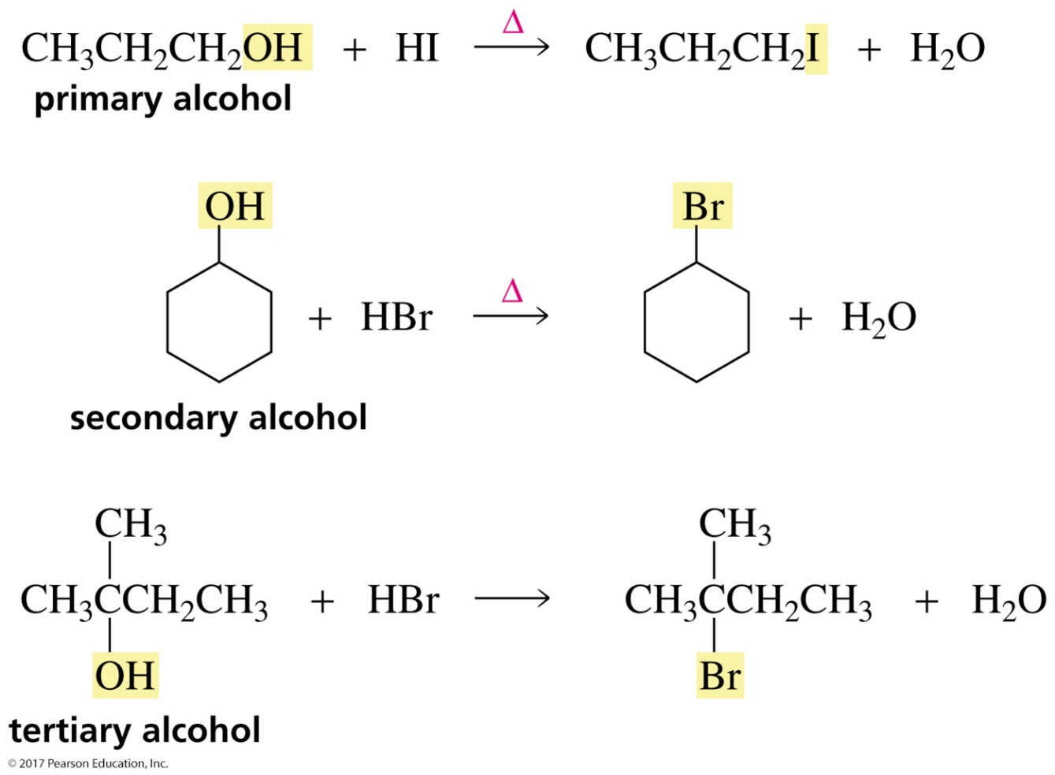
Converting Alcohols into Alkyl Halides
Primary and secondary alcohols require heat; tertiary alcohols do not.

Slide 4
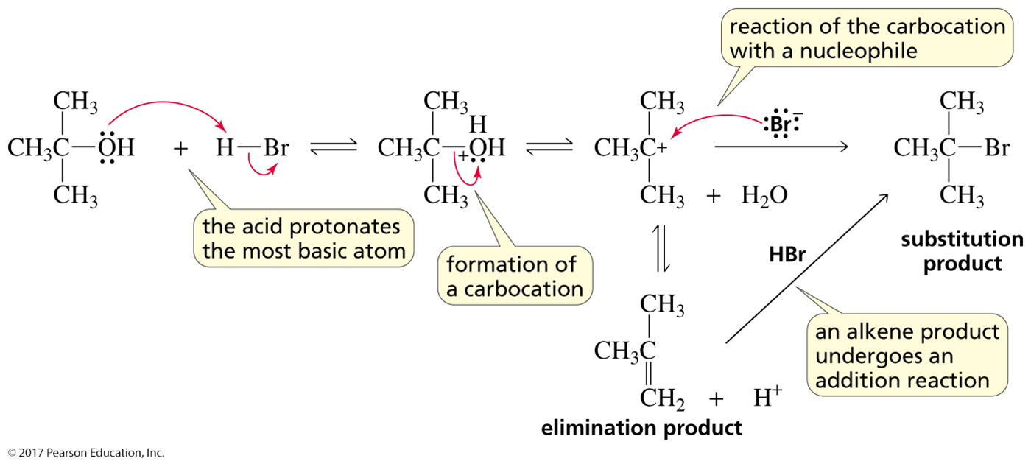
The Reactions of Secondary and Tertiary Alcohols
with Hydrogen Halides are S_{N}1 Reactions

Slide 5
The Reactions of Primary Alcohols
with Hydrogen Halides are S_{N}2 Reactions
Recall that Br⁻ is a good nucleophile in a protic solvent.
Alcohols undergo S_{N}1 reactions unless
they would have to form a primary carbocation.

Slide 6
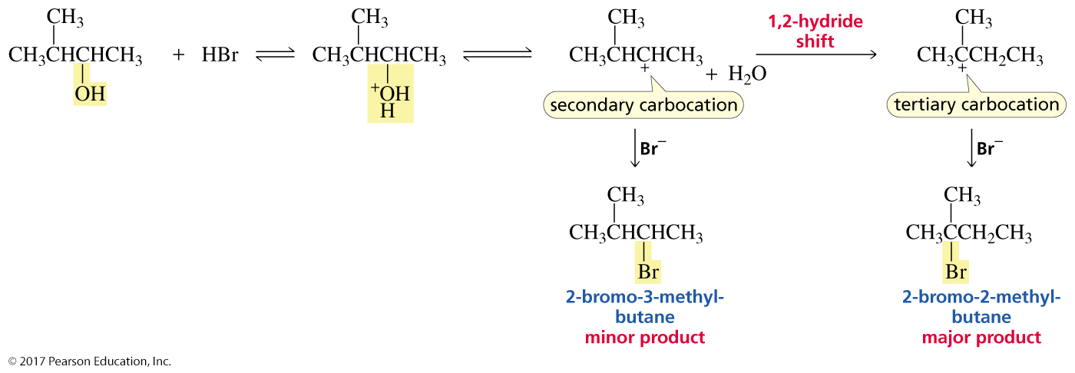
Carbocation Rearrangements
Because the reaction of a secondary alcohol with a hydrogen halide is an S_{N}1 reaction that forms a carbocation intermediate,
always check for the possibility of a carbocation rearrangement.

Slide 7
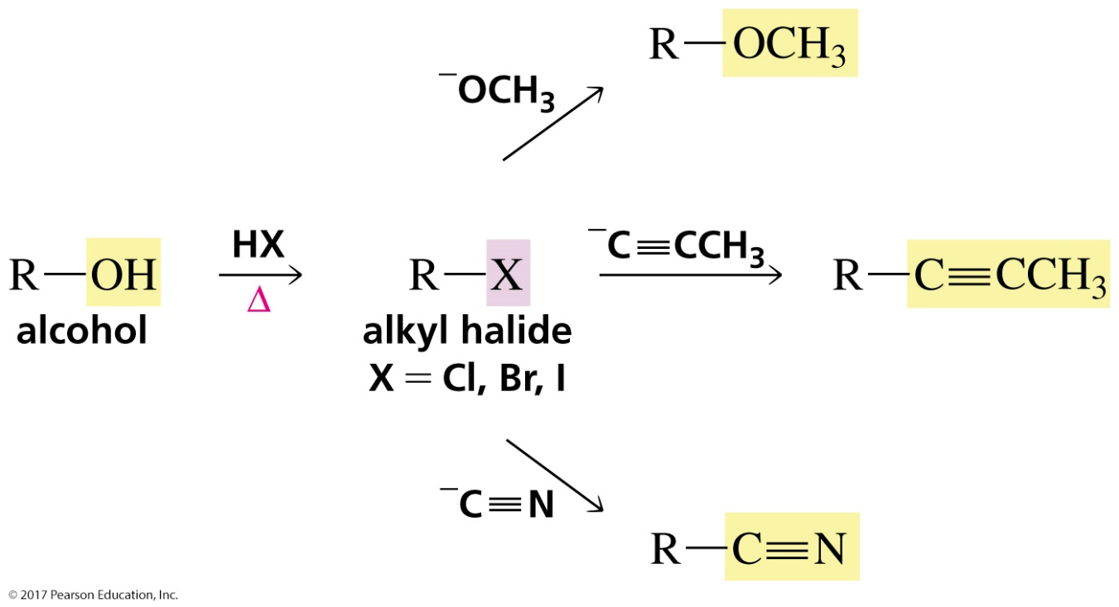
Why is It Important to Be Able
to Convert Alcohols into Alkyl Halides?
Alcohols are readily available but unreactive.
Alkyl halides are less available but reactive and
can be used to synthesize a wide variety of compounds.

Slide 8
Methods to Convert Alcohols into Alkyl Halides

Slide 9
Acid-Catalyzed Dehydration of an Alcohol
Dehydration of an alcohol is an elimination reaction.

Slide 10
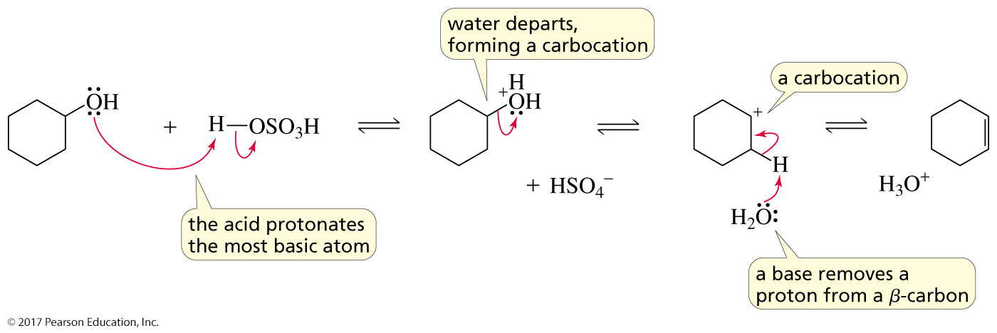
Dehydration of Secondary and
Tertiary Alcohols are E1 Reactions

Slide 11
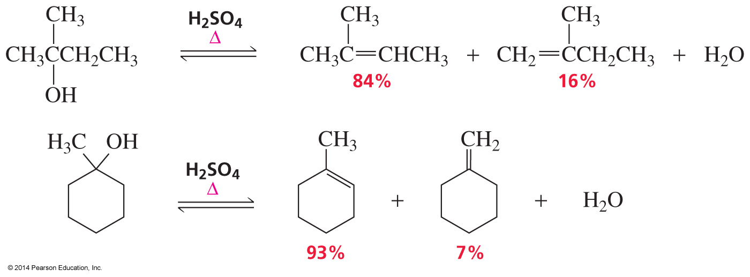
Dehydration is a Regioselective Reaction
The major product is the more stable alkene.

Slide 12
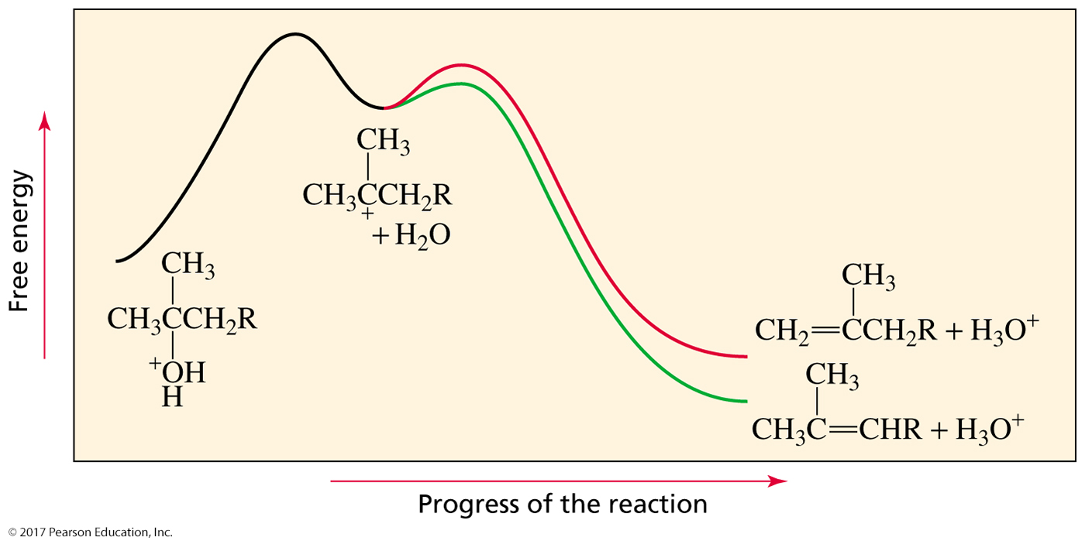
The More Stable Alkene
Has the More Stable Transition State Leading to Its Formation

Slide 13
Dehydration is a Reversible Reaction
To prevent the alkene from adding water and reforming the alcohol,
the water is removed as it is formed.

Slide 14
Tertiary Alcohols are the Easiest to Dehydrate
The rate of dehydration depends on the ease of carbocation formation.

Slide 15
An E1 Reaction Creates a Carbocation Intermediate,
so Watch Out for Carbocation Rearrangements

Slide 16
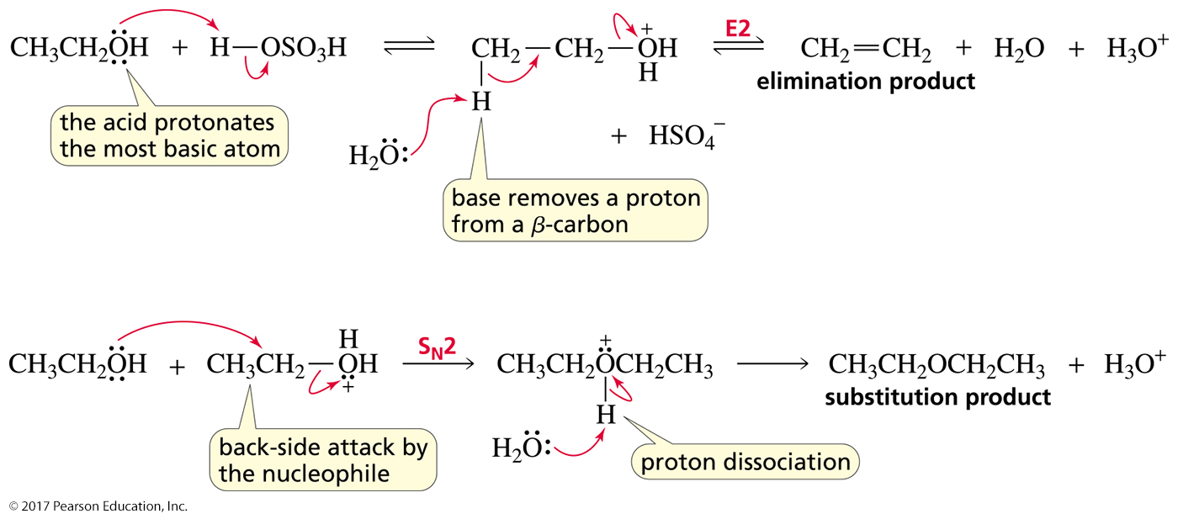
Dehydration of a Primary Alcohol
is an E2 Reaction
Both E2 and S_{N}2 products are obtained.
Dehydration is an E1 reaction unless
a primary carbocation must be formed—then it is E2.

Slide 17
Dehydration is Stereoselective
The major product is the stereoisomer with the
largest groups on opposite sides of the double bond.

Slide 18
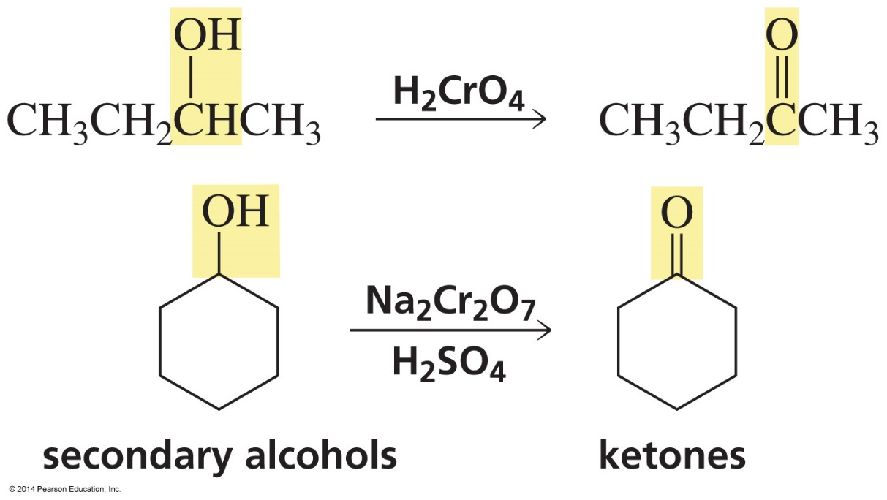
Oxidation of Secondary Alcohols

Slide 19
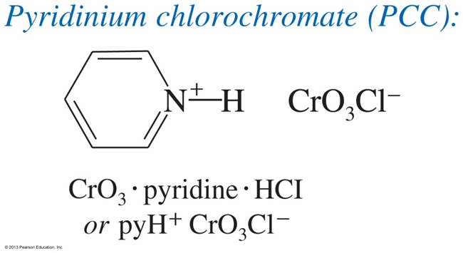
Oxidation of Primary Alcohols
cannot stop at the aldehyde
to stop at the aldehyde

Slide 20
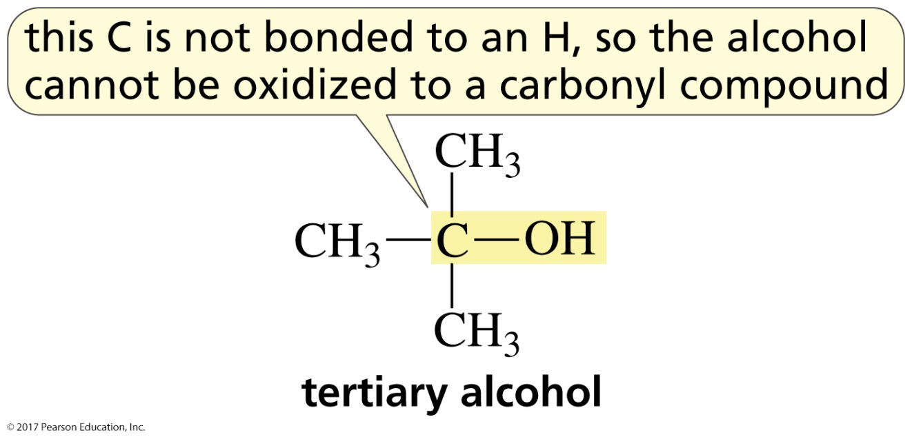
Tertiary Alcohols Cannot Be Oxidized
to a Carbonyl Compound

Slide 21
Oxidation by Hypochlorous Acid (HOCl)
A secondary alcohol forms a ketone.
A primary alcohol forms an aldehyde.

Slide 22
The Mechanism

Slide 23
Alcohols and Ethers Have
Similar Leaving Groups
Alcohols and ethers must be “activated” before
the compounds can react.

Slide 24
Synthesis of an Epoxide
An epoxide is an ether with a three-membered ring.

Slide 25
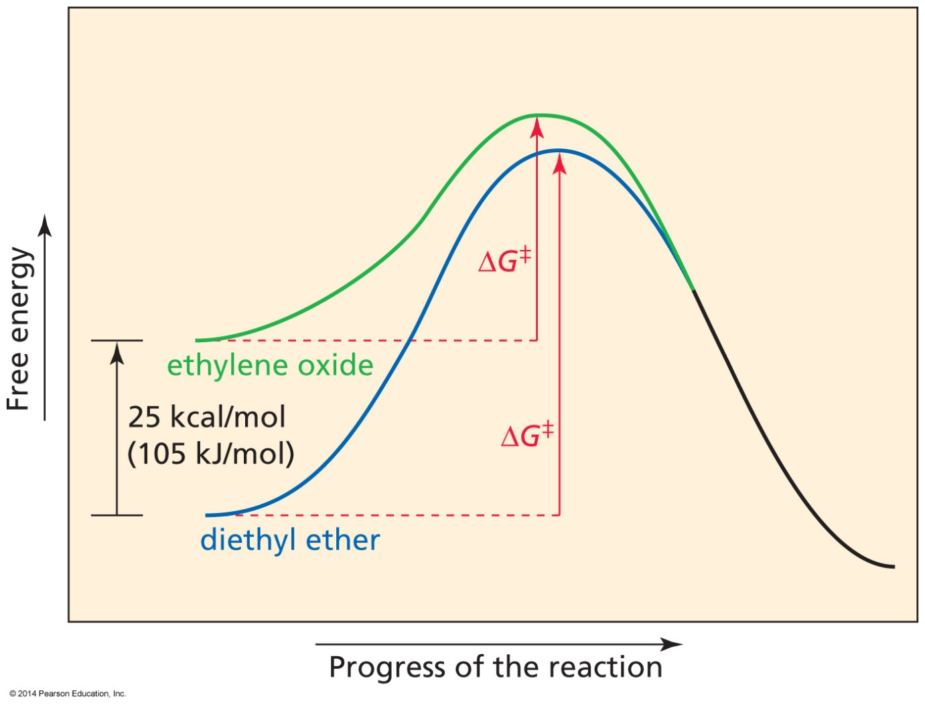
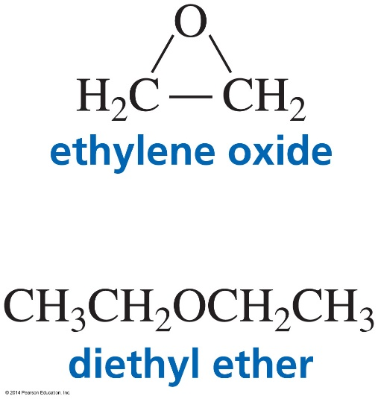
Epoxides are More Reactive Than Ethers
Because of Ring Strain

Slide 26
The Acid-Catalyzed Mechanism
Epoxides are more reactive than ethers,
so the reaction easily occurs at room temperature.

Slide 27
Nucleophile Substitution Acidic Conditions
Under acidic conditions,
the nucleophile preferentially attacks the more substituted ring carbon.

Slide 28
Why the More Substituted Ring Carbon?

Slide 29
Nucleophilic Substitution Neutral or Basic Conditions
Under neutral or basic conditions,
the nucleophile preferentially attacks the less sterically hindered ring carbon.

Slide 30
An Unusual Antibiotic[העשרה]

