Slide 1
Characteristics of Gases
Physical properties of gases are all similar.
Composed mainly of nonmetallic elements with simple formulas and low molar masses.
Unlike liquids and solids, gases
expand to fill their containers.
are highly compressible.
have extremely low densities.
Two or more gases form a homogeneous mixture.
Of the few elements that exist as gases at ordinary temperatures and pressures, He, Ne,
Ar, Kr, and Xe are monatomic and H₂, N₂, O₂, F₂, and Cl₂ are diatomic.

Slide 2
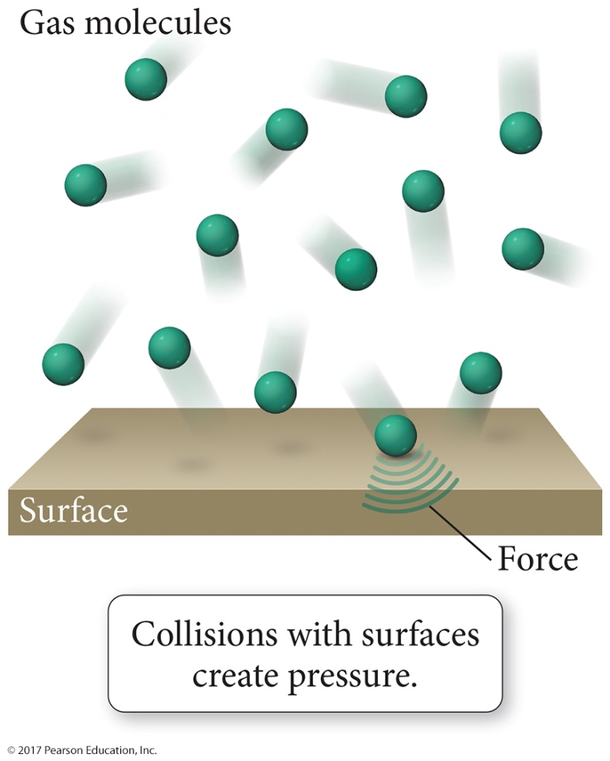
Gas Pressure
Force is exerted when gas molecules strike container walls.
mass x acceleration
Force
Area
Pressure =
Pressure Units
SI: 1 pascal (Pa) = 1 kg m⁻¹s⁻² = 1 N m⁻²
others: 1 bar = 10⁵ Pa = 100 kPa
1 atm = 101.325 kPa = 1.01325 bar
1 atm = 760 torr = 760 mm Hg
  1 atm = 14.7 psi (Pounds per Square Inch)

Slide 3
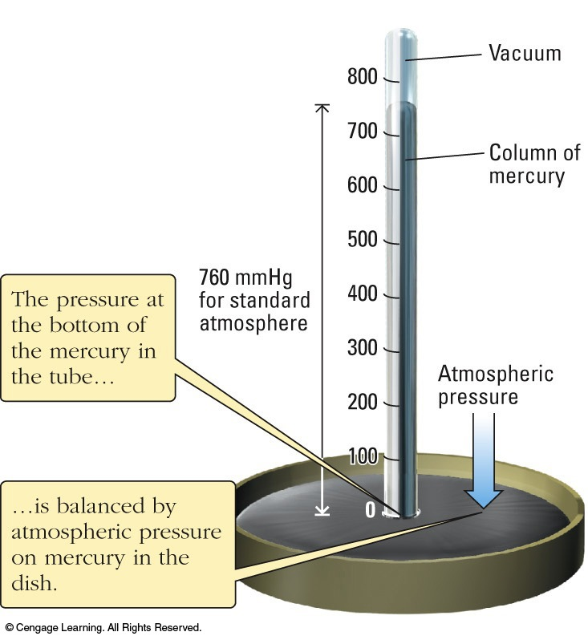
Gas Pressure
Pressure can be measured with a barometer:
gravity
g = 9.81 ms⁻²
P = m x acceleration
area
= m x g x height
volume
= density x g x h
= d g h
Figure A

Slide 4
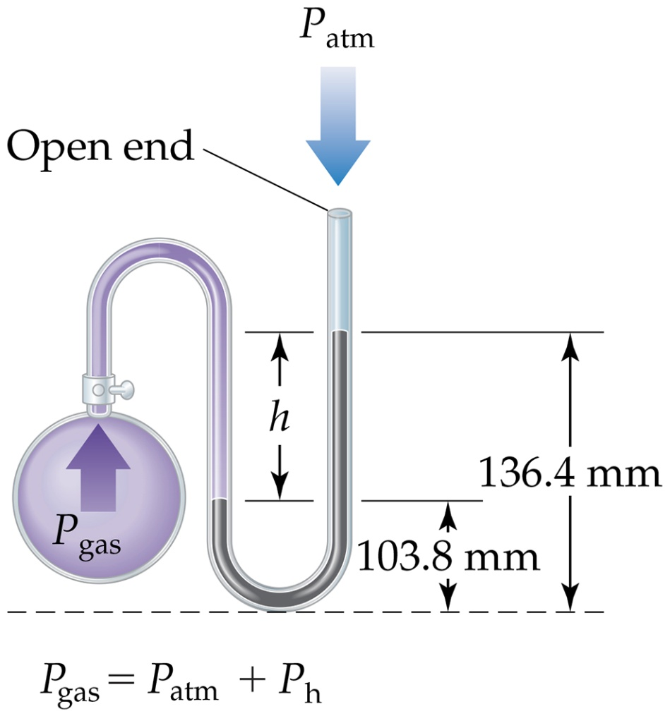
Manometer
The manometer is used to measure the difference in pressure between atmospheric pressure and that of a gas in a vessel.

Slide 5
Standard Pressure
Normal atmospheric pressure at sea level is referred to as standard atmospheric pressure.
It is equal to
1 atm
760 torr (760 mmHg)
101.325 kPa

Slide 6
The Behavior of Ideal Gases: Gas Laws
Any equation relating volume (V), pressure (P), temperature (T ) and/or the amount of gas, in moles, (n) is called a gas law.
Most gases at room T and P are ideal; they follow a simple set of gas laws.

Slide 7
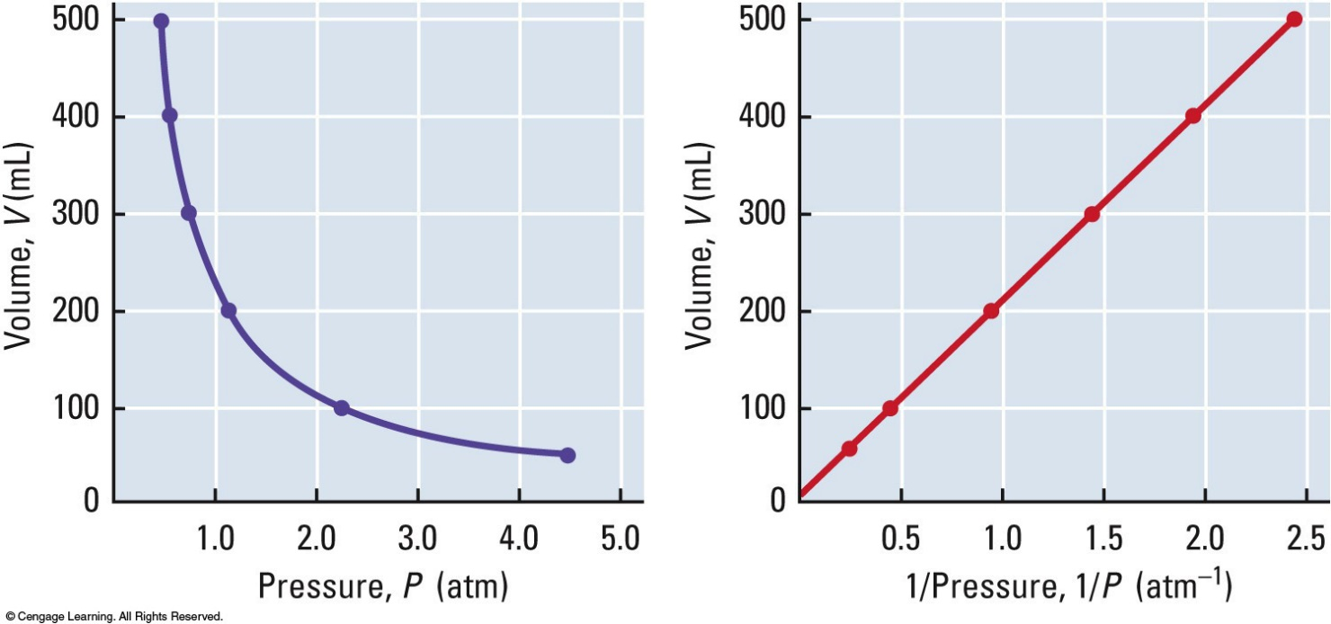
Boyle’s Law
Volume varies inversely with pressure:
V ∝ 1/P
V = constant / P or PV = constant
Thus P₁V₁ = P₂V₂
(T and n must be held constant)

Slide 8
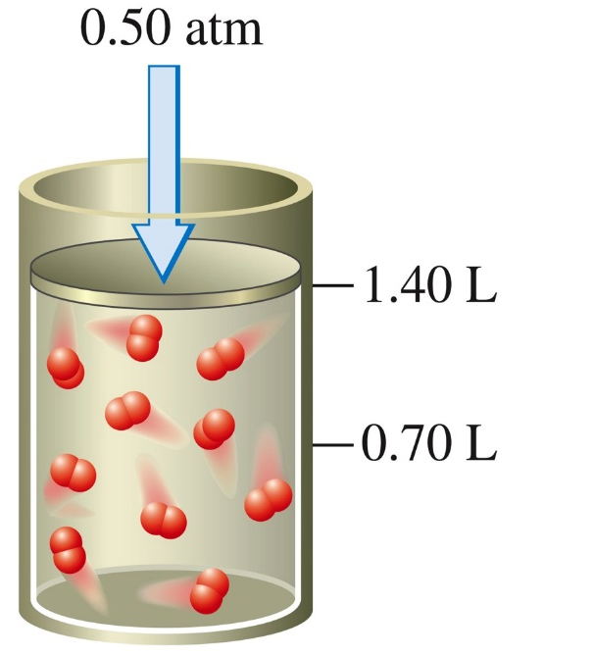
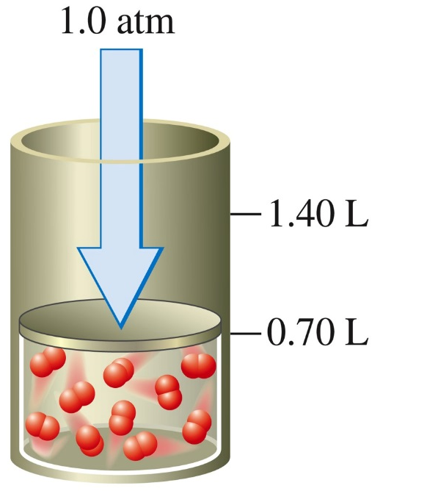
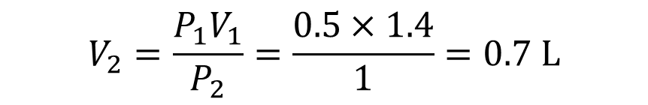
Boyle’s Law
When a 1.00-g sample of O₂ gas at 0°C is placed in a container at a pressure of 0.50 atm, it occupies a volume of 1.40 L.
P₁= 0.5 atm
V₁= 1.40 L
When the pressure on the O₂ is doubled to 1.0 atm, the volume is reduced to 0.70 L, half the original volume.
P₂= 1 atm
$$V_{2}=\frac{P_{1}V_{1}}{P_{2}}=\frac{0.5×1.4}{1}=0.7 L$$

Slide 9
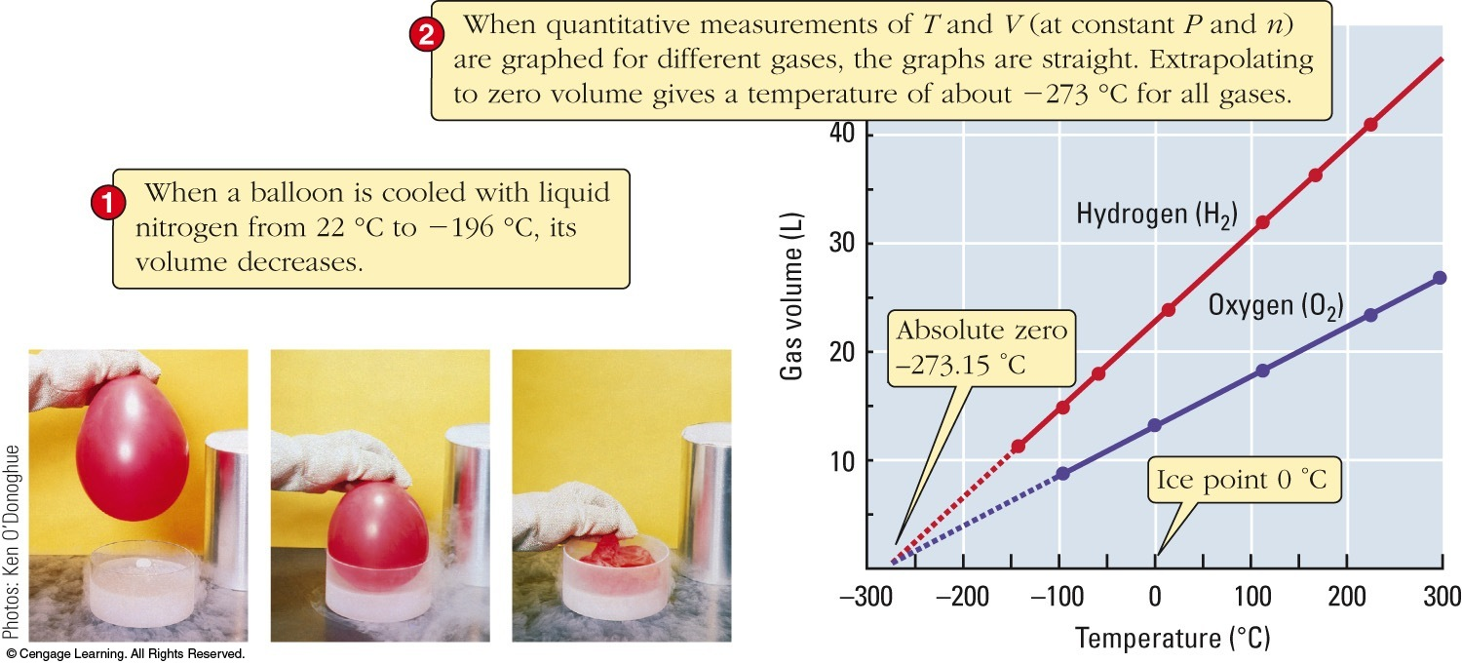
Charles’s Law
Volume is proportional to absolute temperature:
Zero volume is projected to occur when T = -273.15 °C. This is called absolute zero (T = 0 K).

Slide 10
Absolute Temperature
0 K = “absolute zero”.
The degree Celsius and kelvin “steps” are equally sized.
The zeros are different.
0 K = −273.15 °C
0 °C = +273.15 K
100°C
373 K
water boils
100
steps
0°C
273 K
water freezes
T(K) = t (°C) + 273.15

Slide 11
Charles’s Law
V ∝ T
V
T
= constant
V₁ V₂
T₁ T₂
Temperatures must be expressed on the kelvin scale
Thus: =
(P and n must be held constant)

Slide 12
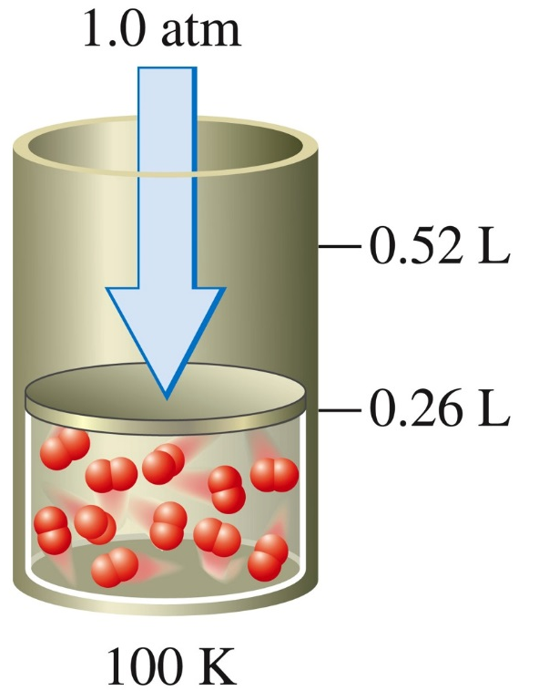
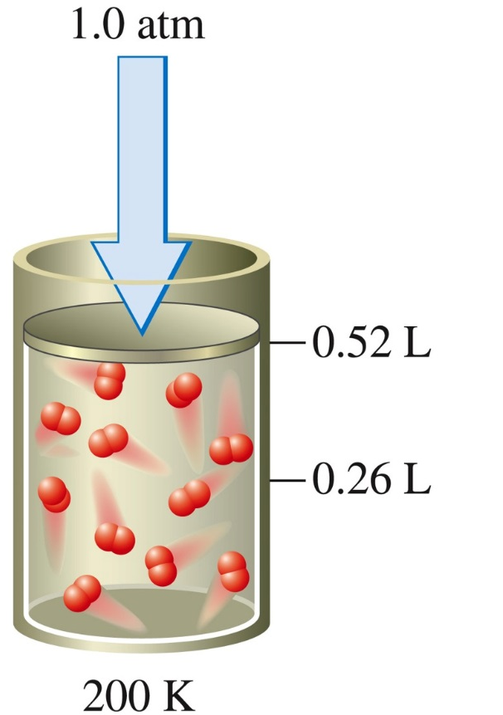
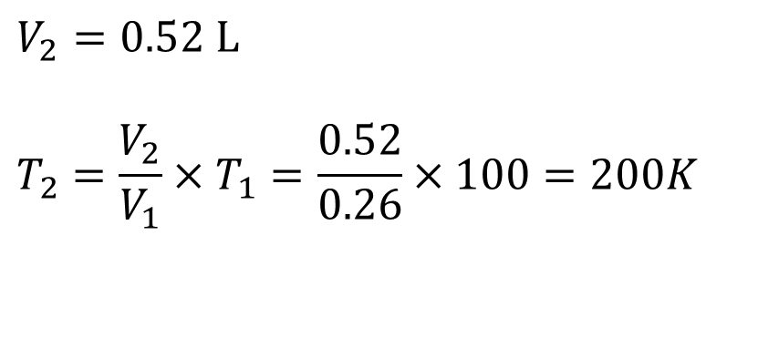
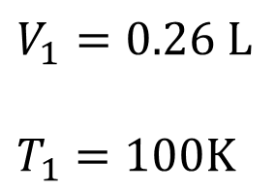
When the absolute temperature of the gas is doubled to 200 K, the volume of O₂ doubles to 0.52 L.
Charles’s Law
A 1.0-g sample of O₂ at 100K and 1.0 atm of pressure occupies a volume of 0.26 L.
$$V_{2}=0.52 L$$
$$T_{2}=\frac{V_{2}}{V_{1}}×T_{1}=\frac{0.52}{0.26}×100=200K$$
$$V_{1}=0.26 L$$
$$T_{1}=100K$$
Notes:
Figure 5.10. Page 150.

Slide 13
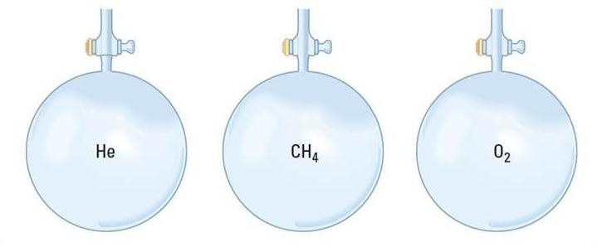
Avogadro’s Law
At constant temperature and pressure:
V ∝ n
or V = constant x n
V₁
n₁
V₂
n₂
So =
V | 22.4 L | 22.4 L | 22.4 L
P | 1 atm | 1 atm | 1 atm
T | 0 °C | 0 °C | 0 °C
Amount of gas | 1 mol | 1 mol | 1 mol
Mass of gas | 4.00 g | 16.04 g | 32.00 g
Standard Temperature & Pressure
(0 °C and 1 atm)
At STP: One mole of any ideal gas occupies 22.4 L

Slide 14
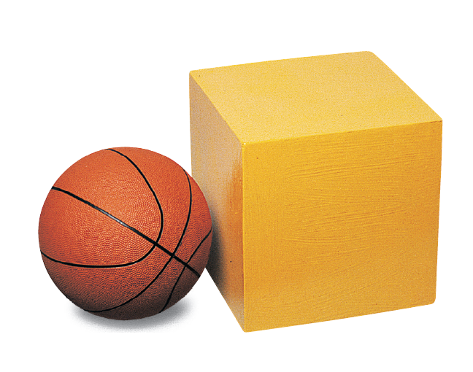
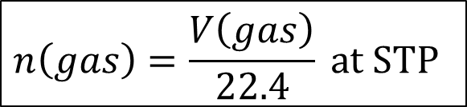
Standard Temperature and Pressure (STP)
The reference conditions for gases chosen by convention to be exactly 0°C and 1 atm pressure.
The molar volume of a gas at STP is 22.4 L/mol.
$$n\left(gas\right)=\frac{V\left(gas\right)}{22.4} at STP$$
The volume of the yellow box is 22.4 L. To its left is a basketball.
©2017 Cengage Learning. All Rights Reserved. May not be copied, scanned, or duplicated, in whole or in part, except for use as permitted in a license distributed with a certain product or service or otherwise on a password-protected website for classroom use.
Notes:
Figure 5.12. Page 153.

Slide 15
The Ideal Gas Law
The ideal gas law is a combination of:
Boyle’s Law
1
P
fixed n and T
Charles’s Law
V ∝ T
fixed n and P
Avogadro’s Law
V ∝ n
fixed P and T
V ∝
IDEAL GAS LAW
V = or PV = nRT
nRT
P

Slide 16
The Ideal Gas Law
R is the ideal gas constant
PV = nRT
absolute T !
R = 0.08206 L atm K⁻¹ mol⁻¹
R = 0.08314 L bar K⁻¹ mol⁻¹
R = 62.36 L torr K⁻¹ mol⁻¹
R = 8.314 dm³ kPa K⁻¹ mol⁻¹
R = 8.314 J K⁻¹ mol⁻¹
(Note: 1L = 1 dm³ = 1000 cm³ )
R =
1.9872

Slide 17
Combined Gas Law
P₁V₁
n₁T₁
P₂V₂
n₂T₂
= R
=
If n remains constant:
P₁V₁
T₁
P₂V₂
T₂
=
Combined Gas Law

Slide 18
Combined Gas Law
A gas occupies 401 mL at P = 1.000 atm. What will be its volume if P is decreased to 0.750 atm at constant T?
P₁V₁
T₁
P₂V₂
T₂
=
T₁ = T₂ (cancel out)
P₁V₁
P₂V₂
=
1.000 atm (401 mL) = (0.750 atm) V₂
1 atm
0.750 atm
V₂ = 401 mL = 535 mL

Slide 19
Ideal Gas Law
3 variables known? Use the ideal gas law to get the 4th.
Example
What volume will 2.64 mol of N₂ occupy at 0.640 atm and 31.0°C?
PV = nRT
V = nRT / P
choose R so that the units will cancel
V =(2.64 mol)(0.08206 L atm K⁻¹mol⁻¹)(31.0+273.15K)
(0.640 atm)
change to absolute T
  V = 103 L

Slide 20
Density of Gases
If we divide both sides of the ideal-gas equation by V and by RT, we get
n/V = P/RT.
  Also: moles × molecular mass = mass
n × Mw = m.
If we multiply both sides by M, we get
m/V = MwP/RT
and m/V is density, d; the result is:
d = MwP/RT.

Slide 21
Density and Molar Mass of a Gas
To recap:
One needs to know only the molecular mass, the pressure, and the temperature to calculate the density of a gas.
d = MwP/RT
Also, if we know the mass, volume, and temperature of a gas, we can find its
molar mass.
Mw = mRT/PV

Slide 22
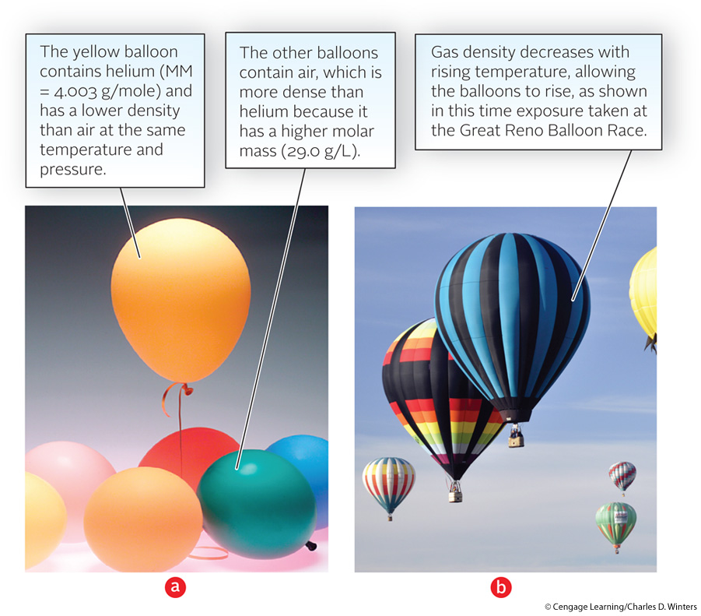
Density of a Gas

Slide 23
Gas Density and Molar Mass
A 1.00 L flask contains 1.13g of an unknown gas at 0.850 atm and 20°C. Determine its molar mass.
molar mass = number of grams per mole.
(1.13 g) (0.08206 L atm mol⁻¹ K⁻¹ )(293.2 K)
Mw = mRT/PV=
(0.850 atm)(1.00 L)
Molar mass
= 32.0 g/mol

Slide 24
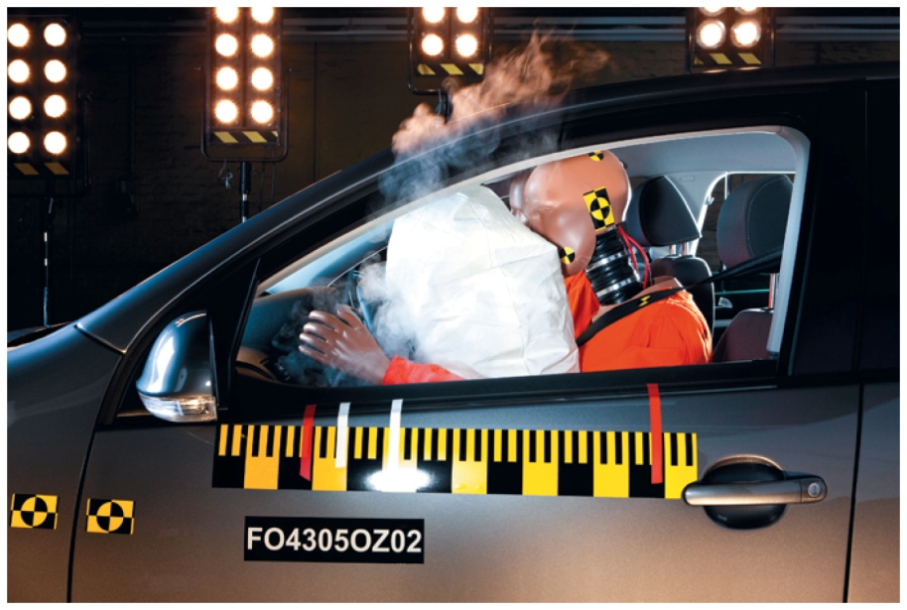
Stoichiometric Relationships with Gases
The reaction used in the deployment of automobile airbags is the high-temperature decomposition of sodium azide, NaN₃, to produce N₂ gas. How many liters of N₂ at 1.15 atm and 30.0 °C are produced by decomposition of 45.0 g NaN₃?
2NaN₃(s)
2Na(s) + 3N₂(g)

Slide 25
Stoichiometric Relationships with Gases
2NaN₃(s)
2Na(s) + 3N₂(g)
Moles of N₂ produced:
1 mol NaN₃
3 mol N₂
45.0 g NaN₃
×
×
= 1.04 mol N₂
65.0 g NaN₃
2 mol NaN₃
Volume of N₂ produced:
L atm
(1.04 mol)
0.08206
(303.2 K)
K mol
nRT
V =
=
= 22.5 L
P
(1.15 atm)

Slide 26
Gas Mixtures & Partial Pressures
In a gas mixture (gas A, gas B,…) the partial pressure of gas A equals the pressure the gas would exert if it was in the container by itself, etc.
Dalton’s law of partial pressures
“The total pressure of mixture of gases is the sum of the partial pressure of the individual gases in the mixture.”
P_{total} = P_{A} + P_{B} + P_{C} + …
partial pressure of gas A

Slide 27
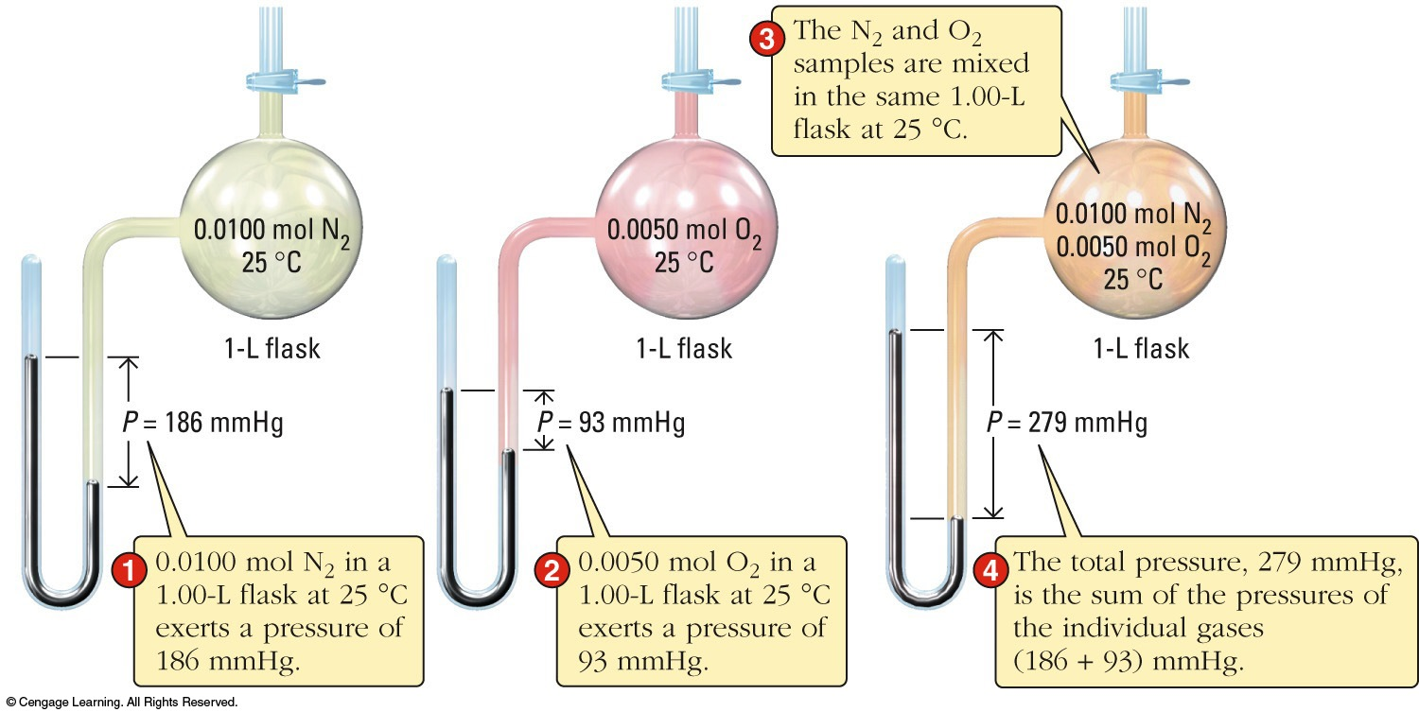
Gas Mixtures & Partial Pressures
n_{A}RT
V
n_{B}RT
V
P_{total} = P_{A} + P_{B} + … = + + …

Slide 28
Gas Mixtures & Partial Pressures
n_{A}RT
V
n_{B}RT
V
RT
V
RT
V
P_{total} = + + … = (n_{A}+ n_{B} + ...) = n_{total}
So
P_{A} n_{A}
P_{total} n_{total}
= = X_{A}
etc.
with X_{A} = mole fraction of gas A.
Notice that: X_{A} + X_{B} + X_{C} + ….. = 1
and: P_{A} = X_{A}P_{total} etc.

Slide 29
Dalton’s Law
A 1.00-L sample of dry air at 25°C and 786 mmHg contains 0.925 g N₂, plus other gases including oxygen, argon, and carbon dioxide.
Determine the partial pressure (in mmHg) of N₂ in the air sample
Determine the mole fraction and mole percent of N₂ in the mixture.
©2017 Cengage Learning. All Rights Reserved. May not be copied, scanned, or duplicated, in whole or in part, except for use as permitted in a license distributed with a certain product or service or otherwise on a password-protected website for classroom use.

Slide 30
פתרון:
Converting 0.925 g N₂ to moles N₂
0.0330 mol N₂
Substituting into the ideal gas law (25°C = 298 K)
0.807atm( = 613 mmHg)

Slide 31
Determining the mole fraction of N₂ in the air:
:

Slide 32
Collecting Gas Over Water
Gases are often collected over water. The result is a mixture of the gas and water vapor.
The partial pressure of water depends only on temperature.
©2017 Cengage Learning. All Rights Reserved. May not be copied, scanned, or duplicated, in whole or in part, except for use as permitted in a license distributed with a certain product or service or otherwise on a password-protected website for classroom use.

Slide 33
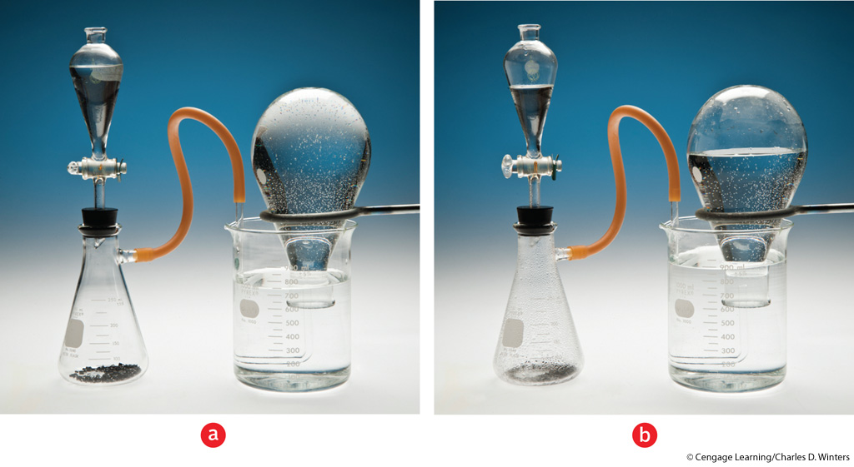
Collecting a Gas by Water Displacement

Slide 34
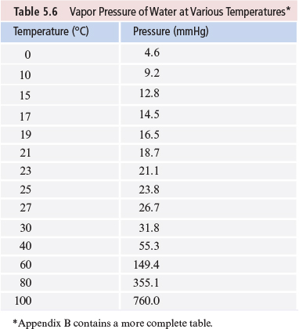
לחץ אדים של מים בטמפרטורות שונות
Notes:
Table 5.6. Page 165

Slide 35
Collecting Gas Over Water
Hydrogen gas is produced by the reaction of HCl on zinc metal.
The gas is collected over water. Determine the mass of hydrogen collected if 156 mL of gas is collected at 19°C and 769 mmHg total pressure.
©2017 Cengage Learning. All Rights Reserved. May not be copied, scanned, or duplicated, in whole or in part, except for use as permitted in a license distributed with a certain product or service or otherwise on a password-protected website for classroom use.

Slide 36
Using Dalton’s law of partial pressures,
Variable Value
P =
V = 156 mL = 0.156 L
T= (19 + 273) K = 292 K
n= ?
©2017 Cengage Learning. All Rights Reserved. May not be copied, scanned, or duplicated, in whole or in part, except for use as permitted in a license distributed with a certain product or service or otherwise on a password-protected website for classroom use.

Slide 37
Collecting Gas Over Water
Calculating the moles of H₂ collected,
= 0.00644 mol
292
Converting moles of H₂ to grams of H₂
0.00644

Slide 38
Main Tenets of Kinetic-Molecular Theory
Gases consist of large numbers of molecules that are in continuous, random motion.
The combined volume of all the molecules of the gas is negligible relative to the total volume in which the gas is contained.
Attractive and repulsive forces between gas molecules are negligible.

Slide 39
Main Tenets of Kinetic-Molecular Theory
Energy can be transferred between molecules during collisions, but the average kinetic energy of the molecules does not change with time, as long as the temperature of the gas remains constant.
The average kinetic energy of the molecules is proportional to the absolute temperature.

Slide 40
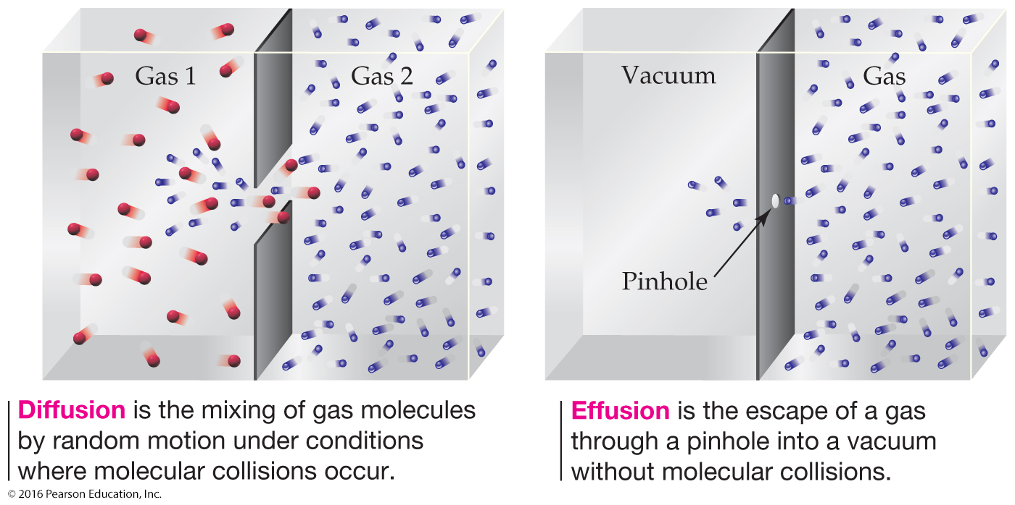
Diffusion and Effusion of Gases:
Graham’s Law

Slide 41
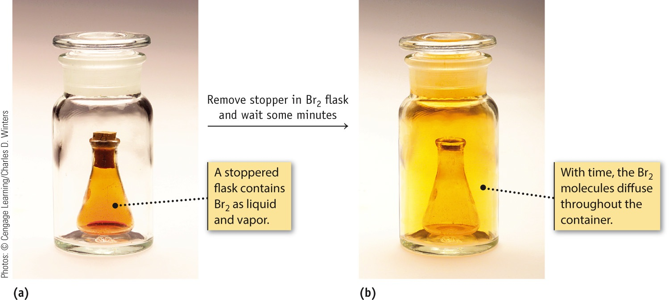
Gaseous Diffusion

Slide 42
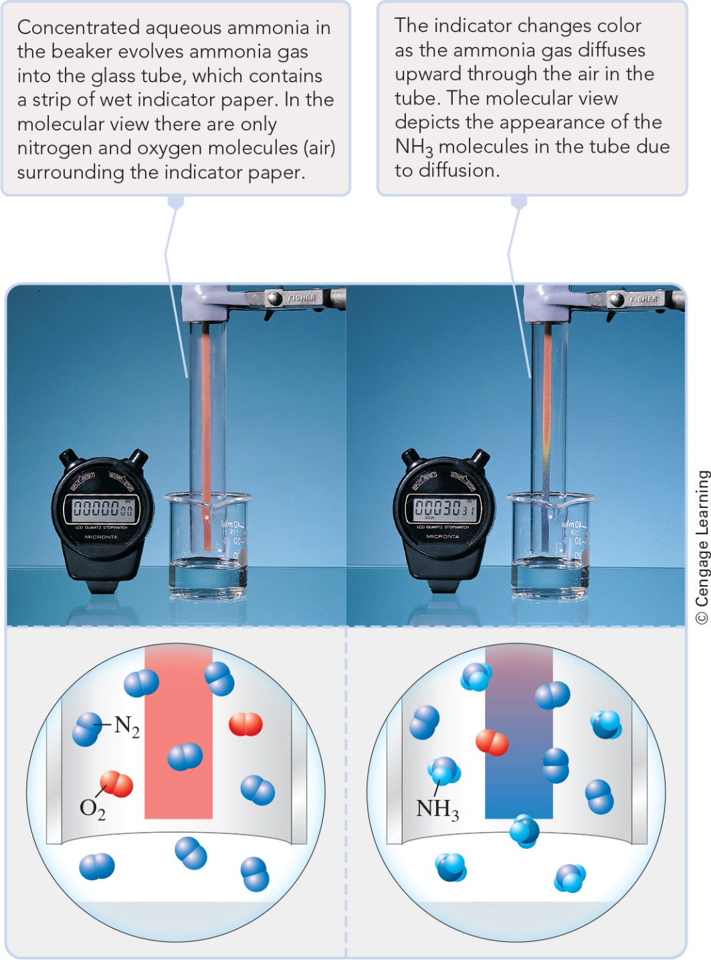
Gaseous Diffusion

