Slide 1
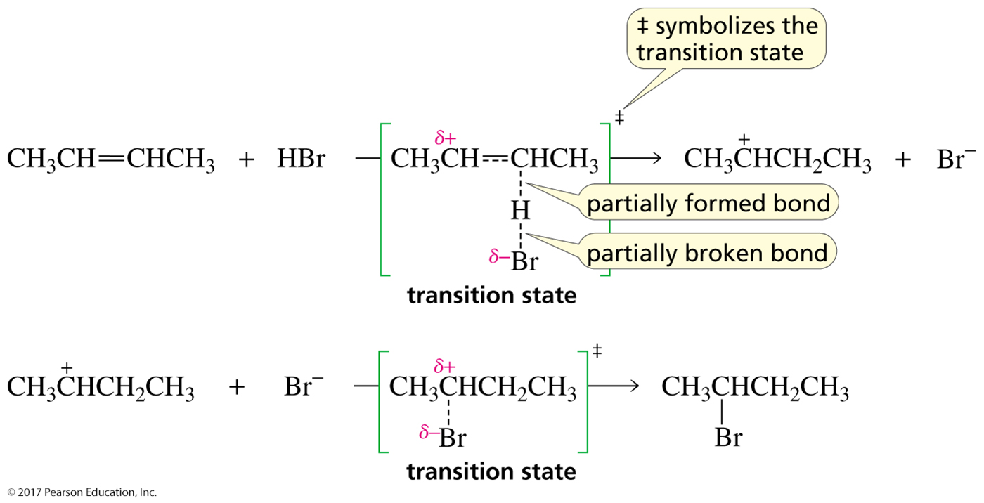
The Structure of the Transition State
Transition states have partially formed bonds.

Slide 2
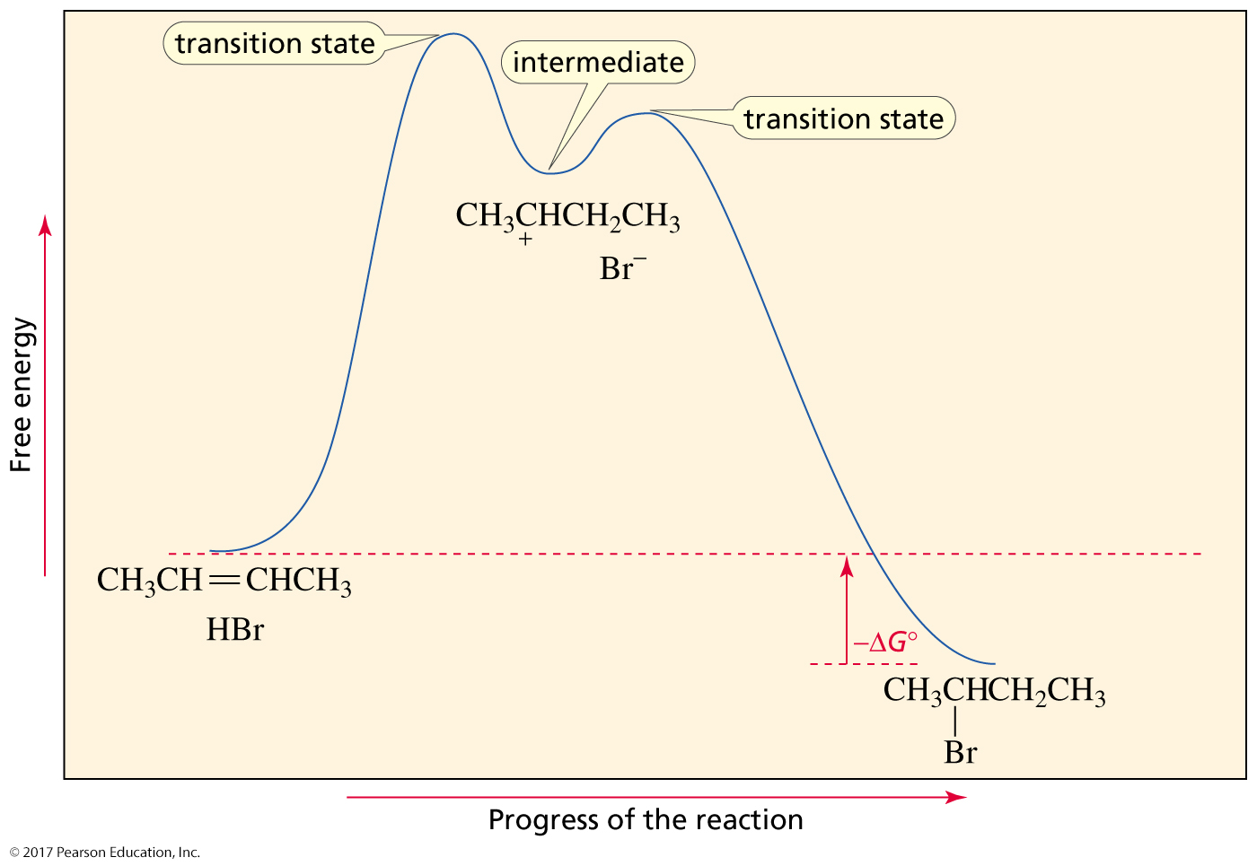
Reaction Coordinate Diagram for the Addition of HBr to 2-Butene
The rate-limiting step has its transition state at the
highest point on the reaction coordinate diagram.

Slide 3
A Substitution Reaction
a tertiary alkyl halide and a poor nucleophile
The reaction is surprisingly fast,
so it must be taking place by a different mechanism.

Slide 4
The Rate Depends Only on the
Concentration of the Alkyl Halide
The Rate Law
Only the alkyl halide is in the transition state of the rate-limiting step.
an S_{N}1 reaction
substitution nucleophilic unimolecular

Slide 5
The Mechanism
The leaving group departs before the nucleophile approaches.
The slow step is carbocation formation.

Slide 6
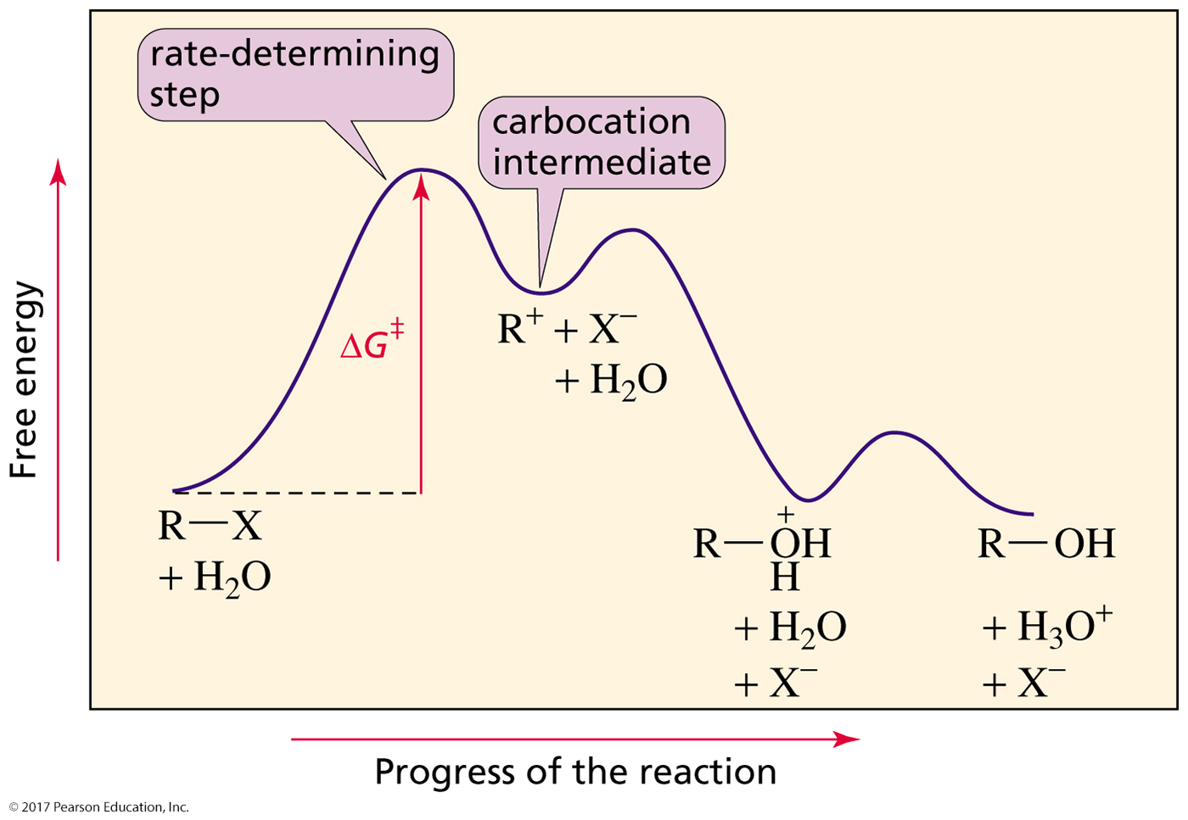
The Reaction Coordinate Diagram

