Slide 1
Enthalpy/Entropy
Enthalpy is the heat absorbed by a system during a constant-pressure process.
Entropy is a measure of the randomness in a system.
Both play a role in determining whether a process is spontaneous.

Slide 2
Entropy
Entropy can be thought of as a measure of the randomness of a system.
It is a state function:
It can be found by heat transfer from surroundings at a given temperature:

Slide 3
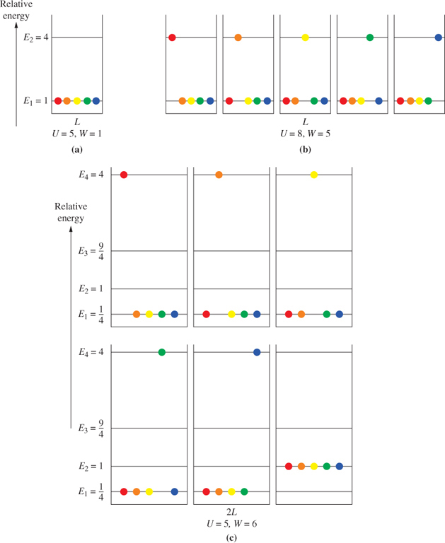
Enumeration of microstates
ההגדרה הסטטיסטית של אנטרופיה
אנטרופיה עולה עם העלייה בטמפרטורה ונפח
FIGURE 13-1

Slide 4
Spontaneous Processes
Spontaneous Process: A process that, once started, proceeds on its own without a continuous external influence

Slide 5
Enthalpy, Entropy, and Spontaneous Processes
All are spontaneous processes. Enthalpy alone isn’t enough to determine spontaneity.
Exothermic:
CH₄(g) + 2 O₂(g)
CO₂(g) + 2 H₂O(l)
ΔH°
= −890.3 kJ
Endothermic:
H₂O(s)
H₂O(l)
ΔH_{fusion}
= +6.01 kJ
H₂O(l)
H₂O(g)
ΔH_{vap}
= +40.7 kJ
N₂O₄(g)
2 NO₂(g)
ΔH°
= +55.3 kJ
H₂O
NaCl(s)
Na⁺(aq) + Cl⁻(aq)
ΔH°
= +3.88 kJ
Notes:
All are spontaneous processes. Enthalpy alone isn’t enough to determine spontaneity.

Slide 6
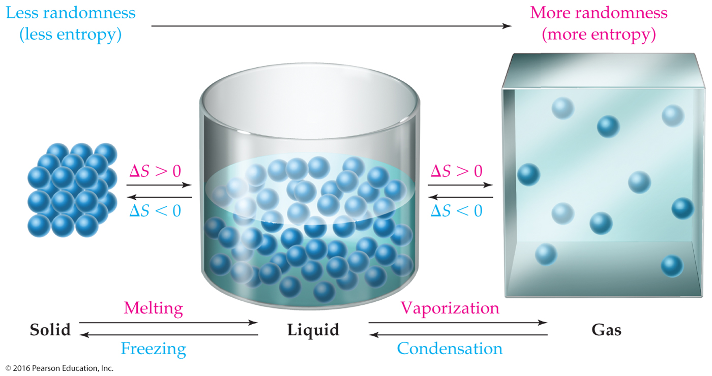
Enthalpy, Entropy, and Spontaneous Processes
ΔS = S_{final} − S_{initial}
אקראיות

Slide 7
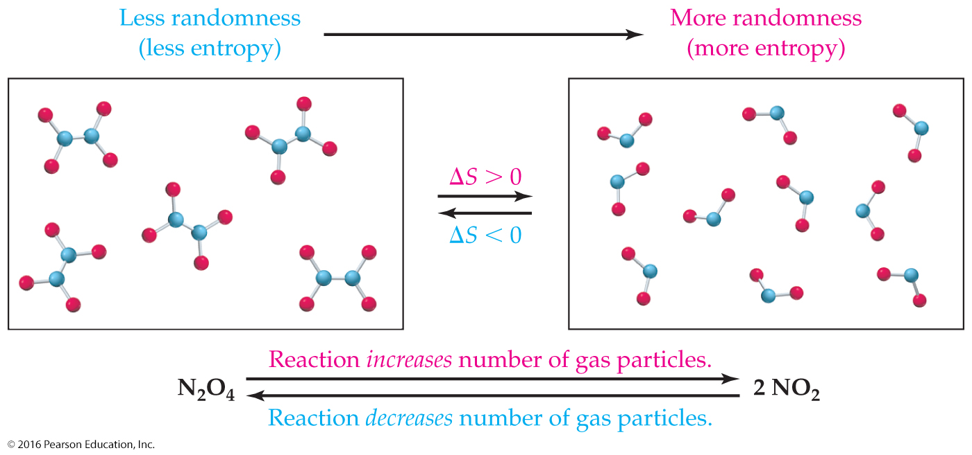
Enthalpy, Entropy, and Spontaneous Processes

Slide 8
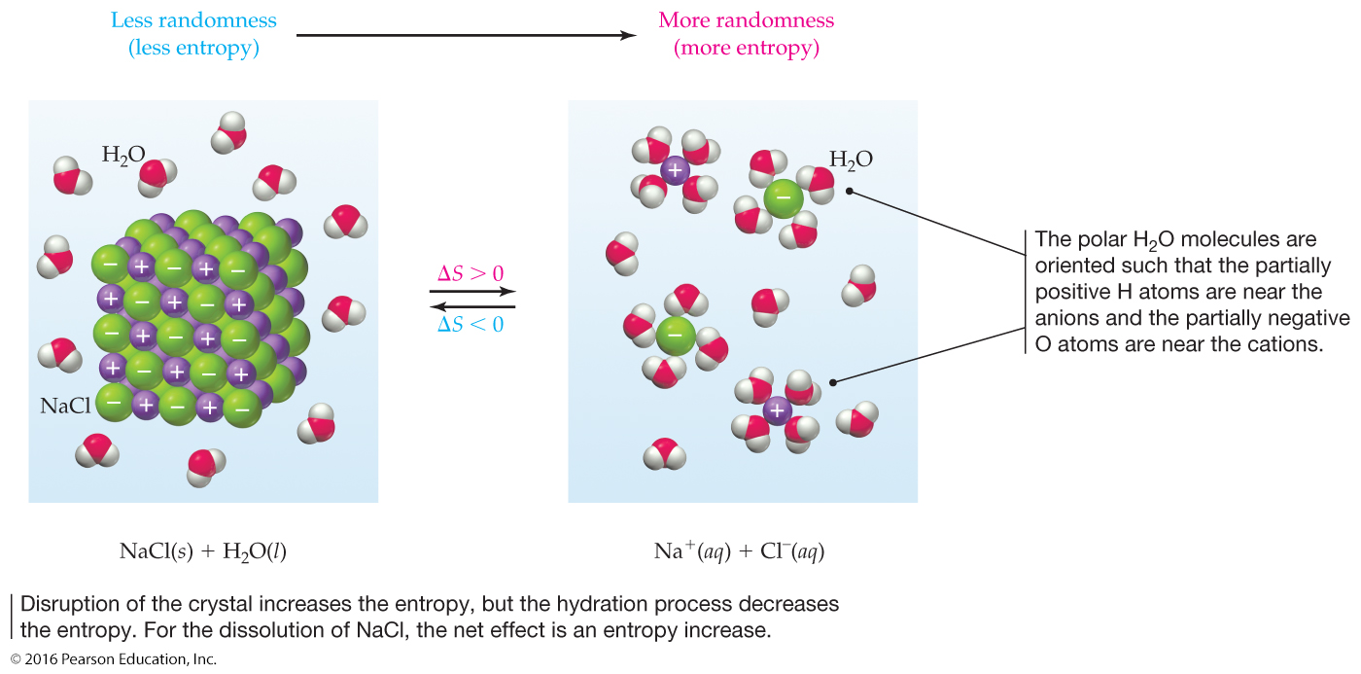
Enthalpy, Entropy, and Spontaneous Processes

Slide 9
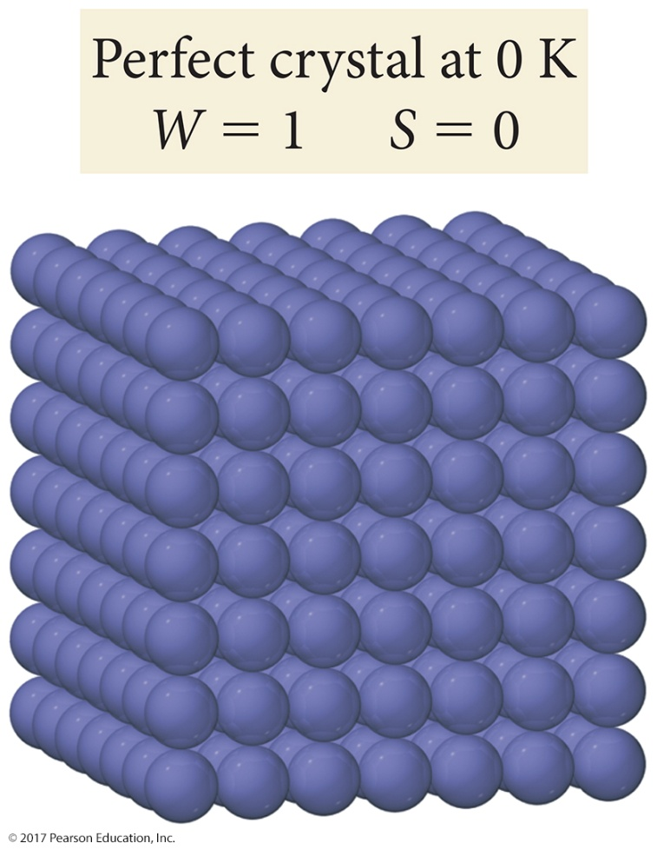
Entropy and Temperature
Third Law of Thermodynamics: The entropy of a perfectly ordered crystalline substance at 0 K is zero.
Notes:
Look back at S = k ln W. If W = 1 (only one way to order a perfectly ordered crystalline substance), then ln W = 0.

Slide 10
Standard Molar Entropies (298.15 K)
Substance | S° (J K⁻¹ mol⁻¹) | Substance | S° (J K⁻¹ mol⁻¹)
C (graphite) | 5.740 | Cl₂(g) | 223.066
C(g) | 158.096 | Br₂(ℓ) | 152.231
CH₄(g) | 186.264 | I₂(s) | 116.135
C₂H₆(g) | 229.60 | HCl(g) | 186.908
C₃H₈(g) | 269.9 | H₂O(g) | 188.825
C₂H₄(g) | 219.4 | H₂O(ℓ) | 69.91
CH₃OH(ℓ) | 126.8 | NaCl(s) | 72.13
CO(g) | 197.674 | KOH(s) | 78.9
CO₂(g) | 213.74 | NaCl(aq) | 115.5
F₂(g) | 202.78 | KOH(aq) | 91.6
Standard Molar Entropy (S°): The entropy of 1 mole of a pure substance at 1 atm pressure and a specified temperature.

Slide 11
Standard Molar Entropies and Standard Entropies of Reaction
ΔS° = S°(products) − S°(reactants)
aA + bB
cC + dD
ΔS° = [cS°(C) + dS°(D)] − [aS°(A) + bS°(B)]
Products
Reactants

Slide 12
Standard Molar Entropies and Standard Entropies of Reaction
Using standard entropies, calculate the standard entropy change for the decomposition of N₂O₄.
N₂O₄(g)
2 NO₂(g)
ΔS° = 2 S°(NO₂(g)) − S°(N₂O₄(g))
J
J
ΔS° = (2 mol)
240.0
− (1 mol)
304.3
K mol
K mol
ΔS° = 175.7 J/K
Notes:
p652

Slide 13
Entropy and the Second Law of Thermodynamics
First Law of Thermodynamics: In any process, spontaneous or nonspontaneous, the total energy of a system and its surroundings is constant.
Second Law of Thermodynamics: In any spontaneous process, the total entropy of a system and its surroundings always increases.
Notes:
The first law was defined in Ch 8 (Thermochemistry: Chemical Energy). Entropy was also introduced in that chapter.

Slide 14
Entropy and the Second Law of Thermodynamics
ΔS_{total} = ΔS_{system} + ΔS_{surroundings}
or
ΔS_{total} = ΔS_{sys} + ΔS_{surr}
ΔS_{total} > 0 The reaction is spontaneous.
ΔS_{total} < 0 The reaction is nonspontaneous.
ΔS_{total} = 0 The reaction mixture is at equilibrium.

Slide 15
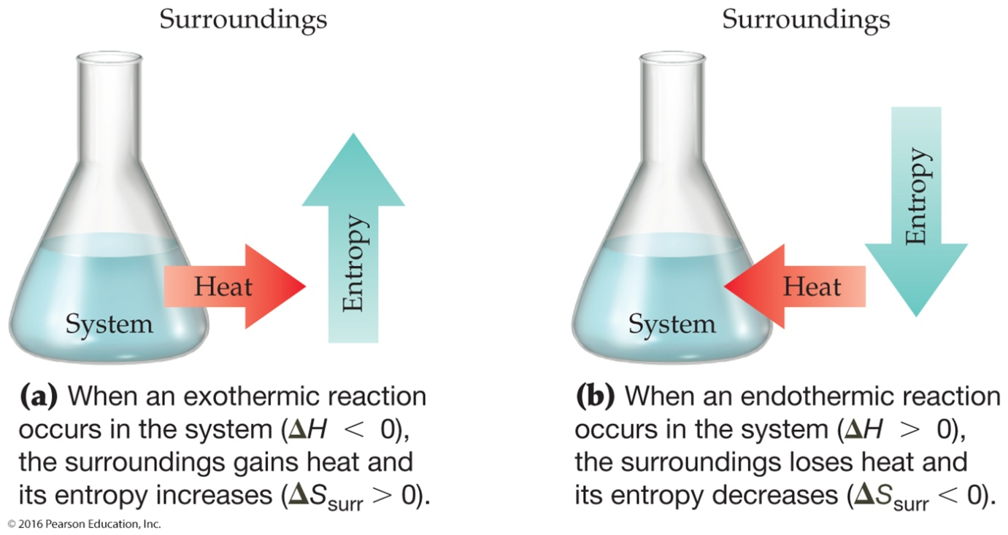
Entropy and the Second Law of Thermodynamics
− ΔH
ΔS_{surr} =
T

Slide 16
Gibbs Free Energy
Neither entropy (S), nor enthalpy (H ), alone can predict whether a reaction is product favored.
Spontaneous (product favored) reactions can:
Be exothermic or endothermic.
Increase or decrease S_{system}.
The Gibbs free energy (G), combines H and S.
Δ_{r}G does predict if a reaction is product favored or not.

Slide 17
Free Energy
ΔG = ΔH − TΔS
ΔG < 0 The reaction is spontaneous.
ΔG > 0 The reaction is nonspontaneous.
ΔG = 0 The reaction mixture is at equilibrium.

Slide 18
Effect of T on Reaction Direction
Δ_{r}G = Δ_{r}H – TΔ_{r}S
Δ_{r}H | Δ_{r}S | Product Favored? |  | Comments
 |  | Low T | High T
< 0 | > 0 | Yes | Yes | exothermic; disorder increase always possible
< 0 | < 0 | Yes | No | exothermic; disorder decrease possible at low T
> 0 | > 0 | No | Yes | endothermic; disorder increase possible at high T
> 0 | < 0 | No | No | endothermic; disorder decrease never occurs

Slide 19
Standard Free-Energy Changes for Reactions
Thermodynamic Standard State: Most stable form of a substance at 1 atm pressure and at a specified temperature, usually 25 °C; 1 M concentration for all substances in solution
ΔG° = ΔH° − TΔS°
Notes:
Standard state was introduced in Ch 8 (Thermochemistry: Chemical Energy).

Slide 20
Standard Free-Energy Changes for Reactions
Calculate the standard free-energy change at 25 °C for the Haber synthesis of ammonia using the given values for the standard enthalpy and standard entropy changes:
N₂(g) + 3 H₂(g)
2 NH₃(g)
ΔH° = −92.2 kJ
ΔS° = −198.7 J/K
ΔG° = ΔH° − TΔS°
−198.7 J
1 kJ
ΔG° = −92.2 kJ − 298 K
×
×
= −33.0 kJ
K
1000 J
Notes:
p658
Negative value for ΔG° means it’s spontaneous.
Spontaneous doesn’t mean fast, however. Rate of reaction is kinetics.

Slide 21
Standard Free Energies of Formation
ΔG° = ΔG°_{f} (products) − ΔG°_{f} (reactants)
aA + bB
cC + dD
ΔG° = [cΔG°_{f} (C) + dΔG°_{f} (D)] − [aΔG°_{f} (A) + bΔG°_{f} (B)]
Products
Reactants

Slide 22
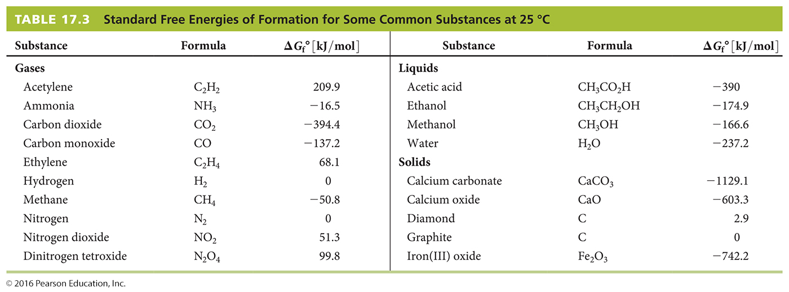
Standard Free Energies of Formation
As with standard enthalpy change, standard free energy change is with respect to the substance’s elements, which are assigned a value of 0
Notes:
As with standard enthalpy change, standard free energy change is with respect to the substance’s elements, which are assigned a value of 0 (think of it as a chemical “sea level”).

Slide 23
Gibbs Free Energy
Calculate Δ_{r}G° for the following reaction at 25°C:
CO(g) + 2 H₂(g) → CH₃OH(ℓ)
Δ_{f}G° values: CO(g) = -137.2 kJ/mol
CH₃OH(ℓ) = -166.3 kJ/mol
ΔG° = Δ_{f}G°_{CH3OH} – (2Δ_{f}G°_{H2} + 1Δ_{f}G°_{CO})
= -166.3 kJ/mol – [2(0) + 1(-137.2 kJ/mol)]
= -29.1 kJ/mol
Product favored
element in its standard state

Slide 24
Free Energy Changes and the Reaction Mixture
ΔG = ΔG° + RT ln Q
ΔG = Free-energy change under nonstandard conditions.
For the Haber synthesis of ammonia:
P
2
NH₃
N₂(g) + 3 H₂(g)
2 NH₃(g)
Q_{p} =
P
P
3
N₂
H₂
Q_{c} would work in the same manner
Notes:
Q_{c} would work in the same manner.

Slide 25
Free Energy Changes and the Reaction Mixture
Calculate ΔG for the formation of ethylene (C₂H₄) from carbon and hydrogen at 25 °C when the partial pressures are 100 atm H₂ and 0.10 atm C₂H₄.
2 C(s) + 2 H₂(g)
C₂H₄(g)
ΔG° = 68.1 kJ
Use:
P
C₂H₄
ΔG = ΔG° + RT ln Q
Q_{p} =
P
2
H₂
Notes:
Problem 16.13 p664

Slide 26
Free Energy Changes and the Reaction Mixture
Calculate ln Q:
0.10
ln
= −11.51
100²
Calculate ΔG:
ΔG = ΔG° + RT ln Q
J
1 kJ
8.314
×
(298 K) (−11.51)
= 68.1 kJ/mol +
×
×
K mol
1000 J
ΔG = 39.6 kJ/mol
Since the value of ΔG is positive, it is nonspontaneous in the forward direction
Notes:
Since the value of ∆G is positive, it is nonspontaneous in the forward direction.

Slide 27
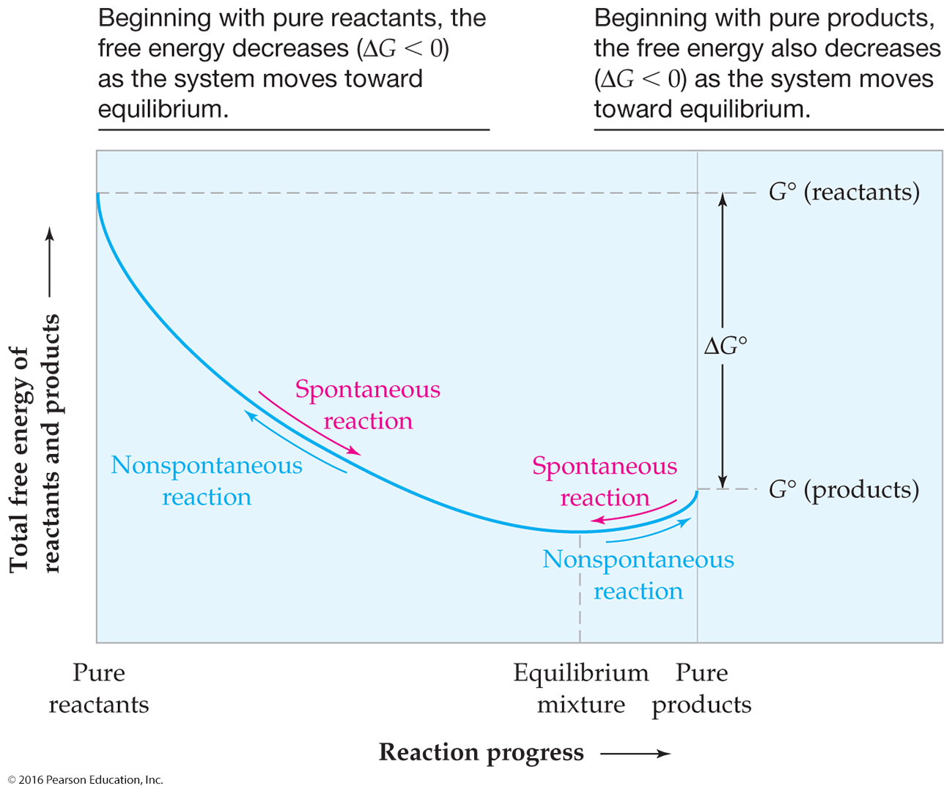
Free Energy and Chemical Equilibrium

Slide 28
Free Energy and Chemical Equilibrium
ΔG = ΔG° + RT ln Q
At equilibrium, ΔG = 0 and Q = K.
ΔG° = −RT ln K

Slide 29
Free Energy and Chemical Equilibrium
Calculate K_{p} at 25 °C for the following reaction:
CaCO₃(s)
CaO(s) + CO₂(g)
Calculate ΔG°:
ΔG° = [ΔG°_{f} (CaO(s)) + ΔG°_{f} (CO₂(g))] − [ΔG°_{f} (CaCO₃(s))]
= [(1 mol)(−603.3 kJ/mol) + (1 mol)(−394.4 kJ/mol)]
− [(1 mol)(−1129.1 kJ/mol)]
הנתונים נלקחו מהטבלאות המתאימות
ΔG° = +131.4 kJ/mol
Notes:
Problem 16.15 p668

Slide 30
Free Energy and Chemical Equilibrium
Calculate ln K:
ΔG° = −RT ln K
−ΔG°
−131.4 kJ/mol
ln K =
=
RT
J
1 kJ
8.314
×
×
(298 K)
K mol
1000 J
ln K = −53.04
Calculate K:
K = e
^{−53.04}
= 9.2 × 10⁻²⁴
תערובת שווי המשקל מורכבת בעיקר ממגיבים

Slide 31
Gibbs Free Energy & Maximum Work
Δ_{r}G = maximum useful work that can be done by a reaction on its surroundings (constant T and P).
Δ_{r}G = w_{system} = - w_{max}
“free” energy = available energy
For:
2 H₂(g) + O₂(g) 2 H₂O(g) Δ_{r}G°= -474.3 kJ/mol
Every 2 moles of H₂ consumed can do up to 474.3 kJ of work.

Slide 32
Gibbs Free Energy & Maximum Work
Δ_{r}G also equals the minimum work required to cause a reactant-favored process to occur.
2 H₂O(g) 2 H₂(g) + O₂(g) Δ_{r}G°= 474.3 kJ/mol
A minimum of 474.3 kJ of work must be used to produce 2 mol of H₂ from liquid water.

Slide 33
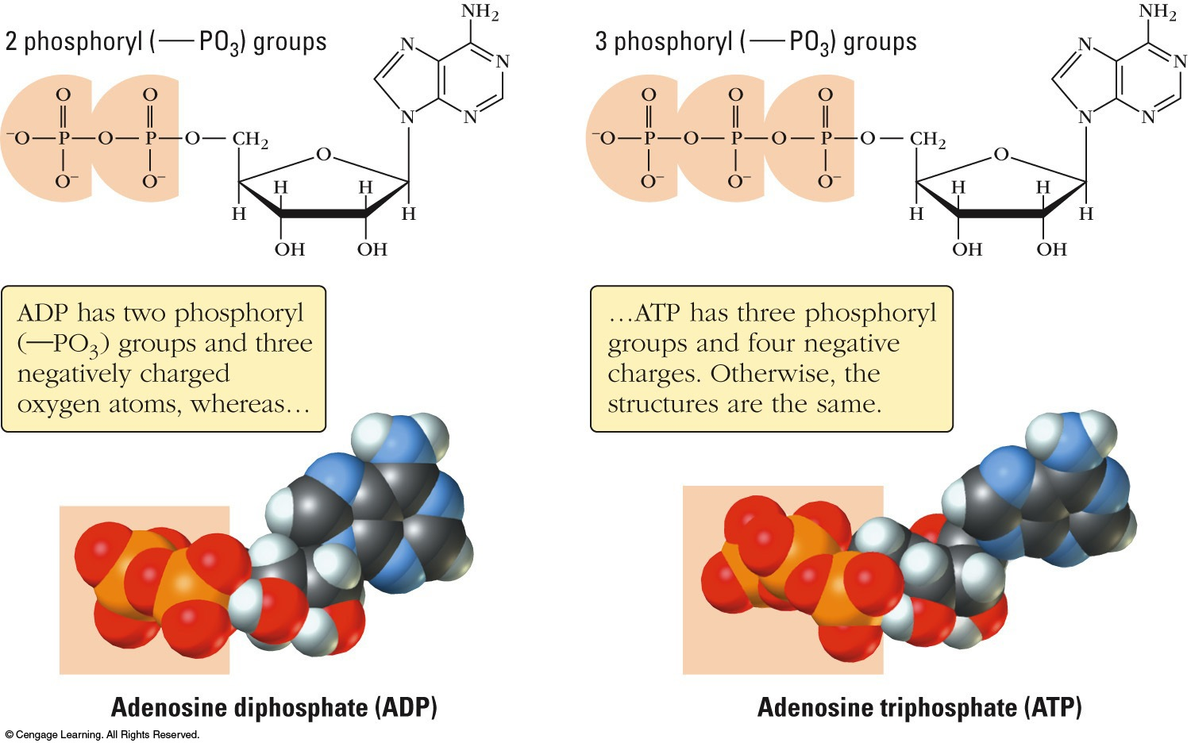
Gibbs Free Energy & Biological Systems
at pH =7
Energy released by oxidizing glucose:
C₆H₁₂O₆(aq) + 6 O₂(g) → 6 CO₂(g) + 6 H₂O(ℓ) Δ_{r}G°′= -2870 kJ/mol
Is stored in 32 more manageable “chunks”:
32[ADP³⁻(aq) + H₂PO₄⁻(aq) → ATP⁴⁻(aq) + H₂O(ℓ) Δ_{r}G°′= 30.5 kJ/mol]
x32 = 976 kJ

Slide 34
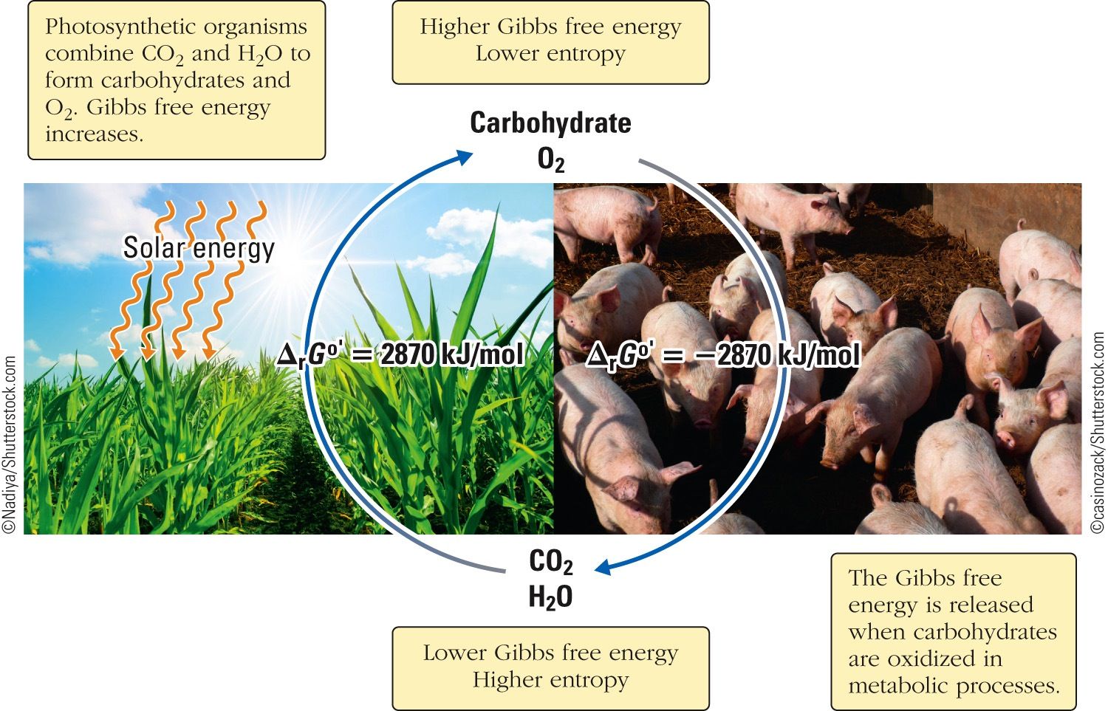
Photosynthesis & Gibbs Free Energy
6 CO₂(g) + 6 H₂O(ℓ) → C₆H₁₂O₆(aq) + 6 O₂(g)

Slide 35
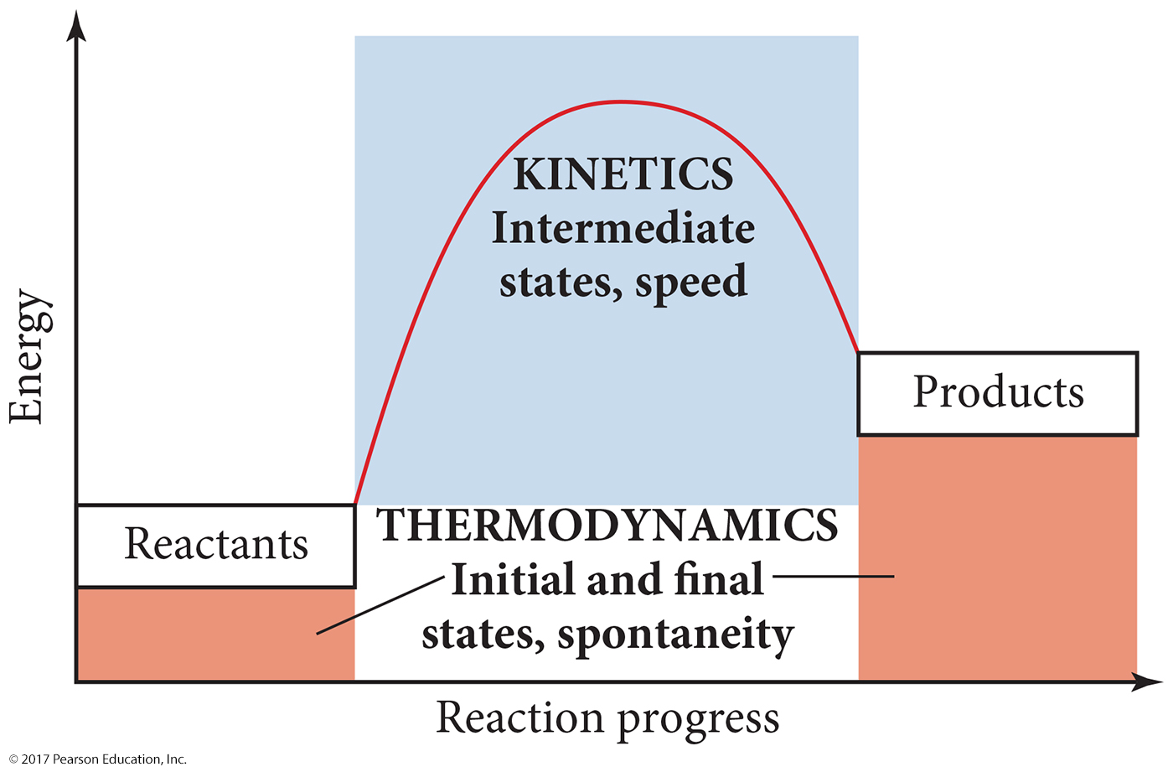
Thermodynamics versus Kinetics

Slide 36
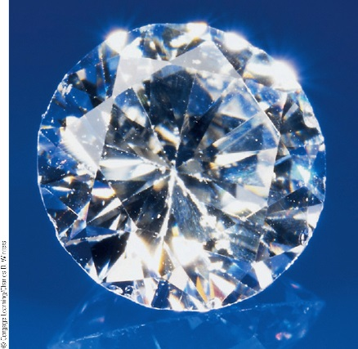
Thermodynamic & Kinetic Stability
Thermodynamically stable: process is reactant-favored.
Thermodynamically stable:
Pd + O₂ → PdO₂ Δ_{r}G° = +326 kJ/mol
Thermodynamically unstable:
4 Al + 3 O₂ → 2 Al₂O₃ Δ_{r}G° = -3164.6 kJ/mol
אנדרגוני
אקסרגוני
Kinetically stable: product-favored, but too slow to be important.
Diamond is thermodynamically unstable
C_{diamond} → C_{graphite} Δ_{r}G° = -2.9 kJ/mol
but it is kinetically stable
E_{a} is too large

Slide 37
Galvanic Cells
Electrochemistry is the study of the relationships between electricity and chemical reactions. It includes the study of both spontaneous and nonspontaneous processes.
Galvanic (Voltaic) Cell: A spontaneous chemical reaction that generates an electric current
Electrolytic Cell: An electric current that drives a nonspontaneous reaction
וולטאי

Slide 38
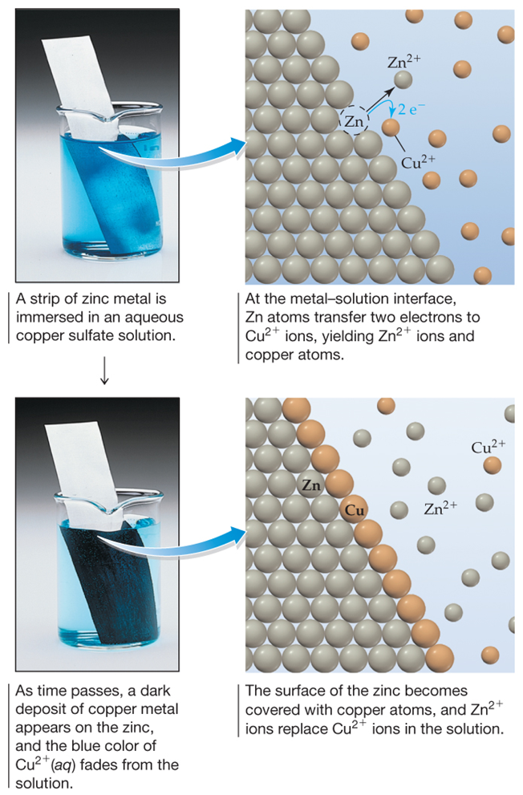
Galvanic Cells
Zn(s) + Cu²⁺(aq)
Zn²⁺(aq) + Cu(s)
Oxidation half-reaction:
Zn(s)
Zn²⁺(aq) + 2 e⁻
Reduction half-reaction:
Cu²⁺(aq) + 2 e⁻
Cu(s)

Slide 39
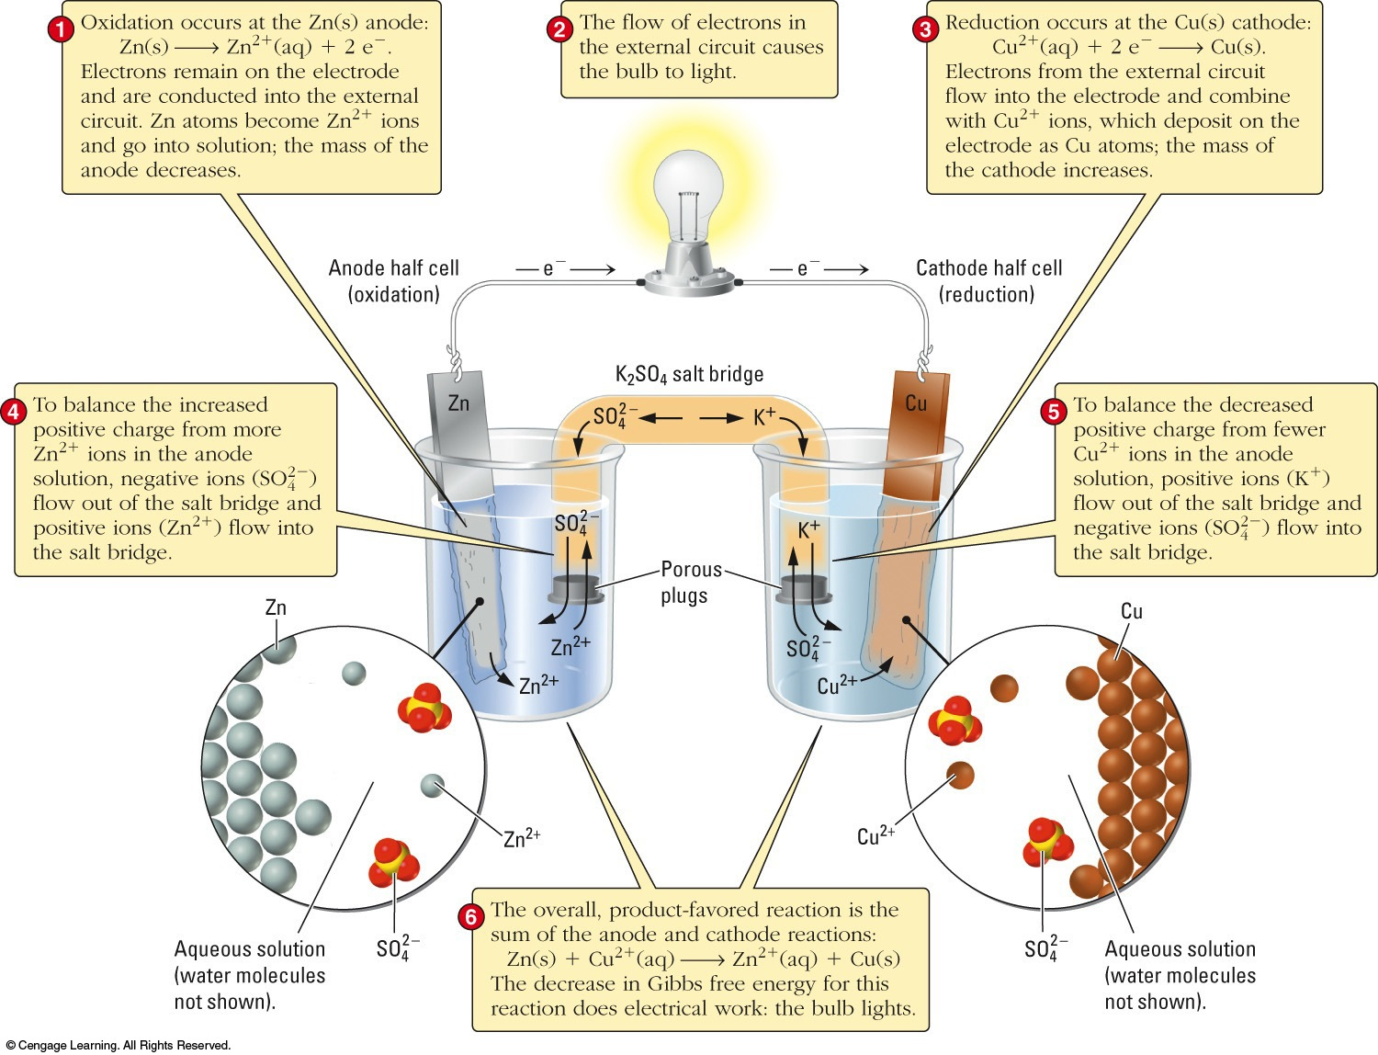
Voltaic Cells
Cu²⁺(aq) + Zn(s) → Cu(s) + Zn²⁺(aq)

Slide 40
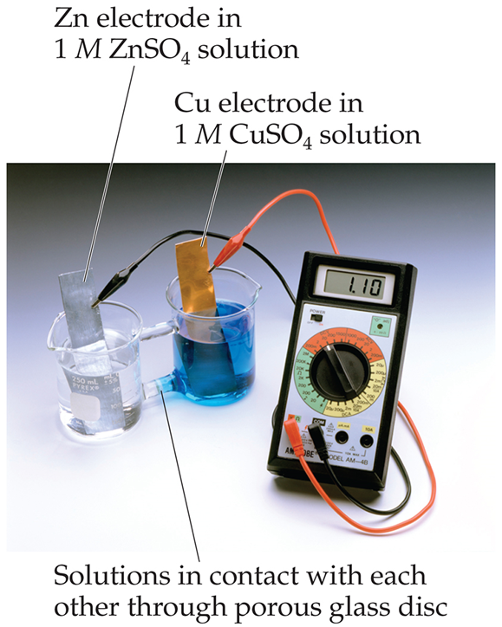
Voltaic Cells
The oxidation occurs at the anode.
The reduction occurs at the cathode.
When electrons flow, charges aren’t balanced. So, a salt bridge, usually a U-shaped tube that contains a salt/agar solution, is used to keep the charges balanced.

Slide 41
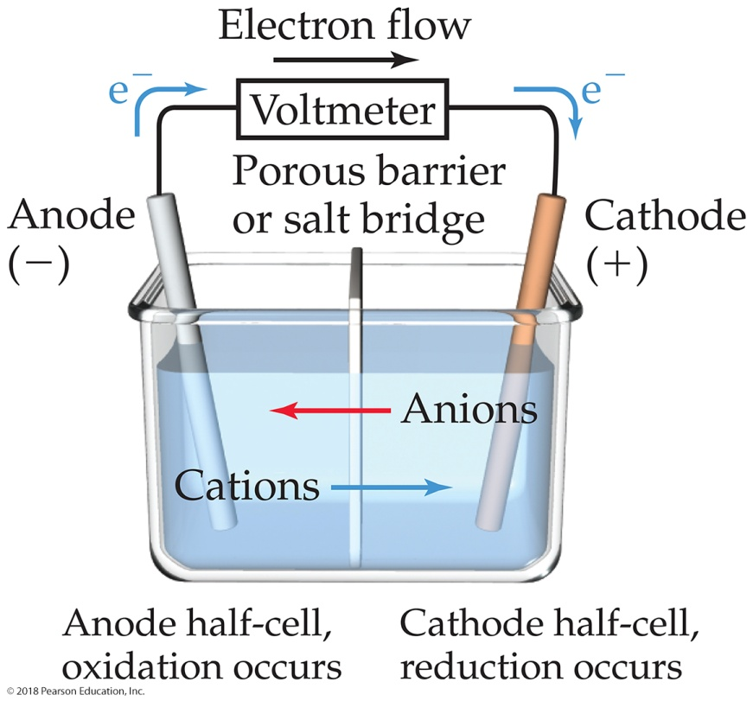
Voltaic Cells
In the cell, electrons leave the anode and flow through the wire to the cathode.
Cations are formed in the anode compartment.
As the electrons reach the cathode, cations in solution are attracted to the now negative cathode.
The cations gain electrons and are deposited as metal on the cathode.

Slide 42
Shorthand Notation for Galvanic Cells
Anode half-reaction:
Zn(s)
Zn²⁺(aq) + 2 e⁻
Cathode half-reaction:
Cu²⁺(aq) + 2 e⁻
Cu(s)
Overall cell reaction:
Zn(s) + Cu²⁺(aq)
Zn²⁺(aq) + Cu(s)
Salt bridge
Anode half-cell
Cathode half-cell
Zn(s) | Zn²⁺(aq) || Cu²⁺(aq) | Cu(s)
Electron flow
Phase boundary
Phase boundary

Slide 43
Electromotive Force (emf)
כוח אלקטרו מניע- בקיצור: כא"מ
The potential difference between the anode and cathode in a cell is called the electromotive force (emf).
It is also called the cell potential and is designated E_{cell}.
It is measured in volts (V). One volt is one joule per coulomb (1 V = 1 J/C).

Slide 44
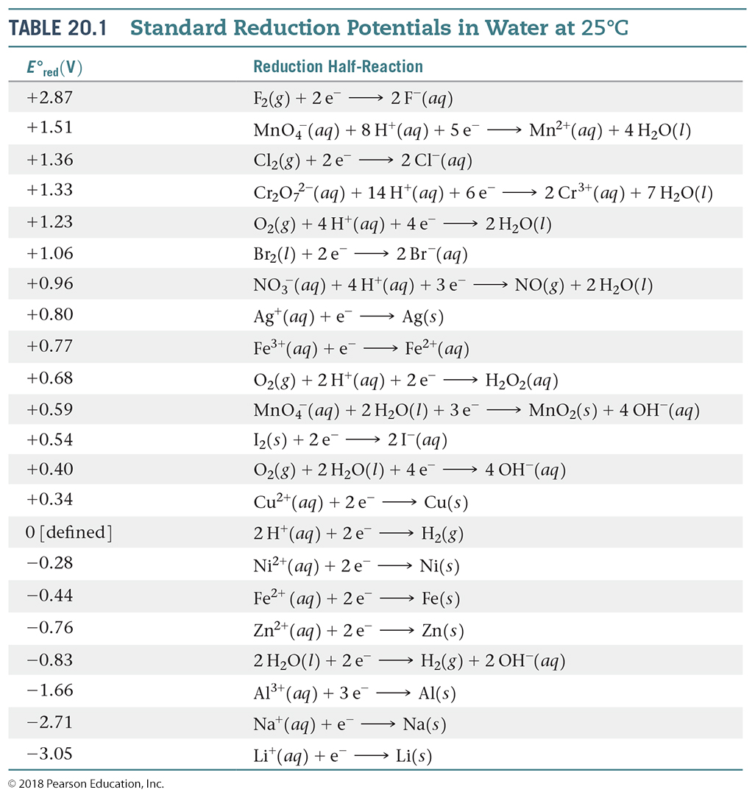
Standard Reduction Potentials
Reduction potentials for many electrodes have been measured and tabulated.
The values are compared to the reduction of hydrogen as a standard.
Standard condition are 1 M, 101.3 kPa, 25°C.

Slide 45
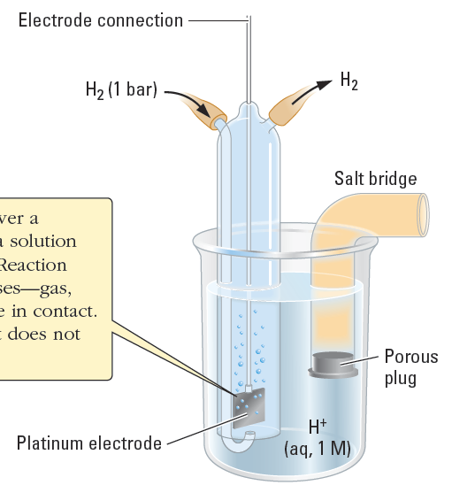
Standard Reduction Potentials
The standard hydrogen electrode (S.H.E.) has been chosen to be the reference electrode.
2H⁺(aq, 1 M) + 2e⁻
H₂(g, 1 atm)
E°_{ox} = 0 V
H₂(g, 1 atm)
2H⁺(aq, 1 M) + 2e⁻
E°_{red} = 0 V
Compact notation:
H⁺(aq), 1M| H₂(g, 1bar) | Pt
Gas + soln.
in contact with Pt
The Standard Hydrogen Electrode (SHE) is assigned a value of E° = 0 V:

Slide 46
Standard Cell Potentials
The cell potential at standard conditions can be found through this equation:
Because cell potential is based on the potential energy per unit of charge, it is an intensive property.

Slide 47
Using Standard Reduction Potentials
Zn²⁺(aq) + 2 e⁻
Zn(s)
E° = −0.76 V
Cu²⁺(aq) + 2 e⁻
Cu(s)
E° = 0.34 V
Zn(s)
Zn²⁺(aq) + 2 e⁻
E° = −(−0.76 V)
Cu²⁺(aq) + 2 e⁻
Cu(s)
E° = 0.34 V
Zn(s) + Cu²⁺(aq)
Zn²⁺(aq) + Cu(s)
E° = 1.10 V
Half-cell potentials are intensive properties.

Slide 48
Using Standard Reduction Potentials
Ag⁺(aq) + e⁻
Ag(s)
E° = 0.80 V
Cu²⁺(aq) + 2 e⁻
Cu(s)
E° = 0.34 V
2 × [Ag⁺(aq) + e⁻
Ag(s)]
E° = 0.80 V
Cu(s)
Cu²⁺(aq) + 2 e⁻
E° = −0.34 V
2 Ag⁺(aq) + Cu(s)
2 Ag(s) + Cu²⁺(aq)
E° = 0.46 V
Half-cell potentials are intensive properties.

Slide 49
Cell Potentials and Free-Energy Changes for Cell Reactions
1 J = 1 C × 1 V
joule (J)
SI unit of energy
volt (V)
SI unit of electric potential
coulomb (C)
Electric charge
1 coulomb is the amount of charge transferred when a current of 1 ampere (A) flows for 1 second.

Slide 50
Cell Potentials and Free-Energy Changes for Cell Reactions
faraday or Faraday constant
The electric charge on 1 mol of electrons and is equal to 96,500 C/mol e⁻
ΔG = −nFE
or
ΔG° = −nFE°
Free-energy change
Cell potential
Number of moles of electrons transferred in the reaction

Slide 51
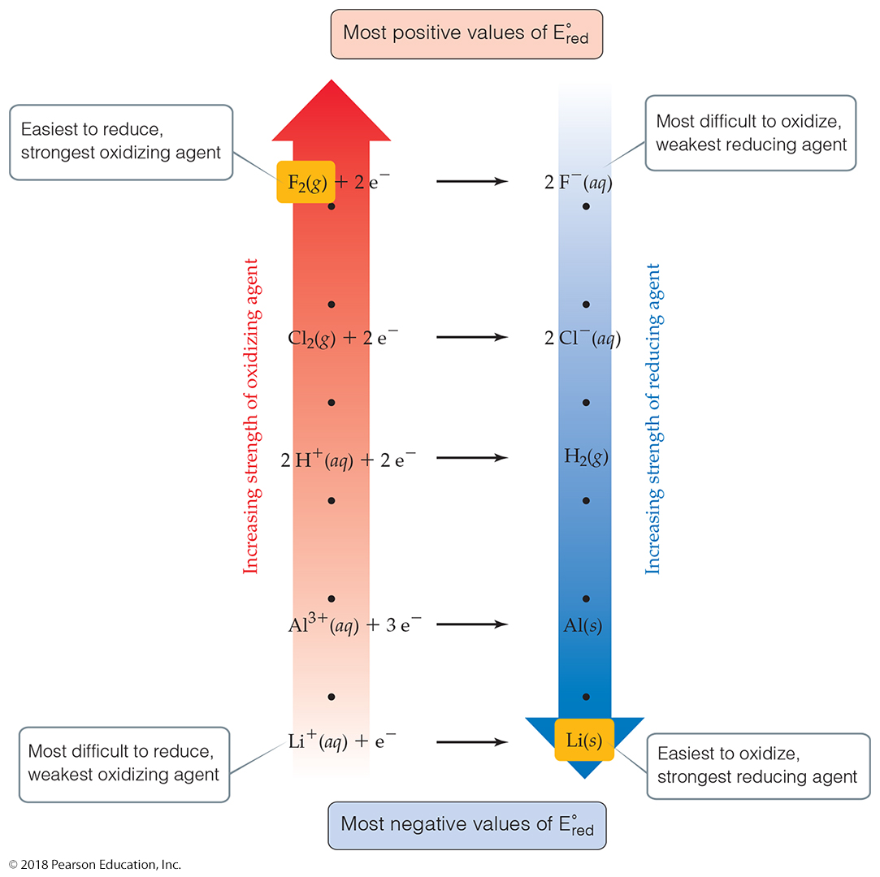
Oxidizing and Reducing Agents
The more positive the value of E°_{red}, the greater the tendency for reduction under standard conditions.
The strongest oxidizers have the most positive reduction potentials.
The strongest reducers have the most negative reduction potentials.

Slide 52
The Nernst Equation
ΔG = ΔG° + RT ln Q
Using:
ΔG = −nFE and ΔG° = −nFE°
RT
Nernst Equation:
E = E° −
ln Q
nF
F= 96,500 C/mol e⁻
or
2.303RT
E = E°−
log Q
nF
0.0592
E = E° −
log Q
in volts, at 25 °C
n

Slide 53
The Nernst Equation
Consider a galvanic cell that uses the reaction:
Cu(s) + 2 Fe³⁺(aq)
Cu²⁺(aq) + 2 Fe²⁺(aq)
What is the potential of a cell at 25 °C that has the following ion concentrations?
[Fe³⁺] = 1.0 × 10⁻⁴ M
[Cu²⁺] = 0.25 M
[Fe²⁺] = 0.20 M
Cu²⁺(aq) + 2 e⁻
Cu(s)
E° = 0.34 V
Fe³⁺(aq) + e⁻
Fe²⁺(aq)
E° = 0.77 V

Slide 54
The Nernst Equation
0.0592
E = E° −
log Q
n
Cu(s) + 2 Fe³⁺(aq)
Cu²⁺(aq) + 2 Fe²⁺(aq)
Calculate E°:
Cu(s)
Cu²⁺(aq) + 2 e⁻
E° = −0.34 V
Fe³⁺(aq) + e⁻
Fe²⁺(aq)
E° = 0.77 V
E°_{cell} = −0.34 V + 0.77 V = 0.43 V

Slide 55
The Nernst Equation
0.0592
E = E° −
log Q
n
Cu(s) + 2 Fe³⁺(aq)
Cu²⁺(aq) + 2 Fe²⁺(aq)
Calculate E:
0.0592
[Cu²⁺][Fe²⁺]²
E = E° –
log
n
[Fe³⁺]²
0.0592
(0.25)(0.20)²
= 0.43 V −
log
2
(1.0 x 10⁻⁴)²
E = 0.25 V

Slide 56
Standard Cell Potentials and Equilibrium Constants
Using
ΔG° = −nFE°
and
ΔG° = −RT ln K
−nFE° = −RT ln K
RT
2.303 RT
E° =
ln K
=
log K
nF
nF
0.0592
E° =
log K
in volts, at 25 °C
n

Slide 57
Standard Cell Potentials and Equilibrium Constants
Three methods to determine equilibrium constants:
[C]^{c}[D]^{d}
K from concentration data:
K =
[A]ª[B]^{b}
−ΔG°
K from thermochemical data:
ln K =
RT
RT
nFE°
K from electrochemical data:
E° =
ln K
or
ln K =
nF
RT
0.0592
E° =
log K
in volts, at 25 °C
n

Slide 58
E° and K
Determine K for the following reaction at 25 °C:
2 Ag(s) + Hg²⁺(aq) → 2 Ag⁺(aq) + Hg(ℓ)
Half Reaction |  |  | Half Cell | E° (V)
Hg²⁺(aq) + 2 e⁻ | → | Hg(ℓ) | Hg²⁺(aq)|Hg(ℓ) | +0.8535
Ag⁺(aq) + e⁻ | → | Ag(s) | Ag⁺(aq)|Ag(s) | +0.7991
E°_{cell} = 0.8535 V – 0.7991 V = 0.0544 V
0.0592
E° =
log K
in volts, at 25 °C, n=2, E° = 0.0544V
n
${K=10 }^{\frac{nE^{°}}{0.0592}}$ ${=10 }^{\frac{2X0.0544}{0.0592}}=68.8$

