Slide 1
Thermodynamics
is the study of energy and its interconversions.
Thermochemistry
An area of thermodynamics that concerns the study of the heat absorbed or evolved by a chemical reaction.
energy is the ability to do work or transfer heat.

Slide 2

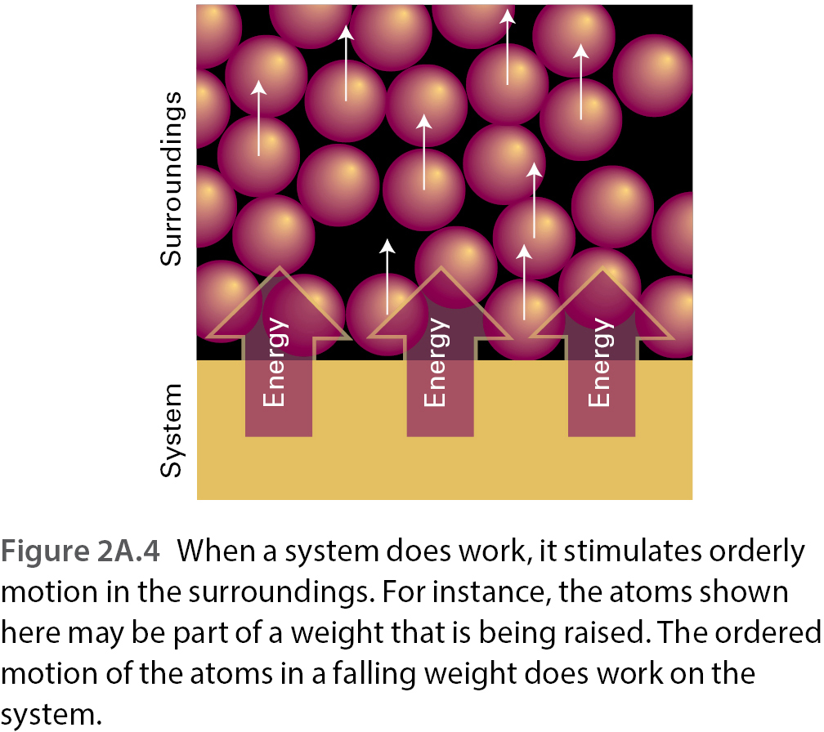
Physical Chemistry Chapter2A: Figure 2A.4
w
עבודה,

Slide 3

Work, w
An energy transfer into or out of a thermodynamic system whose effect on the surroundings is equivalent to moving an object through a field of force.
Work is chosen to be positive when work is done on the thermodynamic system and negative when work is done by the thermodynamic system.
w = F • d
where w is work, F is the force, and d is the distance over which the force is exerted.

Slide 4
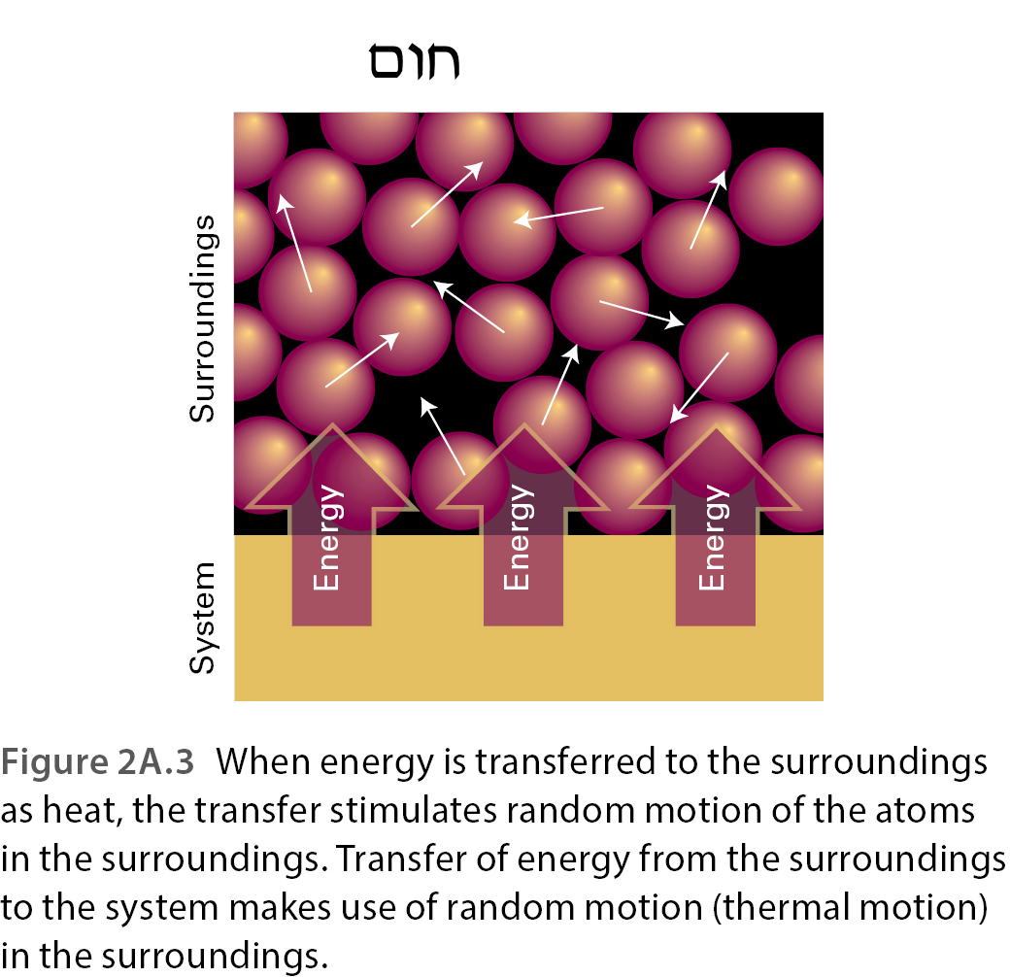
q,

Slide 5
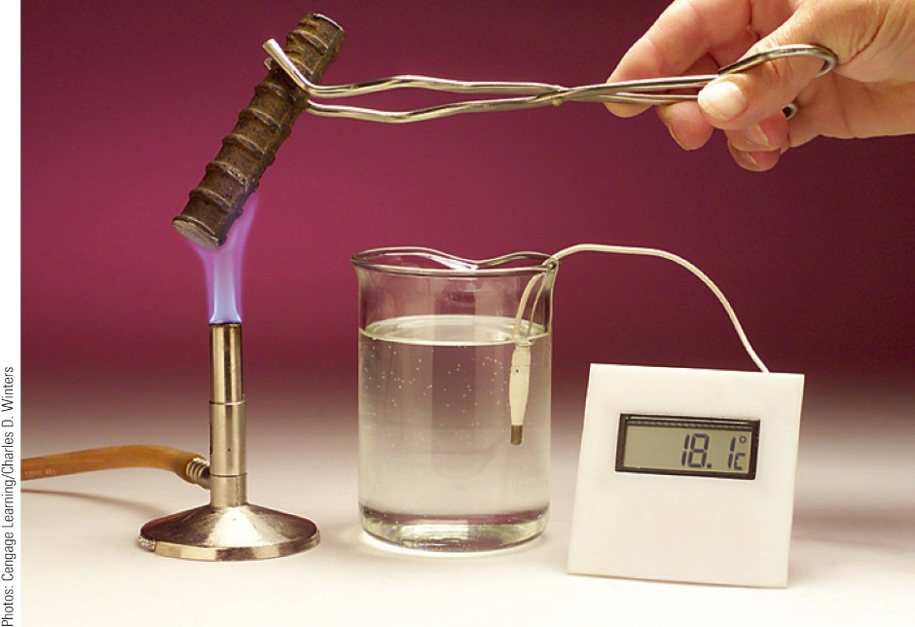
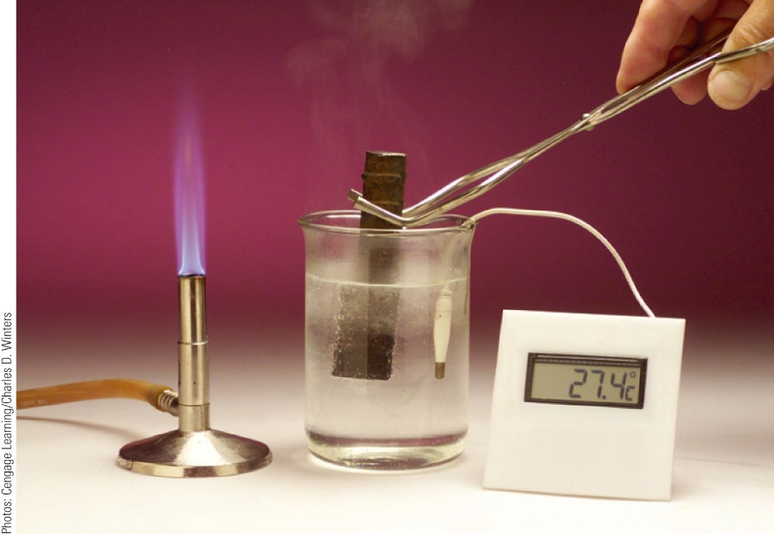
Heat, q
A transfer of energy into or out of a thermodynamic system caused by a temperature difference between the system and its surroundings.
Heat flows spontaneously from a region of higher temperature to a region of lower temperature.
• q is defined as positive if heat is absorbed by the system (heat is added to the system)
• q is defined as negative if heat is evolved by a system (heat is subtracted from the system)

Slide 6
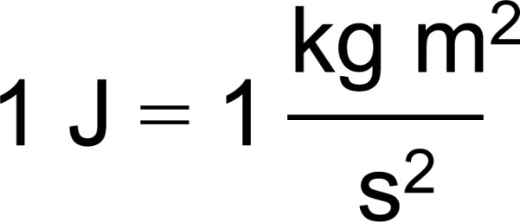
Units of Energy
The SI unit of energy is the joule (J):
Calorie
A commonly-used non-SI unit of energy.
It is the amount of energy required to raise the temperature of one gram of water by one degree Celsius.
1 cal = 4.184 J

Slide 7
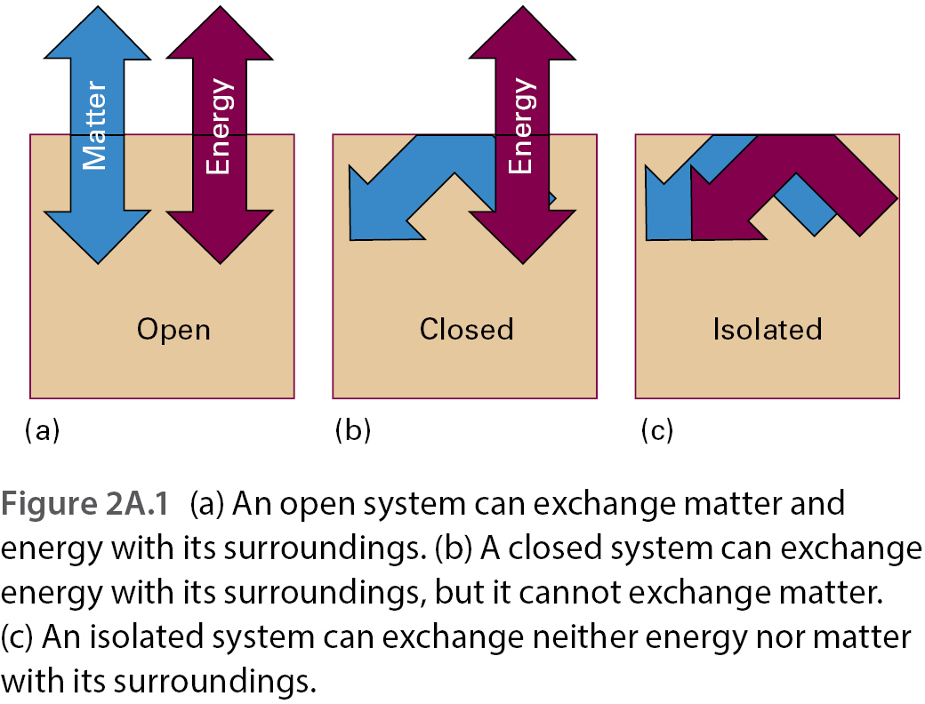
Physical Chemistry Chapter2A: Figure 2A.1
מערכת וסביבה

Slide 8
Internal Energy, U ( or E)
The sum of the kinetic and potential energies of the particles making up a substance.
Law of Conservation of Energy
Energy may be converted from one form to another, but the total quantity of energy remains constant.
Change in Internal Energy
It is determined by the formula
U_{f} = final internal energy
U_{i} = initial internal energy
or ΔE = E_{final} − E_{initial}

Slide 9
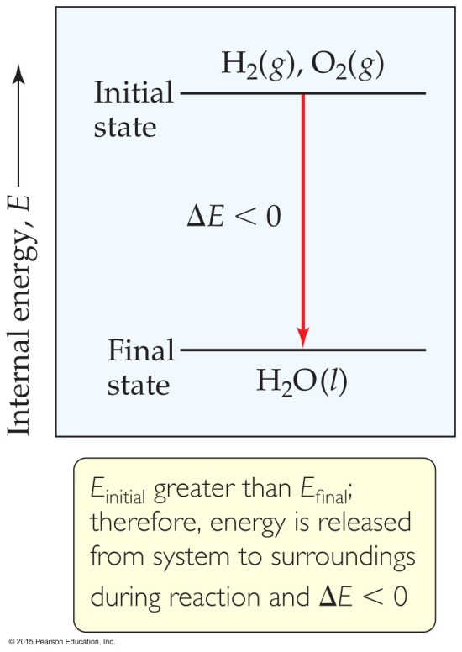
Internal Energy
By definition, the change in internal energy, ΔE, is the final energy of the system minus the initial energy of the system:
ΔE = E_{final} − E_{initial}

Slide 10
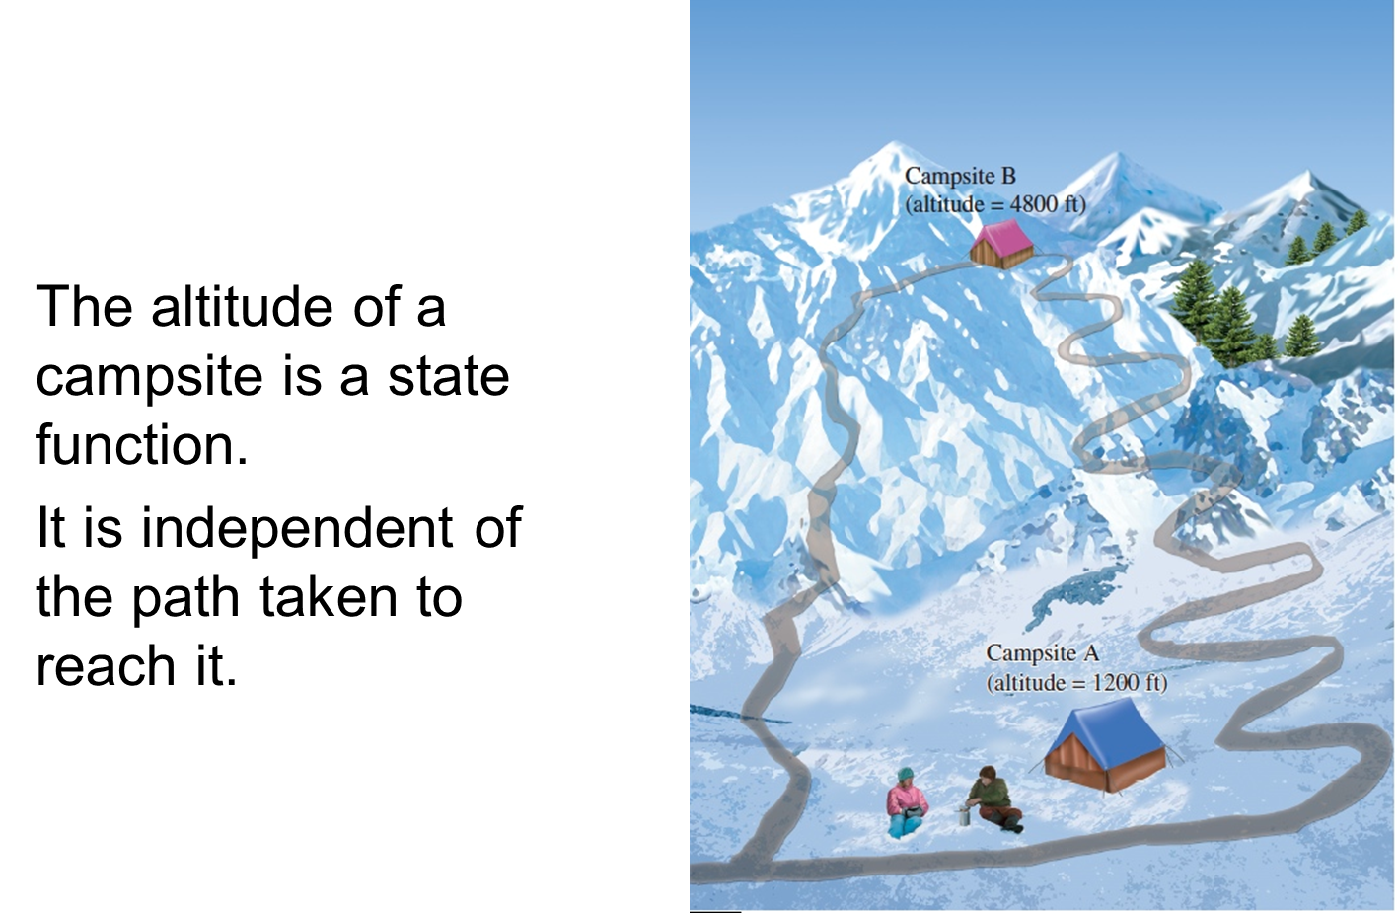
State function
A property of a system that depends only on its present state. It is independent of any previous history of the system.

Slide 11
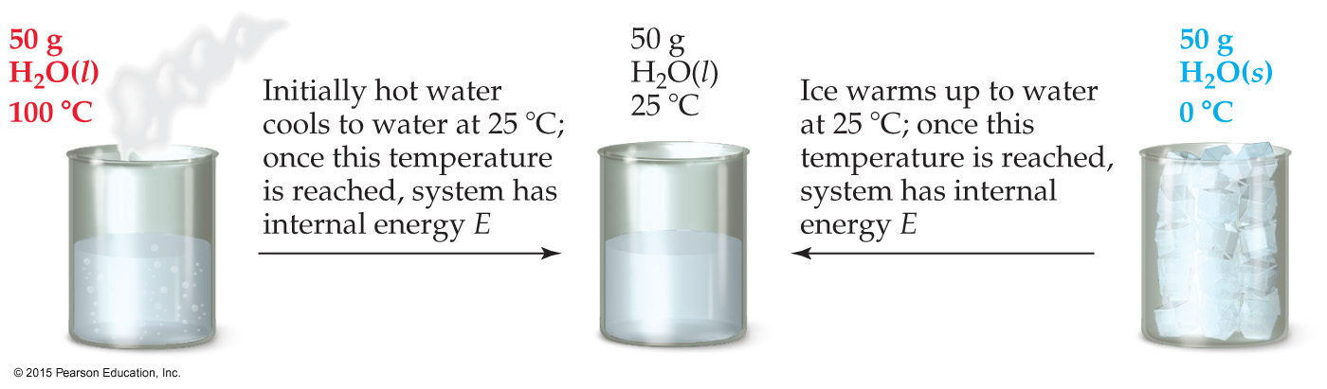
State Functions
Usually we have no way of knowing the internal energy of a system; finding that value is simply too complex a problem.
However, we do know that the internal energy of a system is independent of the path by which the system achieved that state.
  In the system below, the water could have reached room temperature from either direction.

Slide 12
State Functions
Therefore, internal energy is a state function.
It depends only on the present state of the system, not on the path by which the system arrived at that state.
And so, ΔE depends only on E_{initial} and E_{final}.

Slide 13
First Law of Thermodynamics
The change in the internal energy of a system, ΔU, is the sum of heat, q, and work, w.
or
ΔE = q + w
Energy is neither created nor destroyed.
In other words, the total energy of the universe is a constant; if the system loses energy, it must be gained by the surroundings, and vice versa.

Slide 14
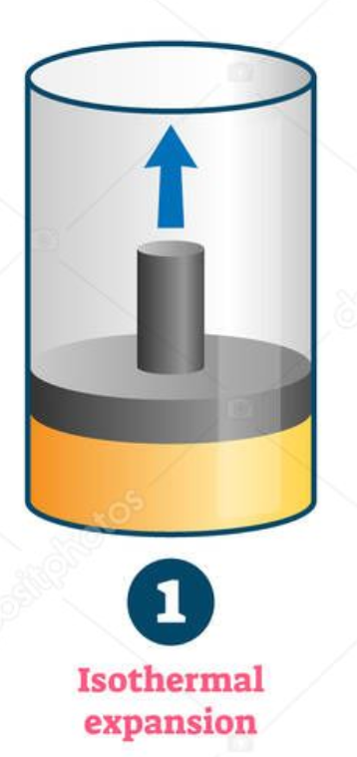
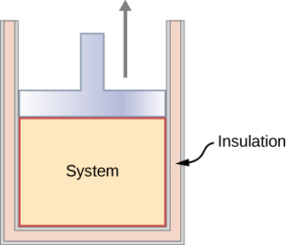
First Law of Thermodynamics
ΔU=15-10 = +5 J
q = +3 J
w = +2J
ΔU = 15-10 =+5 J
q = +7 J
w = -2 J
ΔU = 0
q = +5 J
w = -5 J
ΔU = -2 J
q = 0
w = -2 J
תהליך אדיאבטי הוא תהליך המתרחש ללא מעבר חום
תהליך איזותרמי הוא תהליך תרמודינמי בו הטמפרטורה נשארת קבועה

Slide 15
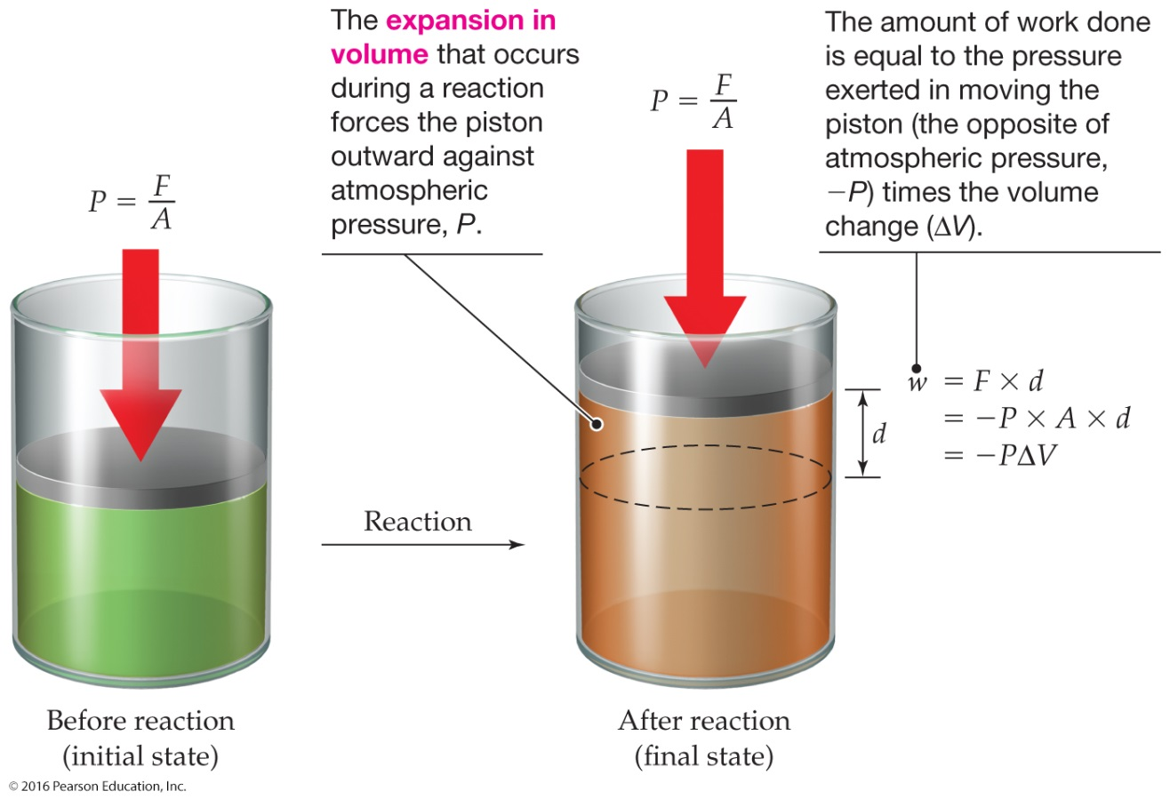

Expansion Work
עבודה כנגד לחץ חיצוני קבוע
Expansion Work: Work done as the result of a volume change in the system
Usually in an open container the only work done is by a gas pushing on the surroundings (or by the surroundings pushing on the gas).
C₃H₈(g) + 5O₂(g)
3CO₂(g) + 4H₂O(g)
6 mol of gas
7 mol of gas
1 L atm = 101.325 J
$$w={−P}_{ex}∆V$$

Slide 16
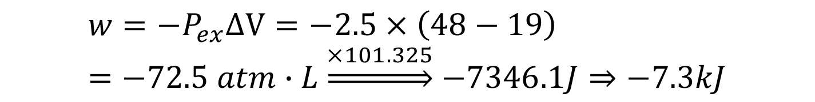
גז מתפשט מנפח 19 ליטר ל- 48 ליטר כנגד לחץ חיצוני של 2.5 אטמוספרה.
חשב את העבודה הנעשית בג'אול.
( 101.325 J=1 Latm)
פתרון:
$$w={−P}_{ex}∆V=−2.5×\left(48−19\right)=−72.5 atm∙L\underset{⇒}{×101.325}−7346.1J⇒−7.3kJ$$

Slide 17
Enthalpy
If a process takes place at constant pressure (as the majority of processes we study do) and the only work done is this pressure–volume work, we can account for heat flow during the process by measuring the enthalpy of the system.
Enthalpy is the internal energy plus the product of pressure and volume:
פונקציית מצב
H = E + PV

Slide 18
Enthalpy
When the system changes at constant pressure, the change in enthalpy, ΔH, is
ΔH = Δ(E + PV)
This can be written
ΔH = ΔE + PΔV

Slide 19
Enthalpy
Since ΔE = q + w and w = −PΔV, we can substitute these into the enthalpy expression:
ΔH = ΔE + PΔV
ΔH = (q + w) − w
ΔH = q
So, at constant pressure, the change in enthalpy is the heat gained or lost.

Slide 20
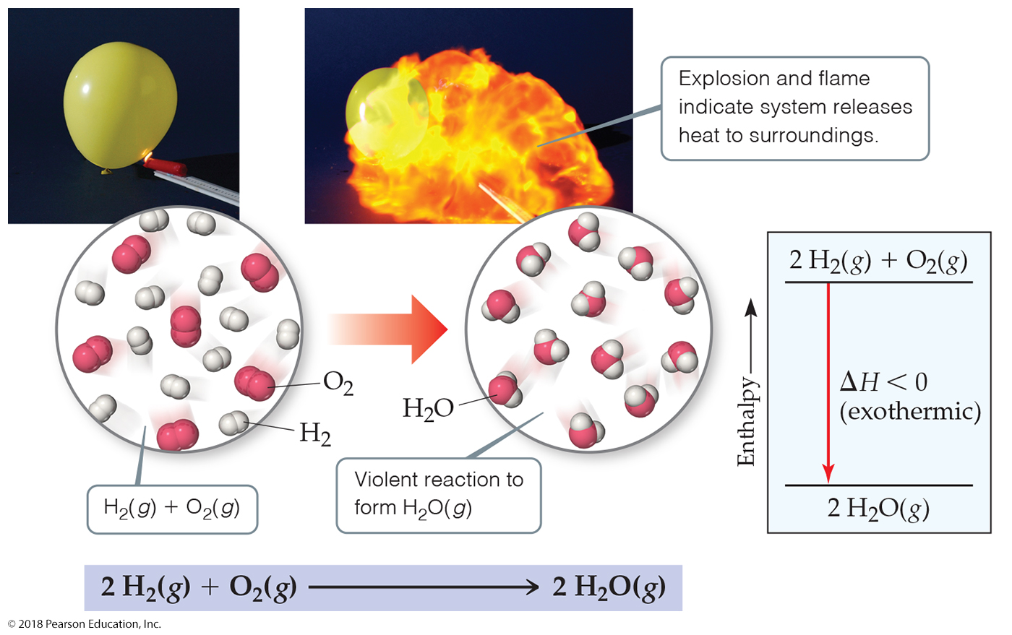
In an exothermic reaction:
  The reaction vessel warms.
  Heat is evolved.
  Energy is subtracted from the system.
  q is negative.

Slide 21
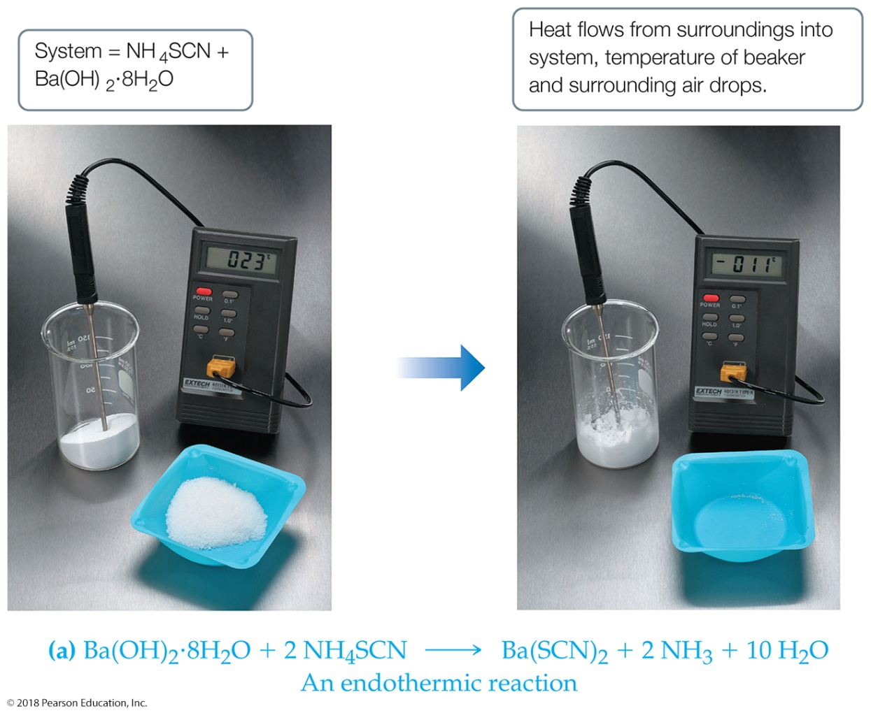
In an endothermic reaction:
  The reaction vessel cools.
  Heat is absorbed.
  Energy is added to the system.
  q is positive.
ΔH= H(products)- H(reactants)>0

Slide 22
Thermochemical Equation
The chemical equation for a reaction (including phase labels) in which the equation is given a molar interpretation, and the enthalpy of reaction for these molar amounts is written directly after the equation.
For the reaction of sodium metal with water, the thermochemical equation is:

Slide 23
Manipulating a Thermochemical Equation
When the thermochemical equation is multiplied by any factor, the value of ΔH for the new equation is obtained by multiplying the value of ΔH in the original equation by that same factor.
When a chemical equation is reversed, the sign of ΔH is reversed.

Slide 24
Thermochemical Equation
Natural gas consists primarily of methane, CH₄. It is used in a process called steam reforming to prepare a gaseous mixture of carbon monoxide and hydrogen for industrial use.
The reverse reaction, the reaction of carbon monoxide and hydrogen, has been explored as a way to prepare methane (synthetic natural gas). Which of the following are exothermic? Of these, which one is the most exothermic?
a.
b.
c.
d.

Slide 25
Thermochemical Equation
a.
This reaction is identical to the given reaction.
It is endothermic.
ΔH = 206 kJ

Slide 26
Thermochemical Equation
b.
This reaction is double the given reaction.
It is endothermic.
ΔH = 412 kJ

Slide 27
Thermochemical Equation
c.
This reaction is the reverse of the given reaction.
It is exothermic.
ΔH = -206 kJ

Slide 28
Thermochemical Equation
d.
This reaction is reverse and double the given reaction.
It is exothermic.
ΔH = -412 kJ
Equations c and d are exothermic.
Equation d is the most exothermic reaction.

Slide 29
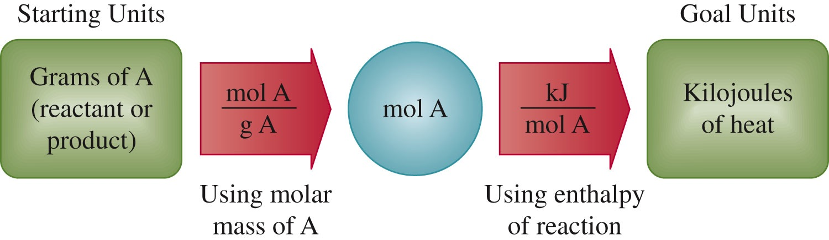
Applying Stoichiometry to Heats of Reaction

Slide 30
Applying Stoichiometry to Heats of Reaction
Determine the amount evolved when 9.07 ×10⁵ g of ammonia is produced according to the following equation. Assume that the reaction occurs at constant pressure.
The conversion factor is obtained from the second step of the thermodynamic equation. Hence,
The amount of heat evolved is 2.45 ×10⁶ kJ
− 2.45  10⁶ kJ

Slide 31
Specific Heat Capacity, s (specific heat)
The quantity of heat needed to raise the temperature of one gram of substance by one degree Celsius (or one kelvin) at constant pressure.
The heat required to raise the temperature of the sample can be determined by the formula:
s (or c) = specific heat of the substance
m = mass in grams
Δt = temperature change
or
q = m c ΔT

Slide 32
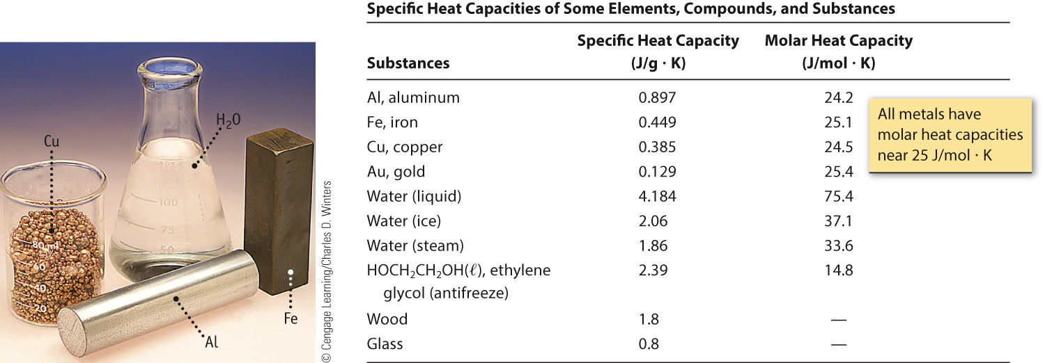
Specific Heat Capacity (C) of Some Common Materials

Slide 33
Heat Capacity
How much energy will be used to heat 500.0 g of iron from 22°C to 55°C? c_{Fe} = 0.451 J g⁻¹ °C⁻¹.
Heat required = q = m c ΔT
q = 500.0 g (0.451 J g⁻¹ °C⁻¹)(55 − 22)°C
q = 7442 J = +7.4 kJ
+ sign, E added to the system (the iron)

Slide 34
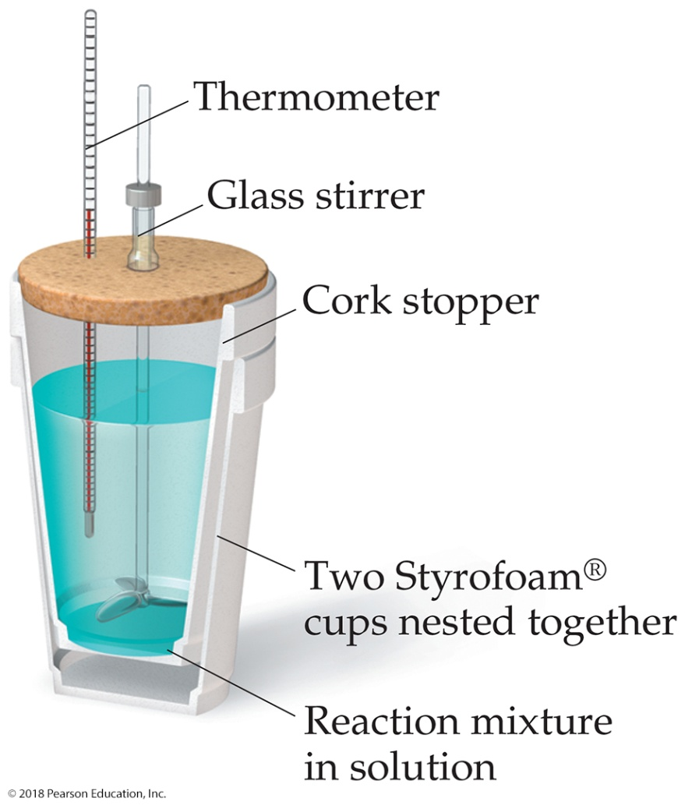
Calorimetry
Since we cannot know the exact enthalpy of the reactants and products, we measure ΔH through calorimetry, the measurement of heat flow.
The instrument used to measure heat flow is called a calorimeter.

Slide 35
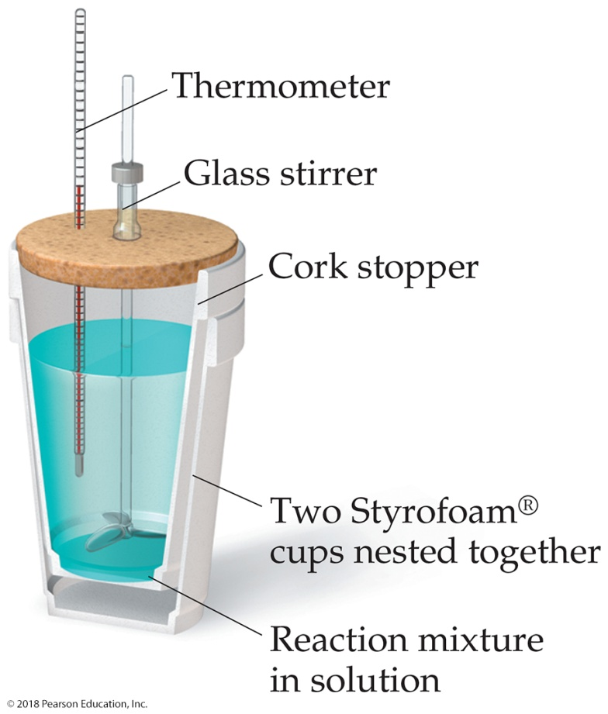
Constant Pressure Calorimetry
By carrying out a reaction in aqueous solution in a simple calorimeter, the heat change for the system can be found by measuring the heat change for the water in the calorimeter.
The specific heat for water is
4.184 J/g∙K. We use this value for dilute solutions.
We can calculate ΔH for the reaction with this equation:
q_{soln} = m_{soln}× C_{s} × ΔT = –q_{rxn}

Slide 36
Hess’s Law of Heat Summation
For a chemical equation that can be written as the sum of two or more steps, the enthalpy change for the overall equation equals the sum of the enthalpy changes for the individual steps.
A → B ΔH_{AB} = H_{B} – H_{A}
B → C ΔH_{BC} = H_{C} – H_{B}
A → C ΔH_{AC} = H_{C} –H_{A}= ?
ΔH_{AC} = ΔH_{AB} + ΔH_{BC} = H_{B} – H_{A} + H_{C} – H_{B} = H_{C} –H_{A}

Slide 37
Hess’s Law
Determine the enthalpy of reaction, ΔH, for the formation of tungsten carbide, WC, from the elements.
The heats of combustion of the elements and of tungsten carbide are:
(3)

Slide 38
Hess’s Law
Reversing Equation 3 to get WC(s) on the right side,
Comparing Equation 1 with the desired equation and multiplying Equation 1 by ½ gives:
Equation 2 is left as is; it has C(graphite) on the left side.

Slide 39
Hess’s Law
Comparing Equation 3′ with the desired equation and multiplying Equation 3′ by ½ gives:
Adding the last three equations with their corresponding ΔH’s gives:

Slide 40
Standard Enthalpies of Formation
The term standard state refers to the standard thermodynamic conditions chosen for substances when listing or comparing thermodynamic data: 1 atm pressure and the specified temperature (usually 25°C). These standard conditions are indicated with a degree sign (°).
When reactants in their standard states yield products in their standard states, the enthalpy of reaction is called the standard enthalpy of reaction, ΔH°. (ΔH° is read “delta H zero.”)

Slide 41
Standard Enthalpies of Formation
אנתלפיית התהוות תקנית
Elements can exist in more than one physical state, and some elements exist in more than one distinct form in the same physical state. For example, carbon can exist as graphite or as diamond; oxygen can exist as O₂ or as O₃ (ozone).
These different forms of an element in the same physical state are called allotropes.
The reference form is the most stable form of the element (both physical state and allotrope).

Slide 42
The standard enthalpy of formation, ΔH_{f}°, is the enthalpy change for the formation of one mole of the substance from its elements in their reference forms and in their standard states. ΔH_{f}° for an element in its reference and standard state is zero.
For example, the standard enthalpy of formation for liquid water is the enthalpy change for the reaction

Slide 43
The standard enthalpy of formation
Standard enthalpies of formation can be used to calculate the standard enthalpy for a reaction, ΔH°.
Listing down the thermochemical equations with enthalpies of formation:

Slide 44
Applying Hess’s law, reversing Equation 1 and adding Equation 2 and 4 ×Equation 3,
If the formula is written in parentheses after ΔH_{f}°, the calculation can be written as:
In general,

Slide 45
The standard enthalpy of formation
Determine the standard enthalpy change for the following reaction:
קטליזטור או זרז
Adding values to the components of the reaction:

Slide 46
The standard enthalpy of formation

Slide 47
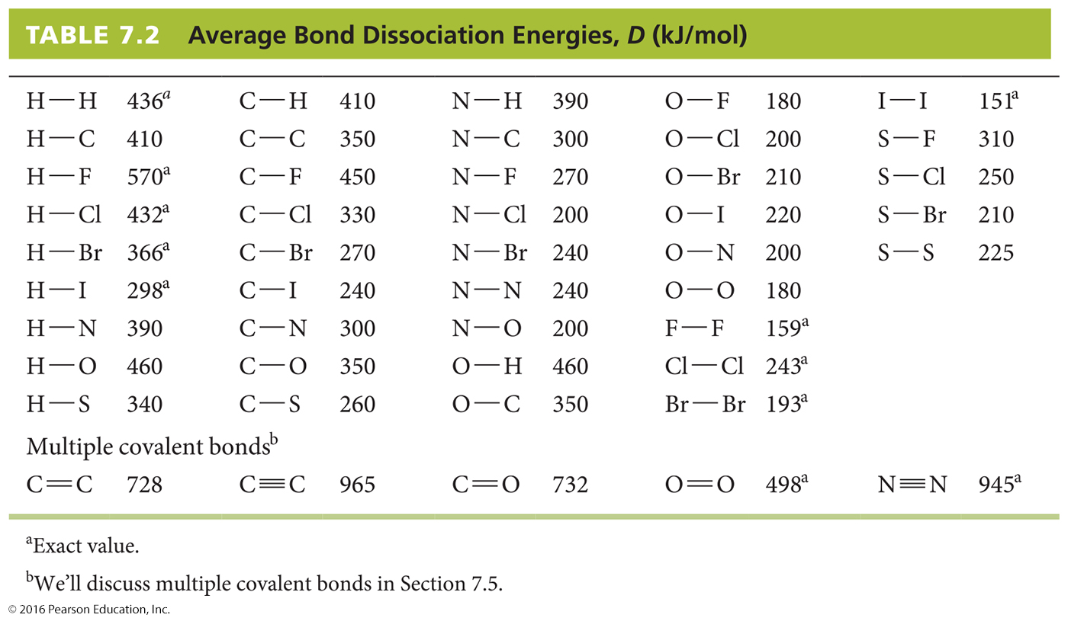
Bond Dissociation Energies
Bond dissociation energies are standard enthalpy changes for the corresponding bond-breaking reactions.

Slide 48
Bond Dissociation Energies
H₂(g) + Cl₂(g)
2HCl(g)
ΔH° = D(Reactant bonds) – D(Product bonds)
ΔH° = (D_{H—H} + D_{Cl—Cl}) – (2D_{H—Cl})
ΔH° = [(1 mol)(436 kJ/mol) + (1 mol)(243 kJ/mol)] –
(2 mol)(432 kJ/mol)
ΔH° = –185 kJ

