Slide 1
Chemical Kinetics
The speed at which reactions take place is called reaction rate.
The study of reaction rate is called chemical kinetics.
A step-by-step view of the change of reactants to products is called a mechanism.

Slide 2
Reaction Rates
Reaction Rate: Either the increase in the concentration of a product per unit time or the decrease in the concentration of a reactant per unit time
2 N₂O₅(g)
4 NO₂(g) + O₂(g)
1
Δ[N₂O₅]
1
Δ[NO₂]
Δ[O₂]
rate =
–
=
=
2
Δt
4
Δt
Δt
General rate of reaction:
a A + b B
d D + e E
1
Δ[A]
1
Δ[B]
1
Δ[D]
1
Δ[E]
rate =
–
=
–
=
=
a
Δt
b
Δt
d
Δt
e
Δt
The rate of reaction should be independent of whether you monitor the reactants or the products. The negative sign in front of the reactants is needed since their rate decreases.
Notes:
The rate of reaction should be independent of whether you monitor the reactants or the products. The negative sign in front of the reactants is needed since their rate decreases.

Slide 3
Calculate the average rate of decomposition of N₂O₅, – Δ[N₂O₅]/Δt, by the reaction
During the time interval from t = 600s to t = 1200s (regard all time figures as significant). Use the following data:
Time [N₂O₅]
600s
1200s

Slide 4
Solution
Note that this rate is twice the rate of formation of O₂ in the same time interval.
Average Rate
-
קצב התגובה ( Rate)
= $\frac{(5.2×{10}^{−6})}{2}=2.6×{10}^{−6}$M/s

Slide 5
Dependence of Rate on Concentration
Experimentally, it has been found that a reaction rate depends on the concentration of one or more reactants as well as the concentration of catalyst (if any).
This information is captured in the rate law, an equation that relates the rate of a reaction to the concentration of a reactant (and catalyst) raised to various powers. The proportionality constant, k, is the rate constant.
The rate law for a reaction must be determined experimentally.

Slide 6
Dependence of Rate on Concentration
For the generic reaction
the rate law can be written in the following manner:
The exponents m, n, and p are frequently integers and must be experimentally determined.

Slide 7
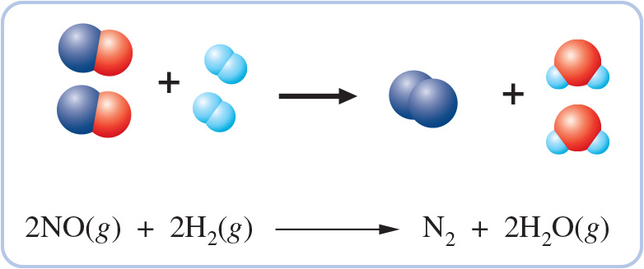
Reaction Order
Nitrogen monoxide, NO, reacts with hydrogen according to the equation
The experimentally determined rate law is
Thus, the reaction is second order in NO, first order in H₂, and third order overall.

Slide 8
Reaction Order
Bromide ion is oxidized by bromate ion in acidic solution.
The experimentally determined rate law is
What is the order of reaction with respect to each reactant species?
What is the overall order of the reaction?

Slide 9
Reaction Order
Solution
a. The reaction is first order with respect to Br –.
The reaction is first order with respect to BrO₃ –.
The reaction is second order with respect to H⁺.
b. The reaction is fourth order overall (1+1+2).

Slide 10
Rate Constant
Note that the units on the rate constant are specific to the overall order of the reaction.
• For a zero-order reaction, the unit is M/s or mol/(L  s).
• For a first-order reaction, the unit is 1/s or s⁻¹.
• For a second-order reaction, the unit is 1/(M  s) or L/(mol  s).
If you know the rate constant, you can deduce the overall rate of reaction.

Slide 11
Relative Value of k
The rate constant is often used to determine the relative rate of a reaction.
For reactions with k ~ 10⁹ or higher, the reaction is considered fast.
For reactions with k ~ 10 or lower, the reaction is considered slow.

Slide 12
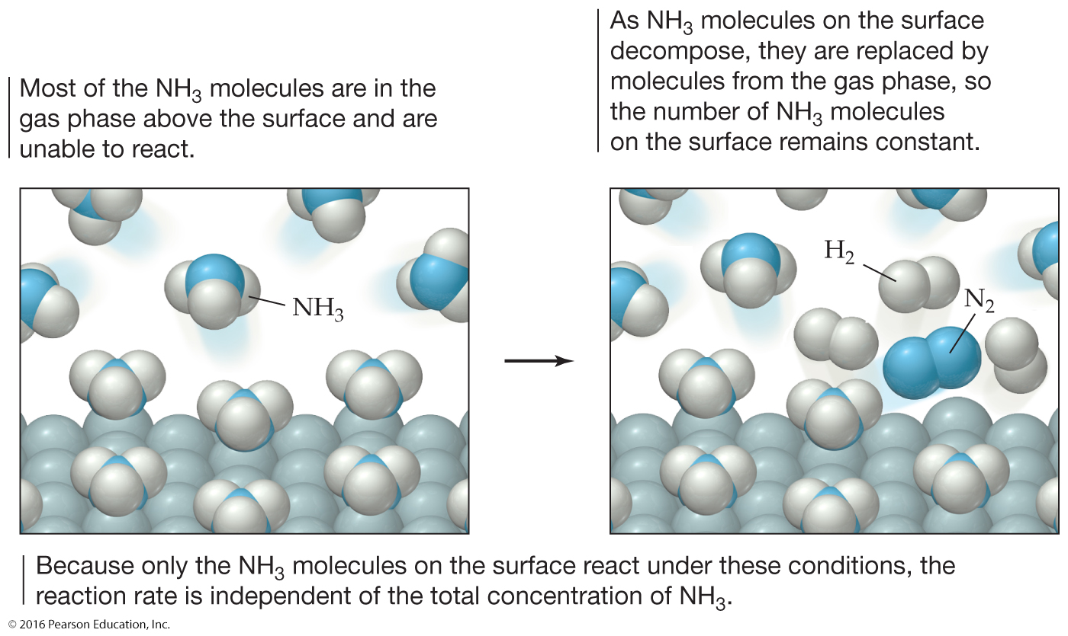
Zeroth-Order Reactions
Pt catalyst
2 NH₃(g)
N₂(g) + 3 H₂(g)
1130 K
rate = k[NH₃]⁰ = k

Slide 13
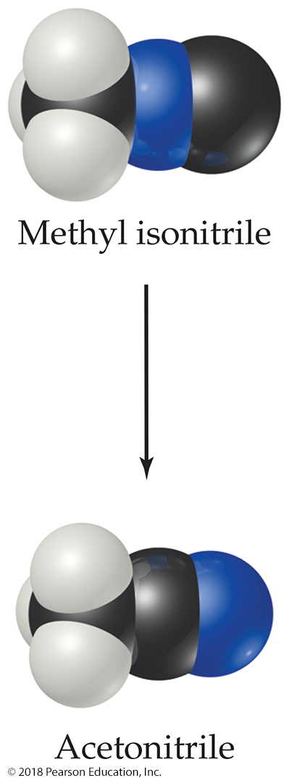
First-Order Reactions
Some rates depend only on one reactant to the first power.
These are first-order reactions.
The rate law becomes:
Rate = k [A]
The conversion of methyl isonitrile to acetonitrile is a first-order reaction.

Slide 14
Second-Order Reactions
Some rates depend only on a reactant to the second power.
These are second-order reactions.
The rate law becomes:
Rate = k [A]²
Second-Order Reaction
A+B→P Rate = k [A] [B]
Second-Order Reaction

Slide 15
Temperature and Rate
In most cases reactions speed up when the temperature increases.

Slide 16
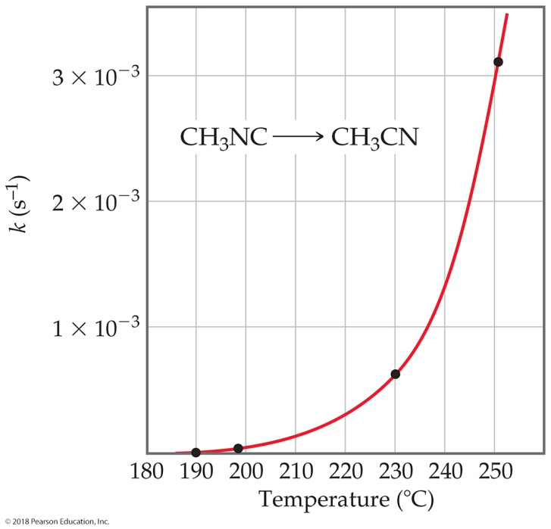
Temperature and Rate
Generally, as temperature increases, rate increases.
The rate constant is temperature dependent: It increases as temperature increases.
Rate constant doubles (approximately) with every 10 °C rise.

Slide 17
Frequency of Collisions
The collision model is based on the kinetic molecular theory.
Molecules must collide to react.
If there are more collisions, more reactions can occur.
So, if there are more molecules, the reaction rate is faster.
In a chemical reaction, bonds are broken and new bonds are formed. Molecules can only react if they collide with each other.

Slide 18
Orientation of Molecules
Molecules can often collide without forming products.
Aligning molecules properly can lead to chemical reactions.
Bonds must be broken and made, and atoms need to be in proper positions.
Importance of Molecular Orientation in the Reaction of NO and Cl₂
NO approaches with its N atom toward Cl₂, and an N–Cl bond forms. Also, the angle of approach is close to that in the product NOCl.
NO approaches with its O atom toward Cl₂. No N–Cl bond can form, so NO and Cl₂ collide and then fly apart.

Slide 19
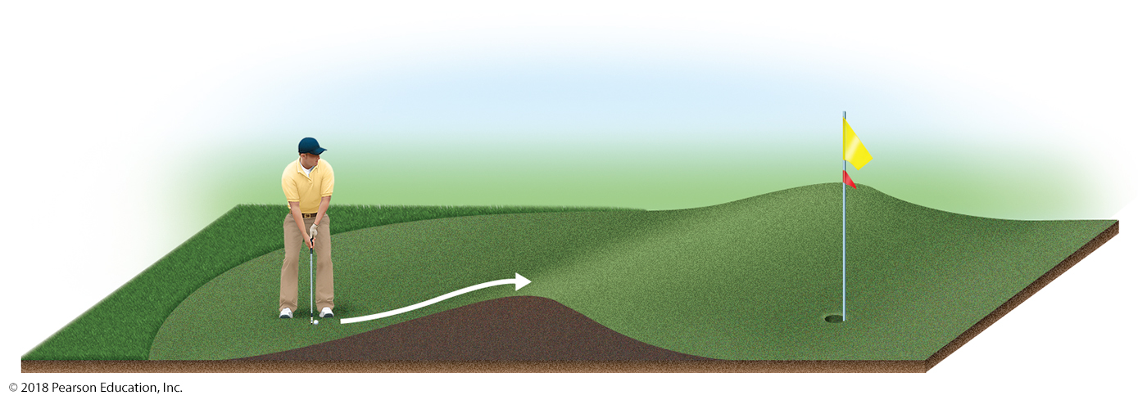
Energy Needed for a Reaction to Take Place (Activation Energy)
The minimum energy needed for a reaction to take place is called activation energy.
An energy barrier must be overcome for a reaction to take place, much like the ball must be hit to overcome the barrier in the figure below.

Slide 20
Transition State (Activated Complex)
Reactants gain energy as the reaction proceeds until the particles reach the maximum energy state.
The organization of the atoms at this highest energy state is called the transition state (or activated complex).
The energy needed to form this state is called the activation energy.

Slide 21
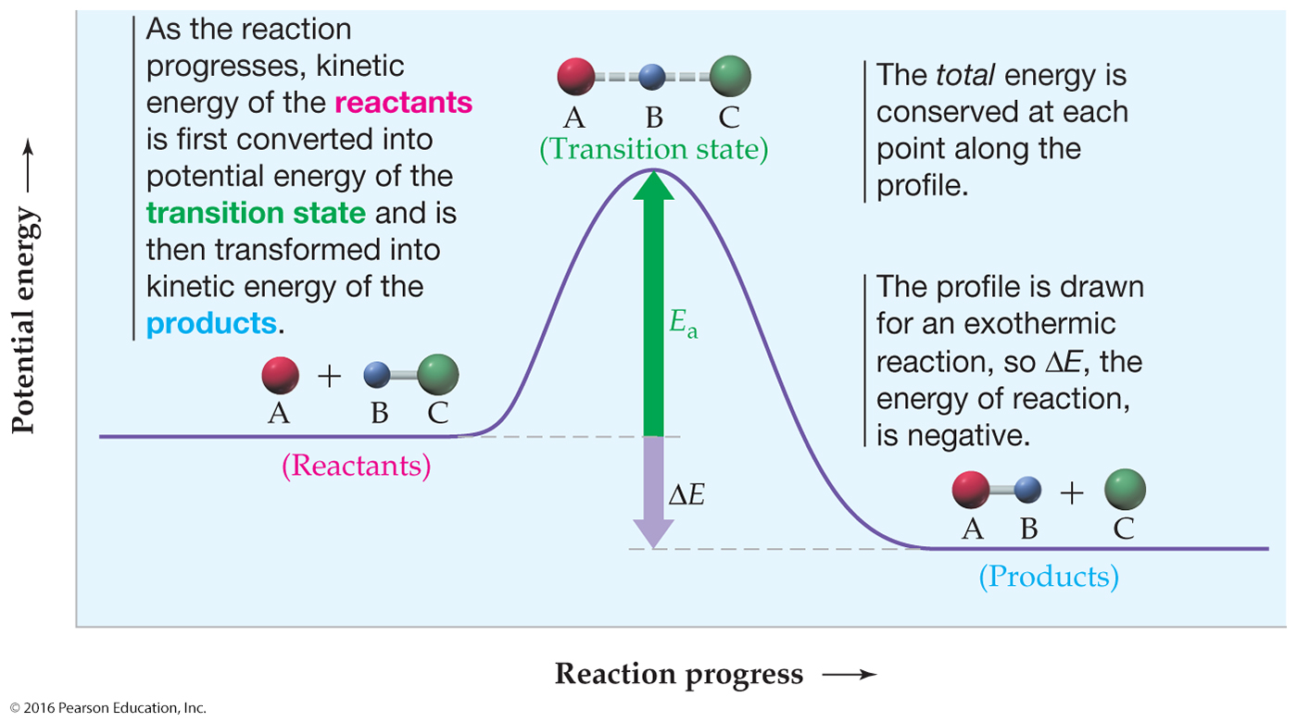
Reaction Rates and Temperature
Transition State: The configuration of atoms at the maximum in the potential energy profile. This is also called the activated complex.

Slide 22
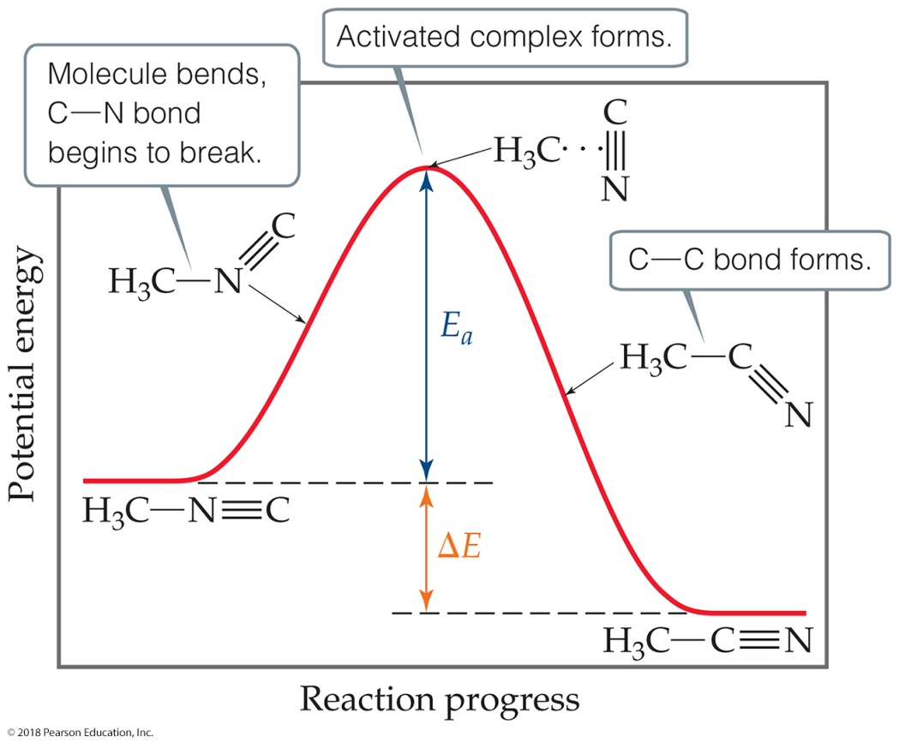
Reaction Progress
Plots are made to show the energy possessed by the particles as the reaction proceeds.
At the highest energy state, the transition state is formed.
Reactions can be endothermic or exothermic after this.
Rate constant depends on the magnitude of E_{a}.

Slide 23
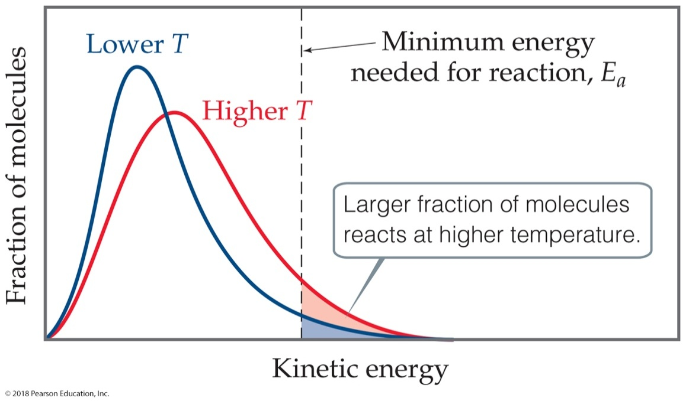
Distribution of the Energy of Molecules
Gases have an average temperature, but each individual molecule has its own energy.
At higher energies, more molecules possess the energy needed for the reaction to occur.

Slide 24
Arrhenius Equation
Rate constants for most chemical reactions closely follow an equation in the following form:
This is called the Arrhenius equation, where
e is the base of natural logarithms.
E_{a} is the activation energy.
R is the gas constant, 8.31 J/(K·mol).
T is the absolute temperature.
A is the frequency factor, a constant.

Slide 25
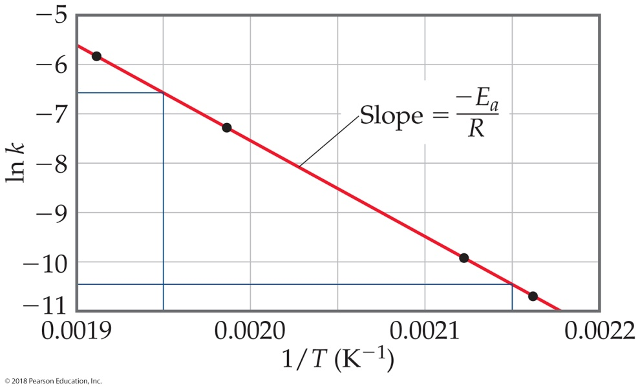
The Relationship between Activation Energy and Temperature
Arrhenius noted the relationship between activation energy and temperature: k = Ae^{−Ea/RT}
Activation energy can be determined graphically by reorganizing the equation: ln k = −E_{a}/RT + ln A

Slide 26
Reaction Mechanism
A balanced chemical equation is a description of the overall result of a chemical reaction. However, what actually happens on a molecular level may be more involved than what is represented by this single equation. For example, the reaction may take place in several steps.

Slide 27
Reaction Mechanism
Each step in the reaction mechanism is called an elementary reaction. It is a single molecular event.
The set of elementary reactions whose overall effect is given by the net chemical equation is called the reaction mechanism.
A reaction intermediate is a species produced during a reaction that does not appear in the net equation because it reacts in a subsequent step in the mechanism.

Slide 28
Molecularity
Elementary reactions are classified according to their molecularity, the number of molecules on the reactant side of an elementary reaction.
Unimolecular reactions involve one reactant molecule.
Bimolecular reactions involve two reactant molecules.
Termolecular reactions involve three reactant molecules.

Slide 29
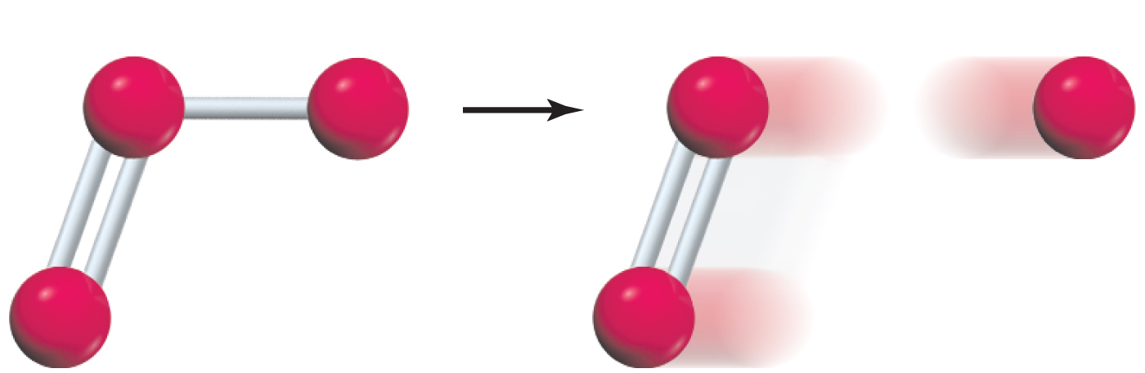
Reaction Mechanisms-Molecularity
Unimolecular Reaction
O₃*(g)
O₂(g) + O(g)

Slide 30
Reaction Mechanisms-Molecularity
Bimolecular Reaction
O₃(g) + O(g)
2 O₂(g)

Slide 31
Reaction Mechanisms-Molecularity
Termolecular Reaction
O(g) + O(g) + M(g)
O₂(g) + M(g)

Slide 32
Rate Laws for Elementary Reactions
Because an elementary reaction is an actual molecular event, the rate of an elementary reaction is proportional to the concentration of each reactant molecule. This means we can write the rate law directly from an elementary reaction.

Slide 33
Rate Laws for Elementary Reactions
Unimolecular Reaction
O₃*(g)
O₂(g) + O(g)
rate = k[O₃]
Bimolecular Reaction
O₃(g) + O(g)
2 O₂(g)
rate = k[O₃][O]
Termolecular Reaction
O(g) + O(g) + M(g)
O₂(g) + M(g)
rate = k[O]²[M]

Slide 34
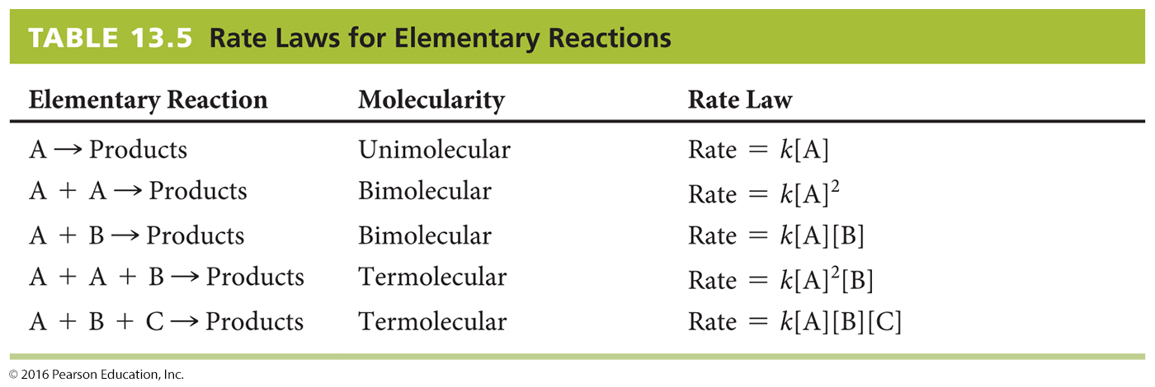
Rate Laws for Elementary Reactions

Slide 35
Reaction Mechanisms
Experimental evidence suggests that the reaction between NO₂ and CO takes place by a two-step mechanism:
NO₂(g) + NO₂(g)
NO(g) + NO₃(g)
elementary reaction
NO₃(g) + CO(g)
NO₂(g) + CO₂(g)
elementary reaction
NO₂(g) + CO(g)
NO(g) + CO₂(g)
overall reaction
A reactive intermediate is formed in one step and consumed in a subsequent step.

Slide 36
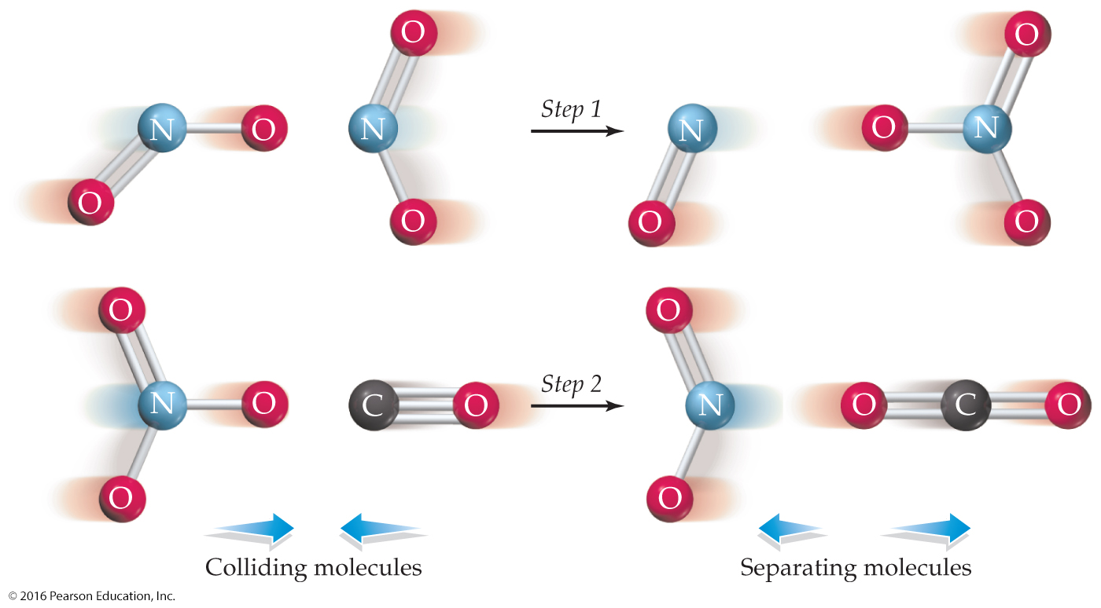
Reaction Mechanisms
NO₂(g) + NO₂(g)
NO(g) + NO₃(g)
NO₃(g) + CO(g)
NO₂(g) + CO₂(g)

Slide 37
Rate Law and Reaction Mechanism
A reaction mechanism cannot be directly observed.
We can, however, determine the rate law by experiment and decide if the reaction mechanism is consistent with that rate law.
The rate of a reaction is determined completely by the rate-determining step.

Slide 38
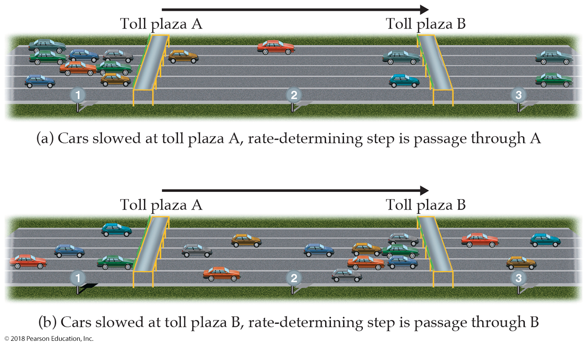
What Limits the Rate?
The overall reaction cannot occur faster than the slowest reaction in the mechanism.
We call that the rate-determining step.

Slide 39
Rate Laws for Overall Reactions
Multistep Reactions with an Initial Slow Step
k₁
NO₂(g) + NO₂(g)
NO(g) + NO₃(g)
slow step
k₂
NO₃(g) + CO(g)
NO₂(g) + CO₂(g)
fast step
NO₂(g) + CO(g)
NO(g) + CO₂(g)
overall reaction
Based on the slow step: rate = k₁[NO₂]²

Slide 40
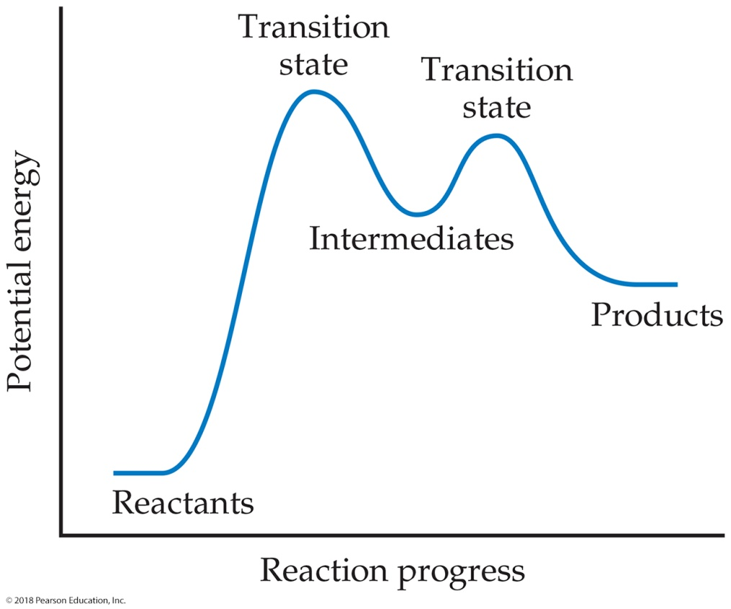
Intermediates
An intermediate is NOT a reactant or a product.
It is also NOT the transition state.
Intermediates are stable.
In some instances, it is possible to isolate or identify an intermediate.

Slide 41
Rate Laws for Overall Reactions
Multistep Reactions with an Initial Fast Step
k₁
2 NO(g)
N₂O₂(g)
fast step, reversible
K_{–1}
k₂
N₂O₂(g) + H₂(g)
N₂O(g) + H₂O(g)
slow step
k₃
N₂O(g) + H₂(g)
N₂(g) + H₂O(g)
fast step
2 NO(g) + 2H₂(g)
N₂(g) + 2 H₂O(g)
overall reaction
Based on the slow step: rate = k₂[N₂O₂][H₂]

Slide 42
Rate Laws for Overall Reactions
rate = k₂[N₂O₂][H₂]
intermediate
First step:
Rate_{forward} = k₁[NO]²
Rate_{reverse} = k_{–1}[N₂O₂]
k₁[NO]² = k_{–1}[N₂O₂]
k₁
[N₂O₂] =
[NO]²
K_{–1}
k₁
Slow step: rate = k₂[N₂O₂][H₂]
rate = k₂
[NO]²[H₂]
K_{–1}

Slide 43
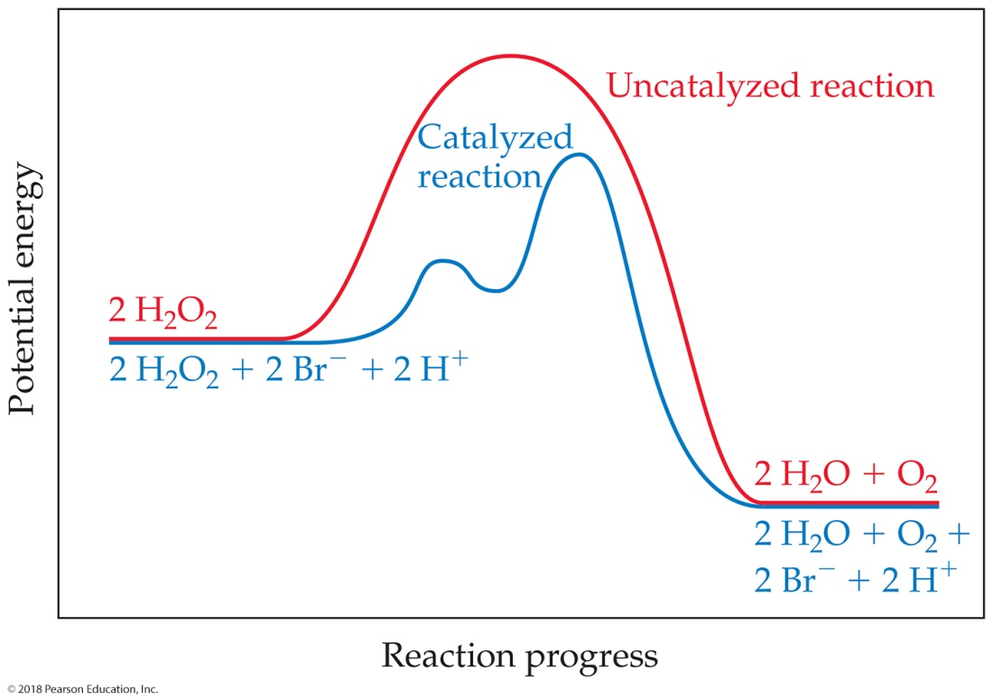
Catalysts
Catalysts increase the rate of a reaction by decreasing the activation energy of the reaction.
Catalysts change the mechanism by which the process occurs.

Slide 44
Catalysis
Since the catalyst is involved in the rate determining step, it often appears in the rate law.
rate = k[H₂O₂][I^{1–}]
rate-determining
step
H₂O₂(aq) + I^{1–}(aq)
H₂O(l) + IO^{1–}(aq)
H₂O₂(aq) + IO^{1–}(aq)
H₂O(l) + O₂(g) + I^{1–}(aq)
fast step
2H₂O₂(aq)
2H₂O(l) + O₂(g)
overall reaction

Slide 45
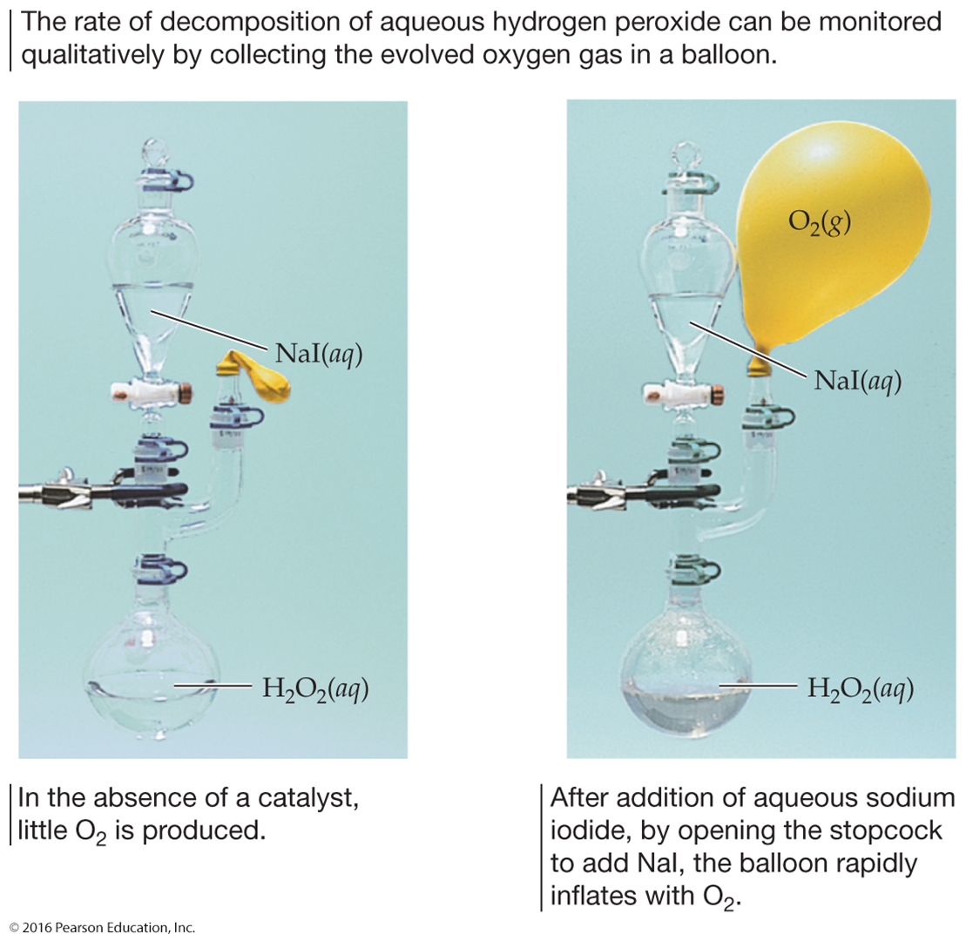
Catalysis
2H₂O₂(aq)
2H₂O(l) + O₂(g)

Slide 46
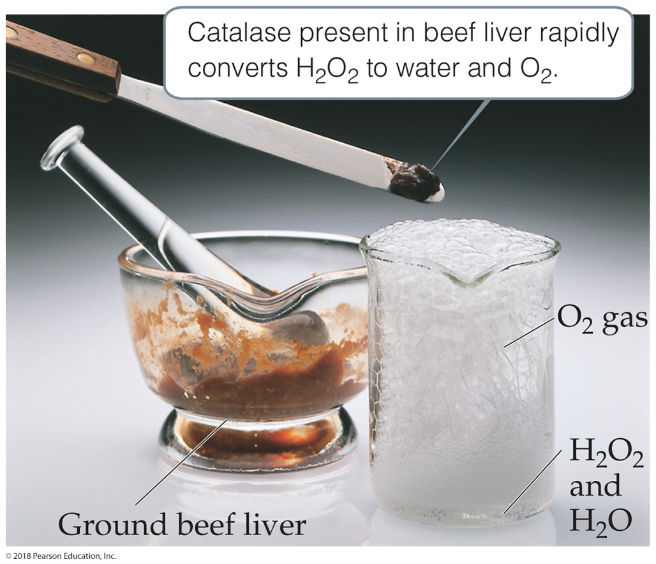
Enzymes
Enzymes are biological catalysts.
They have a region where the reactants attach. That region is called the active site. The reactants are referred to as substrates.

Slide 47
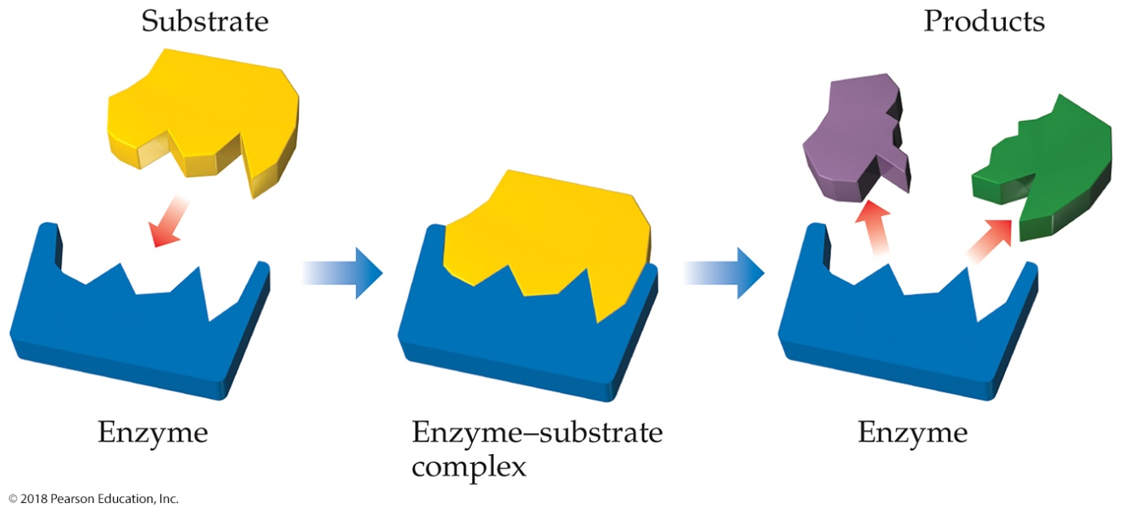
Lock-and-Key Model
In the enzyme–substrate model, the substrate fits into the active site of an enzyme, much like a key fits into a lock.
They are specific.

