Slide 1
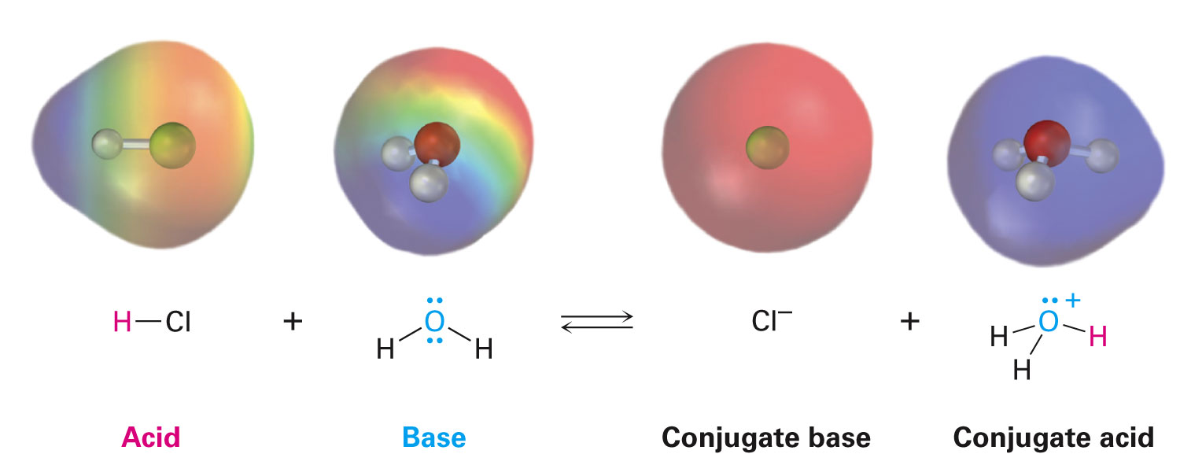
Acids and Bases: The Brønsted-Lowry Definition
Brønsted-Lowry acid: Substance that donates a hydrogen ion, H⁺
Brønsted-Lowry base: Substance that accepts a hydrogen ion, H⁺
Proton is a synonym for H⁺
Loss of valence electron from H leaves only the nucleus—a proton

Slide 2
Acids and Bases: The Brønsted-Lowry Definition
Conjugate base: Product that results from deprotonation of a Brønsted-Lowry acid
Conjugate acid: Product that results from protonation of a Brønsted-Lowry base
Notes:
Acids and bases: The Brønsted–Lowry definition

Slide 3
Equilibria in Solutions of Weak Acids
HA(aq) + H₂O(l)
H₃O⁺(aq) + A⁻(aq)
[H₃O⁺][A⁻]
Acid-Dissociation Constant:
K_{a} =
[HA]
K_{a} גדול יותר חומצה יותר חזקה
ככול שהחומצה חזקה יותר הבסיס המצומד חלש יותר
Acid strengths are normally expressed using pK_{a} values
pK_{a}: Negative common logarithm of the K_{a}
Stronger acids have smaller pK_{a}
Weaker acids have larger pK_{a}
pK_{a} גדול יותר חומצה יותר חלשה

Slide 4
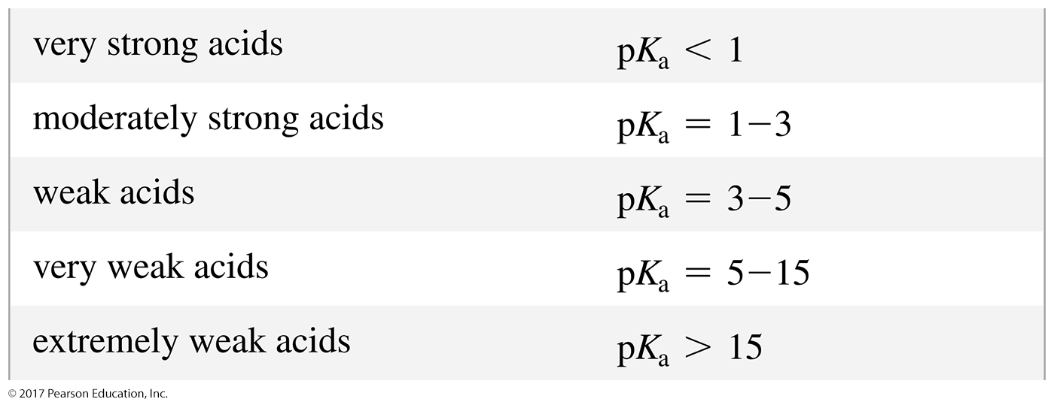
Acid Strength
The stronger the acid, the larger the K_{a}.
The stronger the acid, the smaller the pK_{a}.

Slide 5
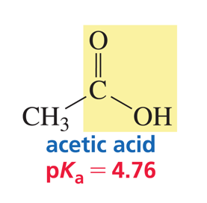
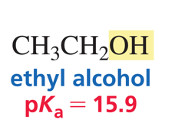
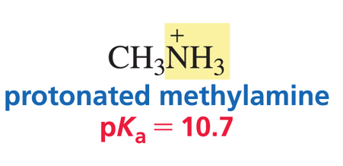
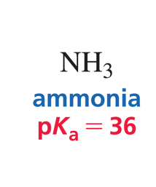
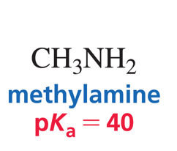
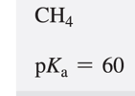
חומצות חזקות:
HCl (חומצת מלח) pK_{a}= -7
HBr ((pK_{a}= -9
HI ((pKa= -10
חומצה חנקתית (HNO₃, pKa= -1.3)
חומצה גופרתית (H₂SO₄, pKa= -5) למימן הראשון
HF חומצה חלשה
pKa=3.46
כוהל
חומצה קרבוקסילית
מתאן
אמין

Slide 6
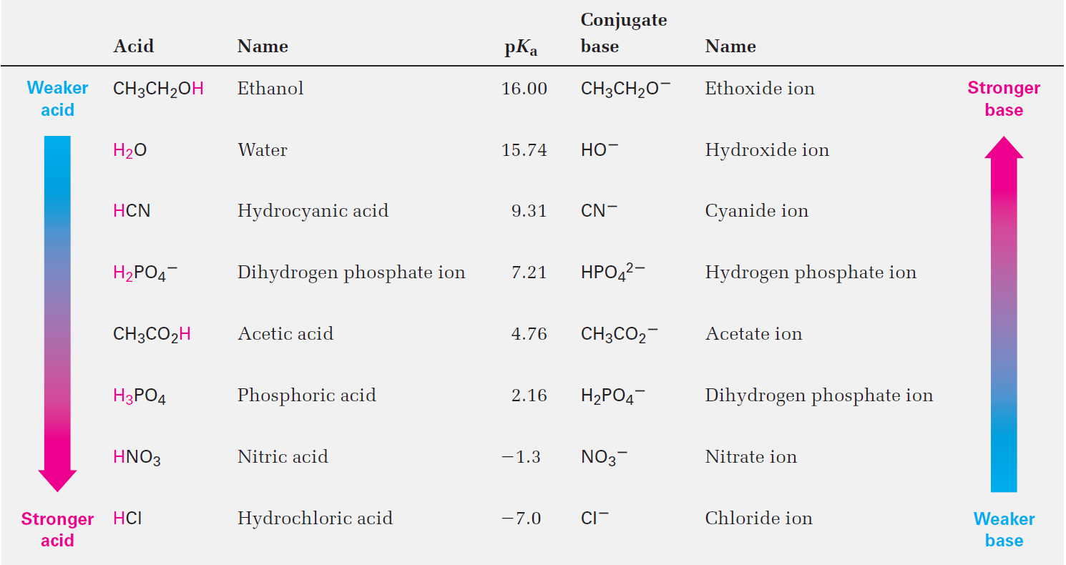
Table 2.3 - Relative Strengths of Some Common Acids and Their Conjugate Bases
Notes:
Acid and base strength

Slide 7
Which Reactant is the Acid?
The stronger acid behaves as the acid.
Water is the base.
Water is the acid.

Slide 8
The Position of Equilibrium
The equilibrium favors formation of the weaker acid.

Slide 9
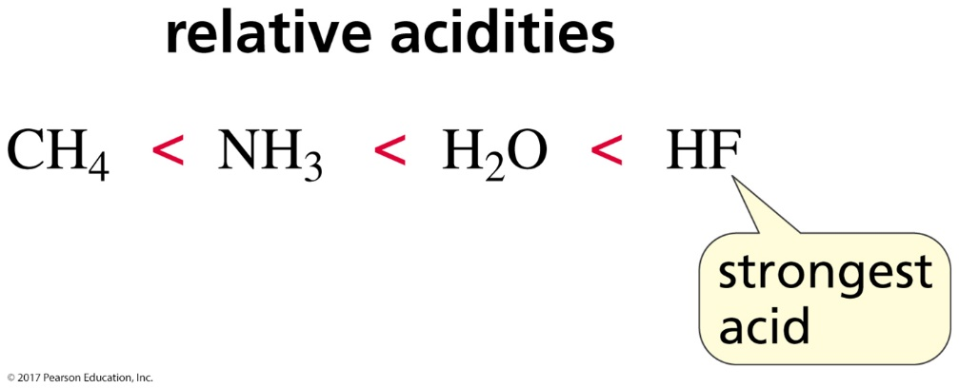
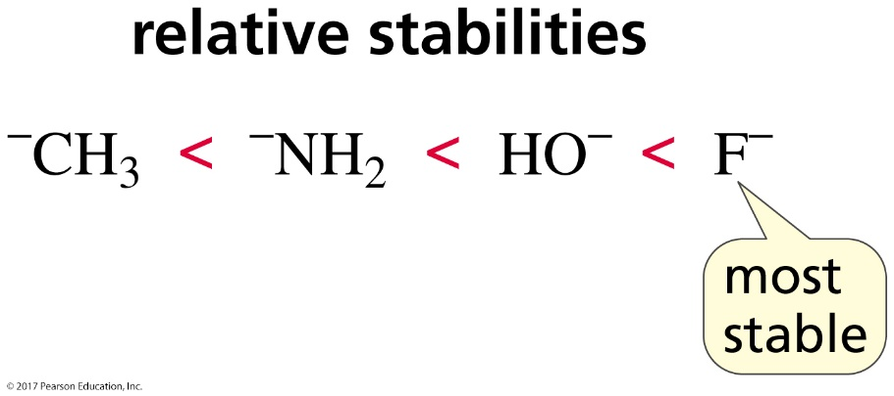
The Strength of an Acid is Determined by the Stability of Its Conjugate Base
The more stable the conjugate base, the stronger the acid.
Stable bases are weak bases.

Slide 10
Electronegativity Affects pK_{a} Values
When atoms are the same size,
the strongest acid has its hydrogen attached
to the most electronegative atom.

Slide 11
Why are Alcohols Stronger Acids
than Amines?
Oxygen is more electronegative than nitrogen.

Slide 12
Why are Protonated Alcohols Stronger Acids than Protonated Amines?
Oxygen is more electronegative than nitrogen.

Slide 13
Hybridization Affects Electronegativity
The strongest acid has the
most stable (weakest) conjugate base.

Slide 14
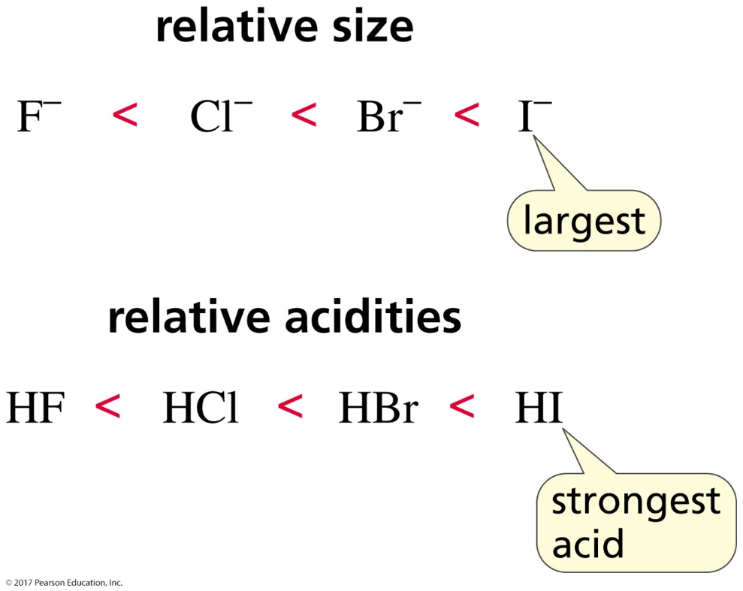
Size Affects pK_{a} Values
When atoms differ in size,
the strongest acid has its hydrogen bonded
to the largest atom.

Slide 15
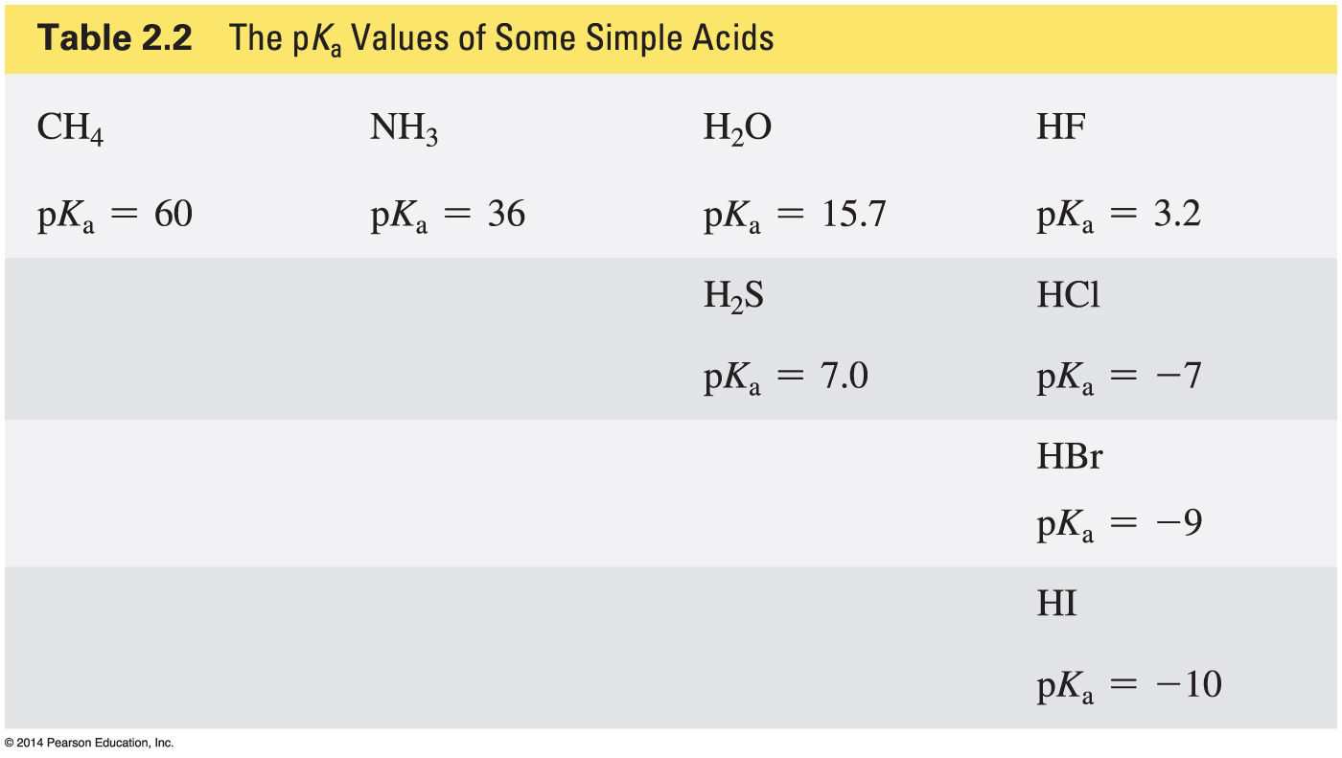
Some pK_{a} Values

Slide 16
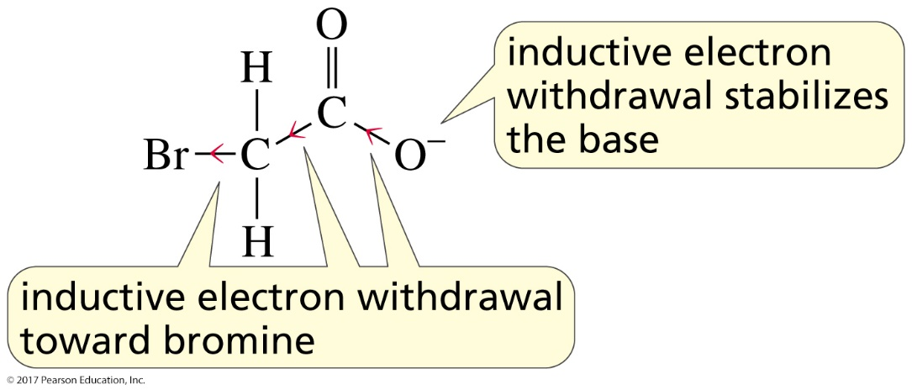
Substituents Affect the Strength of an Acid
inductive electron withdrawal

Slide 17
A Substituent’s Effect on pK_{a} Depends on Distance

Slide 18
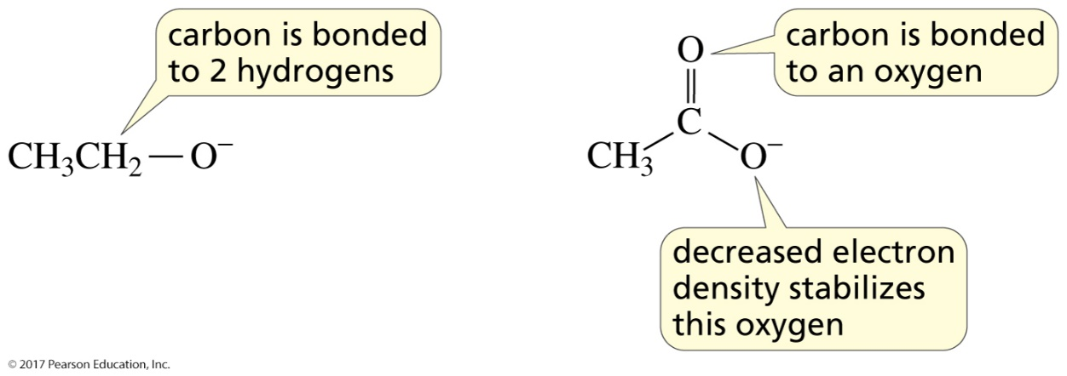
Why is a Carboxylic Acid a Stronger Acid than an Alcohol?
1. Inductive electron withdrawal

Slide 19
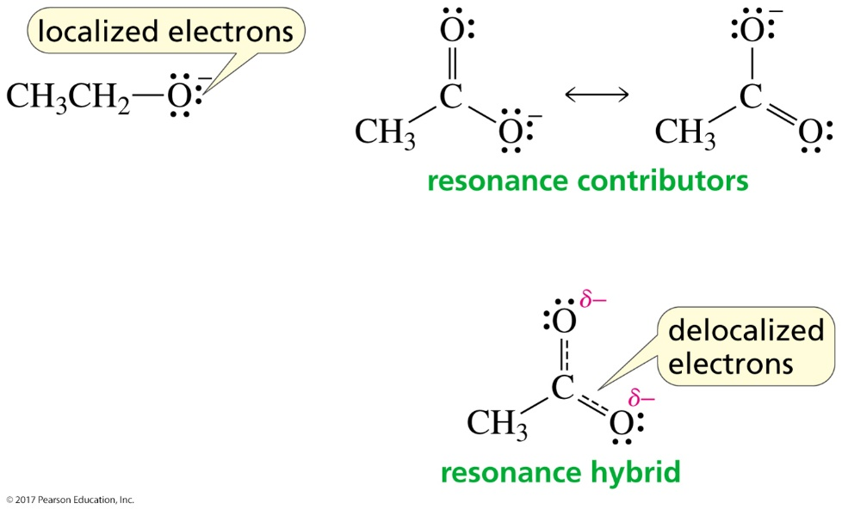
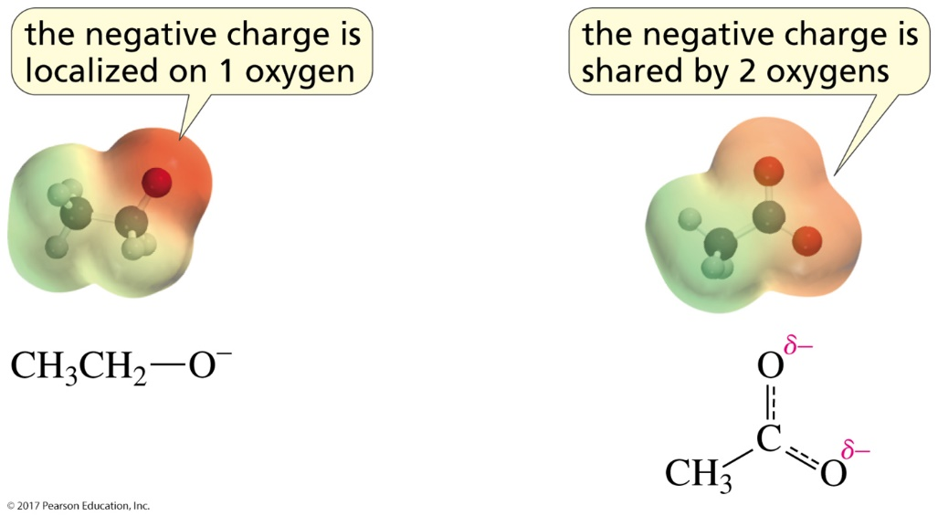
Why is a Carboxylic Acid a Stronger Acid than an Alcohol?
2. Delocalized electrons

Slide 20
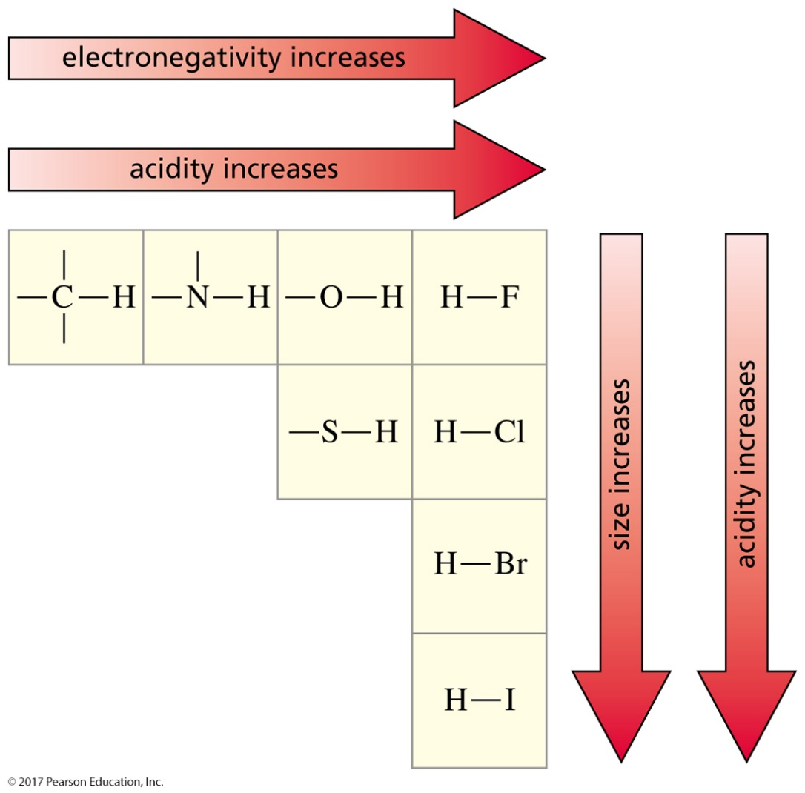
Summary of Factors
That Affect Acid Strength
electronegativity and size

Slide 21
Summary of Factors
That Affect Acid Strength
hybridization

Slide 22
Summary of Factors
That Affect Acid Strength
inductive electron withdrawal
CF₃CO₂H חומצה יותר חזקה מ- CFH₂CO₂H כי מכילה יותר F.

Slide 23
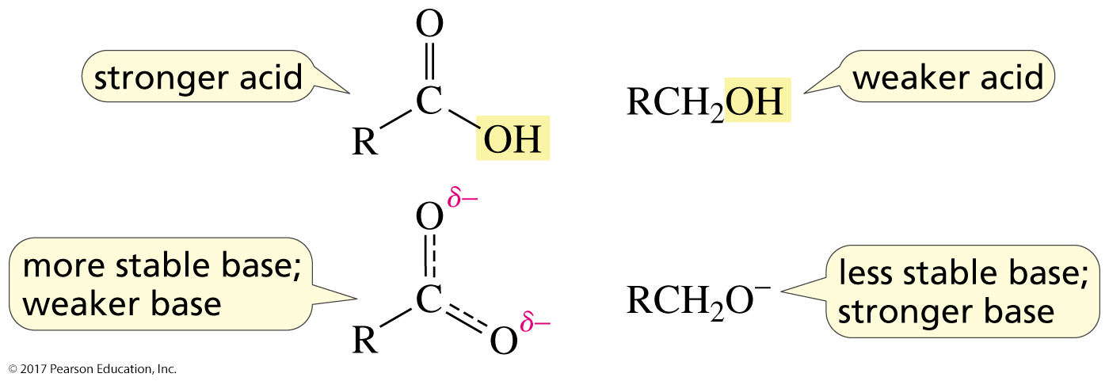
Summary of Factors
That Affect Acid Strength
electron delocalization

Slide 24
Calculating Equilibrium Concentrations of Weak Acids
Calculate the pH of a 0.10 M HCN solution. At 25 ºC, K_{a} = 4.9 × 10⁻¹⁰.
HCN(aq) + H₂O(l)
H₃O⁺(aq) + CN⁻(aq)
0.10 |  | ≈0 | 0
−x |  | +x | +x
0.10 − x |  | x | x
[H₃O⁺][CN⁻]
K_{a} =
[HCN]

Slide 25
Calculating Equilibrium Concentrations of Weak Acids
(x)(x)
x²
4.9 × 10⁻¹⁰ =
≈
(0.10 − x)
0.10
x = [H₃O⁺] = 7.0 × 10⁻⁶ M
pH =−log([H₃O⁺]) = −log(7.0 × 10⁻⁶) = 5.15
$$\frac{x}{0.1}x100\%≤5\%=\frac{7×{10}^{−6}}{0.1}×100\%=7×{10}^{−3}\%$$
הקירוב מוצדק

Slide 26
Equilibria in Solutions of Weak Bases
B(aq) + H₂O(l)
BH⁺(aq) + OH⁻(aq)
Base
Acid
Acid
Base
[BH⁺][OH⁻]
Base-Dissociation Constant:
K_{b} =
[B]
NH₃(aq) + H₂O(l)
NH₄⁺(aq) + OH⁻(aq)
[NH₄⁺][OH⁻]
K_{b} =
[NH₃]

Slide 27
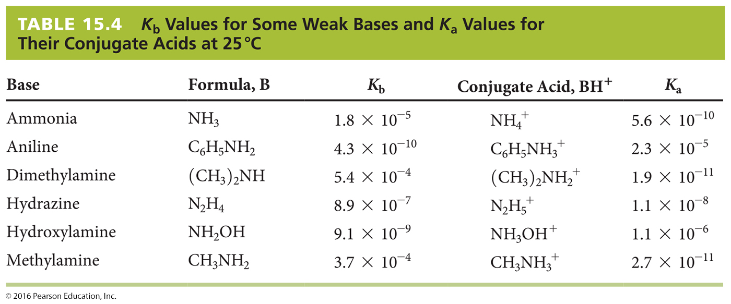
Equilibria in Solutions of Weak Bases
אמינים בסיסים חלשים

Slide 28
Equilibria in Solutions of Weak Bases
Calculate the pH of a 0.40 M NH₃ solution. At 25 ºC, K_{b} = 1.8 × 10⁻⁵.
NH₃(aq) + H₂O(l)
NH₄⁺(aq) + OH⁻(aq)
0.40 |  | 0 | ≈0
−x |  | +x | +x
0.40 − x |  | x | x
[NH₄⁺][OH⁻]
K_{b} =
[NH₃]

Slide 29
Equilibria in Solutions of Weak Bases
(x)(x)
x²
1.8 × 10⁻⁵ =
(0.40 − x)
≈
0.40
x = [OH⁻] = 0.0027 M
1.0 × 10⁻¹⁴
[H₃O⁺] =
= 3.7 × 10⁻¹² M
0.0027
pH =−log([H₃O⁺]) = −log(3.7 × 10⁻¹²) = 11.43

Slide 30
Relation Between K_{a} and K_{b}
NH₄⁺(aq) + H₂O(l)
H₃O⁺(aq) + NH₃(aq)
K_{a}
NH₃(aq) + H₂O(l)
NH₄⁺(aq) + OH⁻(aq)
K_{b}
2 H₂O(l)
H₃O⁺(aq) + OH⁻(aq)
K_{w}
[H₃O⁺][NH₃]
[NH₄⁺][OH⁻]
K_{a} × K_{b} =
×
= [H₃O⁺][OH⁻] = K_{w}
[NH₄⁺]
[NH₃]
= (5.6 × 10⁻¹⁰)(1.8 × 10⁻⁵) = 1.0 × 10⁻¹⁴
מתקיים: K_{a} x K_{b} = 10⁻¹⁴

Slide 31
Relation Between K_{a} and K_{b}
K_{a} × K_{b} = K_{w}=10⁻¹⁴
conjugate acid-base pair
K_{w}
K_{w}
K_{a} =
K_{b} =
K_{b}
K_{a}
pK_{a} + pK_{b} = pK_{w} = 14.00

Slide 32
Acid–Base Properties of Salts
Salts That Yield Acidic Solutions
Salts such as NH₄Cl that are derived from a weak base (NH₃) and a strong acid (HCl) yield acidic solutions.
NH₄⁺(aq) + H₂O(l)
H₃O⁺(aq) + NH₃(aq)
Ammonium ion (NH₄⁺) is the conjugate acid of the weak base ammonia (NH₃) while chloride ion (Cl⁻) is neither acidic nor basic.

Slide 33
Acid–Base Properties of Salts
Salts That Yield Basic Solutions
Salts such as NaCN that are derived from a strong base (NaOH) and a weak acid (HCN) yield basic solutions.
CN⁻(aq) + H₂O(l)
HCN(aq) + OH⁻(aq)
Cyanide ion (CN⁻) is the conjugate base of the weak acid hydrocyanic acid (HCN) while sodium ion (Na⁺) is neither acidic nor basic.
מלחים בסיסיים
NaAc

Slide 34
pH of a Salt Solution
What is the pH of a 1.50 M Na₂CO₃(aq)? K_{b} = 2.1 x 10⁻⁴
CO₃²⁻(aq) + H₂O(ℓ) HCO₃⁻(aq) + OH⁻(aq)
[ ]_{initial} 1.50 0 0
[ ]_{change} - x +x +x
[ ]_{equil} 1.50 - x x x
[HCO₃⁻][OH⁻]
[CO₃²⁻]
x²
(1.50 – x)
x²
1.50
K_{b} = 2.1 x 10⁻⁴ = = ≈
x = 1.77 x 10⁻² pOH = −log(1.77 x 10⁻²) = 1.75
pH = 14.00 - 1.75 = 12.25

Slide 35
pH of a Salt Solution
0.132 M NH₄Br? Acidic, basic or neutral? K_{a}(NH₄⁺) = 5.6 x 10⁻¹⁰.
NH₄⁺(aq) + H₂O(ℓ) NH₃(aq) + H₃O⁺(aq)
[ ]_{initial} 0.132 0 0
[ ]_{change} - x +x +x
[ ]_{equil} 0.132 - x x x
[NH₃][H₃O⁺]
[NH₄⁺]
x²
(0.132 – x)
x²
0.132
K_{a} = 5.6 x 10⁻¹⁰ = = ≈
x = 8.57 x 10⁻⁶ pH = −log(8.57 x 10⁻⁶) = 5.07
Acidic!

Slide 36
The Henderson–Hasselbalch equation
For a weak acid: K_{a} = [H⁺][A–]/[HA]
Take –log of both sides:
–log K_{a} = –log[H⁺] + –log([A–]/[HA])
Rearrange:
–log[H⁺] = –log K_{a} +log([A–]/[HA])
Which is:
pH = pK_{a} + log([A–]/[HA])
[BH⁺]
[B]
pOH = pK_{b} + log
B: weak base

Slide 37
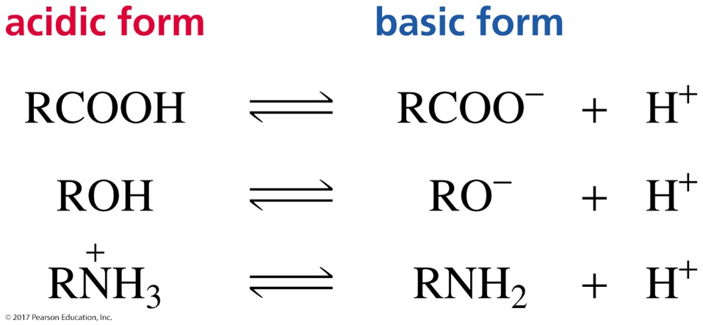
The Henderson–Hasselbalch Equation
The Henderson–Hasselbalch equation tells us
whether (at a given pH) a compound will be
in its acidic form (with its proton) or
in its basic form (without its proton).

Slide 38
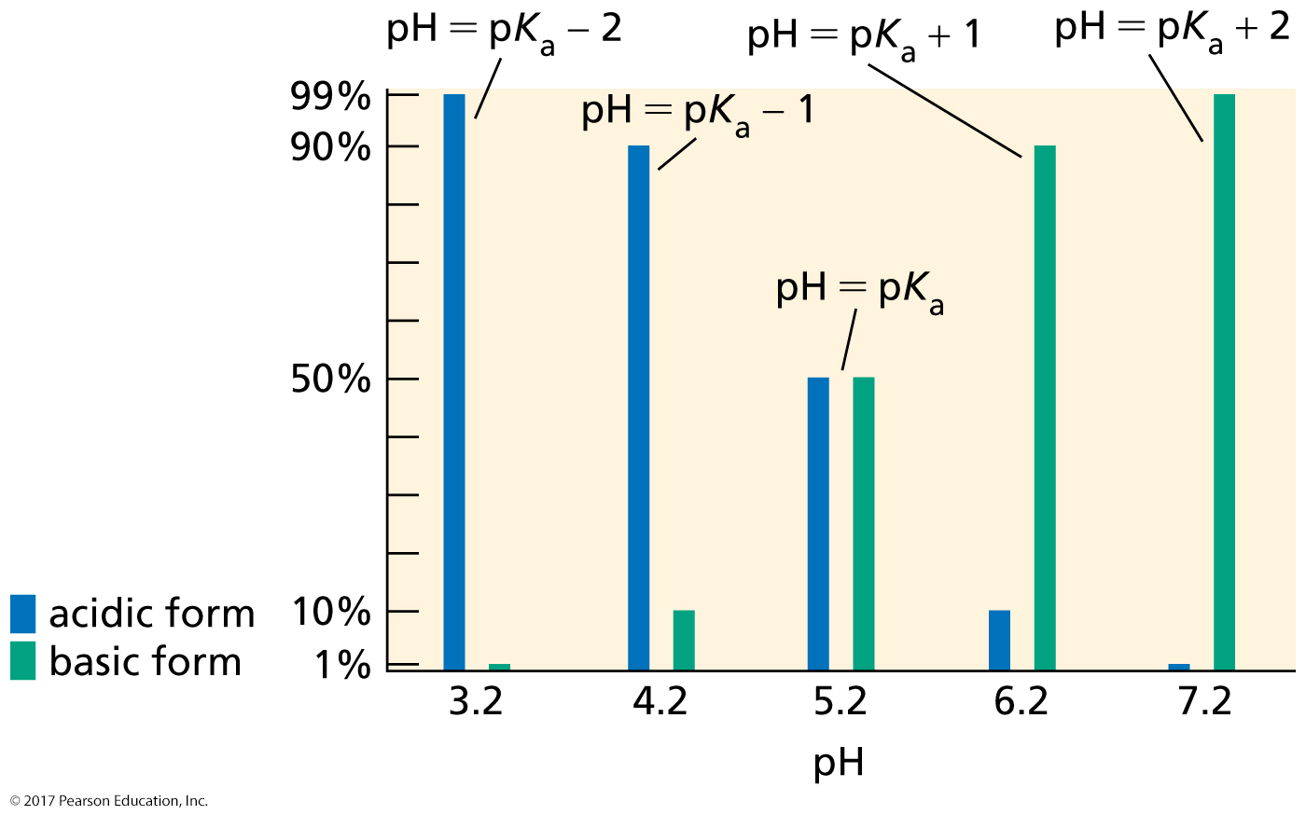
A Compound with a pK_{a} = 5.2

Slide 39
Is a Compound Neutral or Charged?
A carboxylic acid is
neutral in its acidic form and charged in its basic form.
An alcohol is
neutral in its acidic form and charged in its basic form.
An amine is
charged in its acidic form and neutral in its basic form.

Slide 40
Buffer Solutions
Buffer Solution: A solution that contains a weak acid and its conjugate base and resists drastic changes in pH
Weak acid
+
Conjugate base
CH₃CO₂H + CH₃CO₂–
HF + F–
NH₄⁺ + NH₃
H₂PO₄– + HPO₄^{2–}
For
example:
Buffers are made with ~equal quantities of a conjugate acid-base pair.
(e.g. CH₃COOH + CH₃COONa)

Slide 41
Buffer Solutions
Buffer = chemical system that resists changes in pH.
Example
Add 0.010 mol of HCl or NaOH to:
1 L of solution | pH Initial after HCl after NaOH
Pure water | 7.00 | 2.00 | 12.00
[CH₃COOH] = 0.5 M + [CH₃COONa] = 0.5 M | 4.74 | 4.72 | 4.76
A buffered solution

Slide 42
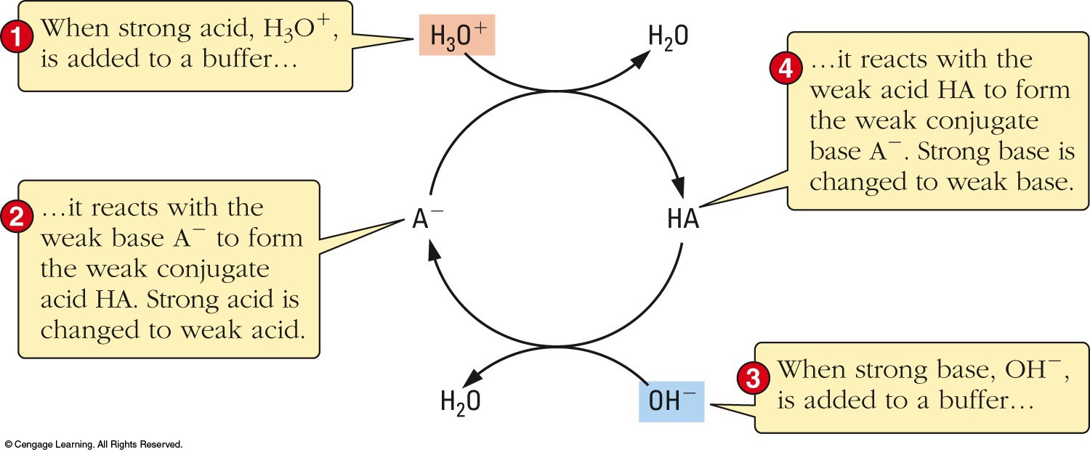
Buffer Action
Added OH⁻ removed by the acid:
CH₃COOH + OH⁻ CH₃COO⁻ + H₂O
Added H₃O⁺ removed by the conjugate base:
CH₃COO⁻ + H₃O⁺ CH₃COOH + H₂O

Slide 43
The pH of Buffer Solutions
What is the pH of a 0.050 M (monoprotic) pyruvic acid + 0.060 M sodium pyruvate buffer? K_{a} = 3.2 x 10⁻³.
pH = – log(3.2 x 10⁻³) + log(0.060/0.050)
= 2.49 + 0.08
= 2.57
What is the HPO₄²⁻/H₂PO₄⁻ ratio in blood at pH =7.40. K_{a}(H₂PO₄⁻ ) = K_{a,2}(H₃PO₄) = 6.2 x 10⁻⁸.
7.40 = −log(6.2 x 10⁻⁸) + log([HPO₄²⁻]/[H₂PO₄⁻])
log([HPO₄²⁻]/[H₂PO₄⁻]) = 0.192
[HPO₄²⁻]/[H₂PO₄⁻] = 1.5

Slide 44
Addition of Acid or Base to a Buffer
1.0 L of buffer is prepared with [NaH₂PO₄] = 0.40 M and [Na₂HPO₄] = 0.25 M. Calculate the pH of: (a) the buffer (b) after 0.10 mol of NaOH is added.
K_{a} (H₂PO₄⁻) = 6.3 x 10⁻⁸
pK_{a} = -log(6.3 x 10⁻⁸) = 7.20
(a) No base added:
[A⁻]
[HA]
pH = pK_{a} + log
0.25
0.40
pH = 7.20 + log = 7.00

Slide 45
Addition of Acid or Base to a Buffer
1.00 L Buffer: [NaH₂PO₄]= 0.40 M ; [Na₂HPO₄] = 0.25 M. (b) calculate pH after 0.10 mol of NaOH is added. K_{a} (H₂PO₄⁻) = 6.3 x 10⁻⁸
(b) 0.10 mol of NaOH, converts conj. acid to base:
H₂PO₄⁻ + OH⁻ → HPO₄²⁻ + H₂O
n_{initial} 0.40 0.25
n_{added} 0.10
n_{after} (0.40 – 0.10) 0 (0.25 + 0.10)
[A⁻]
[HA]
Use n directly. [ ] = n/ V and V is the same for both (cancels)
pH = pK_{a} + log
0.35
0.30
pH = 7.20 + log = 7.27

Slide 46
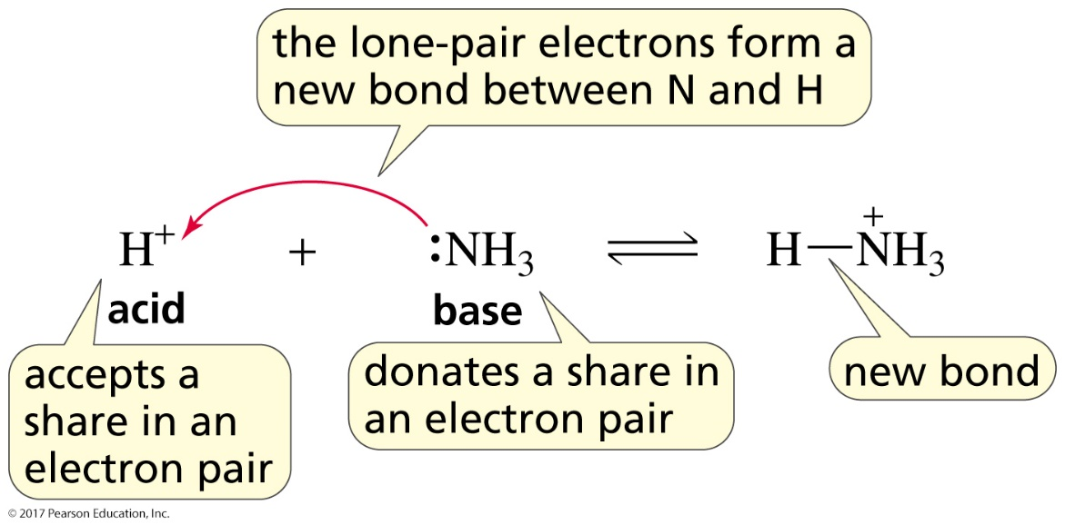
Lewis Acids and Bases
Lewis acid: a species that accepts a share in an electron pair
Lewis base: a species that donates a share in an electron pair
All Brønsted acids are Lewis acids.
All Brønsted bases are Lewis bases.

Slide 47
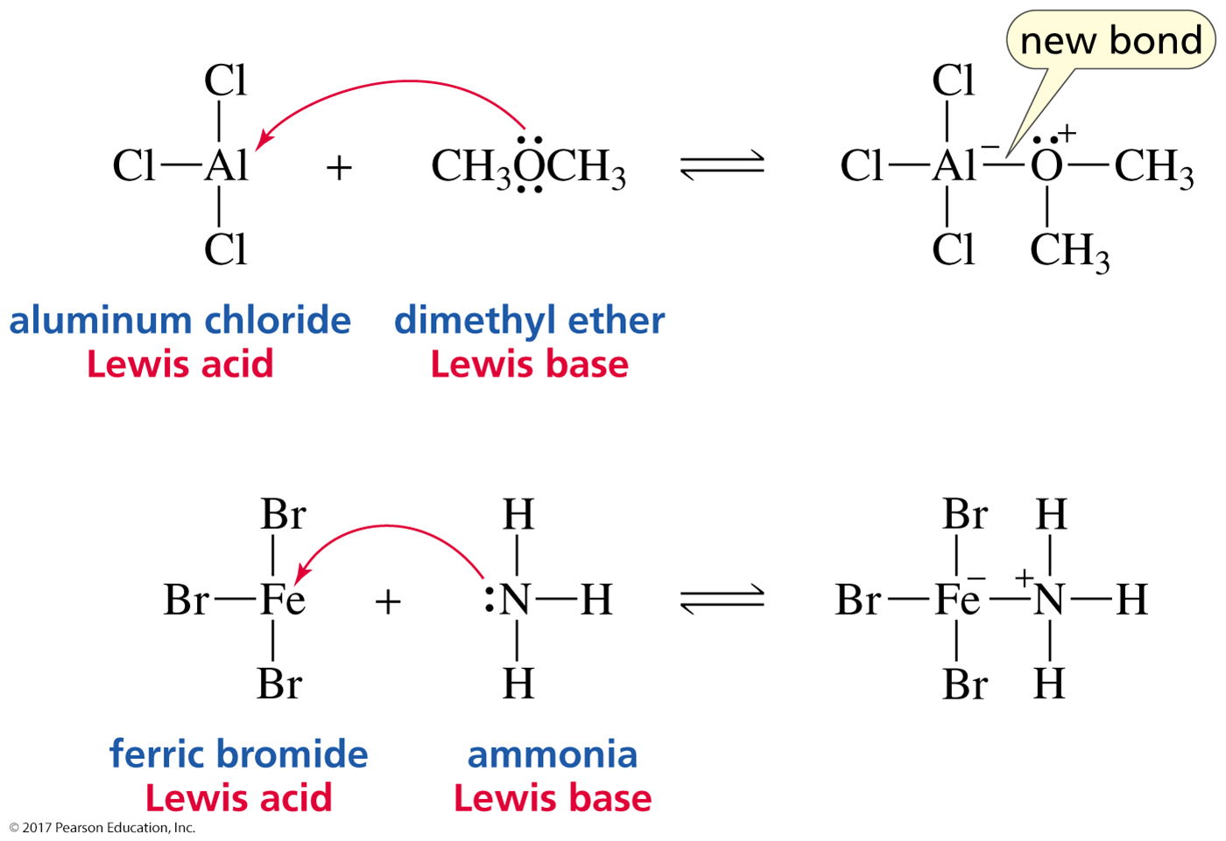
Lewis Acids and Bases

Slide 48
How Chemists Use the Terms
“acid” = a proton-donating acid
“Lewis acid” = a non-proton-donating acid
All bases are Lewis bases
because they have a pair of electrons they can share.

