Slide 1
Chemical Equilibrium
Chemical reactions often seem to stop before they are complete.
Actually, such reactions are reversible. That is, the original reactants form products, but then the products react with themselves to give back the original reactants.
When these two reactions—forward and reverse—occur at the same rate, a chemical equilibrium exists.

Slide 2
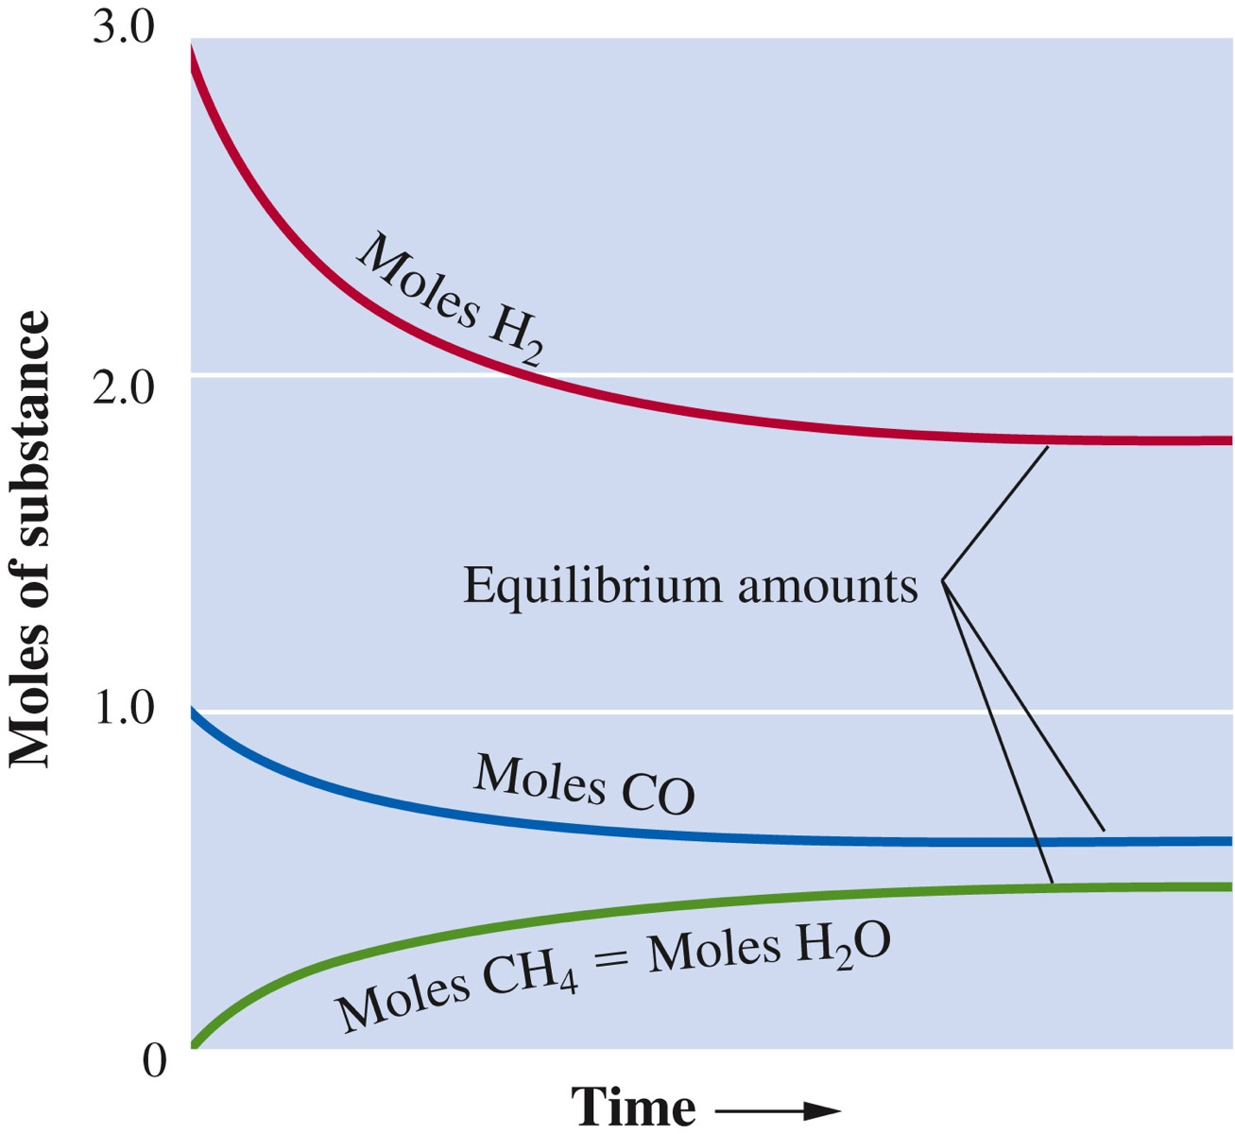
Chemical Equilibrium
CO(g) + 3H₂(g)  CH₄(g) + H₂O(g)
The graph shows how the amounts of reactants and products change as the reaction approaches equilibrium.

Slide 3
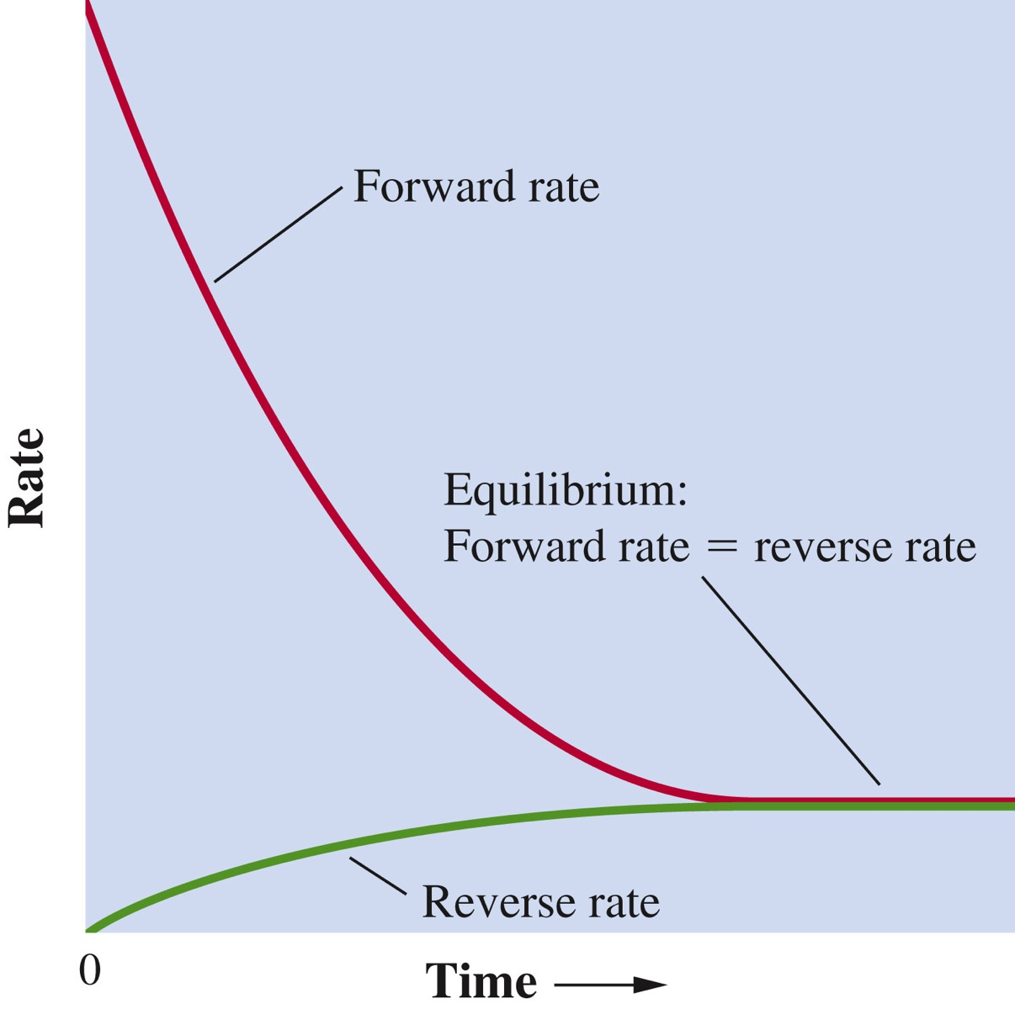
Chemical Equilibrium
CO(g) + 3H₂(g)  CH₄(g) + H₂O(g)
This graph shows how the rates of the forward reaction and the reverse reaction change as the reaction approaches equilibrium.

Slide 4
Chemical equilibrium is the state reached by a reaction mixture when the rates of the forward and reverse reactions have become equal.
Continuous forward and reverse reactions make the equilibrium a dynamic process.

Slide 5
Applying Stoichiometry to an Equilibrium Mixture
Carbon monoxide and hydrogen react according to the following equation:
CO(g) + 3H₂(g)  CH₄(g) + H₂O(g)
When 1.000 mol CO and 3.000 mol H₂ are placed in a 10.00-L vessel at 927◦ C (1200K) and allowed to come to equilibrium, the mixture is found to contain 0.387 mol H₂O. What is the molar composition of the equilibrium mixture? That is, how many moles of each substance are present?

Slide 6
Applying Stoichiometry to an Equilibrium Mixture
Using the information given in the problem, set up the following table:
The problem statement gives the equilibrium amount of H₂O. That means x = 0.387. Using this amount, calculate the amounts of the other substances.

Slide 7
Applying Stoichiometry to an Equilibrium Mixture
Therefore, the amounts of substances in the equilibrium mixture are 0.613 mol CO, 1.839 mol H₂, 0.387 mol CH₄, and 0.387 mol H₂O.

Slide 8
The Equilibrium Constant, K_{c}
Equilibrium constant expression: Obtained by multiplying the concentrations of products, divided by the concentrations of reactants, and raising each concentration term to a power equal to its coefficient in the balanced chemical equation.
Equilibrium constant, K_{c}: Value obtained for the K_{c} expression when equilibrium concentrations are substituted.

Slide 9
The Equilibrium Constant, K_{c}
For the reaction , the equilibrium constant expression is as follows:
Values of the equilibrium constant expression K_{c} are constant for a specific reaction at a given temperature, whatever equilibrium concentrations are substituted.
aA + bB  cC + dD

Slide 10
The Equilibrium Constant, K_{c}
Write the equilibrium-constant expression K_{c} for catalytic methanation.
CO(g) + 3H₂(g)  CH₄(g) + H₂O(g)
Solution
The expression for the equilibrium constant is:

Slide 11
Obtain an equilibrium constant from reaction composition
Hydrogen iodide, HI, decomposes at moderate temperatures according to the equation.
2HI(g)  H₂(g) + I₂(g)
When 4.00 mol HI was placed in a 5.00-L vessel at 458^{ₒ}C, the equilibrium mixture was found to contain 0.442 mol I₂. What is the value of K_{c} for the decomposition of HI at this temperature?

Slide 12
Solution
To obtain the concentrations of HI and I₂, divide the molar amounts by the volume of the reaction vessel (5.00L).

Slide 13
Solution
From these values, set up the following table:
Concentration (M)
2HI(g)
H₂(g) +
I₂(g)
Starting
0.800
0
0
Change
–2x
+x
+x
Equilibrium
0.800 – 2x
x
x=0.0884
0.623 M
0.0884 M
0.0884 M

Slide 14
Solution
Now substitute into the equilibrium-constant expression for the reaction.
Substituting yields

Slide 15
The Equilibrium Constant K_{p}
For the reaction
aA(g) + bB(g)  cC(g) + dD(g)
The equilibrium constant expressions are
K_{c} = and K_{p} =
The equilibrium constant K_{p} is the expression of an equilibrium constant for a gaseous reaction in terms of partial pressures.

Slide 16
Homogenous equilibrium involves reactants and products in a single phase.
Heterogeneous equilibrium involves reactants and products in more than one phase.
Concentrations of solids and pure liquids are constant.
Equilibrium is not affected by solids and pure liquids as long as some of each is present.
Write the K_{c} expression by replacing the concentration of a solid or pure liquid with 1.

Slide 17
The Equilibrium Constant
Examples
[NO]²
[N₂] [O₂]
N₂(g) + O₂(g) 2 NO(g)
K_{c} =
[SO₂]
[O₂]
1
S₈(s) + O₂(g) SO₂(g)
K_{c} =
8
S₈ is ignored. All pure solids are omitted from K_{c}.

Slide 18
Equilibria Involving Pure Liquids & Solids
[Solid] is constant throughout a reaction.
density
mol. wt
g / L
g / mol
pure solid concentration =
[S₈] = d_{S8} / mol. wt S₈
d and mol. wt. are constants, so [S₈] is constant.
This constant factor is “absorbed” into K_{c}.
Pure liquids are omitted for the same reason.

Slide 19
Equilibria in Dilute Solutions
Water is omitted from K_{c} in dilute solution reactions:
It is in large excess (pure water = 55.5 M).
Even if consumed or produced, [H₂O] ≈ constant.
The constant factor is incorporated into K_{c}.
NH₃(aq) + H₂O(ℓ) NH₄⁺(aq) + OH⁻(aq)
[NH₄⁺][OH⁻]
[NH₃]
K_{c} =
= 1.8 x 10⁻⁵ (at 25°C)
(Units are customarily omitted from K_{c})

Slide 20
Meaning of the Equilibrium Constant
When:
K_{c} >> 1 Reaction is strongly product favored.
very little reactant remains.
often written as a forward reaction only.
assume reaction goes to completion.
K_{c} << 1 Reaction is strongly reactant favored.
very little product forms.
usually written as “no reaction” or NR.
K_{c} ≈ 1 Reactants & products present at equilibrium.
use equilibrium methods discussed here.

Slide 21
Predicting the Direction of a Reaction
The reaction quotient, Q can predict the direction of a reaction:
For the reaction: aA + bB cC + dD
[C]^{c} [D]^{d}
[A]ª [B]^{b}
Q =
Q looks identical to K_{c}, BUT… the concentrations are not equilibrium values.
(K_{c} = Q whenever a system is at equilibrium)

Slide 22
Predicting the Direction of a Reaction
[Products]
[Reactants]
[Products]_{equilib}
[Reactants]_{equilib}
Q =
K_{c}=
Changes as a reaction moves to equilibrium
Constant!
(If T is constant)
If Q < K_{c}, Q must increase to reach equilibrium.
make more product (and less reactant).
move forward.
If Q > K_{c}, Q must decrease to reach equilibrium.
make less product (and more reactant).
move back.

Slide 23
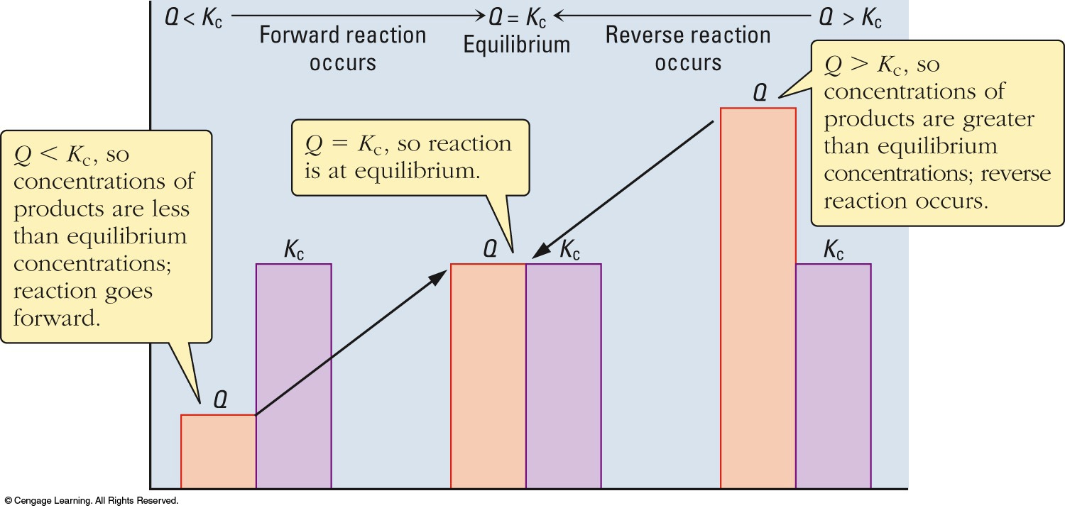
Predicting the Direction of a Reaction

Slide 24
Predicting the Direction of a Reaction
2 SO₂(g) + O₂(g) 2 SO₃(g) K_{c} = 245 at 1000 K
Predict the direction of the reaction if SO₂ (0.085 M), O₂ (0.100 M) and SO₃ (0.250 M) are mixed in a reactor at 1000 K.
[ SO₃]²
[SO₂]²[O₂]
(0.250)²
(0.085)²(0.100)
Q =
=
= 86.5
Q < K_{c}, Q must increase to reach equilibrium.
Need more product (less reactant).
Forward direction.

Slide 25
Calculating Equilibrium Concentrations
When all but one equilibrium concentration and the value of K_{c} are known.
2. When the value of K_{c} and the initial concentrations are known.
When the K_{c} expression is a perfect square: solving a linear equation.
When the K_{c} expression is not a perfect square: solving a quadratic equation.

Slide 26
Obtaining One Equilibrium Concentration Given the Others
A gaseous mixture contains 0.30 mol CO, 0.10 mol H₂, and 0.020 mol H₂O, plus an unknown amount of CH₄, in each liter. This mixture is at equilibrium at 1200K.
CO(g) + 3H₂(g)  CH₄(g) + H₂O(g)
What is the concentration of CH₄ in this mixture? The equilibrium constant K_{c} equals 3.92.

Slide 27
Solution
The equilibrium-constant equation is
Substituting the known concentrations and the value of K_{c},
[CH₄] = 0.059 mol/L

Slide 28
Solving an Equilibrium Problem ( Involving a Linear Equation in X)
The following reaction is used to increase the ratio of hydrogen in synthesis gas (mixtures of CO and H₂).
CO(g) + H₂O(g)  CO₂(g) +H₂(g)
If you start with 1.00 mol each of carbon monoxide and water in a 50.0-L vessel, how many moles of each substance are in the equilibrium mixture at 1000^{ₒ}C?
K_{c} at this temperature is 0.58.

Slide 29
Solution
Step 1
The starting concentrations of CO and H₂O are
The starting concentrations of the products CO₂ and H₂ are 0. The change in concentration when the mixture goes to equilibrium are not given.
They can be written in terms of a single unknown.

Slide 30
Solution
Let x be the moles of CO₂ formed per liter. The moles of H₂ formed per liter is also x.
Similarly x moles of each CO and H₂O are consumed. The changes for these can be written as – x.
The equilibrium concentrations can be obtained by adding the change in concentration to the starting concentrations.

Slide 31
Solution
Concentration (M)
CO(g)+
H₂O(g)
CO₂(g)
H₂(g)
Starting
0.0200
0.0200
0
0
Change
– x
– x
+ x
+ x
Equilibrium
0.0200 – x
0.0200–x
x
x

Slide 32
Solution
Step 2
Substitute the values for the equilibrium concentrations into the equilibrium-constant equation:

Slide 33
Solution
Step 3
The right hand side is a perfect square. Taking the square root of both sides:
Rearranging the equation gives

Slide 34
Solution
The negative values can be dismissed as they are physically impossible.
Substituting the value of x in the last line of the table, equilibrium concentrations are:
CO = H₂O = 0.0114 M
CO₂ = H₂ = 0.0086 M
The equilibrium composition for the reaction mixture is:
CO = H₂O = 0.570 mol
CO₂ = H₂ = 0.43 mol

Slide 35
Solving an Equilibrium Problem ( Involving a Quadratic Equation in X)
When the K_{c} expression is not a perfect square, the equation must be rearranged to fit the quadratic format:
The solution is

Slide 36
Solving an Equilibrium Problem ( Involving a Quadratic Equation in X)
Hydrogen and iodine react according to the equation:
H₂(g) + I₂(g)  2HI(g)
Suppose 1.00 mol H₂ and 2.00 mol I₂ are placed in a 1.00-L vessel. How many moles of each substance are in the gaseous mixture when it comes to equilibrium at 458^{ₒ}C?
K_{c} at this temperature is 49.7.

Slide 37
Solution
Step 1
The concentrations of substances are as follows:
Concentration (M)
H₂(g) +
I₂(g) +
2HI(g)
Starting
1.00
2.00
0
Change
– x
– x
+ 2x
Equilibrium
1.00–x
2.00–x
2x

Slide 38
Solution
Step 2
Substituting into the equilibrium constant equation:
Or

Slide 39
Solution
Step 3
Since the right-hand side is not a perfect square, use the quadratic formula to solve x. The equation is rearranged to give:
Hence,
x = 2.33 and x = 0.93

Slide 40
Solution
Since x = 2.33 gives a negative value to 1.00 – x, use x = 0.93 while substituting.
Equilibrium composition of the substances are as follows:
H₂ = 0.07 mol (1.00 – 0.93)
I₂ = 1.07 mol (2.00 – 0.93)
HI = 1.86 mol (2x)

Slide 41
Le Châtelier’s Principle
עקרון לה שטלייה
If a change is imposed on a system at equilibrium, the position of the equilibrium will shift in a direction that tends to reduce that change.
When more reactant is added to, or some product is removed from, an equilibrium mixture, net reaction occurs left to right (forward direction) to give new equilibrium and produce more products.
When more product is added to, or some reactant is removed from, an equilibrium mixture, net reaction occurs from right to left (reverse direction) to give new equilibrium and produce more reactants.

Slide 42
Applying Le Châtelier’s Principle When a Concentration Is Altered
Predict the direction of reaction when H₂ is removed from a mixture (lowering its concentration) in which the following equilibrium has been established:
H₂(g) + I₂(g)  2HI(g)
Solution
When H₂ is removed, the reaction goes in reverse direction to partially restore the removed substance.

Slide 43
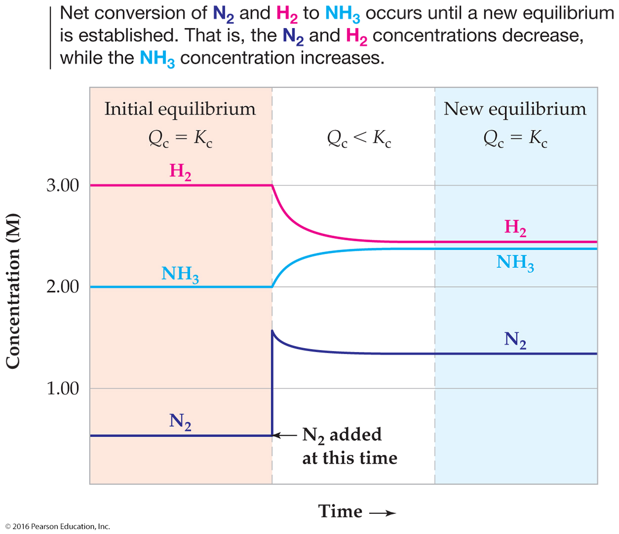
Altering an Equilibrium Mixture: Changes in Concentration
N₂(g) + 3 H₂(g)
2 NH₃(g)

Slide 44
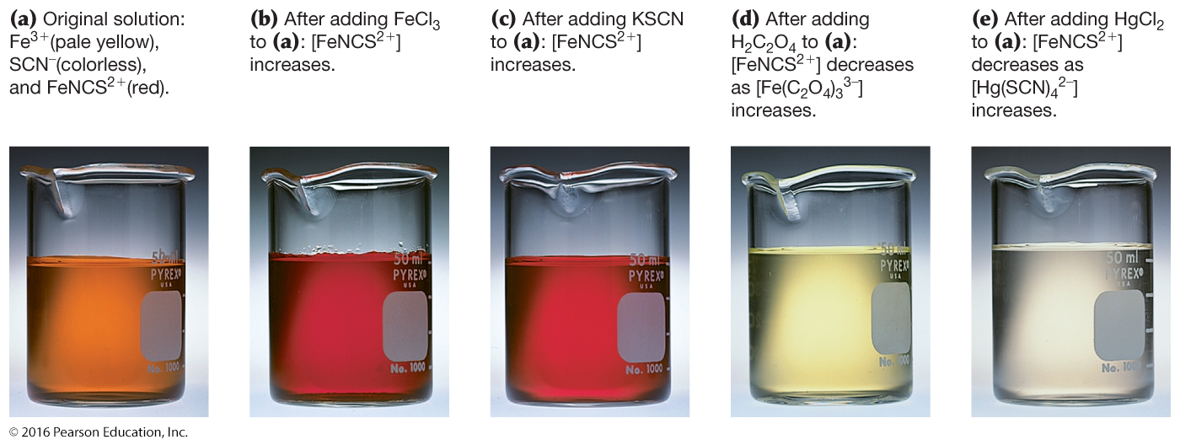
Altering an Equilibrium Mixture: Changes in Concentration
Fe³⁺(aq) + SCN⁻(aq)
FeNCS²⁺(aq)
Pale yellow
Colorless
Red
תמיסה מקורית
הוספת Fe³⁺
הוספת SCN⁻
הוספת חומר אשר מגיב עם Fe³⁺
הוספת חומר אשר מגיב עם SCN⁻

