Slide 1
The Quantum Mechanical Model of the Atom
In 1926, Erwin Schrödinger proposed the quantum mechanical model of the atom, which focuses on the wavelike properties of the electron.
In 1927, Werner Heisenberg stated that it is impossible to know precisely where an electron is and what path it follows—a statement called the Heisenberg uncertainty principle.

Slide 2

The Quantum Mechanical Model of the Atom
Solve
Probability of finding
electron in a region
of space (Ψ ²)
Wave
equation
Wave function
or orbital (Ψ )
Quantum mechanics allows us to make statistical statements about the regions in which we are most likely to find the electron.
Solving Schrödinger’s equation gives us a wave function, represented by the Greek letter psi, ψ, which gives information about a particle in a given energy level.
Psi-squared, ψ ², gives us the probability of finding the particle within a region of space.

Slide 3
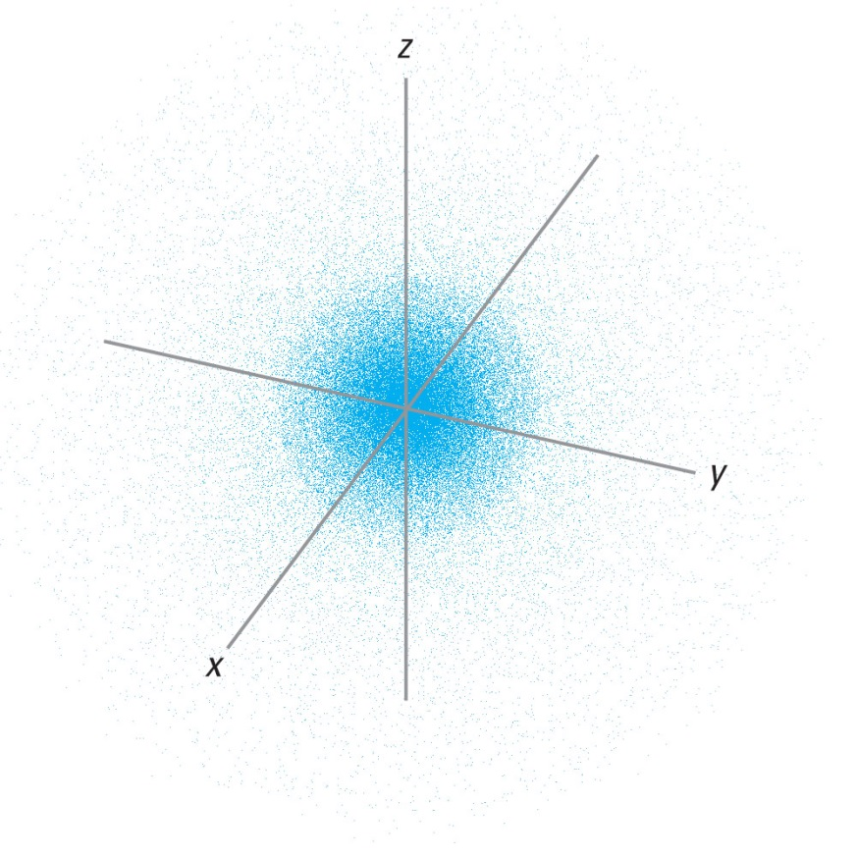
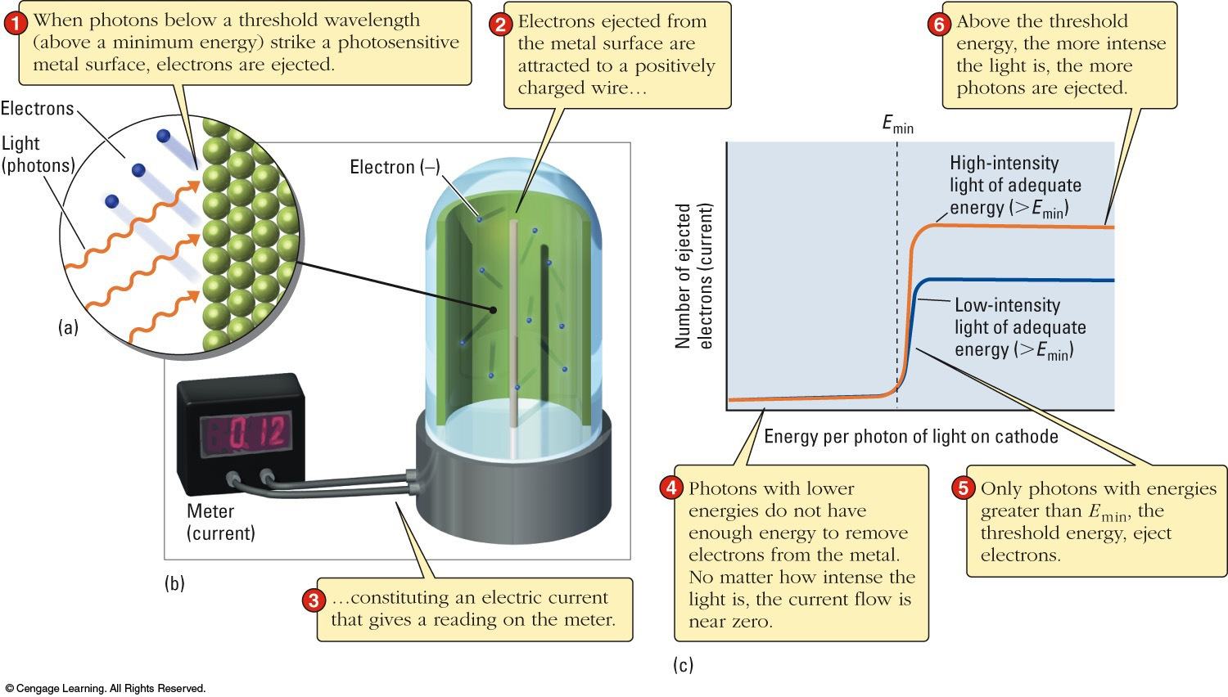
Quantum Mechanics
ψ² = probability of finding an e⁻ at a point in space.
An electron density (probability) map plots ψ² for each point in space.
Bigger value = darker shade.

Slide 4
Quantum Mechanics
Each ψ describes a different energy level.
H-atom wavefunction (ψ) = an orbital.
e⁻ do not follow fixed orbits around the nucleus.
Probability maps are hard to draw.
Boundary surfaces are used
  contain the e⁻ 90% of the time.
  Why not 100%? – it would include the entire universe!
The H-atom ground-state orbital

Slide 5
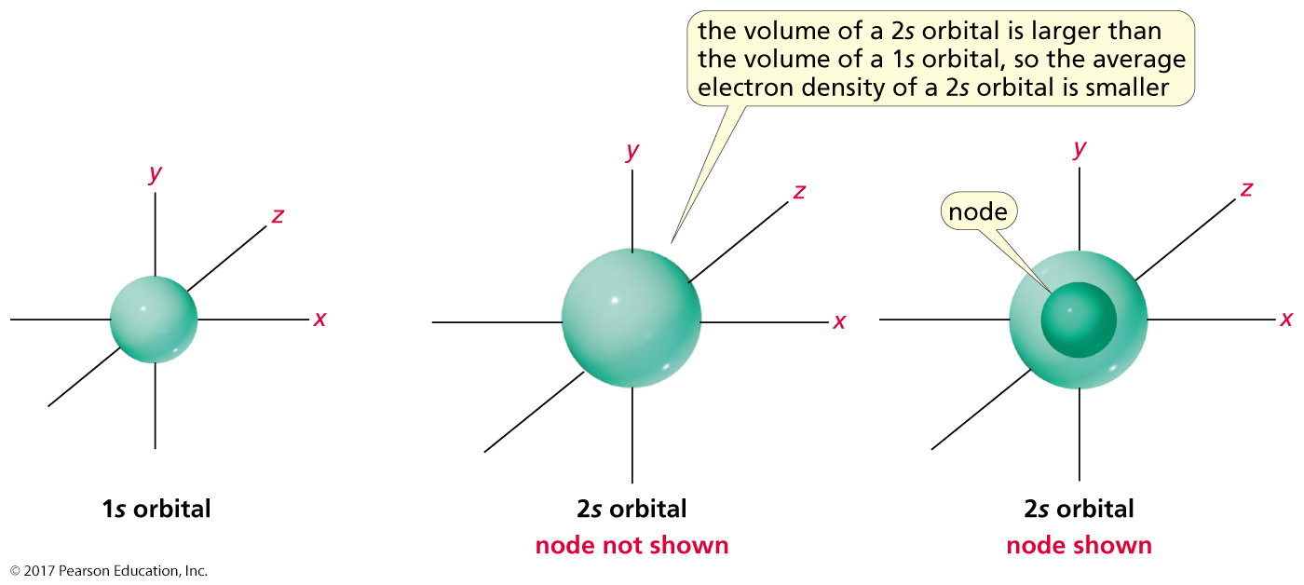
s Atomic Orbitals
An atomic orbital is the region of space around the nucleus
where an electron is most apt to be found.

Slide 6
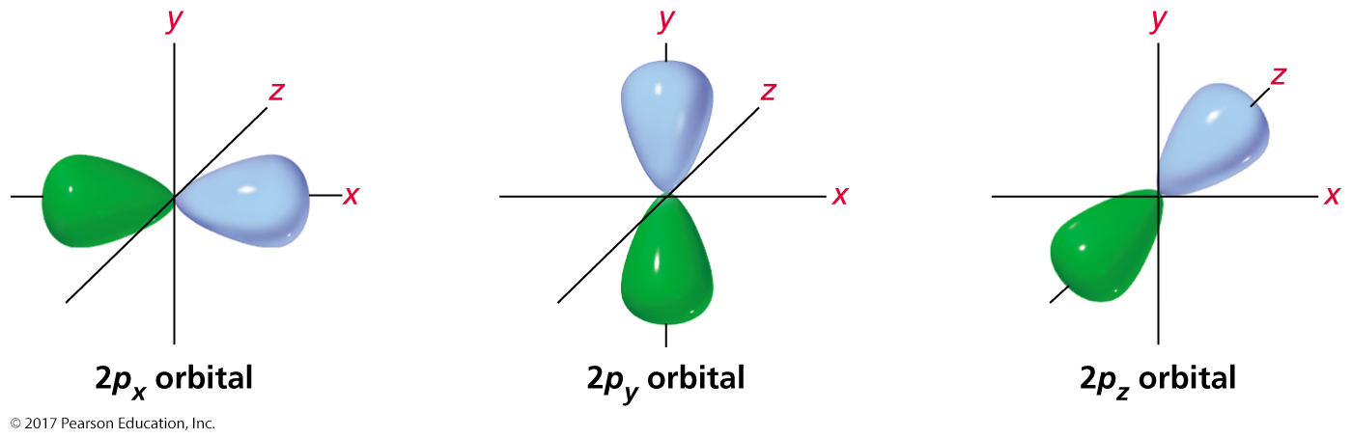
The Three p Orbitals
The lobes of a p atomic orbital have opposite phases.

Slide 7
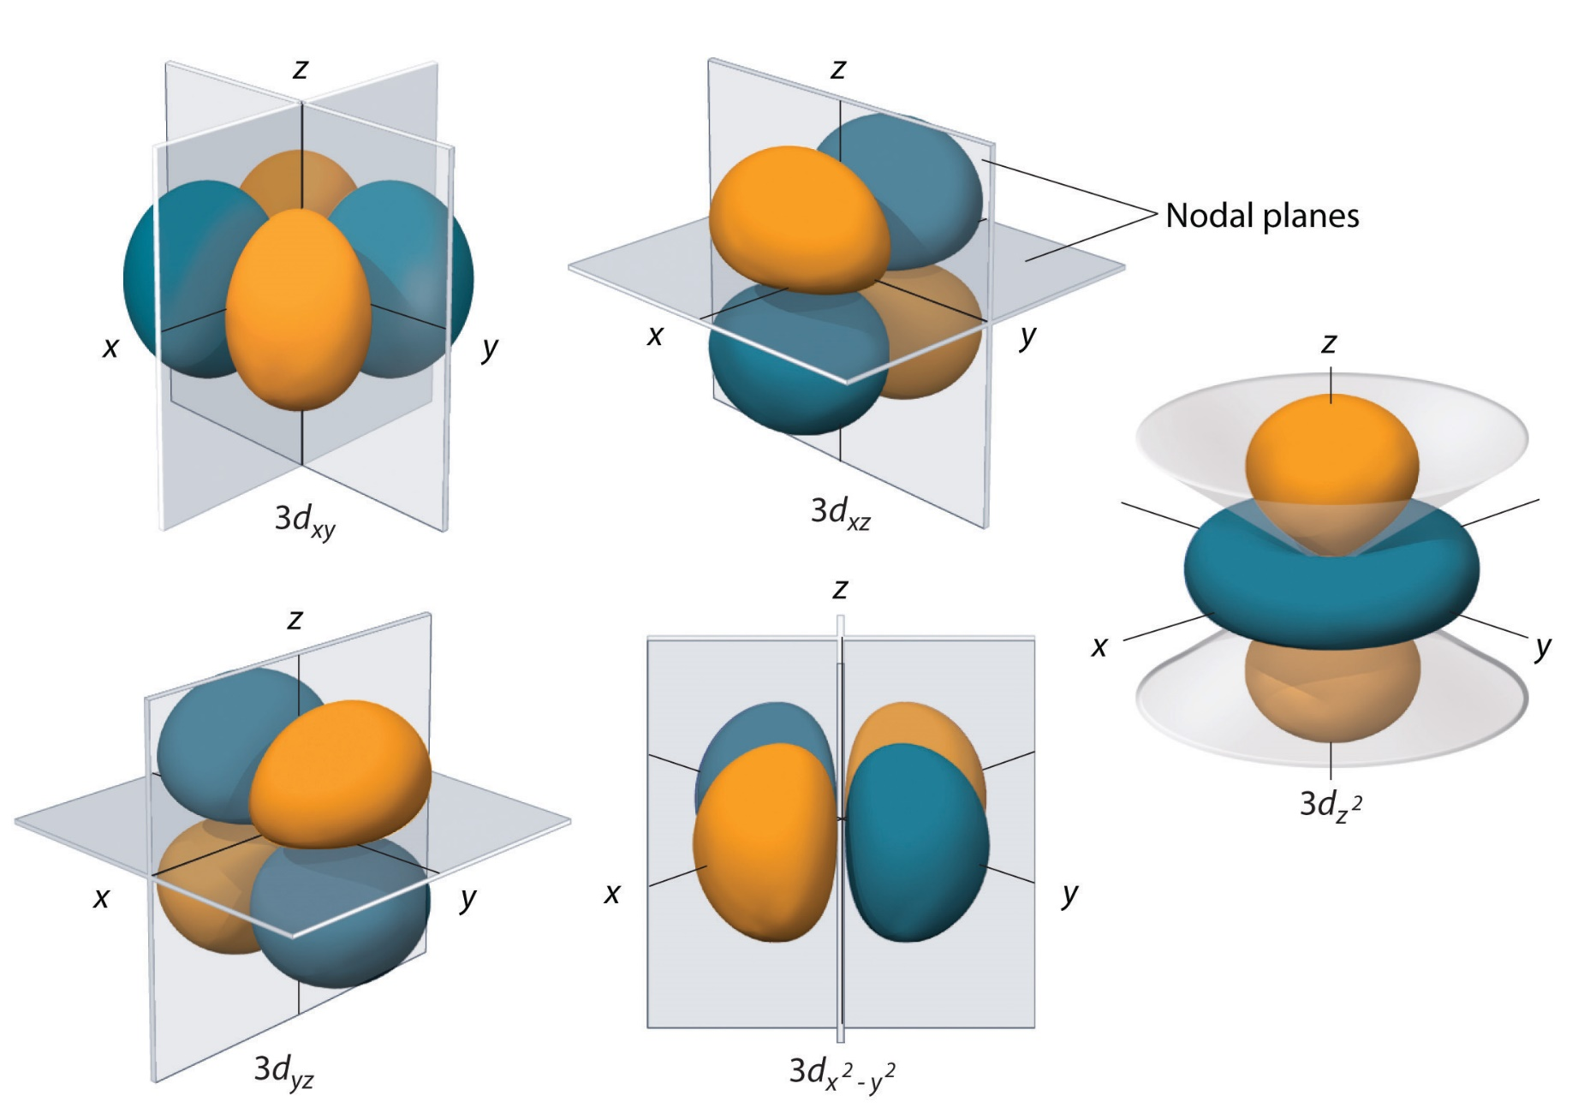
5 אורביטלי d
3 אורביטלים בין הצירים ושניים על הצירים

Slide 8
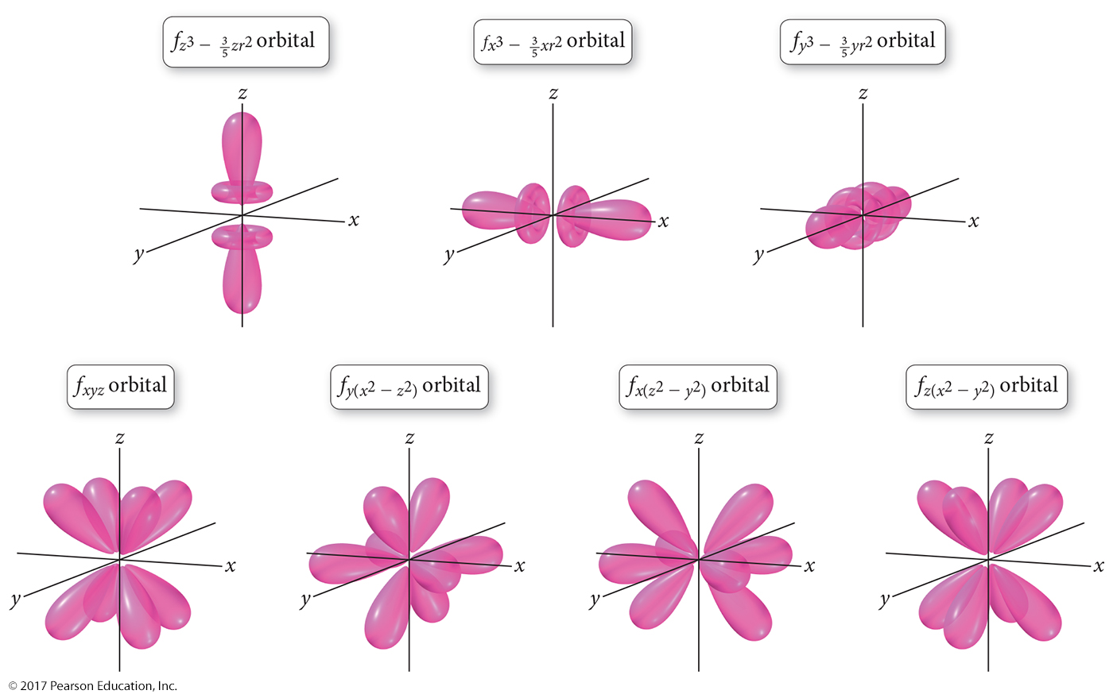
f Orbitals
7 אורביטלי f

Slide 9
Electron Configurations of Multielectron Atoms
Electron Configuration: A description of which orbitals are occupied by electrons
Degenerate Orbitals: Orbitals that have the same energy level—for example, the three p orbitals in a given subshell
Ground-State Electron Configuration: The lowest-energy configuration
Aufbau Principle (“building up”): A guide for determining the filling order of orbitals
1s, 2s, 2p, 3s, 3p, 4s, 3d, 4p, 5s, 4d, 5p,
6s, 4f, 5d, 6p, 7s, 5f.

Slide 10
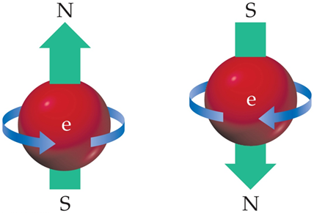
Electron Configurations of Multielectron Atoms
Rules of the aufbau principle:
Lower-energy orbitals fill before higher-energy orbitals.
An orbital can hold only two electrons, which must have opposite spins (Pauli exclusion principle).
If two or more degenerate orbitals are available, follow Hund’s rule.
Hund’s Rule: If two or more orbitals with the same energy are available, one electron goes into each until all are half-full. The electrons in the half-filled orbitals all have the same value of their spin quantum number.

Slide 11
The Pauli exclusion principle
An s subshell, with one orbital,
can hold a maximum of 2 electrons.
A p subshell, with three orbitals,
can hold a maximum of 6 electrons.
A d subshell, with five orbitals,
can hold a maximum of 10 electrons.
An f subshell, with seven orbitals,
can hold a maximum of 14 electrons.

Slide 12
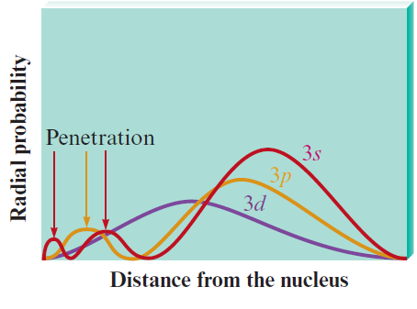
The Penetration Effect
A 2s electron penetrates to the nucleus more than one in the 2p orbital
This causes an electron in a 2s orbital to be attracted to the nucleus more strongly than an electron in a 2p orbital
  The 2s orbital is lower in energy than the 2p orbitals in a polyelectronic atom
  The same occurrence can be noticed in other quantum levels
When electrons are placed in a particular quantum level, the orbital levels vary in energy as follows:
E_{ns} < E_{np} < E_{nd} < E_{nf}

Slide 13
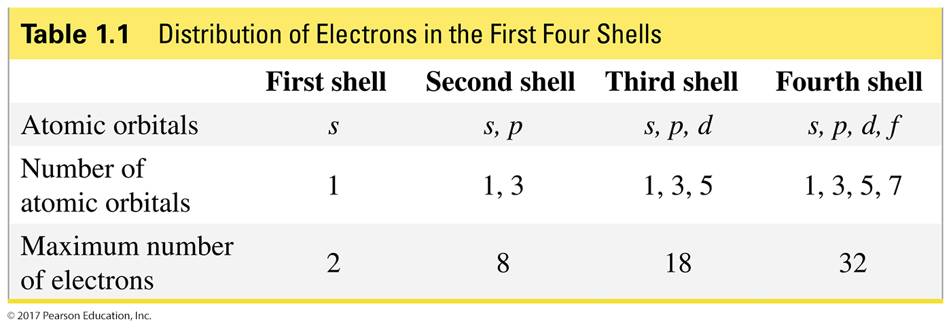
The Distribution of Electrons
in an Atom
The first shell is closest to the nucleus.
The closer the atomic orbital is to the nucleus, the lower its energy.
Within a shell, s < p.

Slide 14
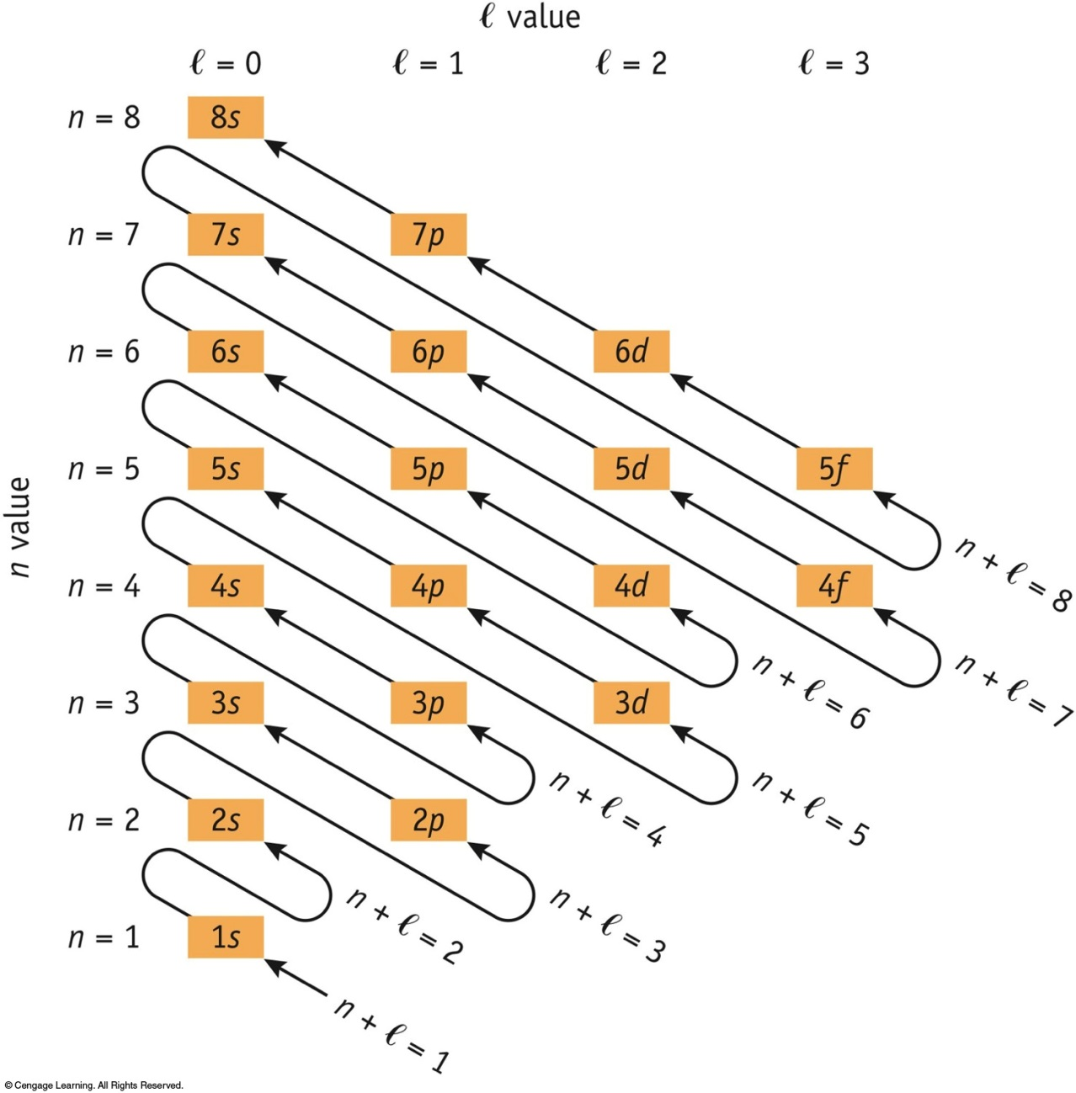
Subshell Filling Order
Increasing (n + ℓ ), then increasing n

Slide 15
Electron Configurations of Multielectron Atoms
Electron
Configuration
Orbital-Filling
Diagram
H:
1s¹
1s
He:
1s²
1s
Li:
1s² 2s¹
1s
2s
N:
1s² 2s² 2p³
1s
2s
2p

Slide 16
Electron Configurations of Multielectron Atoms
Electron
Configuration
Shorthand
Configuration
Na:
1s² 2s² 2p⁶ 3s¹
[Ne] 3s¹
P:
1s² 2s² 2p⁶ 3s² 3p³
[Ne] 3s² 3p³
K:
1s² 2s² 2p⁶ 3s² 3p⁶ 4s¹
[Ar] 4s¹
Sc:
1s² 2s² 2p⁶ 3s² 3p⁶ 4s² 3d¹
[Ar] 4s² 3d¹
Ar configuration

Slide 17
Anomalous Electron Configurations
Expected
Configuration
Actual
Configuration
Cr:
[Ar] 4s² 3d⁴
[Ar] 4s¹ 3d⁵
Cu:
[Ar] 4s² 3d⁹
[Ar] 4s¹ 3d¹⁰
Note: ½ filled and filled shells have extra stability

Slide 18
Ion Electron Configurations
Similar approach.
Positive ion: remove one e⁻ for each “+”
Negative ion: add one e⁻ for each “-”
S²⁻ (16 + 2) = 18 e⁻
S [Ne] 3s² 3p⁴
S²⁻ [Ne] 3s² 3p⁶ or [Ar]
Rb⁺ (37 - 1) = 36 e⁻
Rb [Kr] 5s¹
Rb⁺ [Kr] or [Ar] 3d¹⁰ 4s² 4p⁶

Slide 19
האורביטלים 4s ו- 3d

Slide 20
Transition-Metal Ions
ns e⁻ are lost first.
Fe [Ar] 3d⁶ 4s² → Fe²⁺ [Ar] 3d⁶
→ Fe³⁺ [Ar] 3d⁵
Mn [Ar] 3d⁵ 4s² → Mn²⁺ [Ar] 3d⁵
→ Mn⁴⁺ [Ar] 3d³
→ Mn⁷⁺ [Ar]

Slide 21
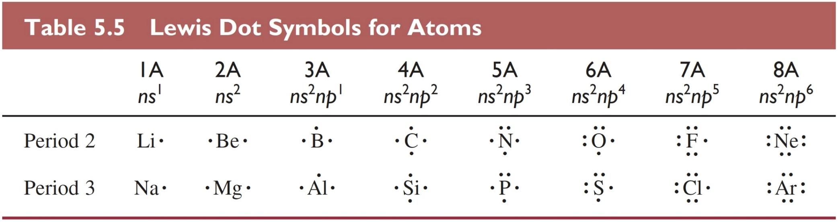
Valence Electrons
Lewis dot symbols:
Dots represent valence e⁻.
Usually only used for s- and p-block elements.
N
Example nitrogen
5 valence e⁻ (group 5A)

Slide 22
Electron Configuration and the
Periodic Table
The group number corresponds to the number of valence electrons.
The length of each “block” is the maximum number of electrons the sublevel can hold.
The period number corresponds to the principal energy level of the valence electrons.

Slide 23
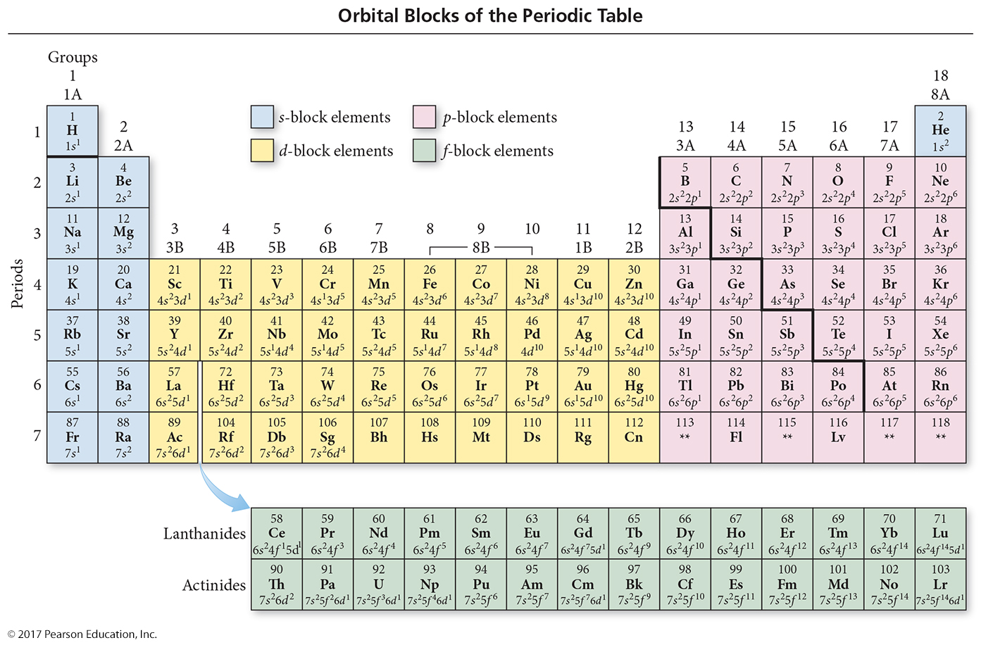

Slide 24
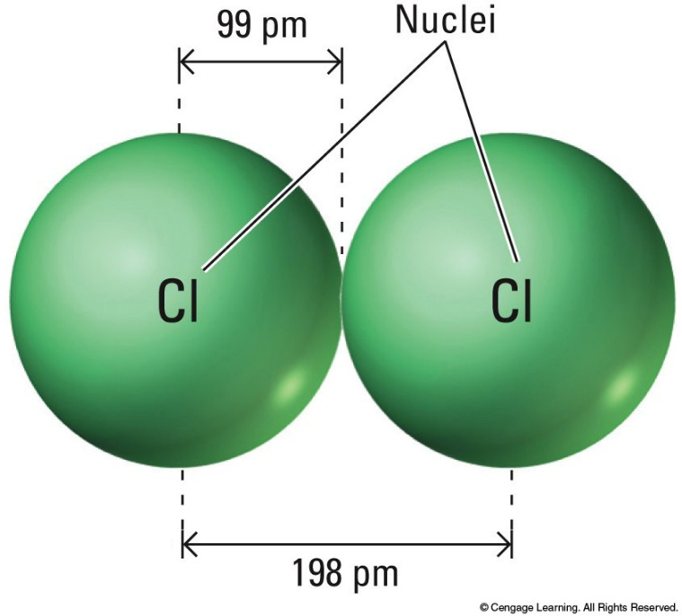
Periodic Trends: Atomic Radii
An estimate of atomic size
½(homonuclear bond length)
Cl = 99 pm
  Cl₂ bond = 198 pm.
C = 77 pm
  diamond bond =154 pm.
Radii are additive.
C-Cl in CCl₄ is 176 pm long.
From radii: (77 + 99) = 176 pm.

Slide 25
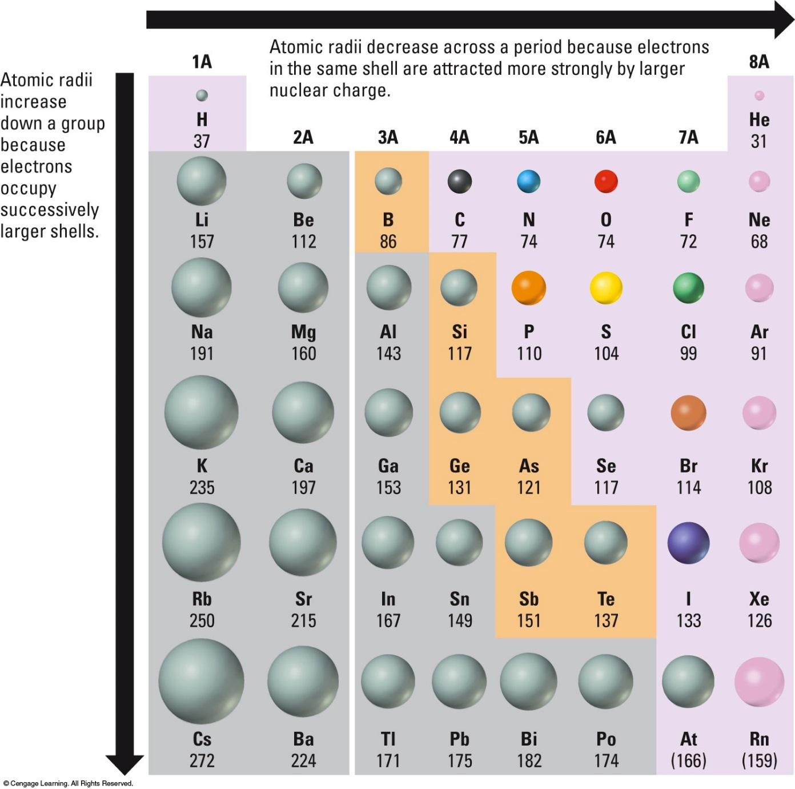
Periodic Trends: Atomic Radii

Slide 26
Periodic Trends: Atomic Radii
Atoms grow in size down a group.
Larger shell (larger n) added in each new row.
Atoms shrink across a period
e⁻ add to the same shell. Size stays ~constant? No,
p⁺ add to the nucleus.
Larger charge pulls all e⁻ in, shrinking the atom.
Big Jump in size from noble gas to alkali metal
A new shell (with larger n) is added.

Slide 27
Ionic Radii
Ne configuration
Isoelectronic Ions | O²⁻ | F⁻ | Na⁺ | Mg²⁺
Ionic radius (pm) | 126 | 119 | 116 | 86
Number of p⁺ | 8 | 9 | 11 | 12
Number of e⁻ | 10 | 10 | 10 | 10
More p+
Smaller size

Slide 28
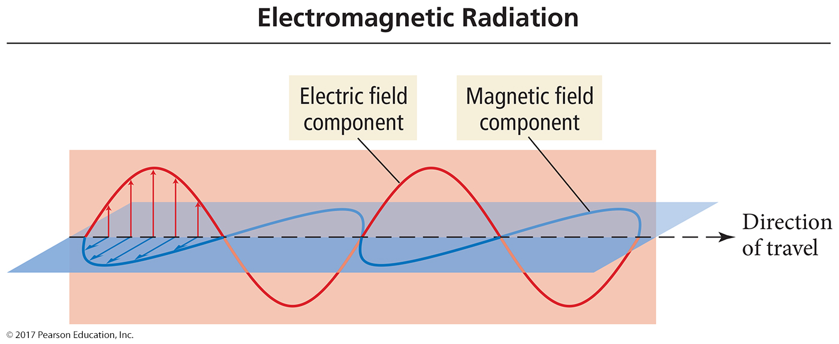
The Wave Nature of Light
A wave is a continuously repeating change or oscillation in matter or in a physical field.
Light is a wave, consisting of oscillations in electric and magnetic fields, traveling through space.

Slide 29
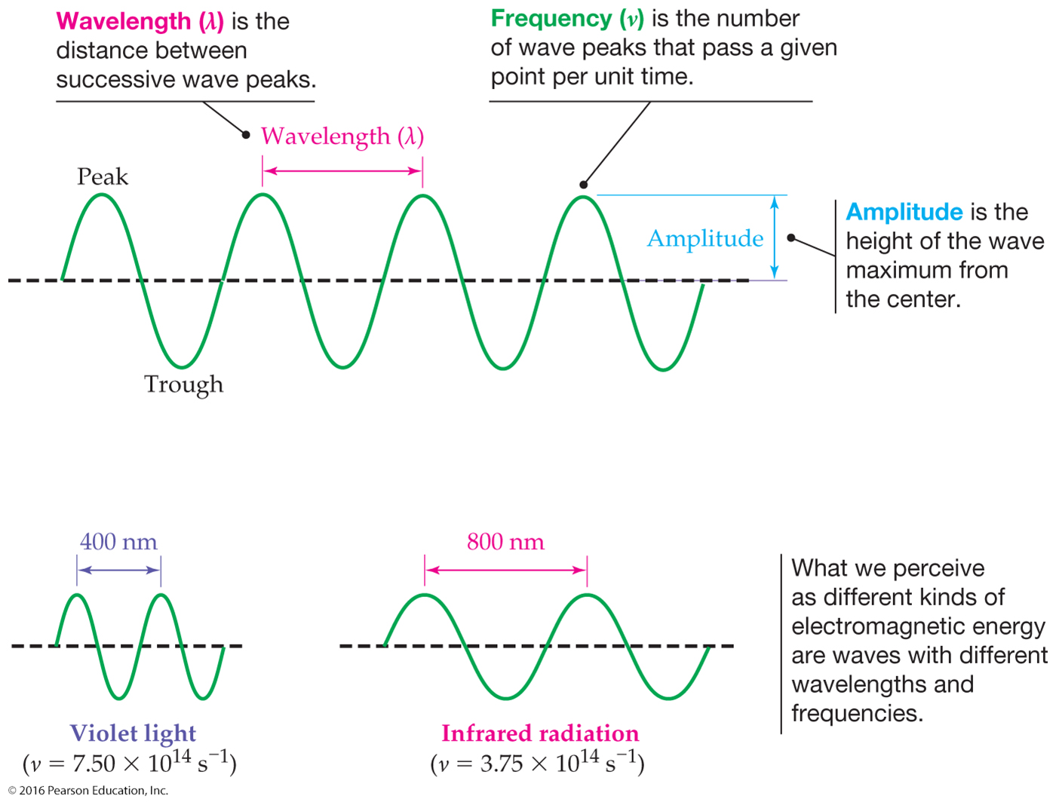
The Wave Nature of Light
A wave can be characterized by its wavelength and frequency.
Wavelength, symbolized by the Greek letter lambda, λ, is the distance between any two identical points on adjacent waves.
Frequency, symbolized by the Greek letter nu, ν, is the number of wavelengths that pass a fixed point in one unit of time (usually a second). The unit is ¹/_{S} or s⁻¹ which is also called the Hertz (Hz).

Slide 30
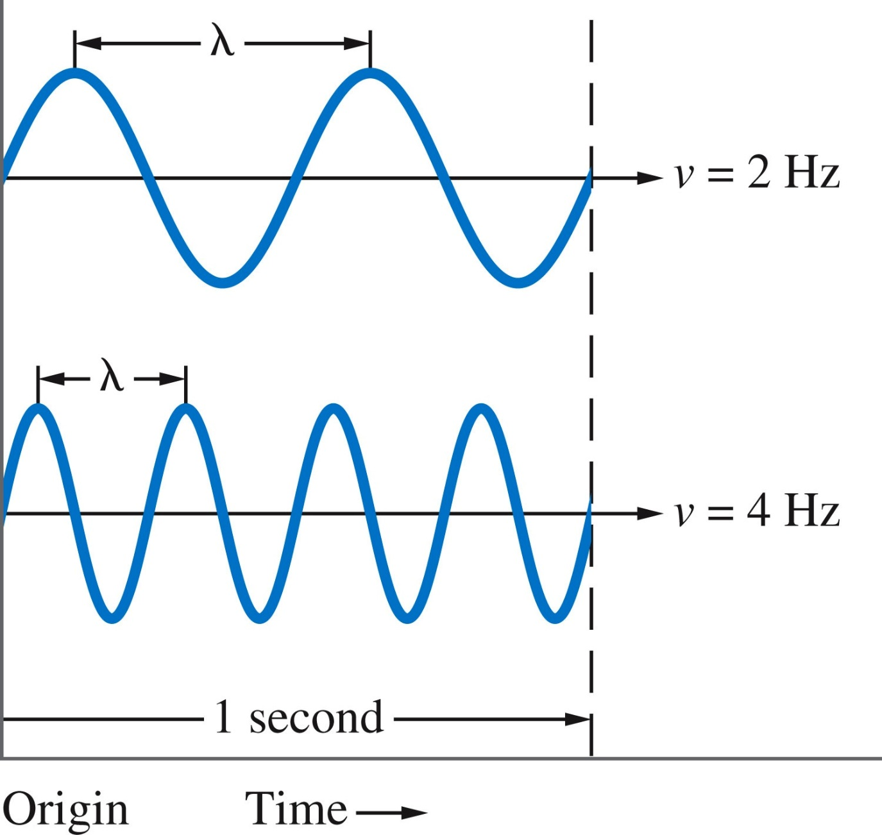
The Wave Nature of Light
Wavelength and frequency are related, their product equals to speed of light. The speed of light, c, is 3.00 x 10⁸ m/s.
c = νλ
When the wavelength is reduced by a factor of two, the frequency increases by a factor of two.

Slide 31
The Wave Nature of Light
What is the wavelength of blue light with a frequency of 5.09× 10¹⁴/s?
ν = 5.09 × 10¹⁴/s
c = 3.00 × 10⁸ m/s
c = νλ so
λ = c/ν

Slide 32
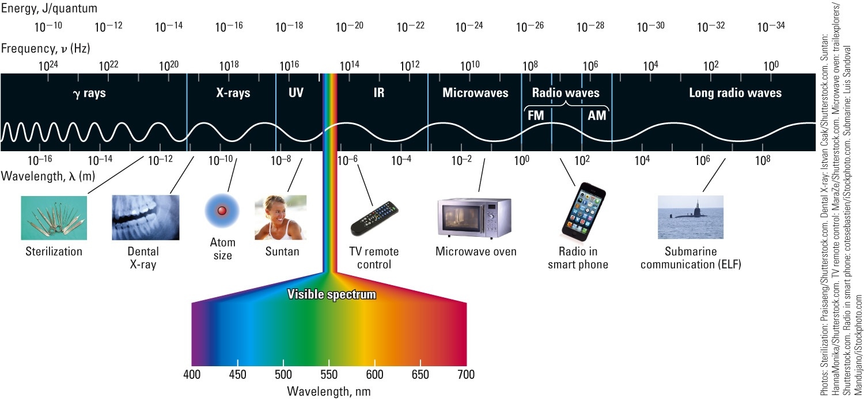
Electromagnetic Radiation
E increasing, ν increasing, λ decreasing
The range of frequencies and wavelengths of electromagnetic radiation is called the electromagnetic spectrum.

Slide 33
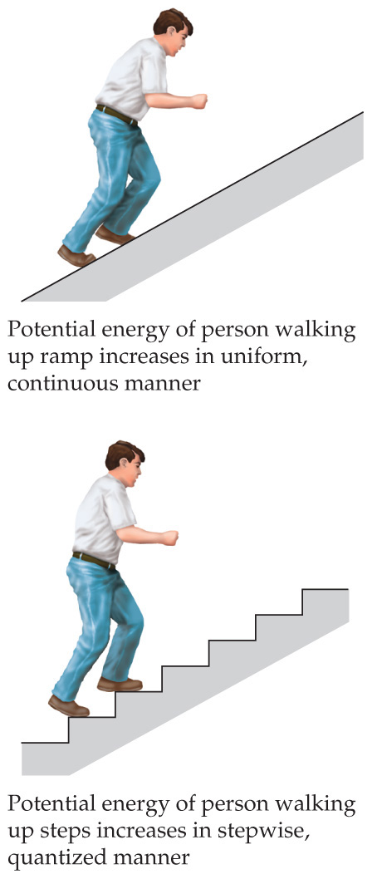
Quantum Effects and Photons
Light consists of quanta(singular: quantum) or particles of electromagnetic energy, called photons. The energy of each photon is proportional to its frequency:
E = hν
h = 6.626 × 10⁻³⁴ J  s (Planck’s constant)
Light, therefore, has properties of both waves and matter. Neither understanding is sufficient alone. This is called the wave-particle duality of light.

Slide 34
Photons
Photons with λ = 452 nm are blue.
What’s the frequency of this radiation?
What’s the energy of 1 of these photons?
What’s the energy of 1 mol of 452-nm photons?
a) νλ = c
c
λ
2.9979 x 10⁸ ms⁻¹
452 x 10⁻⁹ m
ν = =
= 6.63 x 10¹⁴ s⁻¹
b) E = hν
E = 6.626 x 10⁻³⁴ Js (6.63 x 10¹⁴ s⁻¹) = 4.39 x 10⁻¹⁹ J
c) E/mol = 4.39 x 10⁻¹⁹ J (6.022 x 10²³ mol⁻¹)
= 2.6 x 10⁵ J mol⁻¹

Slide 35
Spectra
When atoms or molecules absorb energy, that energy is often released as light energy.
  Fireworks, neon lights, etc.
When that emitted light is passed through a prism, a pattern of particular wavelengths of light is seen that is unique to that type of atom or molecule; the pattern is called an emission spectrum.
  Noncontinuous
  Can be used to identify the material
  Flame tests

Slide 36

Exciting Gas Atoms to Emit Light
Light is emitted when gas atoms are excited via external energy (e.g., electricity or flame).
Each element emits a characteristic color of light.

Slide 37
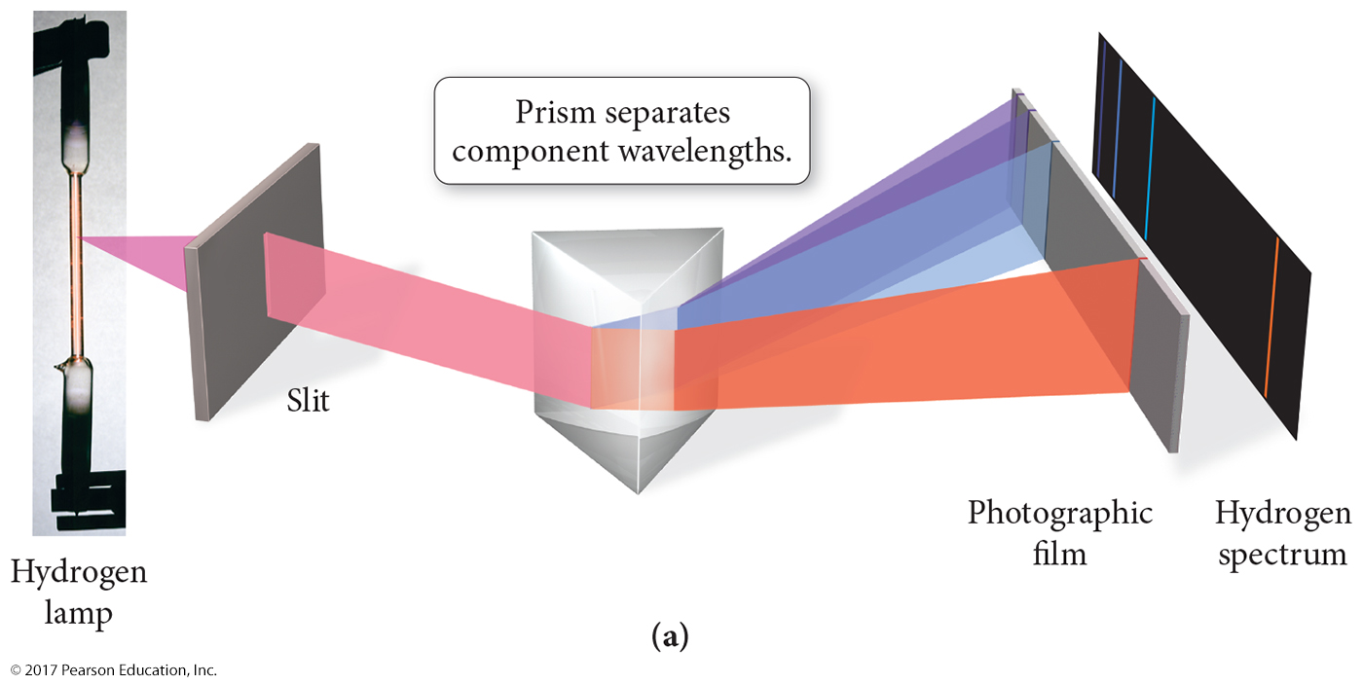
Emission Spectra

Slide 38
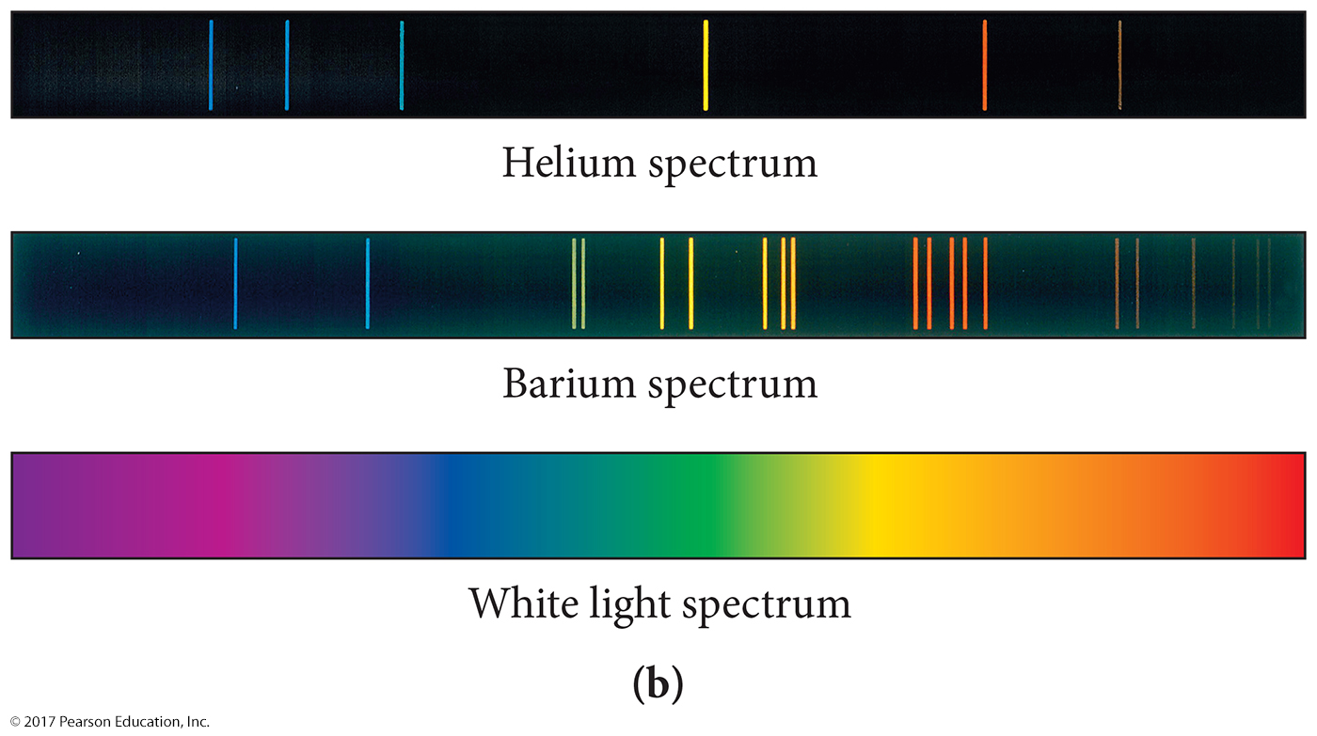
Examples of Spectra
A line spectrum shows only certain colors or specific wavelengths of light.
A continuous spectrum contains all wavelengths of light.

Slide 39

Identifying Elements with Flame Tests
Na
K
Li
Ba

Slide 40
Energy-Level Postulate
An electron can have only specific energy values called energy levels. Energy levels are quantized.
Energy levels of the hydrogen atom can be determined using the formula:
R_{H} = 2.179 × 10⁻¹⁸ J (Rydberg constant)
n = principal quantum number

Slide 41
Atomic Spectroscopy Explained
Each wavelength in the spectrum of an atom corresponds to an electron transition between orbitals.
When an electron is excited, it transitions from an
orbital in a lower energy level to an orbital in a higher
energy level.
When an electron relaxes, it transitions from an orbital in a higher energy level to an orbital in a lower
energy level.
When an electron relaxes, a photon of light is released whose energy equals the energy difference between the orbitals.

Slide 42
Electron Transitions
To transition to a higher energy state, the electron must gain the correct amount of energy corresponding to the difference in energy between the final and initial states.
Electrons in high energy states are unstable and tend to lose energy and transition to lower
energy states.
Each line in the emission spectrum corresponds to the difference in energy between two
energy states.

Slide 43
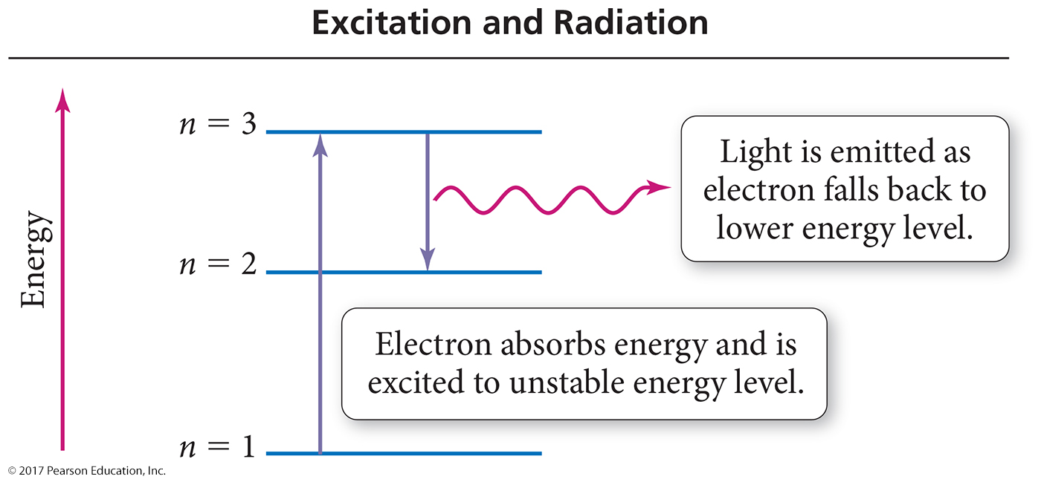

Slide 44
Spectrum of H Atoms
For a hydrogen electron, the energy lost is given by:
If n_{i} is the principal quantum number for of the initial energy level , and n_{f} is the principal quantum number of the final energy level, then,
−

Slide 45
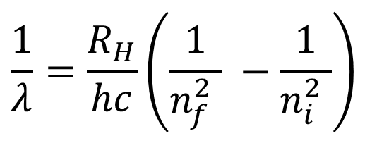
Spectrum of H Atoms
In general, hv equals –ΔE:
That is,
Recalling that v = c/λ, the above equation can be written as:
$$\frac{1}{λ}=\frac{R_{H}}{hc}\left(\frac{1}{{n_{f}^{2}}_{ }} −\frac{1}{{n_{i}^{2}}_{ }}\right)$$

Slide 46
Spectrum of H Atoms
Light is absorbed by an atom when the electron transition is from lower n to higher n (n_{f} > n_{i}). In this case, ΔE will be positive.
Light is emitted from an atom when the electron transition is from higher n to lower n (n_{f} < n_{i}). In this case, ΔE will be negative.
An electron is ejected when n_{f} = ∞.

Slide 47
Spectrum of H Atoms
Determine the wavelength of the light emitted when the electron in a hydrogen atom undergoes a transition from n = 4 to n = 2
It is known that:
Subtracting the lower value from the higher value gives a positive result. If the result is negative, reverse the subtraction.

Slide 48
Spectrum of H Atoms
Equate the result to hν as it equals the energy of the photon.
The frequency of the light emitted is:
Since
The color is blue-green.

