Slide 1
Expressing Solution Composition
Mass Solute
Total Mass of Solution
Mass fraction =
Weight percent =
Mass fraction x 100%
Example
Saline solutions, NaCl(aq), are often used in medicine. What is the weight percent of NaCl in a solution of 4.6 g of NaCl in 500. g of water?
4.6 g
500. g + 4.6 g
mass fraction =
= 0.0091
weight percent = 0.0091 x 100% = 0.91 %

Slide 2
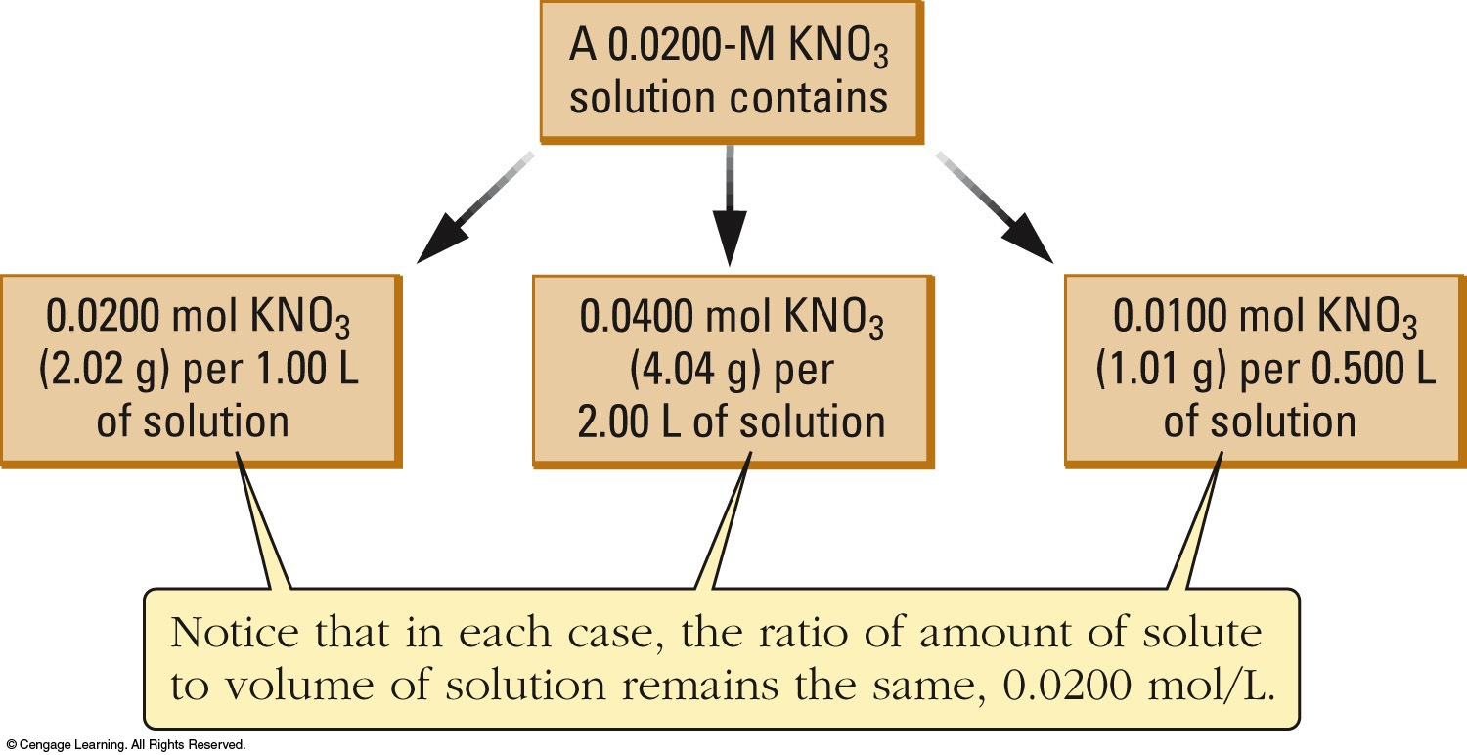
Molarity
moles of solute
liters of solution
n
V
Molarity = M = =
Because V varies with T, molarity is T dependent!

Slide 3
Molality
Molality is another concentration scale:
moles of solute
kilograms of solvent
Molality = m =
A mass-based unit.
Uses solvent mass (not solution).
It is T independent (unlike molarity).

Slide 4
Molarity and Molality
Calculate the molarity and molality of an 93.0 % by mass sulfuric acid solution. Its density = 1.835 g/mL.
93 % = 93.0 g H₂SO₄ + 7.0 g H₂O (in 100.0 g soln.)
93.0 g
98.09 g/mol
n_{H2SO4} =
= 0.9481 mol
100.0 g
1.835 g/mL
V_{soln} =
= 54.50 mL
0.9481 mol
0.05450 L
[H₂SO₄] =
= 17.4 M
0.9481 mol
0.0070 kg
m_{H2SO4} =
= 1.4 x 10² mol/kg (m)

Slide 5
Mole fraction is the moles of component over the total moles of solution. It is abbreviated as X.

Slide 6
Mole Fraction
Determine the mole fractions of glucose and water in a solution containing 5.67 g of glucose dissolved in 25.2 g of water.

Slide 7
Mole Fraction
5.67 g of glucose = 0.0315 mol of glucose.
Calculate the total moles of solution.
The total moles of solution are:
Therefore,

Slide 8
Colligative Properties of Solutions
Colligative properties are those properties that:
Only depend upon the number of “particles” in solution.
each ion or molecules has the same effect; the particle type is unimportant.

Slide 9
Boiling Point Elevation
Non-volatile solutes increase the b.p. of a solvent. Why?
Solvent vapor P is lowered.
Higher T is needed to get the vapor P = external P.
Quantitatively ΔT_{b} = K_{b} m_{solute}
Note: the K_{b} value only depends on the solvent,
the molality, m depends on the solute.

Slide 10
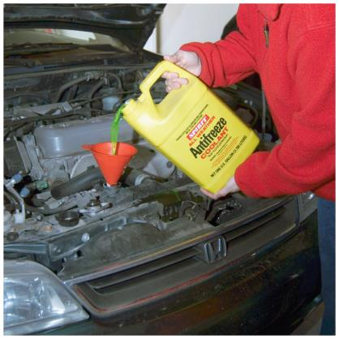
Freezing-Point Lowering
A non-volatile solute lowers the f.p. of a solvent:
Quantitatively ΔT_{f} = K_{f} m_{solute}
K_{f} is a constant for the solvent.
Ethylene glycol (antifreeze) is added to car radiators
to lower the freezing point of water (stops freezing).

Slide 11
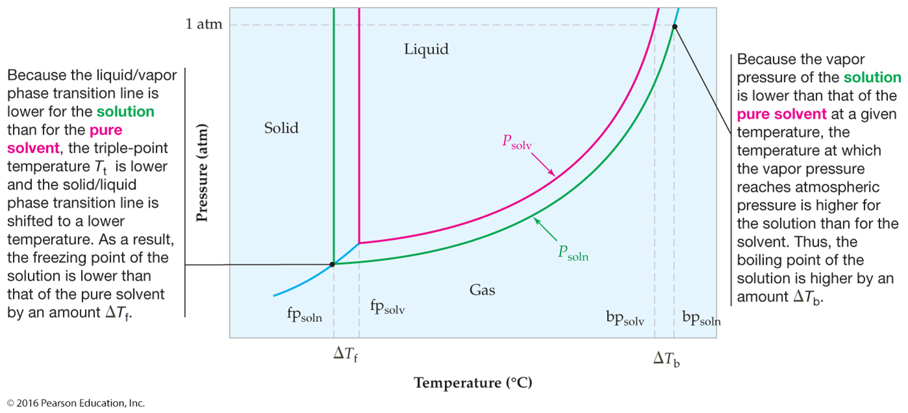
Boiling-Point Elevation and Freezing-Point Depression of Solutions

Slide 12
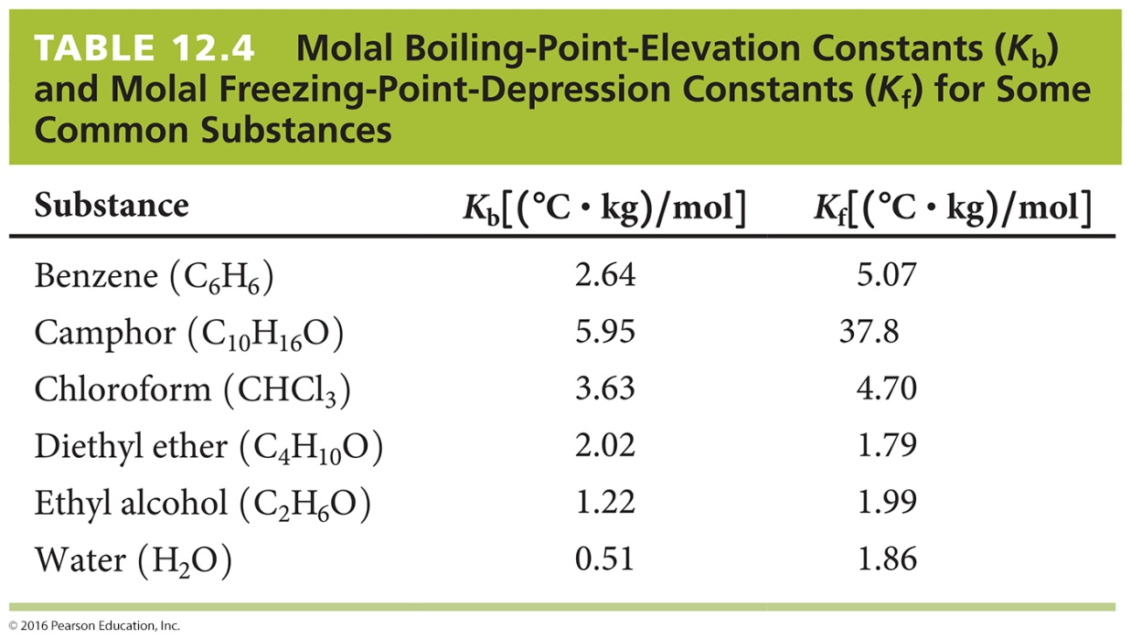
Boiling-Point Elevation and Freezing-Point Depression of Solutions
Nonelectrolytes
Electrolytes
ΔT_{b} = K_{b}m
ΔT_{b} = K_{b}mi
ΔT_{f} = K_{f}m
ΔT_{f} = K_{f}mi

Slide 13
Freezing Point Lowering
Calculate the f.p. of an aqueous 30.0% ethylene glycol mixture. For water K_{f} = -1.86°C kg mol⁻¹.
100.0 g of 30% mix: 30.0 g C₂H₂(OH)₂ + 70.0 g H₂O
n_{glycol} = 30.0 g / 62.07 g mol⁻¹ = 0.4833 mol
m_{glycol} = (0.4833 mol / 0.070 kg) = 6.904 molal
ΔT_{f} = -1.86°C kg mol⁻¹(6.904 mol/kg) = -12.8 °C
Freezing point = 0.00°C – 12.8°C = -12.8°C
normal freezing point of water

Slide 14
Molar Mass By Boiling Point Elevation
Benzyl acetate is one of the active components of oil of jasmine. If 0.125 g of the compound is added to 25.0 g of chloroform (CHCl₃), the boiling point of the solution is 61.82 °C. What is the molar mass of benzyl acetate?
Given:
bp (chloroform) = 61.70 °C
K_{b} (chloroform) = 3.63°C/m
Solution: The molality of the solution can be found from the freezing point depression.
Knowing molality and mass of solvent, one can find the moles of solute.
Knowing mass and moles of solute, the molar mass of the compound can be determined.

Slide 15
Molar Mass By Boiling Point Elevation, continued

Slide 16
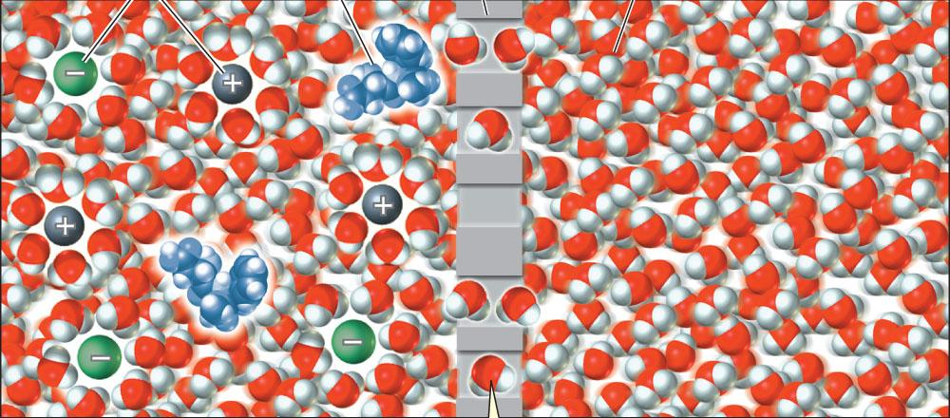
Osmotic Pressure of Solutions
Semipermeable membrane
Allows passage of small “particles”.
Stops large “particles”.
Ion + H₂O coordination sphere – too large to pass through
net solvent flow
Large molecule cannot pass.
e.g. animal bladders and cell membranes.
Osmosis
Movement of solvent through a semipermeable membrane from dilute to more concentrated solution.

Slide 17
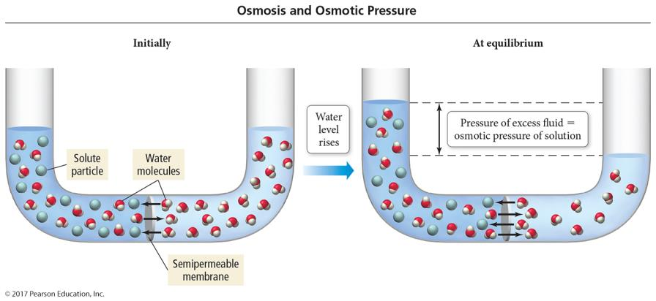
An Osmosis Cell

Slide 18
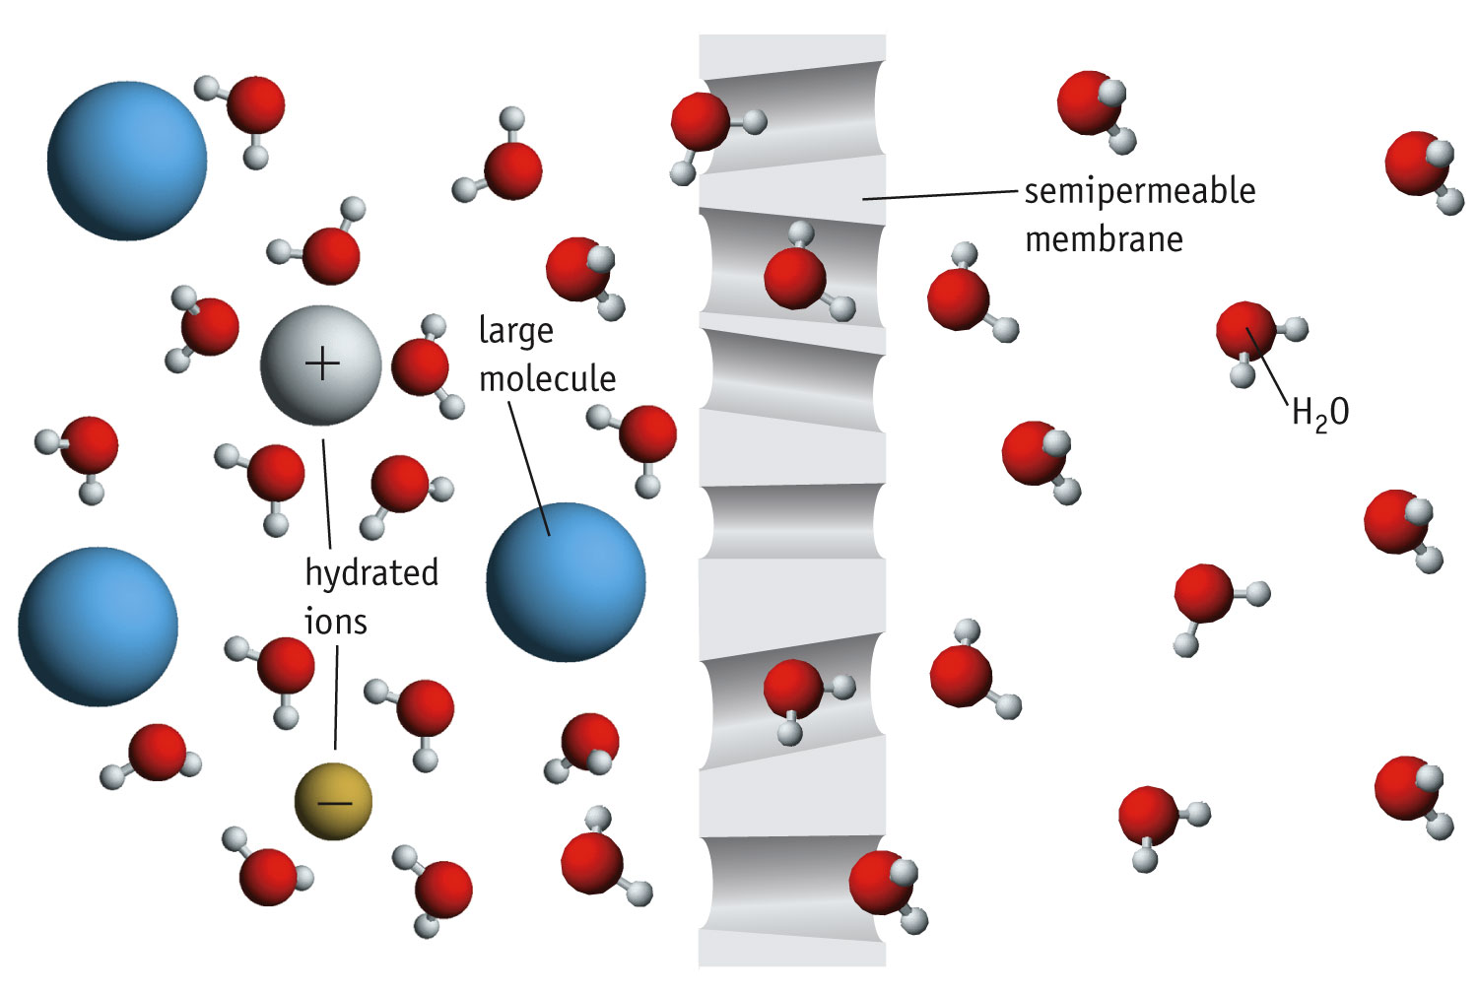
Osmosis at the Particulate Level

Slide 19
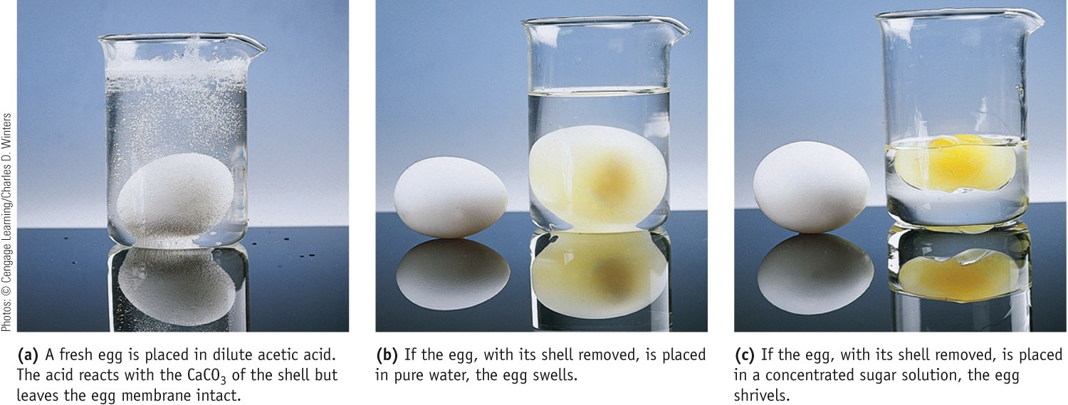
Osmosis

Slide 20
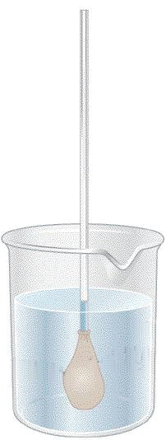
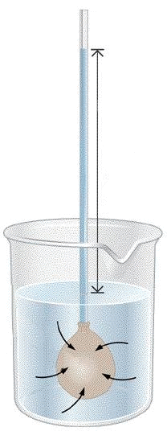
Osmotic Pressure of Solutions
Osmotic pressure = P that must be applied to stop osmosis.
Π = c R T
gas constant
molarity of solution
absolute T
R = 0.08206 (atm∙L)/(mol∙K)
Height of the column of solution is a measure of Π.
Pure water
semipermeable bag of 5% sugar water
Water enters the bag, increasing the P…

Slide 21
Osmotic Pressure
Π = c R T
Easy to remember. Very similar to the ideal gas law:
n R T
V
P = =
c R T

Slide 22
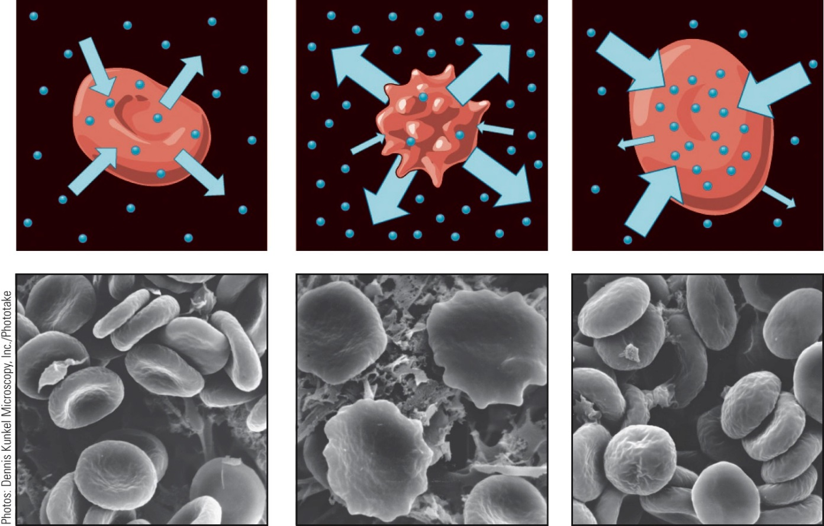
Osmotic Pressure
A cell can be exposed to 3 kinds of solution:
Isotonic
[solute]_{out}=[solute]_{in}
No Net flow.
Hypertonic
[solute]_{out} >[solute]_{in}
Net flow out.
Hypotonic
[solute]_{out} <[solute]_{in}
Net flow in.

Slide 23
Example
A solution made up of 2.00 g of an unknown solute and 275 mL of water (d = 1.00 g/mL) has an osmotic pressure of 0.872 atm at 25°C
What is the molar mass of the unknown solute?

Slide 24
Example
Analysis:
Information given Mass of solute (2.00 g)
Volume of solvent
(275 mL)
π (0.872 atm); T (25°C)
Density of solvent
(1.00 g/mL)
Density of solution
(1.00 g/mL)

Slide 25
Example
Strategy:
Find the molarity M, by substituting in
Determine the volume of the solution by first finding its mass
Mass of solution = mass of solute + mass of water
Volume of solution = mass/density
Find the moles of solute using the defining equation for molarity
M = moles solute/volume of solution (L)
Find the molar mass
Molar mass = mass/moles

Slide 26
Example
Solution:
M
Volume of solution

Slide 27
Example
Moles of solute
Molar mass

Slide 28
Boiling Point Elevation
At what T will 0.100 molal NaCl(aq) boil? K_{b} = 0.51°C kg mol⁻¹
The b.p. of 0.100 molal NaCl:
ΔT_{b} = K_{b} i_{solute}m_{solute}
= 0.51°C kg mol⁻¹(2)(0.100 mol/kg) = 0.10 °C
b.p. = 100.00°C + 0.10°C = 100.10 °C

