Slide 1
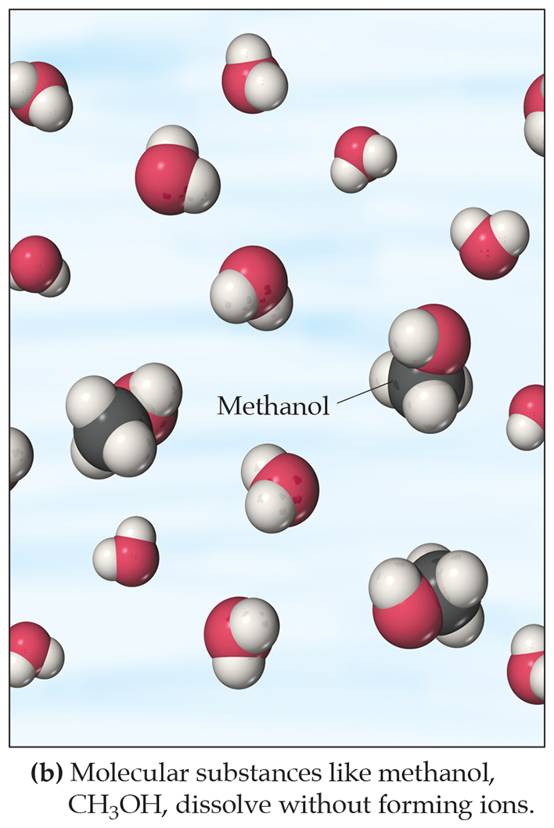
Solutions
Solutions are defined as homogeneous mixtures of two or more pure substances.
The solvent is present in greatest abundance.
All other substances are solutes.
When water is the solvent, the solution is called an aqueous solution.

Slide 2
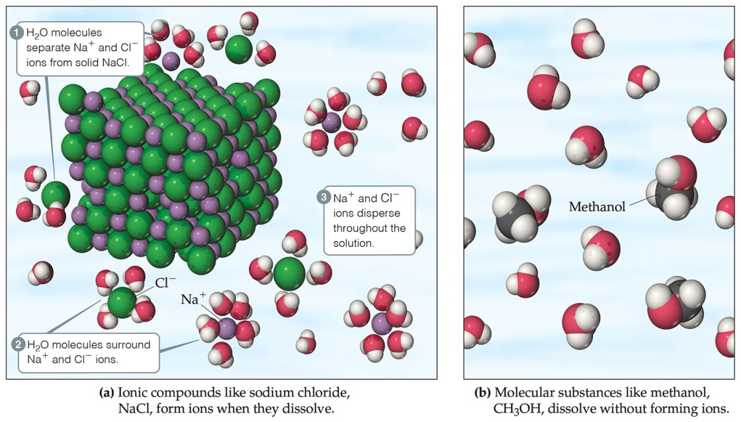
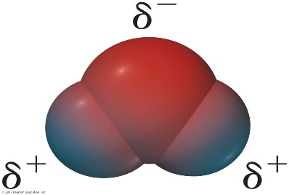
Aqueous Solutions
Substances can dissolve in water by different ways:
Ionic compounds dissolve by dissociation, where water surrounds the separated ions.
Molecular compounds interact with water, but most do NOT dissociate.
Some molecular substances react with water when they dissolve.
All substances dissolve by solvation, surrounding of the solute by solvent.
חמצן
מימן
מימן
מולקולת מים

Slide 3
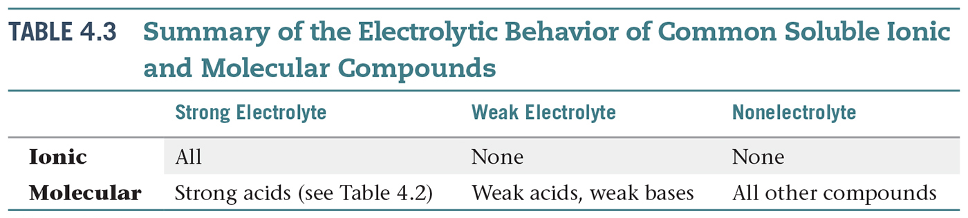
Electrolytes and Nonelectrolytes
An electrolyte is a substance that dissociates into ions when dissolved in water.
A nonelectrolyte may dissolve in water, but it does not dissociate into ions when it does so.

Slide 4
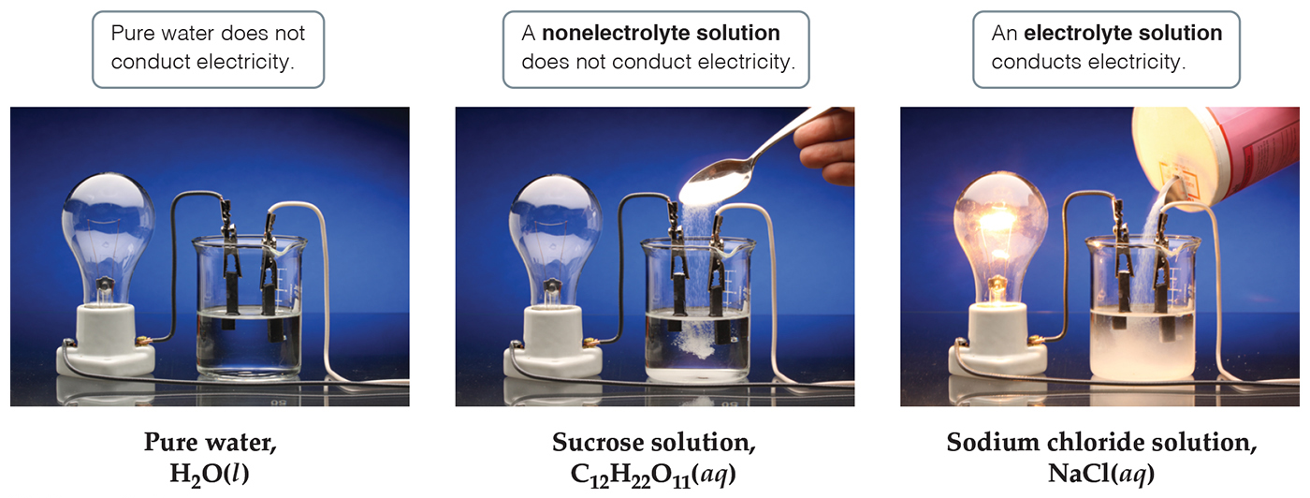
Electrolytes
A strong electrolyte dissociates completely when dissolved in water.
A weak electrolyte only dissociates partially when dissolved in water.
A nonelectrolyte does NOT dissociate in water.

Slide 5
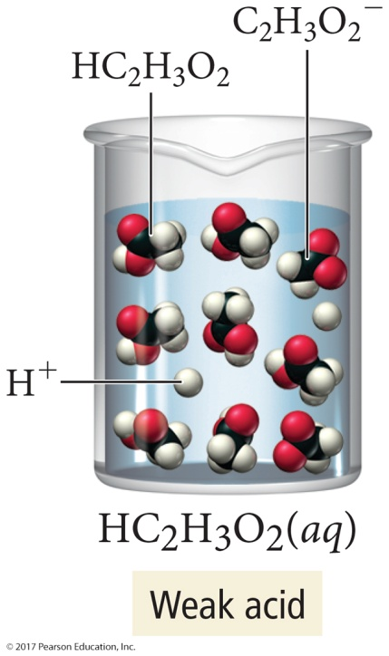
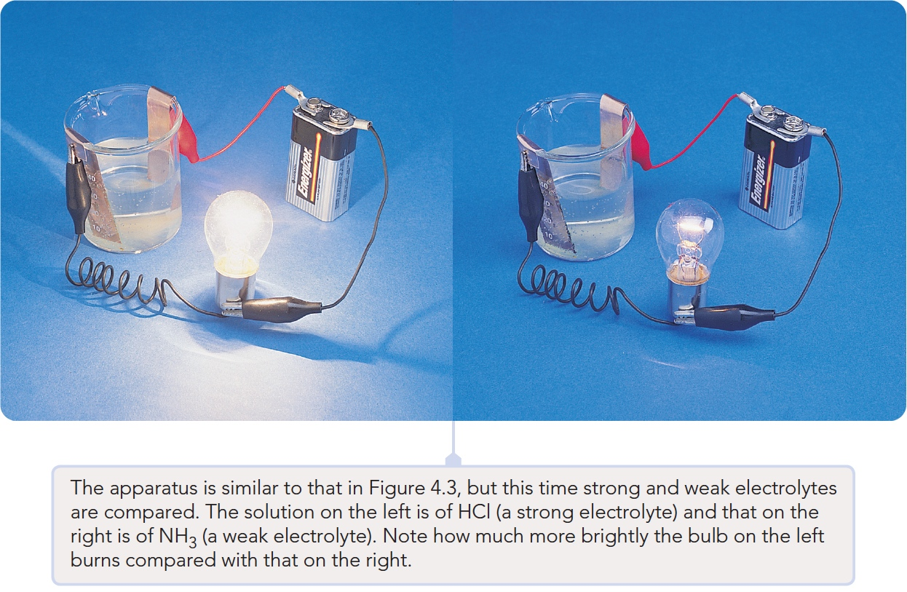
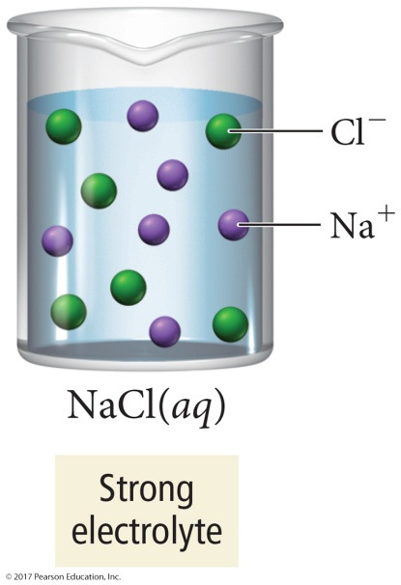
Electrolytes
Solutions that are poor conductors have less or no ions.
Solutions with good conductivity have plenty of ions.

Slide 6
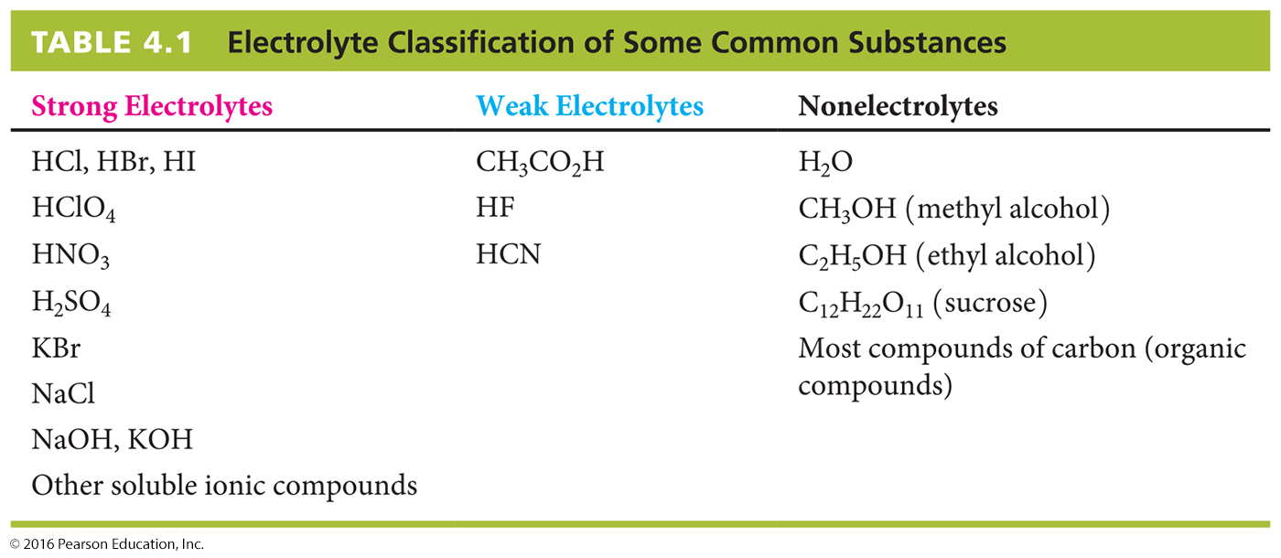
Electrolytes in Aqueous Solution
Weak acids
Strong Acids: Hydrochloric acid, hydrobromic acid, hydroiodic acid, perchloric acid, nitric acid, sulfuric acid

Slide 7
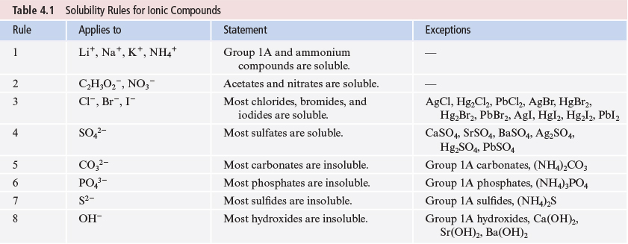
Solubility of Ionic Compounds
Not all ionic compounds dissolve in water.
A list of solubility rules is used to decide what combination of ions will dissolve.
אין צורך לזכור טבלה זו

Slide 8
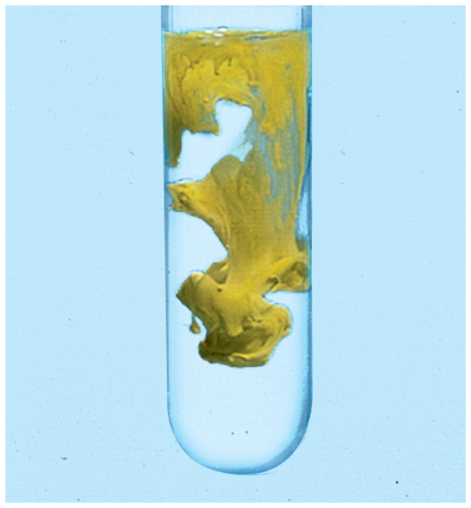
Types of Chemical Reactions in Aqueous Solution
Precipitation Reactions: Processes in which soluble reactants yield an insoluble solid product that falls out of solution
Pb(NO₃)₂(aq) + 2KI(aq)
2KNO₃(aq) + PbI₂(s)
תגובות שיקוע

Slide 9
Aqueous Reactions and Net Ionic Equations
Molecular Equation: All substances in the chemical equation are written using their complete formulas as if they were molecules.
Pb(NO₃)₂(aq) + 2KI(aq)
2KNO₃(aq) + PbI₂(s)
Strong electrolytes
Precipitate

Slide 10
Aqueous Reactions and Net Ionic Equations
Ionic Equation: All of the strong electrolytes are written as ions.
Pb(NO₃)₂(aq)
2KI(aq)
Pb²⁺(aq) + 2NO₃¯(aq) + 2K⁺(aq) + 2I¯ (aq)
2K⁺(aq) + 2NO₃¯(aq) + PbI₂(s)
2KNO₃(aq)

Slide 11
Aqueous Reactions and Net Ionic Equations
Spectator Ions: Ions that undergo no change during the reaction and appear on both sides of the reaction arrow.
Pb²⁺(aq) + 2NO₃¯(aq) + 2K⁺(aq) + 2I¯(aq)
2K⁺(aq) + 2NO₃¯(aq) + PbI₂(s)

Slide 12
Aqueous Reactions and Net Ionic Equations
Net Ionic Equation: Only the ions undergoing change are shown.
Pb²⁺(aq) + 2I¯(aq)
PbI₂(s)

Slide 13
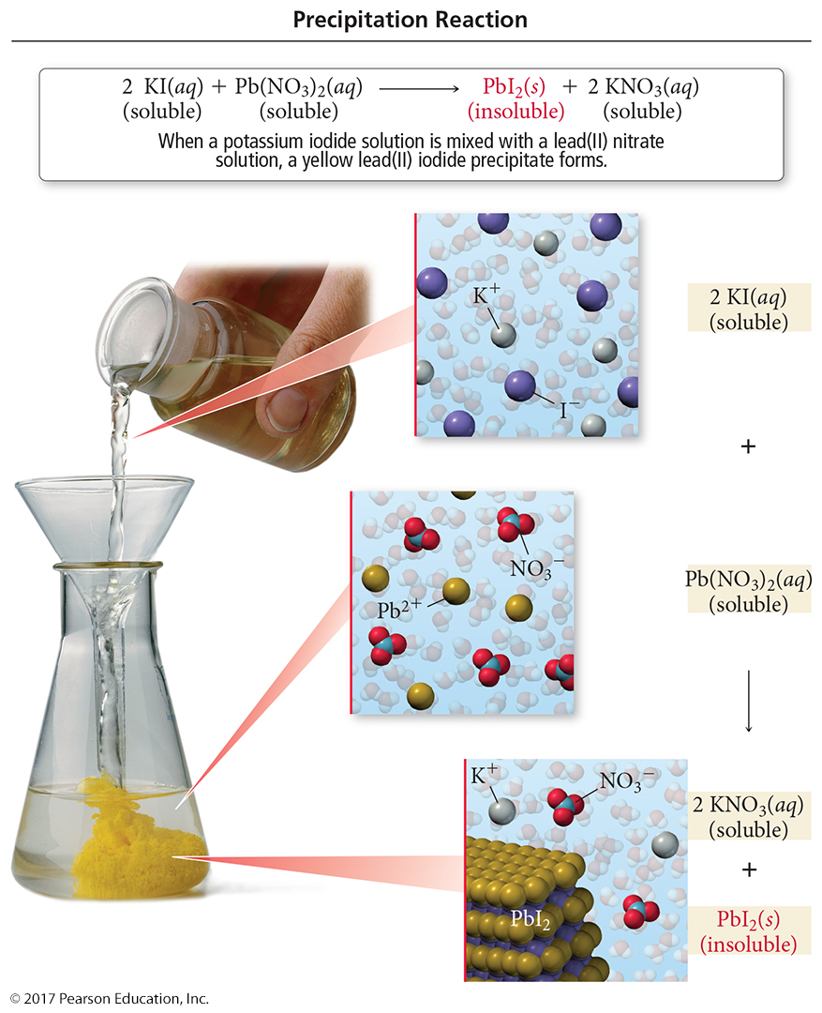
Precipitation of Lead(II) Iodide

Slide 14
Aqueous Reactions and Net Ionic Equations
שאלה:
כאשר מערבבים תמיסות מימיות של אלומיניום סולפט וסודיום הידרוקסיד, מתקבל אלומיניום הידרוקסיד קשה תמס.
רשום משוואה מולקולרית מאוזנת ומשוואה יונית נטו.

Slide 15
Balanced equation
Ionic equation
Net ionic equation

Slide 16
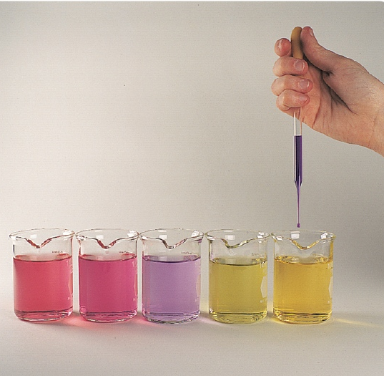
Determining whether a solution is an acid or a base
Acid solutions have a sour taste.
Basic solutions are bitter to taste and soapy to touch.
A dye is used to distinguish between acid and base by the different color changes it undergoes in these solutions.
אינדיקטור

Slide 17
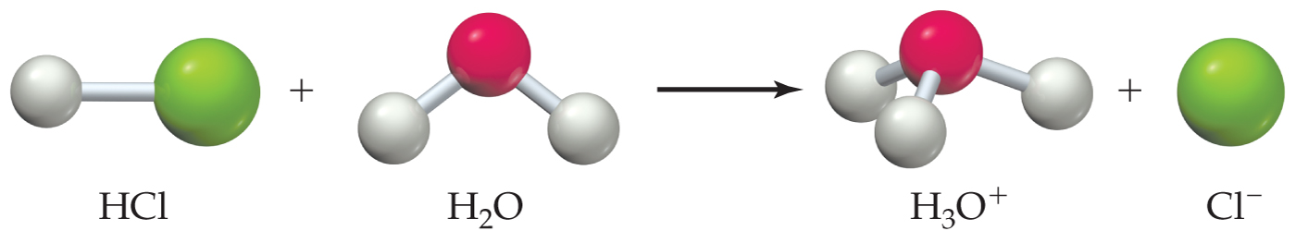
Acids, Bases, and Neutralization Reactions
Acid (Arrhenius): A substance that dissociates in water to produce hydrogen ions, H⁺:
In water, acids produce hydronium ions, H₃O⁺:
HA(aq)
H⁺(aq) + A¯(aq)
HCl(aq)
H⁺(aq) + Cl¯(aq)

Slide 18
Acids, Bases, and Neutralization Reactions
Base (Arrhenius): A substance that dissociates in water to produce hydroxide ions, OH¯:
Ammonia is weakly basic because it reacts to a small extent with water to yield ammonium and hydroxide ions:
MOH(aq)
M⁺(aq) + OH¯(aq)
NaOH(aq)
Na⁺(aq) + OH¯(aq)
NH₃(aq) + H₂O(aq)
NH₄⁺(aq) + OH¯(aq)

Slide 19
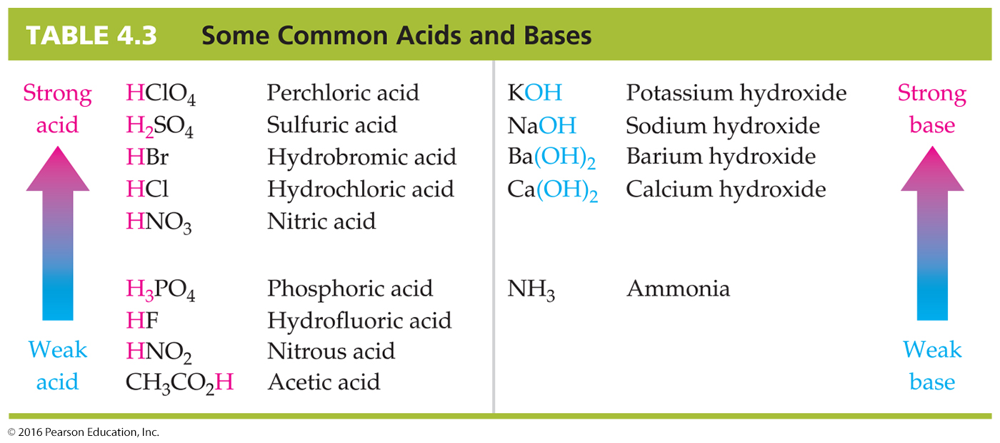
Acids, Bases, and Neutralization Reactions
Strong acids and strong bases are strong electrolytes.
Weak acids and weak bases are weak electrolytes.

Slide 20
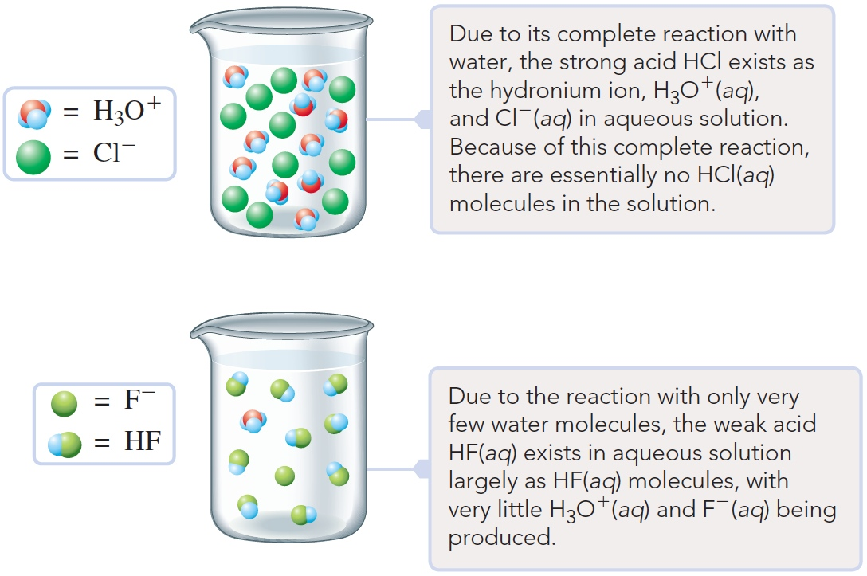
חומצה חזקה וחלשה
In Figure A, a solution of HCl (a strong acid) illustrated on a molecular/ionic level shows the acid in its ionic form.
In Figure B, a solution of HF (a weak acid), also illustrated on a molecular/ionic level, shows mostly molecules with very few ions.
A
B

Slide 21
Neutralization Reaction
A reaction of an acid and a base that results in an ionic compound and possibly water.
The ionic compound that is a product of a neutralization reaction is called a salt.

Slide 22
Acids, Bases, and Neutralization Reactions
Write the molecular, ionic, and net ionic equations for the reaction of aqueous HBr and aqueous Ba(OH)₂.
Write the chemical formulas of the products (use proper ionic rules for the salt).
HBr(aq)
+
Ba(OH)₂(aq)
H₂O
+
BaBr₂
Acid
Base
Water
Salt

Slide 23
Acids, Bases, and Neutralization Reactions
Write the molecular, ionic, and net ionic equations for the reaction of aqueous HBr and aqueous Ba(OH)₂.
2. Molecular Equation: Balance the equation:
2HBr(aq) + Ba(OH)₂(aq)
2H₂O(l) + BaBr₂(aq)

Slide 24
Acids, Bases, and Neutralization Reactions
Write the molecular, ionic, and net ionic equations for the reaction of aqueous HBr and aqueous Ba(OH)₂.
3. Ionic Equation: Dissociate the strong acid and the
soluble ionic compounds.
2HBr(aq)
Ba(OH)₂(aq)
2H⁺(aq) + 2Br¯(aq) + Ba²⁺(aq) + 2OH¯(aq)
2H₂O(l) + Ba²⁺(aq) + 2Br¯(aq)
BaBr₂(aq)

Slide 25
Acids, Bases, and Neutralization Reactions
Write the molecular, ionic, and net ionic equations for the reaction of aqueous HBr and aqueous Ba(OH)₂.
4. Net Ionic Equation: Eliminate the spectator ions from the
ionic equation.
2H⁺(aq) + 2Br¯(aq) + Ba²⁺(aq) + 2OH¯(aq)
2H₂O(l) + Ba²⁺(aq) + 2Br^{1¯}(aq)
2H⁺(aq) + 2OH¯(aq)
2H₂O(l)
H⁺(aq) + OH¯(aq)
H₂O(l)

Slide 26
Acids and Bases
Brönsted-Lowry:
An acid is any substance that donates H⁺(aq) [A proton] to another species in an aqueous solution.
HX(aq) + H₂O(l)→ H₃O⁺(aq) + X–(aq)
A base is any substance that accepts an H⁺(aq) [A proton] in an aqueous solution.
H⁺(aq) + NH₃(aq)→ NH₄⁺(aq)

Slide 27
Acid−base reactions with gas formation
Interchanging the carbonate ion with the chloride ion gives the following equation:
חומצה פחמתית -Carbonic acid
Polyprotic Acid
It is an acid that results in two or more acidic hydrogens per molecule.
חומצה רב פרוטית

Slide 28
תגובות חמצון-חיזור
Cu(29) ,Fe( 26) :מספר אטומי
Cu⁺ + Fe³⁺ → Cu²⁺ + Fe²⁺
מחצית התגובה של החמצון:
Cu⁺ - e → Cu²⁺
+ e Cu⁺ → Cu²⁺
חמצון (עליה בדרגת החמצון) , Cu⁺ מחזר
מחצית התגובה של החיזור:
Fe³⁺ + e → Fe²⁺
חיזור (ירידה בדרגת החמצון) , Fe³⁺ מחמצן
Oxidation Number
This is the actual charge of the atom if it exists as a monoatomic ion, or a hypothetical charge assigned to the atom in the substance using simple rules.

Slide 29
Half-reaction
It is one of two parts of an oxidation–reduction reaction, one part of which involves a loss of electrons (or increase in oxidation number) and the other part of which involves a gain of electrons (or decrease in oxidation number).

Slide 30
Oxidation
It is the half-reaction in which there is a loss of electrons by a species (or an increase of oxidation number).
Reduction
It is the half-reaction in which there is a gain of electrons by a species (or a decrease of oxidation number).

Slide 31
Oxidizing Agent
It is a species that oxidizes another species; it is itself reduced.
Reducing Agent
It is a species that reduces another species; it is itself oxidized.

Slide 32
Rules for Assigning Oxidation Numbers
Elements - The oxidation number of an atom in an element is zero.
Monoatomic ions - The oxidation number of an atom in a monatomic ion equals the charge on the ion.
Oxygen - The oxidation number of oxygen is −2 in most of its compounds. (An exception is O in H₂O₂ and other peroxides, where the oxidation number is −1.)
Hydrogen - The oxidation number of hydrogen is +1 in most of its compounds. (The oxidation number of hydrogen is −1 in binary compounds with a metal such as CaH₂.)

Slide 33
Halogens - The oxidation number of fluorine is −1. Each of the other halogens (Cl, Br, I) has an oxidation number of −1 in binary compounds, except when the other element is another halogen above it in the periodic table or the other element is oxygen.
Compounds and ions - The sum of the oxidation numbers of the atoms in a compound is zero. The sum of the oxidation numbers of the atoms in a polyatomic ion equals the charge on the ion.

Slide 34
Obtain the oxidation number of the chlorine atom in ClO₃–.
Using Rule 6:
(Oxidation number of Cl) +3
×(oxidation number of O) = –1
Using rule 3:
(Oxidation number of Cl) +3 ×(–2) = –1
Oxidation number of Cl (in ClO₃–) = –1 –3 ×(–2) = +5
In ClO₃–, the oxidation number of Cl is 5.

Slide 35
Common Oxidation–Reduction Reactions
Combination reaction
Decomposition reaction
Displacement reaction
Combustion reaction

Slide 36
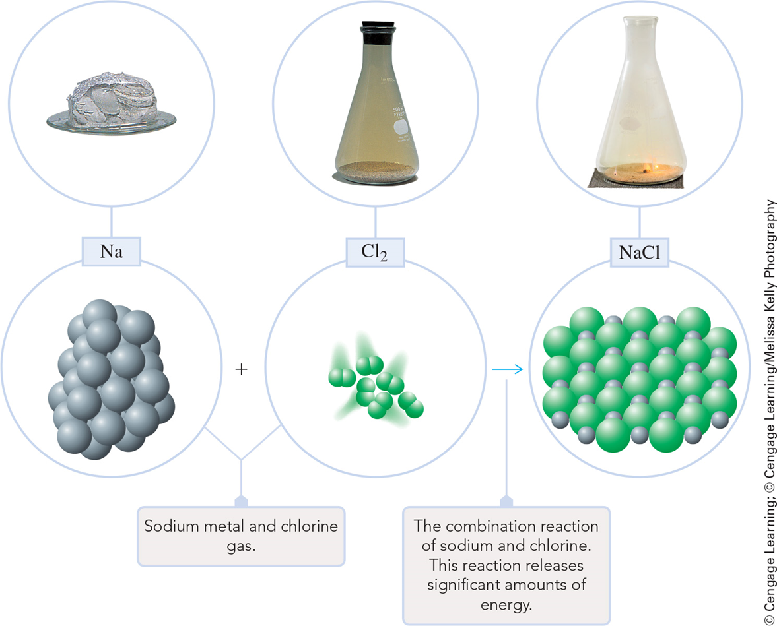
Combination Reaction
A reaction in which two substances combine to form a third substance.
2 Na(s) + Cl₂(g) → 2 NaCl(s)

Slide 37
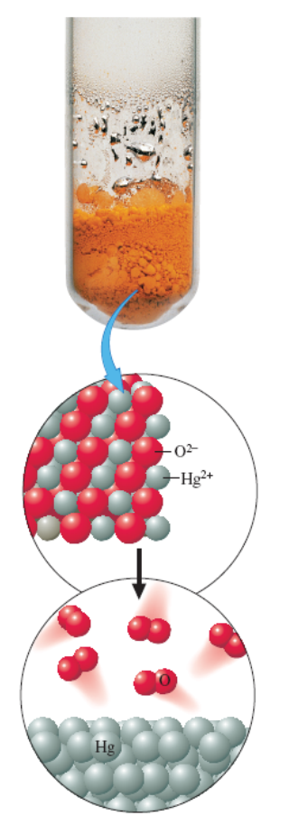
Decomposition Reaction
It is a reaction in which a single compound reacts to give two or more substances.
חימום
©2017 Cengage Learning. All Rights Reserved. May not be copied, scanned, or duplicated, in whole or in part, except for use as permitted in a license distributed with a certain product or service or otherwise on a password-protected website for classroom use.

Slide 38
Displacement Reaction
It is a reaction in which an element reacts with a compound, displacing another element from it.

Slide 39
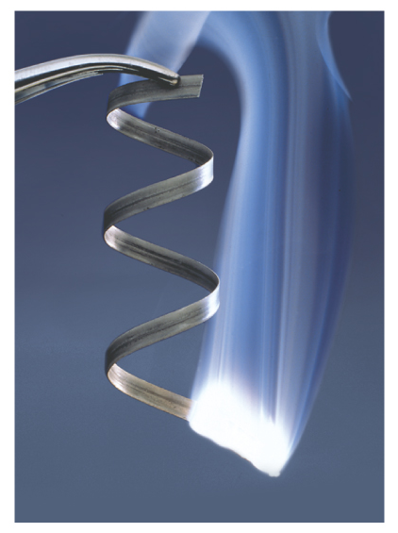
Combustion Reaction
It is a reaction in which a substance reacts with oxygen, usually with the rapid release of heat to produce a flame.
2Mg(s) + O₂(g)
2MgO(s)
©2017 Cengage Learning. All Rights Reserved. May not be copied, scanned, or duplicated, in whole or in part, except for use as permitted in a license distributed with a certain product or service or otherwise on a password-protected website for classroom use.

Slide 40
Balancing Simple Oxidation−Reduction Reactions: Half-Reaction Method
First, identify what is oxidized and what is reduced by determining the oxidation numbers.
Balance each half-reaction and combine them to obtain a balanced oxidation reaction.

Slide 41
Balancing Simple Oxidation−Reduction Reactions
For the reaction
Zn is oxidized, resulting in Zn²⁺.
Ag⁺ is reduced, resulting in Ag.

Slide 42
Balancing Simple Oxidation−Reduction Reactions
Next, balance the charge in each half-reaction by adding electrons to the more positive side.
©2017 Cengage Learning. All Rights Reserved. May not be copied, scanned, or duplicated, in whole or in part, except for use as permitted in a license distributed with a certain product or service or otherwise on a password-protected website for classroom use.

Slide 43
Balancing Simple Oxidation−Reduction Reactions
Zinc loses more electrons during oxidation than silver gains during reduction. Since Ag can gain only one electron, the amount of Ag must be doubled for it to accept all the electrons produced by Zn during oxidation. This can be accomplished by multiplying each half-reaction by a factor.
The electrons cancel, resulting in the balanced oxidation reaction
1(Zn → Zn²⁺ + 2e⁻)
2(Ag⁺ + e⁻ → Ag)

Slide 44
Half-Reaction Method in Acidic and Basic Solutions
In this chapter we will focus on electron transfer rather than proton transfer so the hydronium ion, H₃O⁺(aq), will be represented by its simpler notation, H⁺(aq). Only the notation, not the chemistry, is different.
Notes:
2

Slide 45
Half-Reaction Method in Acidic and Basic Solutions
  First, identify what is being oxidized and what is being reduced.
  Second, identify the species resulting from oxidation and reduction.
  Third, determine if the reaction occurs in an acidic or a basic solution.
Notes:
2

Slide 46
Half-Reaction Method in Acidic and Basic Solutions
For example, consider the skeleton reaction:
+2 +7 +3 +2
(acidic solution)
We determine the oxidation numbers of Fe and Mn in each of the substances.
Fe²⁺(aq) is oxidized from +2 to +3 in Fe³⁺(aq).
MnO₄– is reduced from +7 to +2 in Mn²⁺(aq).
The reaction occurs under acidic conditions.
Fe²⁺(aq) + MnO₄─ (aq) → Fe³⁺(aq) + Mn²⁺ (aq)
Notes:
2

Slide 47
Half-Reaction Method in Acidic and Basic Solutions
Steps in balancing oxidation–reduction equations in acidic solutions:
Assign oxidation numbers to each atom so you know what is oxidized and what is reduced.
Now split the skeleton reaction into half-reactions and:
  Note the species containing the element that increases and decreases in oxidation number.
  Write those species to give oxidation and reduction half-reactions respectively.
Notes:
2

Slide 48
Half-Reaction Method in Acidic and Basic Solutions
Complete and balance each half-reaction
  Balance all atoms except H and O.
  Balance O atoms by adding H₂O to the side of the equation that needs O.
  Balance H by adding H⁺ to the side of the equation that needs H.
  Balance the electric charge by adding electrons (e⁻) to the more positive side of the equation.
Notes:
2

Slide 49
Half-Reaction Method in Acidic and Basic Solutions
Finally, we combine the two half-reactions.
  Multiply each half-reaction by a factor so that each has the same number of electrons.
  Add the two half-reactions (the electrons should cancel).
  Simplify the overall reaction by canceling species that occur on both sides and reducing coefficients to the smallest whole numbers.
  Check that the equation is balanced.
Notes:
2

Slide 50
Half-Reaction Method in Acidic and Basic Solutions
Let us apply these steps to the skeleton equation for the oxidation of iron(II) ion by permanganate ion in acidic solution.
Oxidation half-reaction
Note that since the equation is balanced in Fe as it stands (Step 3a), you need to balance the half-reaction only in electric charge. (Step 3d)
Notes:
2

Slide 51
Reduction half-reaction
The equation is balanced in Mn as it stands. (Step 3a). Next, balance the O atoms (Step 3b).
Then, balance the H atoms (Step 3c).
Finally, balance the half-reaction in electric charge.
Reduction half-reaction
Notes:
2

Slide 52
Half-Reaction Method in Acidic Solutions
Now multiply each half-reaction by a factor such that when the two half-reactions are added, the electrons will cancel.
Now the equation is in its simplest form (step 4b).
The final balanced equation is:
Notes:
2

Slide 53
Half-Reaction Method in Acidic Solutions
Zinc metal reacts with nitric acid, HNO₃, to produce a number of products, depending on how dilute the acid solution is. In a concentrated solution, zinc reduces nitrate ion to ammonium ion; zinc is oxidized to zinc ion, Zn²⁺. Write the net ionic equation for this reaction.

Slide 54
Solution
The skeleton equation, with oxidation numbers for those atoms that change values, is:
Separate this equation into two incomplete half-reactions. Note that zinc is oxidized, and nitrogen is reduced.
The oxidation half-reaction is balanced in Zn.
0
+ 5
+ 2
- 3
Notes:
2

Slide 55
Solution
The reduction half-reaction is balanced in N but is not complete in either O or H. Therefore, add three H₂O’s to the right side to balance O atoms. Add ten H⁺ to the left side to balance the four H atoms in the NH₄⁺ ion and the six H atoms in the H₂Os.
Now add electrons to the more positive side to balance the charge.
Notes:
2

Slide 56
Solution
Multiply the two half-reactions by factors so that when added, the electrons cancel. Multiply the oxidation-half reaction by 4 and the reduction half-reaction by 1.
The equation requires no further simplification. The net ionic equation is:
Notes:
2

Slide 57
Additional steps for balancing oxidation–reduction equations in basic solution
To balance a reaction in basic conditions, first follow the same procedure as for acidic solution.
Then:
Note the number of H⁺ ions in the equation. Add this number of OH⁻ ions to both sides of the equation.
Simplify the equation by noting that H⁺ and OH⁻ react to form H₂O. Cancel water molecules that occur on both sides.
Notes:
2

Slide 58
Balancing oxidation–reduction equations in basic solution
Permanganate ion oxidizes sulfite ion in basic solution according to the following skeleton equation:
Use the half-reaction method to complete and balance this equation.

Slide 59
Solution
After balancing the equation as if it were in acidic solution, we obtain the following:
Following step 5, add 2 OH– to both sides of the equation.
2H₂O
Notes:
2

Slide 60
Solution
Replace 2H⁺ + 2OH– with 2H₂O on the left side. Cancel one of these with the H₂O on the right side. The balanced equation for the reaction in basic solution is:
Notes:
2

Slide 61
Molar Concentration, Molarity, (M or C)
Moles of solute per liter of solution
M ≡ mol/L
c(solute) = 5.12 M
          [solute] = 5.12 M
V of solution not solvent
Brackets [ ] represent “molarity of ”

Slide 62
Solution Preparation from Pure Solute
Prepare a 0.5000 M solution of KMNO₄ (potassium permanganate) in a 250.0 mL volumetric flask.
Mass of KMnO₄ required
n_{KMnO4} = c(KMnO₄) x V
= 0.5000 M x 0.2500 L (M ≡ mol/L)
= 0.1250 mol
mass_{KMnO4} = 0.1250 mol x 158.03 g/mol
= 19.75 g

Slide 63
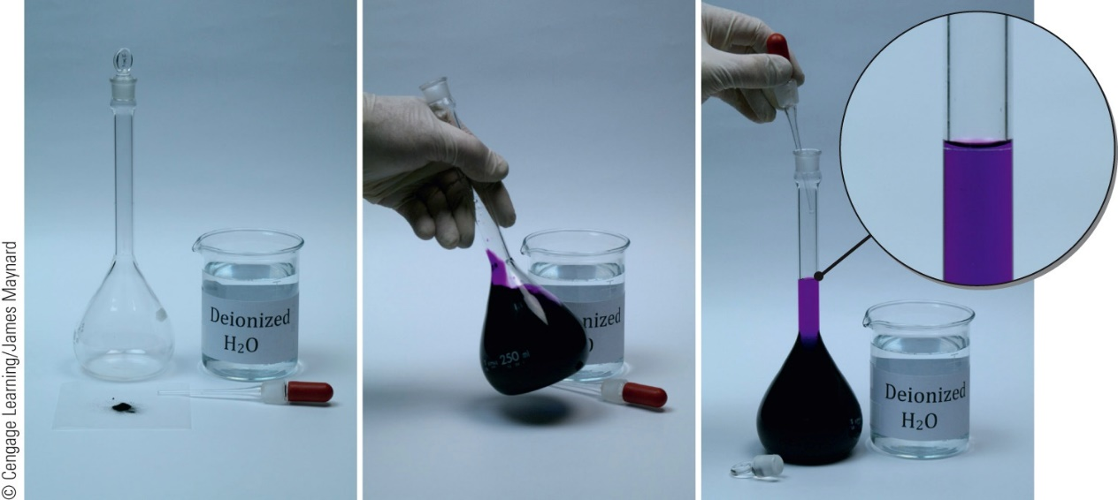
Solution Preparation from Pure Solute
Weigh exactly 19.75 g of pure KMnO₄. Transfer to a volumetric flask.
Rinse all solid from the weighing dish into the flask.
Fill the flask ≈ ⅓ full
Swirl to dissolve the solid
Fill the flask to the mark on the neck.
Shake to thoroughly mix

Slide 64
Molarity
36.0 g of sodium sulfate are dissolved in enough water to make 750.0 mL of solution. Calculate the molarity of the Na₂SO₄.
36.0 g
142.0 g/mol
n_{Na2SO4} =
= 0.2534 mol
0.2534 mol
0.7500 L
c(Na₂SO₄) =
Unit change!
mL → L
c(Na₂SO₄) = 0.338 mol/L = 0.338 M

Slide 65
Molarity
6.37 g of Al(NO₃)₃ are dissolved to make a 250. mL aqueous solution. Calculate (a) c(Al(NO₃)₃) (b) c(Al³⁺) and c(NO₃⁻).
(a) Al(NO₃)₃ molar mass = 26.98 + 3(14.00) + 9(16.00)
g
mol
= 213.0
6.37 g
213.0 g/mol
n_{Al(NO3)3}= = 2.991 x 10⁻² mol
2.991 x 10⁻² mol
0.250 L
c(Al(NO₃)₃) = = 0.120 M

Slide 66
Molarity
6.37 g of Al(NO₃)₃ in a 250. mL solution. (a) c(Al(NO₃)₃)? (b) c(Al³⁺) and c(NO₃⁻)?
(b) Molarity of Al³⁺ , NO₃⁻?
Al(NO₃)₃(aq) → Al³⁺(aq) + 3 NO₃⁻(aq)
1 Al(NO₃)₃ ≡ 1 Al³⁺
1 Al³⁺
1 Al(NO₃)₃
c(Al³⁺) =0.120 M Al(NO₃)₃ = 0.120 M Al³⁺
1 Al(NO₃)₃ ≡ 3 NO₃⁻
3 NO₃⁻
1 Al(NO₃)₃
c(NO₃⁻) = 0.120 M Al(NO₃)₃ = 0.360 M NO₃⁻

Slide 67
Expressing Solution Composition
Mass Solute
Total Mass of Solution
Mass fraction =
Weight percent =
Mass fraction x 100%
Example
Saline solutions, NaCl(aq), are often used in medicine. What is the weight percent of NaCl in a solution of 4.6 g of NaCl in 500. g of water?
4.6 g
500. g + 4.6 g
mass fraction =
= 0.0091
weight percent = 0.0091 x 100% = 0.91 %

Slide 68
Molarity
Commercial 30.0% hydrogen peroxide has density = 1.11 g/mL at 25°C. What is its molarity?
30.0 % H₂O₂ = 30.0 g H₂O₂ in 100.0 g of solution
30.0 g
34.01 g mol⁻¹
Moles of H₂O₂ =
= 0.8821 mol
100.0 g
1.11 g/mL
Volume of solution =
= 90.09 mL
0.8821 mol
0.09009 L
= 9.79 M
[H₂O₂] =

Slide 69
Diluting Solutions
Attaining a solution with specific aqueous content requires diluting it with a predetermined amount of water. This requires knowledge of the relationship between the molarity of the solution before dilution, and that after dilution.
It is known that:
This can be rearranged to give
מיהול

Slide 70
מיהול
This can be rearranged to give:
Upon dilution, the concentration and volume changes.
As the moles of solute have not changed during the dilution, it can be observed that:
or
C₁xV₁ = C₂xV₂
©2017 Cengage Learning. All Rights Reserved. May not be copied, scanned, or duplicated, in whole or in part, except for use as permitted in a license distributed with a certain product or service or otherwise on a password-protected website for classroom use.

Slide 71
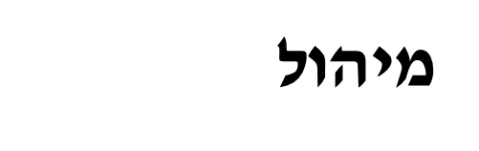
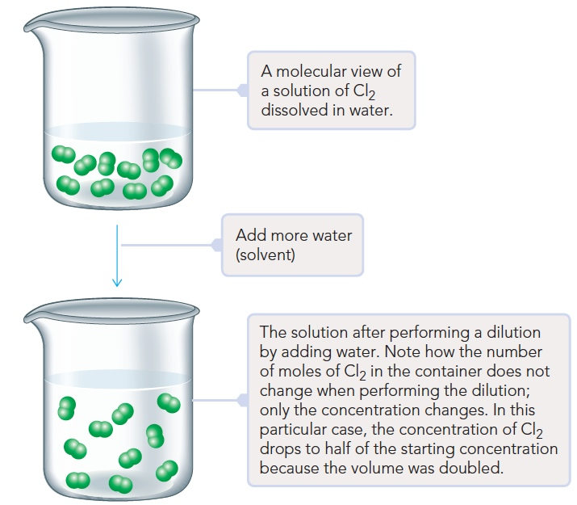
Notes:
Figure 4.19. Page 134.

Slide 72
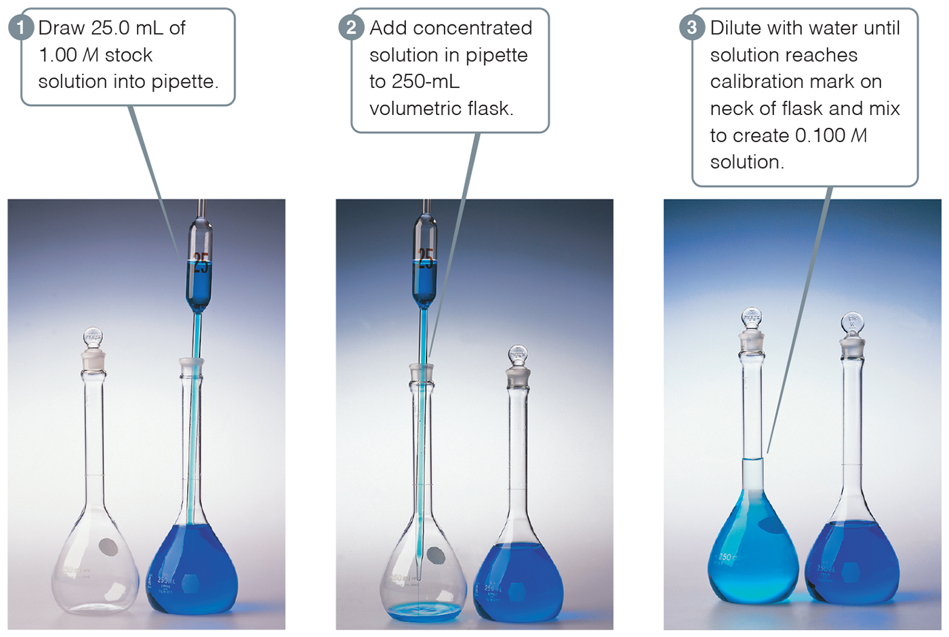
Dilution
A solution can be diluted by adding ONLY solvent. The concentration is LOWER, but the MOLES don’t change.

Slide 73
Determine the milliliters of a solution of 14.8 M NH₃ required to produce 100 mL of NH₃ with a molarity of 1.00 M.
The initial volume can be determined by rearranging the dilution formula.
©2017 Cengage Learning. All Rights Reserved. May not be copied, scanned, or duplicated, in whole or in part, except for use as permitted in a license distributed with a certain product or service or otherwise on a password-protected website for classroom use.

Slide 74
Substituting the known values:
Two concepts that can help verify the result:
The volume of the more concentrated solution should always be less than the volume of the final solution.
The initial concentration of a solution is greater than the final concentration after dilution.
©2017 Cengage Learning. All Rights Reserved. May not be copied, scanned, or duplicated, in whole or in part, except for use as permitted in a license distributed with a certain product or service or otherwise on a password-protected website for classroom use.

Slide 75
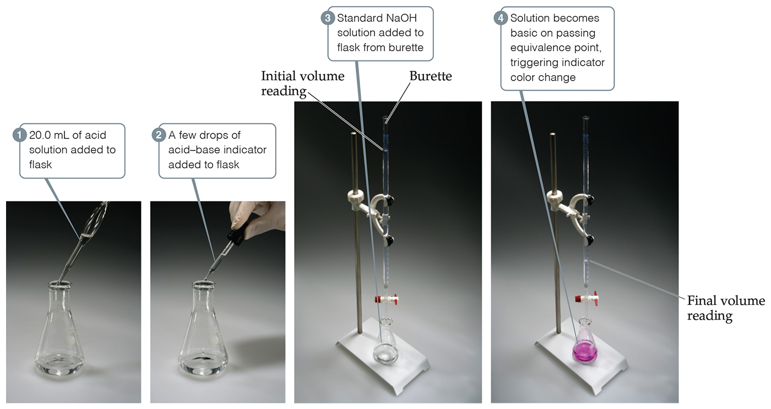
Titration
A titration is an analytical technique in which one can calculate the concentration of a solute in a solution.

Slide 76
Measuring the Concentration of a Solution: Titration
48.6 mL of a 0.100 M NaOH solution is needed to react with 20.0 mL of an unknown HCl concentration. What is the concentration of the HCl solution?
HCl(aq) + NaOH(aq)
NaCl(aq) + H₂O(l)
Volume of
solution of NaOH
Moles of
NaOH
Moles of
HCl
Volume of
solution of HCl
Molarity of NaOH
Mole ratio between NaOH and HCl
Molarity of HCl

Slide 77
Measuring the Concentration of a Solution: Titration
HCl(aq) + NaOH(aq)
NaCl(aq) + H₂O(l)
Moles of NaOH available:
0.100 mol
1 L
48.6 mL NaOH
×
×
= 0.00486 mol NaOH
1 L
1000 mL
Moles of HCl reacted:
1 mol HCl
0.00486 mol NaOH
×
= 0.00486 mol HCl
1 mol NaOH
Concentration of HCl solution:
0.00486 mol HCl
1000 mL
×
= 0.243 M HCl
20.0 mL solution
1 L

Slide 78
Titrations in Aqueous Solution
29.5 mL of 0.100 M H₂SO₄ was required to neutralize 25.0 mL NaOH. What was the NaOH concentration?
H₂SO₄(aq) + 2 NaOH(aq) → Na₂SO₄(aq) + 2 H₂O(ℓ)
0.100 mol
L
n_{H2SO4}= 0.0295 L
= 2.95 x 10⁻³ mol
2 NaOH
1 H₂SO₄
n_{NaOH} = 2.95 x 10⁻³ mol
= 5.90 x 10⁻³ mol
5.90 x 10⁻³ mol
0.0250L
c(NaOH) =
= 0.236 M

Slide 79
Ion Product of Water
Concentrations of H⁺ and OH⁻ ions in pure water are equal
  [H⁺] = 1.0 X 10⁻⁷ M = [OH⁻]
Neutral solution: Aqueous solution in which [H⁺] and [OH⁻] ions are equal
Aqueous solution in which [H⁺] is greater than [OH⁻] is acidic
Aqueous solution in which [OH⁻] is greater than [H⁺] is basic

Slide 80
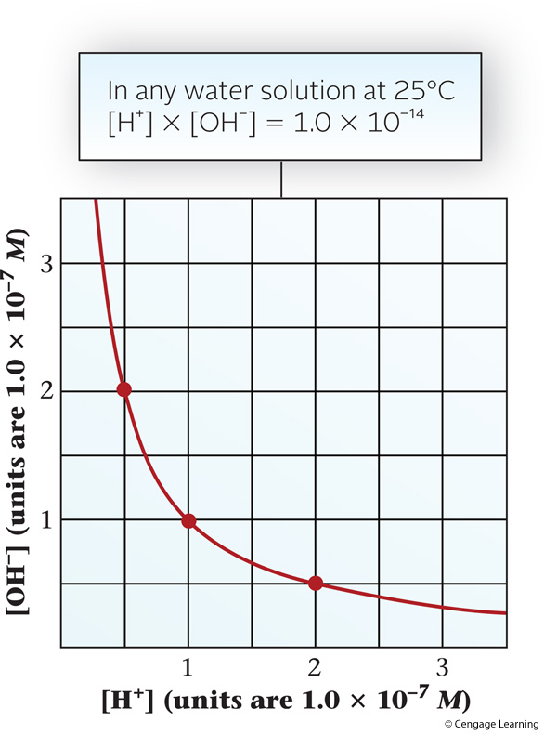
The [H⁺]-[OH⁻] Relationship

Slide 81
pH and pOH
pH
  Power of the hydrogen ion
  Higher the pH, the less acidic the solution
pOH
  Hydroxide ion concentration of a solution
  At 25ºC, pH + pOH = 14.00

Slide 82
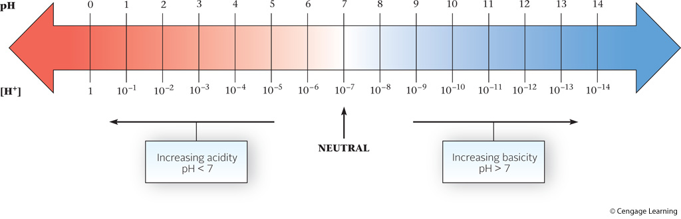
pH-[H⁺] Relationship

Slide 83
Example
Consider the following solutions at 25°C
a) Find the [H⁺] and pH of a tap water sample in which [OH⁻] = 2.0 × 10⁻⁷
  Analysis
    Information given: [OH⁻] (2.0 × 10⁻⁷ M)
    Information implied: K_{w} value
    Asked for: [H⁺] and pH
  Strategy
    Substitute into K_{w} = [H⁺][OH⁻] to obtain [H⁺]
    Substitute into to convert [H⁺] to pH

Slide 84
Example
  Solution
    [H⁺]
    pH
דרך נוספת:
pOH= -log[OH⁻]= -log(2.0x10⁻⁷)=6.70
pH= 14-pOH=14-6.7=7.30

