Slide 1
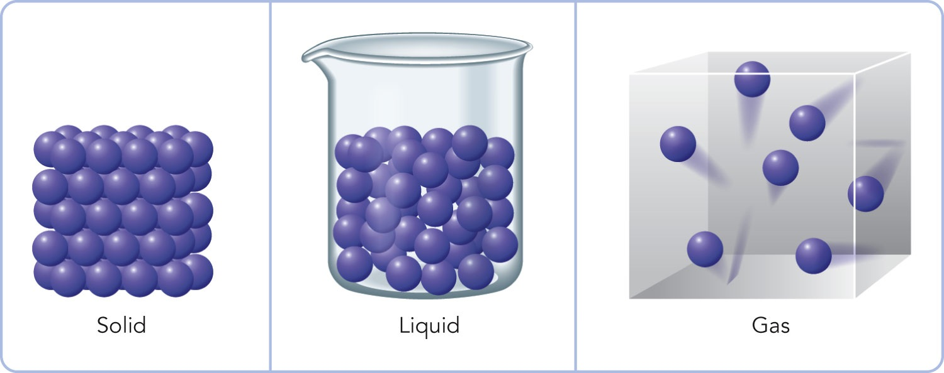
Comparing Gases, Liquids, and Solids
Gases are compressible fluids.
Liquids are relatively incompressible fluids.
Solids are nearly incompressible and rigid.

Slide 2
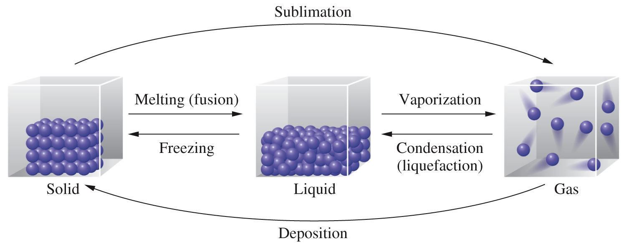
A change of state or phase transition is a change of a substance from one state (solid, liquid, gas) to another. The specific name or names for each of these transitions are given below.

Slide 3
Phase Transition
Melting is the change of a solid to the liquid state.
Freezing is the change of a liquid to the solid state.
Vaporization is the change of a solid to or a liquid to the vapor.
Sublimation is the change of a solid directly to the vapor.
Condensation is the change of a gas to either the liquid or the solid state.

Slide 4
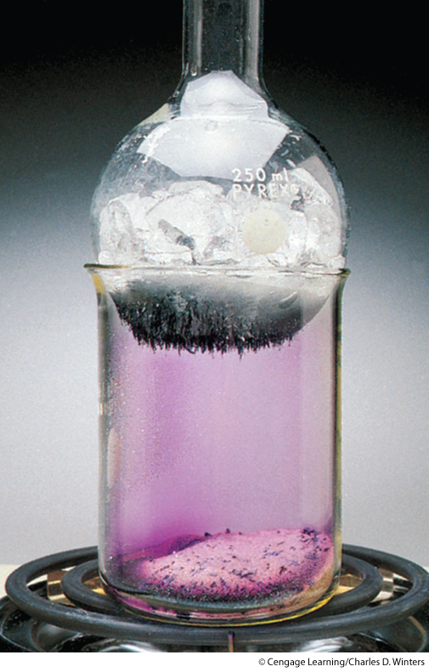
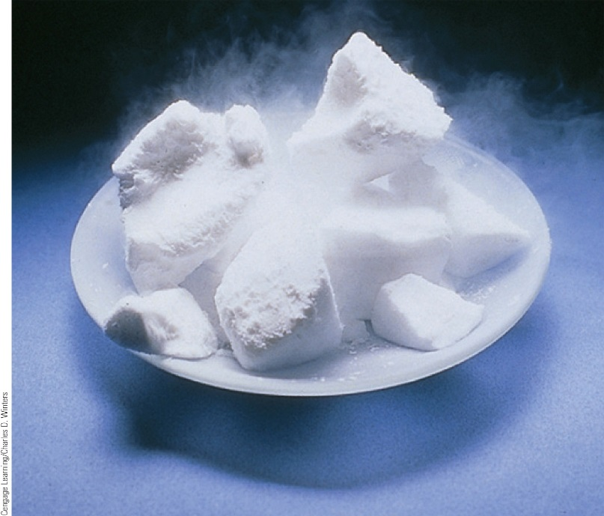
Sublimation
Solid CO₂ (dry ice) sublimes.
I₂(s) I₂(g)

Slide 5
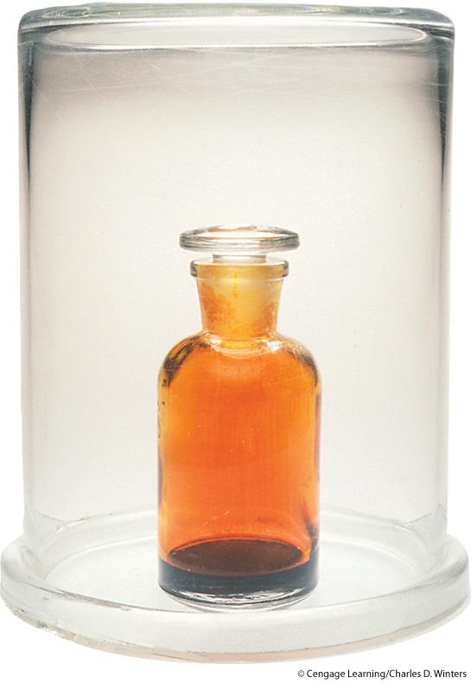
The vapor pressure of a liquid at a particular temperature is the partial pressure of the vapor over the liquid measured at equilibrium.
When a liquid is placed in a closed vessel, condensation and vaporization occurs till the systems reaches equilibrium.
At equilibrium, evaporation and condensation occur at the same rate. This situation, which is called a dynamic equilibrium, is illustrated on the next slide.

Slide 6
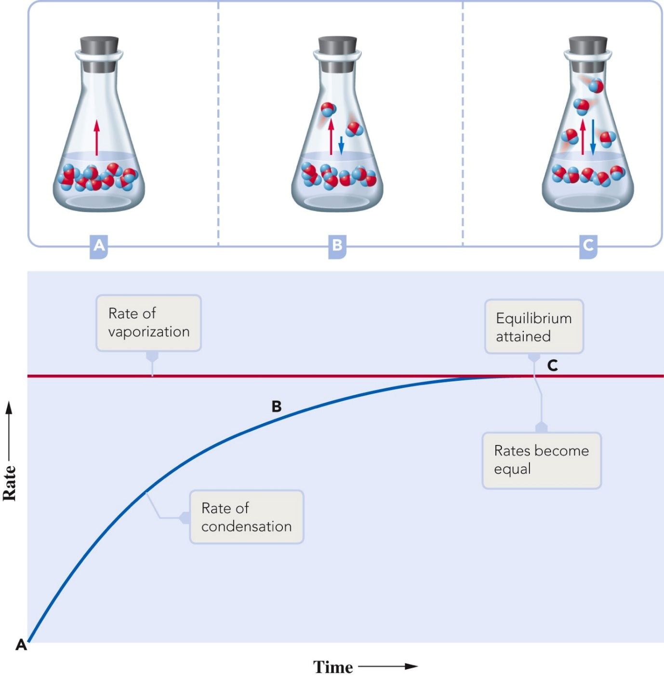
Vapor Pressure

Slide 7
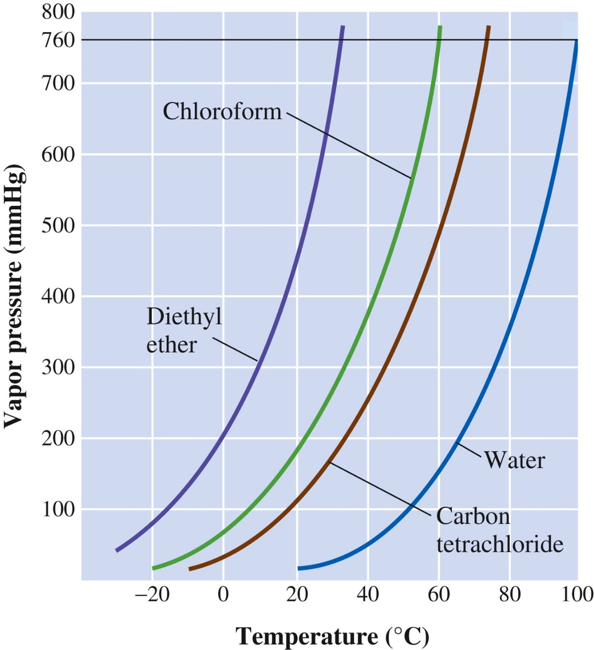
Vapor Pressure
The vapor pressure depends on the temperature. Note that as temperature increases, vapor pressure increases.
Liquids and solids with relatively high vapor pressure at normal temperatures are considered volatile.

Slide 8
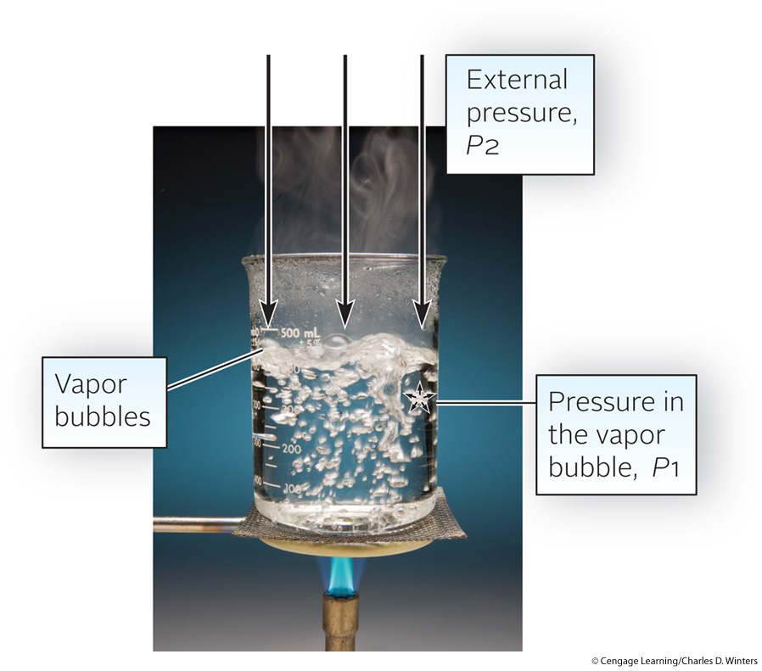
The boiling point is the temperature at which the vapor pressure is equal to the pressure on the liquid, usually atmospheric pressure. When vapor pressure equals atmospheric pressure, bubbles of gas form within the liquid, as illustrated in the figure.

Slide 9
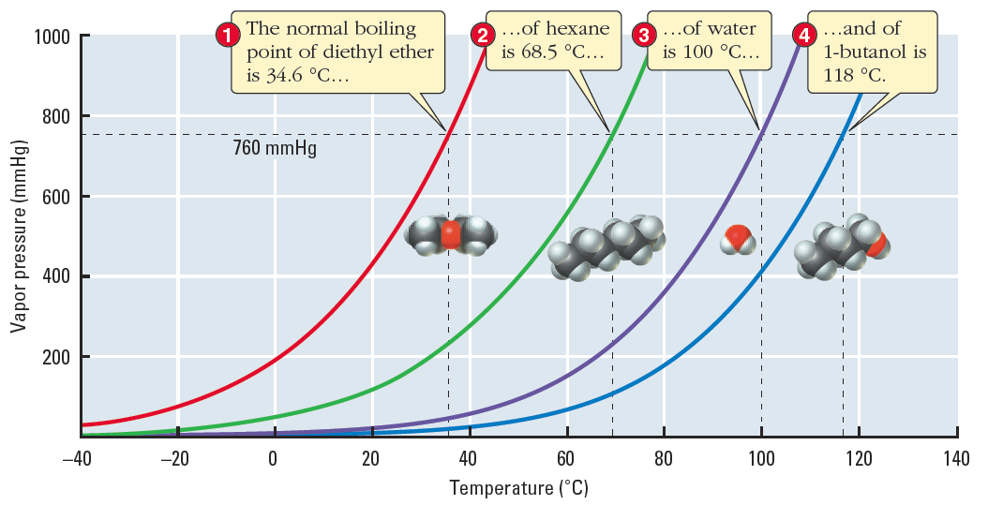
Boiling Point
When the pressure on the liquid increases, as is the case with a pressure cooker, the boiling point increases.
Conversely, when the pressure on the liquid decreases, as is the case at high altitude, the boiling point decreases.
Denver (1609 m) P = 631 mmHg
Denver (94 °C)
Sea level (100 °C)
The normal bp occurs at 1 atm = 760 mmHg.

Slide 10
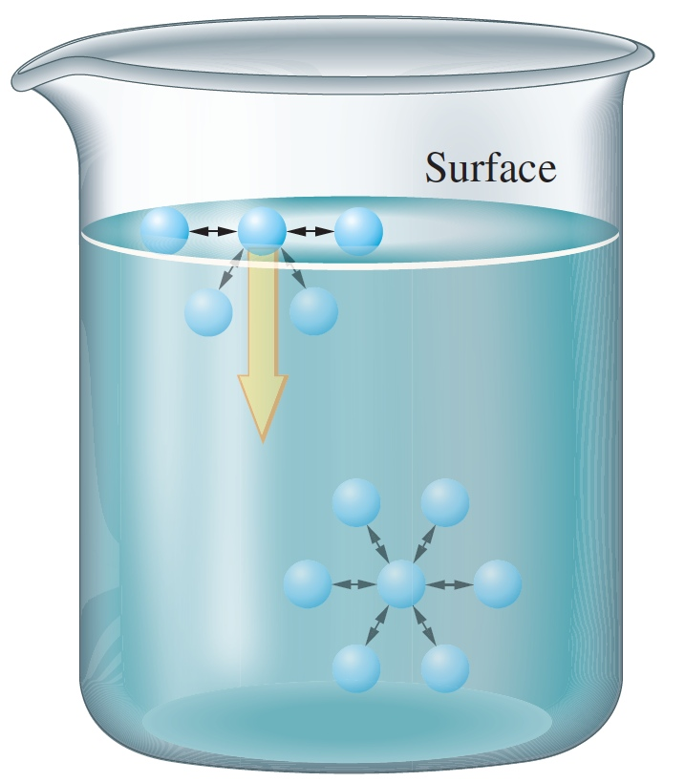
Surface tension is the energy required to increase the surface area of a liquid by a unit amount. The values are given in J/m².

Slide 11
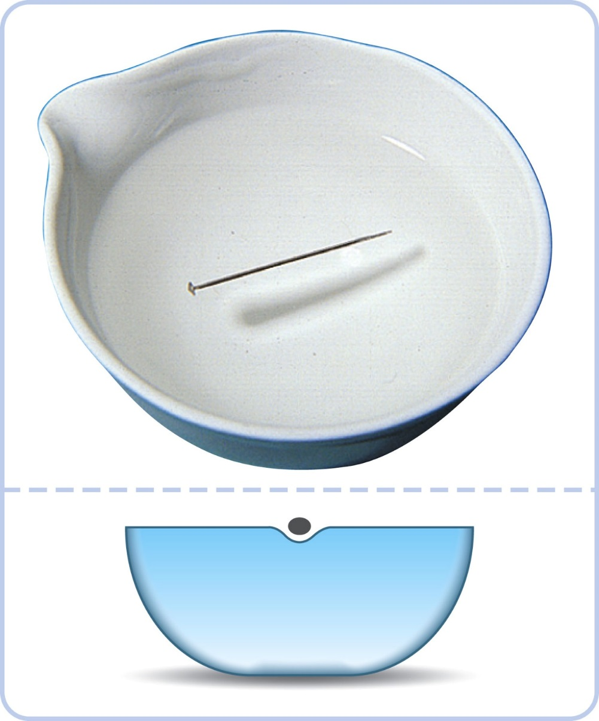
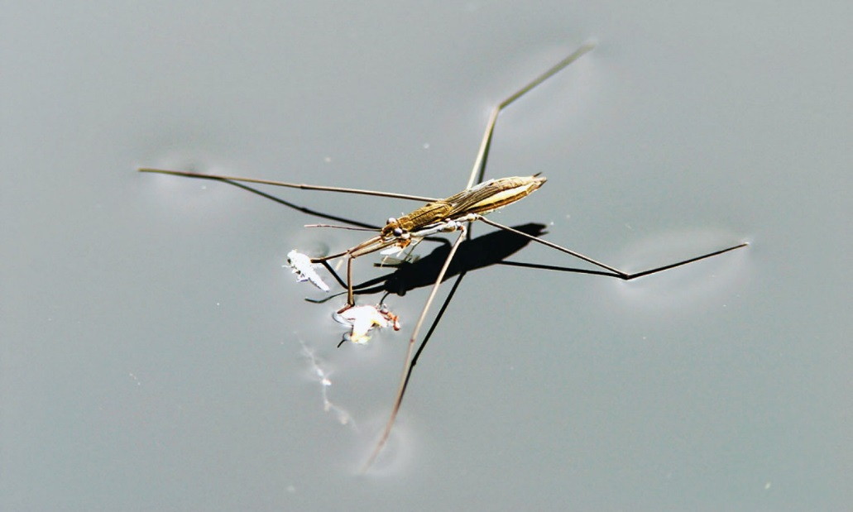
Surface tension is the property that allows insects to walk on the surface of water or a pin to float.

Slide 12
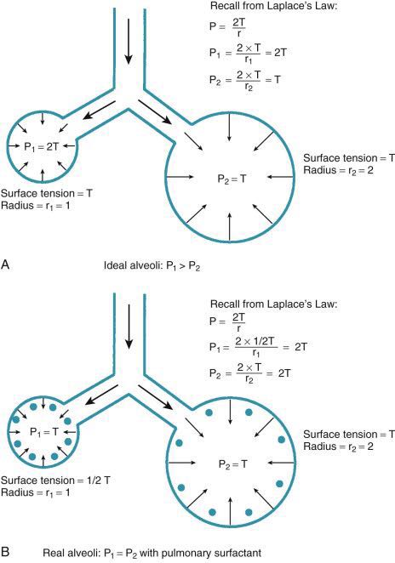
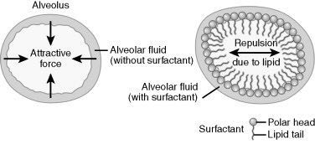
Surface Tension

Slide 13
Factors Affecting Surface Tension
The stronger the intermolecular attractive forces, the higher the surface tension will be.
Raising the temperature of a liquid reduces its surface tension.
Raising the temperature of the liquid increases the average kinetic energy of the molecules.
The increased molecular motion makes it easier to stretch the surface.

Slide 14
Cohesion and Adhesion
Intermolecular forces that bind similar molecules to one another are called cohesive forces.
Intermolecular forces that bind a substance to a surface are called adhesive forces.
These forces are important in capillary action.

Slide 15
Capillary Action
Capillary action is the ability of a liquid to flow up a thin tube against the influence of gravity.
The narrower the tube, the higher the liquid rises.
Capillary action is the result of two forces working in conjunction, the cohesive and adhesive forces.
Cohesive forces hold the liquid molecules together.
Adhesive forces attract the outer liquid molecules to the tube’s surface.

Slide 16
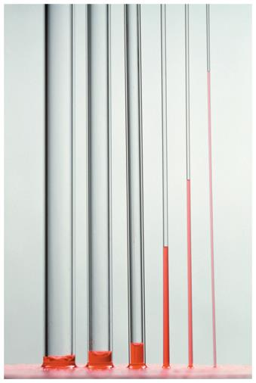
Capillary Action
The adhesive forces pull the surface liquid up the side of the tube, and the cohesive forces pull the interior liquid with it.
The liquid rises up the tube until the force of gravity counteracts the capillary action forces.
The narrower the tube diameter, the higher the liquid will rise up the tube.

Slide 17
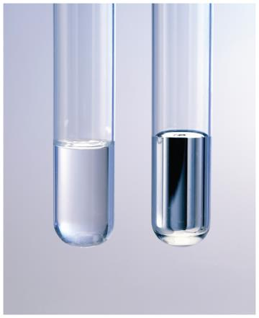
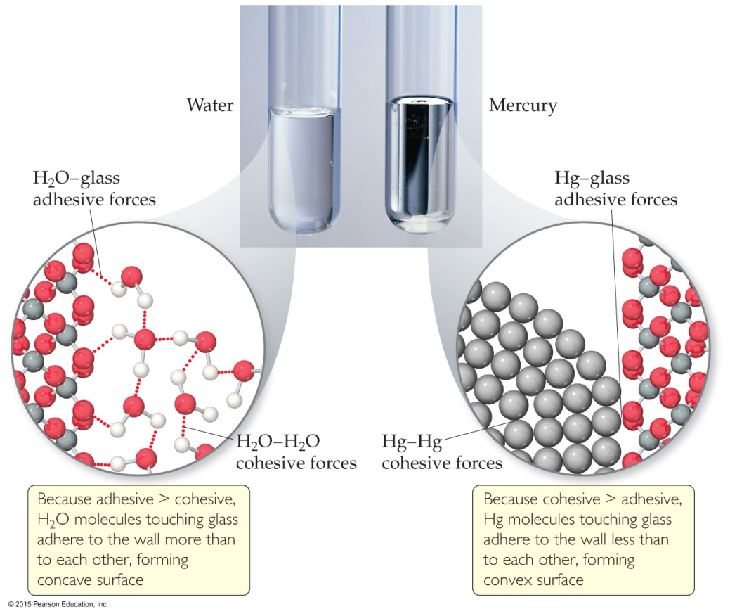
Meniscus
The curving of the liquid surface in a thin tube is due to the competition between adhesive and cohesive forces.
The meniscus of water is concave in a glass tube because its adhesion to the glass is stronger than its cohesion for itself.
The meniscus of mercury is convex in a glass tube because its cohesion for itself is stronger than its adhesion for the glass.
Metallic bonds are stronger than intermolecular attractions.

Slide 18
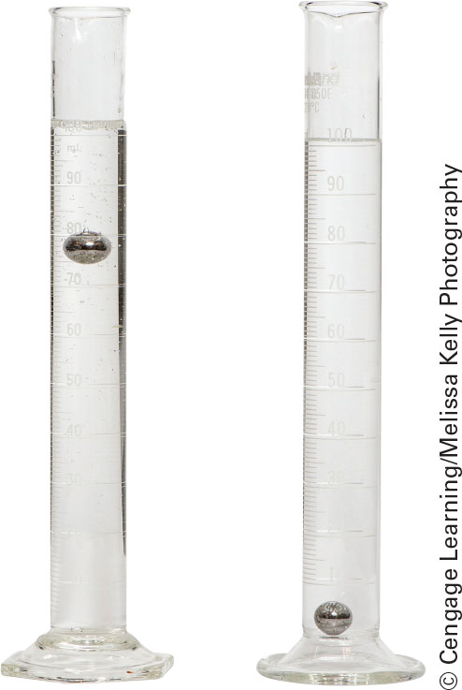
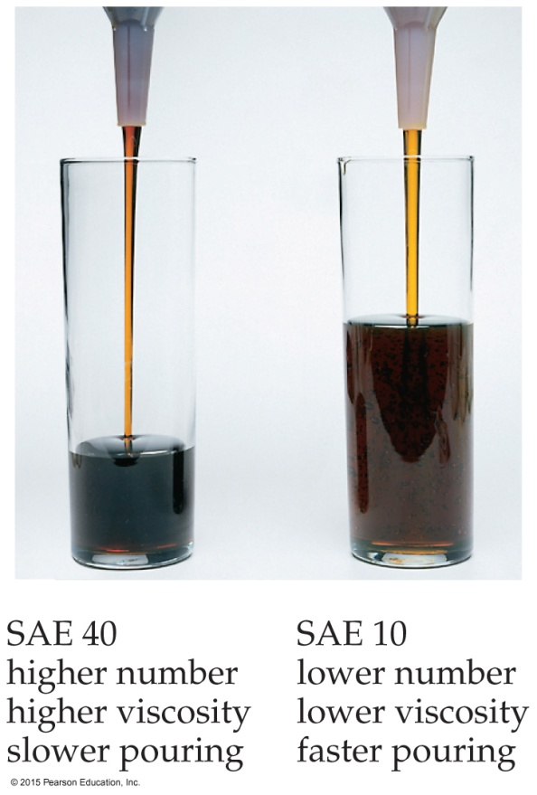
Viscosity
Resistance of a liquid to flow is called viscosity.
It is related to the ease with which molecules can move past each other.
Viscosity increases with stronger intermolecular forces and decreases with higher temperature.
steel balls were dropped into the glycerol and the water at the same time

Slide 19
Viscosity

Slide 20
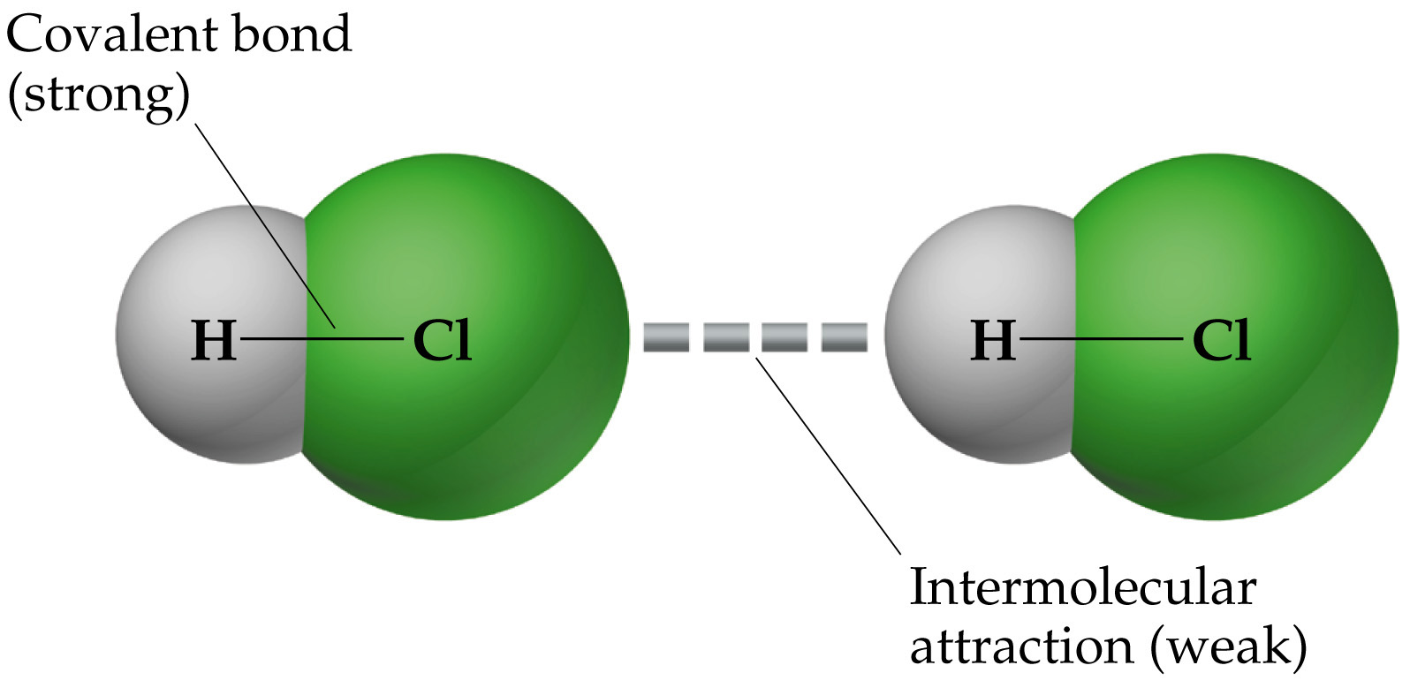
To explain the properties of liquids that we’ve just studied, we need to learn about intermolecular forces—the forces of interaction between molecules.
Intermolecular forces are much weaker than the bonds that make up compounds.

Slide 21
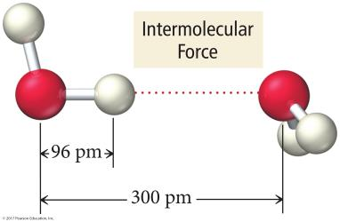
Intermolecular Attractions
The strength of the attractions among the particles of a substance determines its state.
At room temperature, moderate to strong attractive forces result in materials being solids or liquids.
The stronger the attractive forces are, the higher will be the boiling point of the liquid and the melting point of the solid.
Other factors also influence the melting point.

Slide 22
Kinds of Attractive Forces
Temporary polarity in the molecules due to unequal electron distribution leads to attractions called dispersion forces.
Permanent polarity in the molecules due to their structure leads to attractive forces called dipole–dipole attractions.
The term van der Waals forces is a general term that includes both dipole-dipole forces and London forces.
An especially strong dipole–dipole attraction results when H is attached to an extremely electronegative atom. These are called hydrogen bonds.
(London forces)

Slide 23
Dispersion Forces- London
Fluctuations in the electron distribution in atoms and molecules result in a temporary dipole.
Region with excess electron density has partial (–) charge.
Region with depleted electron density has partial (+) charge.
The attractive forces caused by these temporary dipoles are called dispersion forces.
AKA London forces
All molecules and atoms will have them.
As a temporary dipole is established in one molecule, it induces a dipole in all the surrounding molecules.

Slide 24
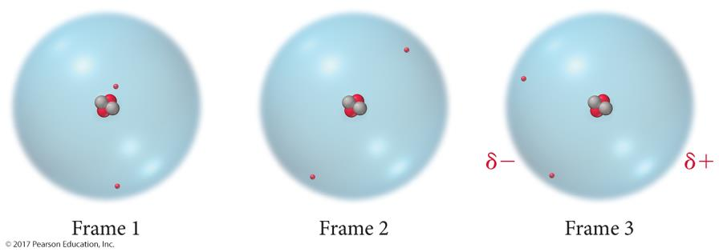
Dispersion Forces- London

Slide 25
Dispersion Forces- London

Slide 26
Size of the Instantaneous Dipole
The magnitude of the instantaneous dipole depends on several factors.
Polarizability of the electrons
Volume of the electron cloud
Larger molar mass = more electrons = larger electron cloud = increased polarizability = stronger attractions
Shape of the molecule
More surface-to-surface contact = larger induced dipole = stronger attraction

Slide 27
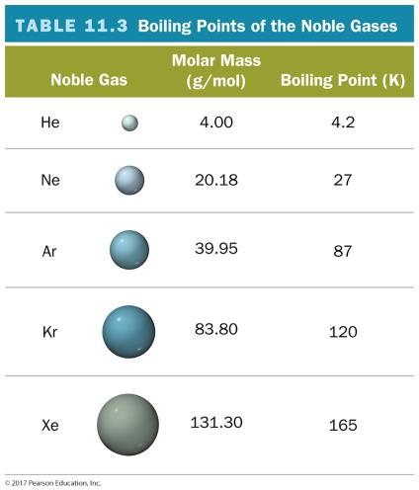
Effect of Molecular Size on Size of Dispersion Force
The noble gases are all nonpolar atomic elements.
The stronger the attractive forces among the molecules, the higher the boiling point will be.

Slide 28
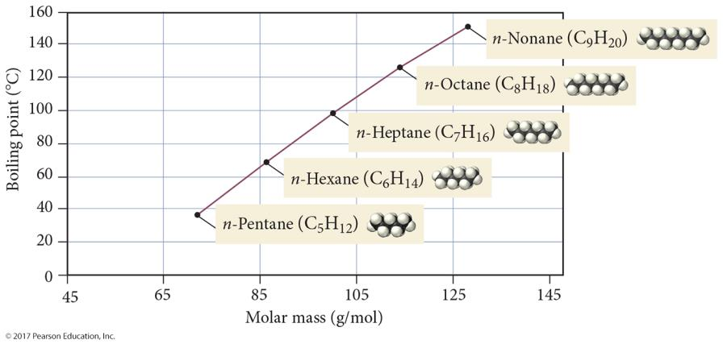
Boiling Points of n-Alkanes

Slide 29
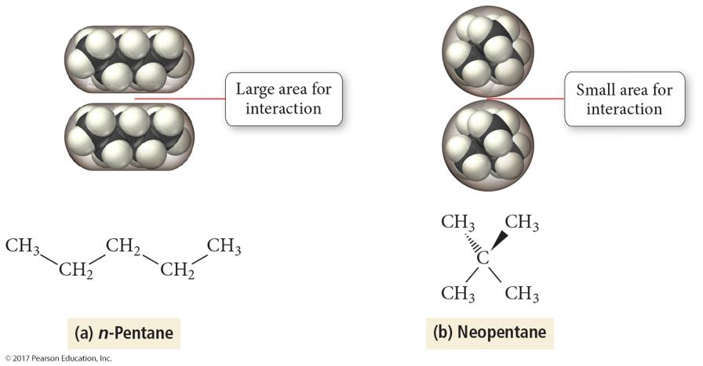
Effect of Molecular Shape on Size of Dispersion Force
Branched chains have lower boiling points than straight chains.
The straight-chain isomers have more surface-to-surface contact.

Slide 30
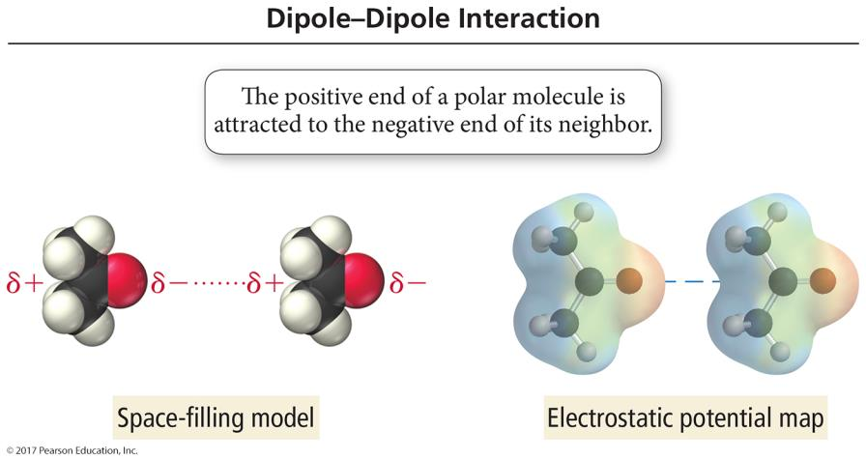
Dipole–Dipole Forces
Polar molecules have a permanent dipole.
The permanent dipole adds to the attractive forces among the molecules, raising the boiling and melting points relative to nonpolar molecules of similar size and shape.

Slide 31
Trends in the Strength of Intermolecular Attraction
The stronger the attractions among the atoms or molecules, the more energy it will take to separate them.
Boiling a liquid requires that we add enough energy to overcome all the attractions among the particles.
However, not breaking the covalent bonds
The higher the normal boiling point of the liquid, the stronger the intermolecular attractive forces.

Slide 32
Effect of Dipole–Dipole Attraction on Boiling and Melting Points

Slide 33
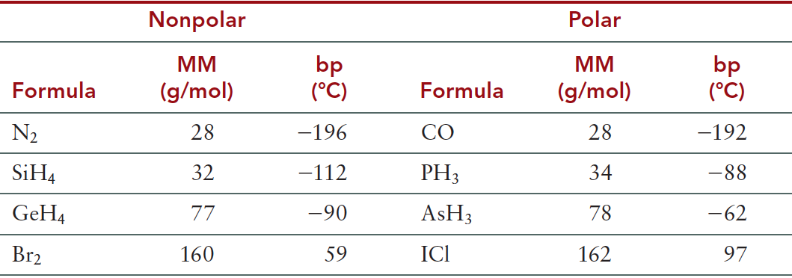
Boiling Points of Nonpolar Versus Polar Substances

Slide 34
Attractive Forces and Solubility
Solubility depends, in part, on the attractive forces of the solute and solvent molecules.
Like dissolves like.
Miscible liquids will always dissolve in each other.
Polar substances dissolve in polar solvents.
Hydrophilic groups = OH, CHO, C═O, COOH, NH₂, Cl
Nonpolar molecules dissolve in nonpolar solvents.
Hydrophobic groups = C—H, C—C
Many molecules have both hydrophilic and hydrophobic parts; solubility in water becomes a competition between the attraction of the polar groups for the water and the attraction of the nonpolar groups for their own kind.

Slide 35
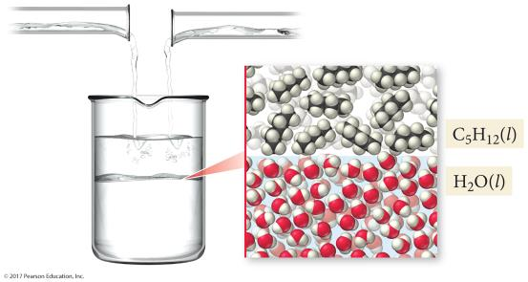
Immiscible Liquids
Pentane, C₅H₁₂, is a nonpolar molecule.
Water is a polar molecule.
The attractive forces among the water molecules are much stronger than their attractions for the pentane molecules. The result is that the liquids are immiscible.

Slide 36
Hydrogen Bonding
When a small, very electronegative atom is bonded to hydrogen, it strongly pulls the bonding electrons toward it.
O─H, N─H, or F─H
Because hydrogen has no other electrons, when its electron is pulled away, the nucleus becomes de-shielded, exposing the H proton.
The exposed proton acts as a very strong center of positive charge, attracting all the electron clouds from neighboring molecules.

Slide 37
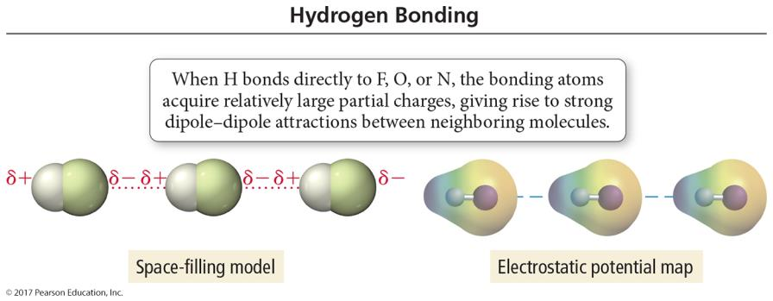
Hydrogen Bonding

Slide 38
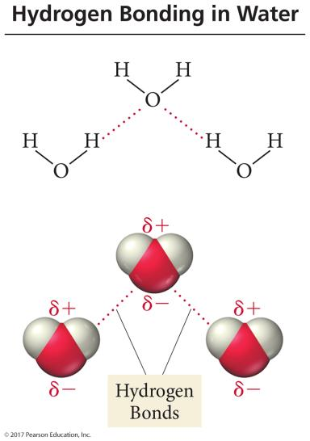
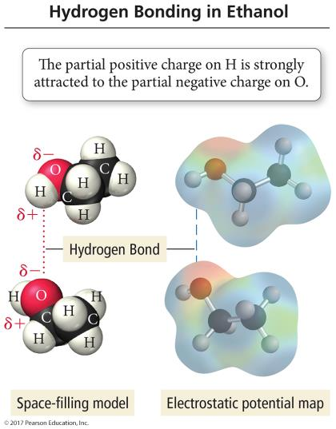
Hydrogen Bonding in Water and Ethanol

Slide 39
Hydrogen Bonds
Hydrogen bonds are very strong intermolecular attractive forces.
Stronger than dipole–dipole or dispersion forces
Substances that can hydrogen bond will have higher boiling points and melting points than similar substances that cannot.
But, hydrogen bonds are not nearly as strong as chemical bonds.
2–5% the strength of covalent bonds

Slide 40
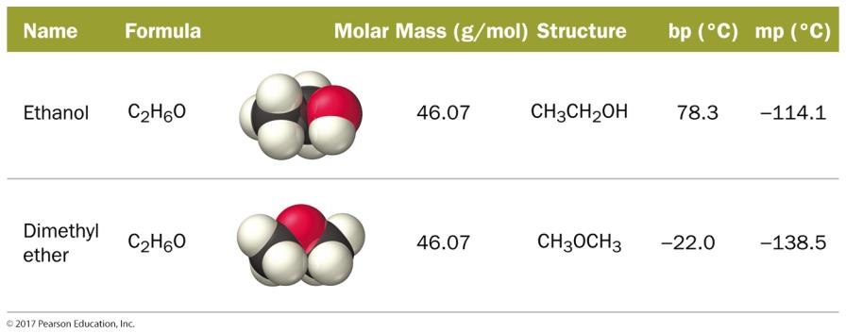
Effect of Hydrogen Bonding on Boiling Point

Slide 41
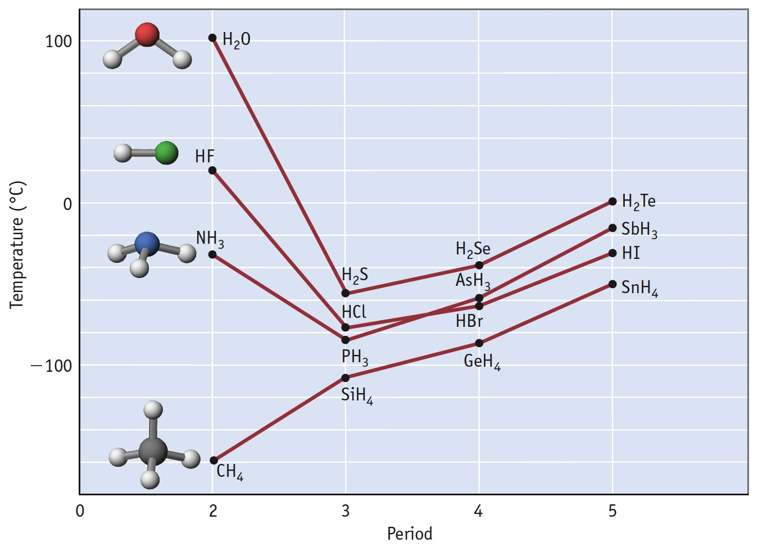
Boiling Points of Simple Hydrogen-Containing Compounds
18 g/mol
Notice that water has an unusually high bp for its M_{wt}...
20 g/mol
17 g/mol
This is a result of hydrogen bonding!
16 g/mol

Slide 42
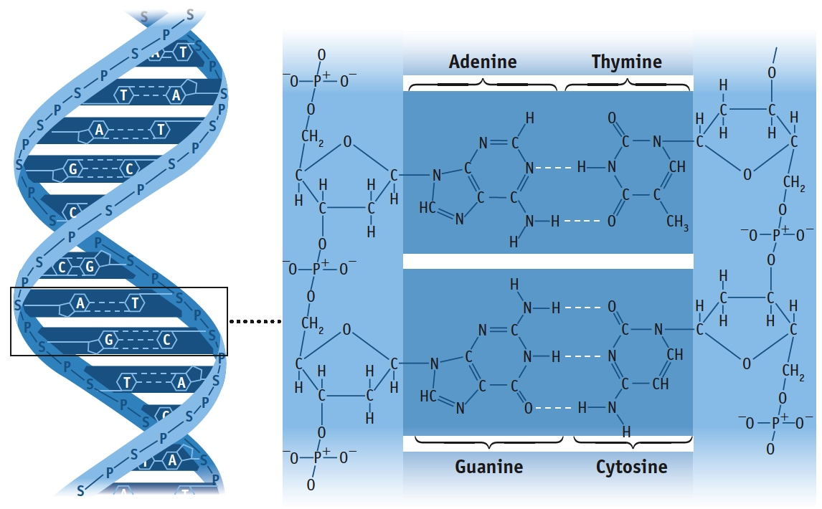
Hydrogen Bonding in DNA

Slide 43
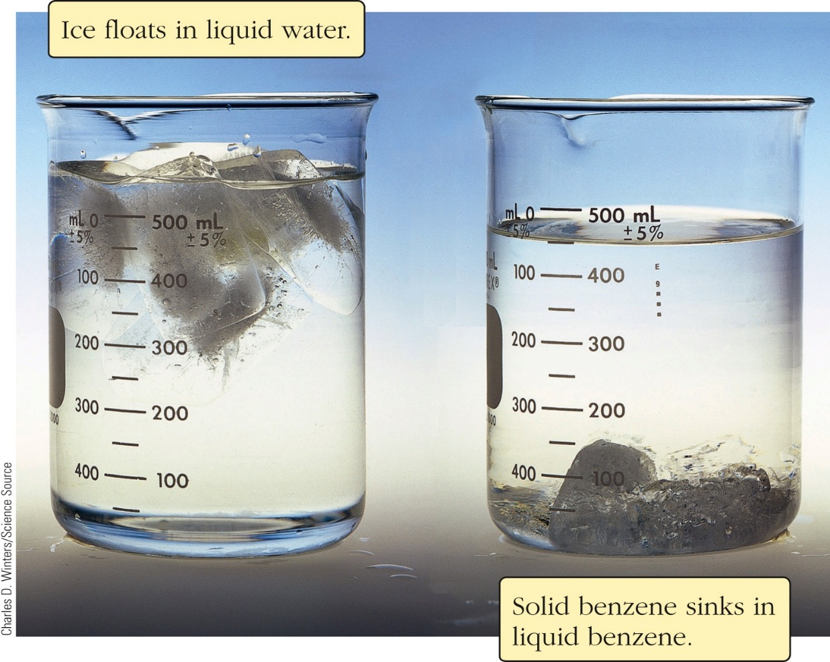
Unusual Properties of Water
Most liquids: Lower T = higher density.
Most materials: d_{solid} > d_{liquid}
Not water!
The H-bonds allow the molecules in the liquid phase to approach closer than normal for non H-bonding liquids
Ice has open lattice-like structure

Slide 44
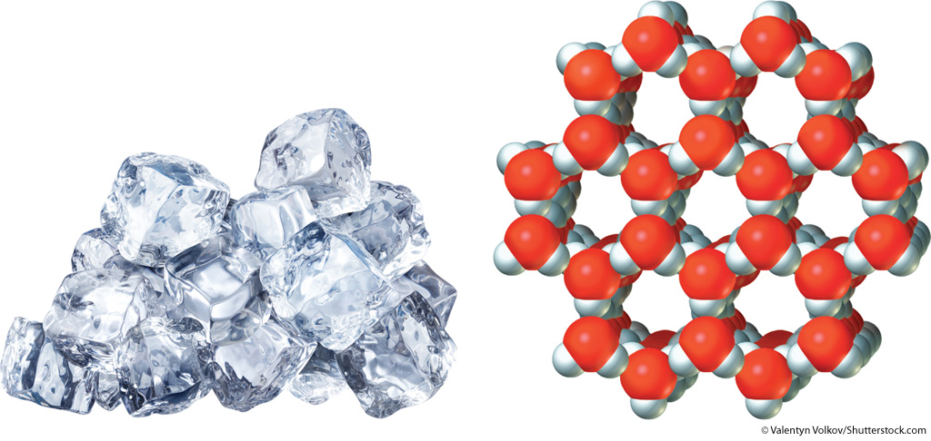
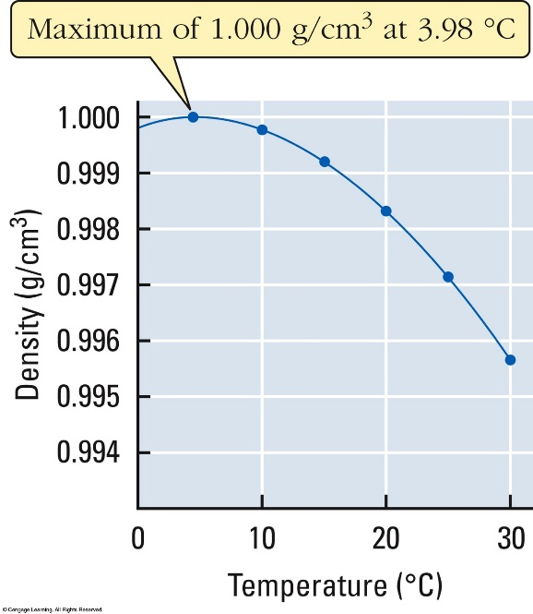
Unusual Properties of Water
Liquid water reaches maximum density at 3.98 °C not at its freezing point (0 °C).
The Structure of Ice
Ice floats on water, insulating the water below it.
These facts allow aquatic life to survive at low T.

Slide 45
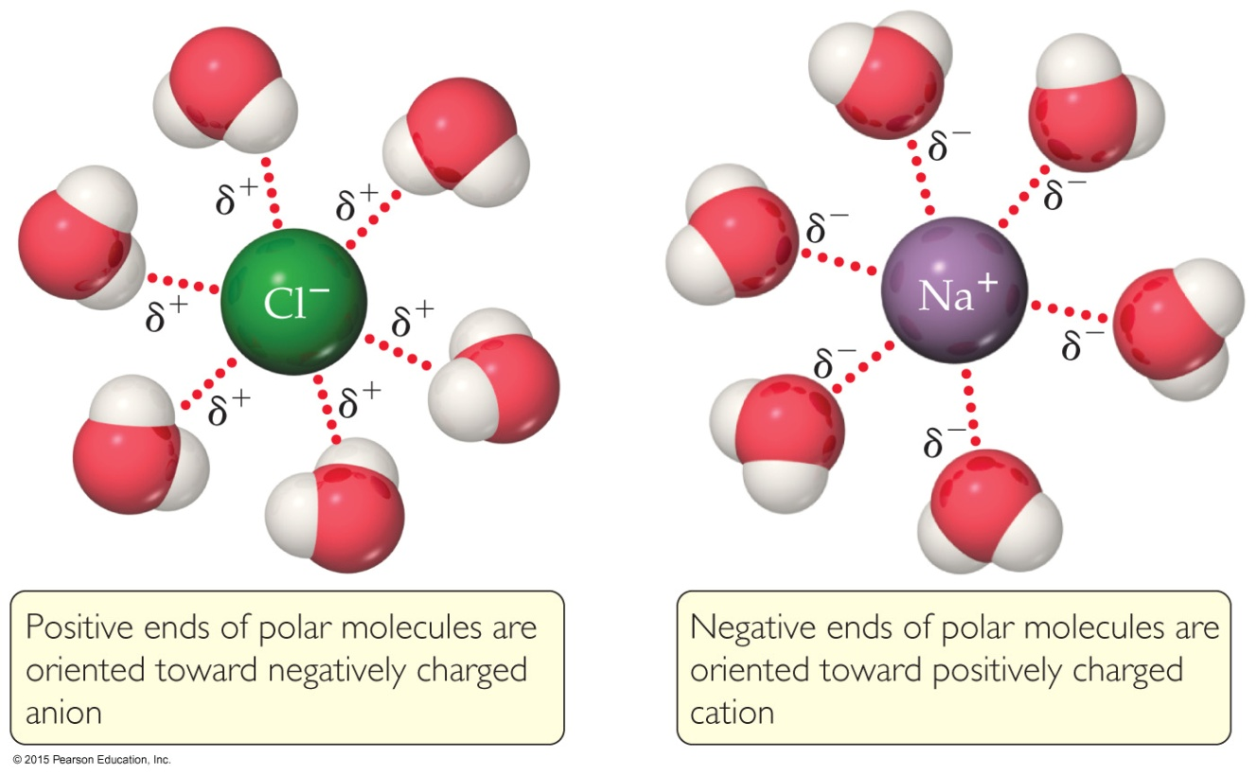
Ion–Dipole Interactions
Ion–dipole interactions are found in solutions of ions.
The strength of these forces is what makes it possible for ionic substances to dissolve in polar solvents.

Slide 46
Enthalpies of Hydration: A Measure of Ion-Dipole Forces
As the size of the ion increases, the exothermicity of the process decreases

Slide 47
Dipole/Induced Dipole
Polar molecules i.e. water can create or induce dipoles in molecules that do not have dipoles

Slide 48
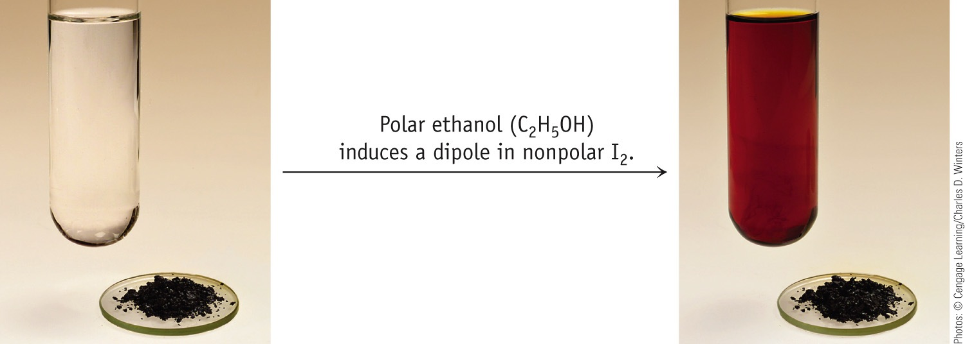
Dipole/Induced Dipole

Slide 49
Why is this important
Various gases such as O₂, N₂, H₂, and CO₂ are not very soluble in water because they are essentially non-polar
But, oxygen must be dissolved in water to sustain fish life
This is due to these Dipole induce Forces

Slide 50
Forces Involving Induced Dipoles
How can non-polar molecules such as O₂ and I₂ dissolve in water?
The water dipole INDUCES a dipole in the O₂ electron cloud.
Dipole-induced dipole

Slide 51
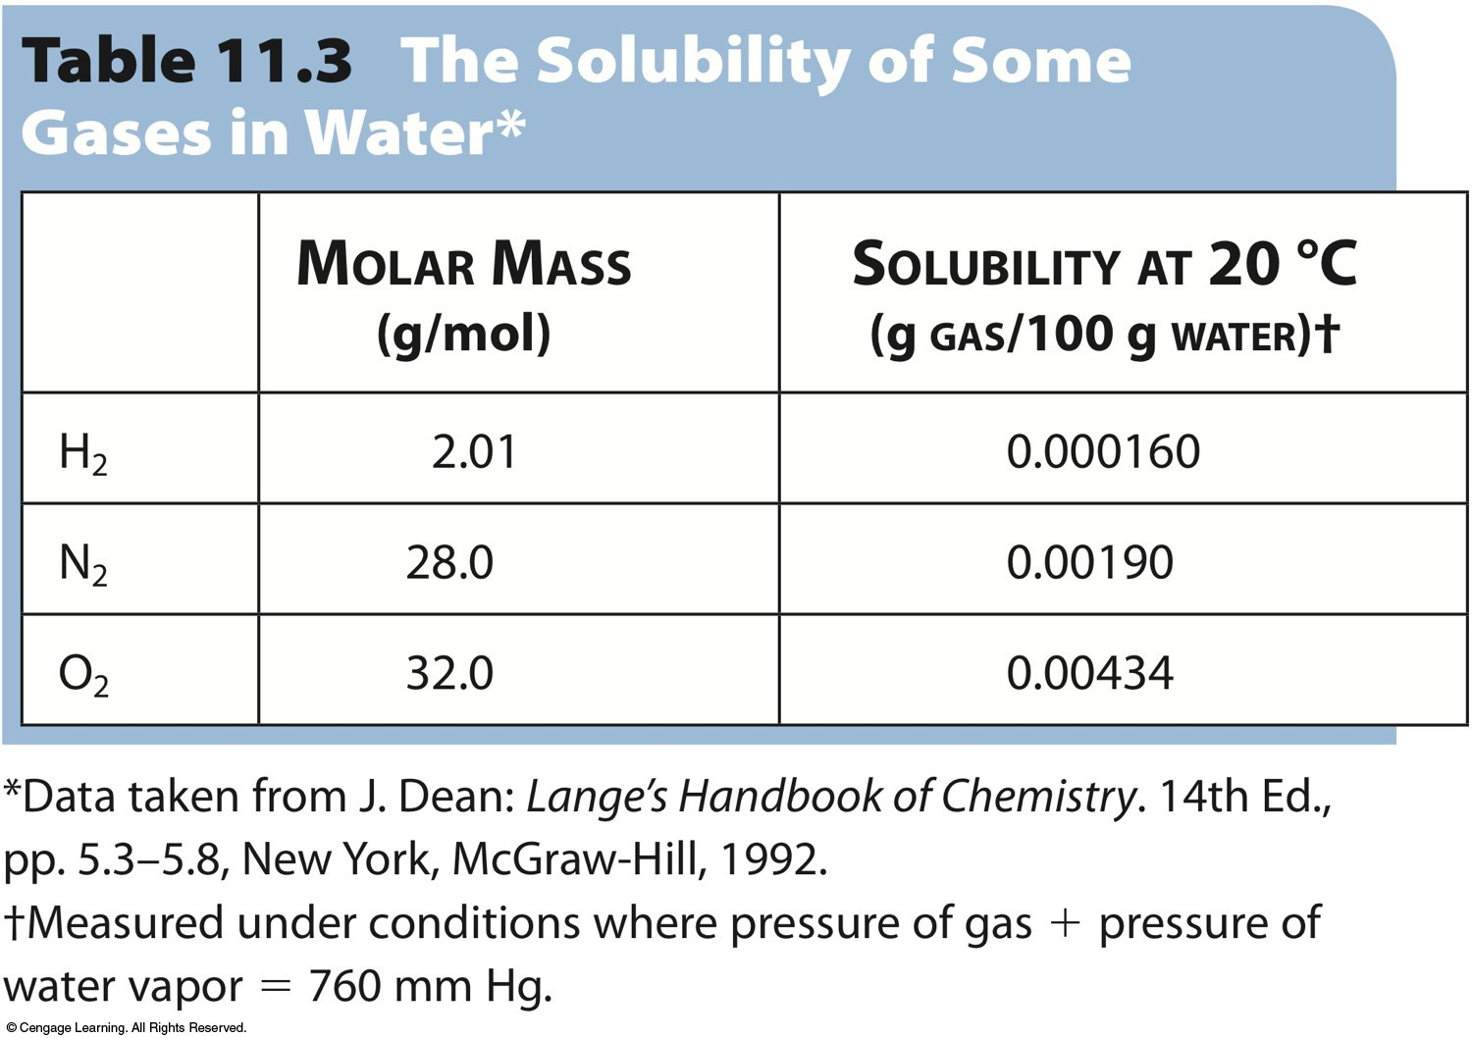
Induced Dipole Forces

Slide 52
Summary
Dispersion forces are the weakest of the intermolecular forces.
Dispersion forces are present in all molecules and atoms.
The magnitude of the dispersion forces increases with molar mass.
Polar molecules also have dipole–dipole attractive forces.

Slide 53
Summary (cont.)
Hydrogen bonds are the strongest of the intermolecular attractive forces a pure substance can have.
Hydrogen bonds will be present when a molecule has H directly bonded to either O, N, or F atoms.
The only example of H bonded to F is HF.
Ion–dipole attractions are present in mixtures of ionic compounds with polar molecules.
Ion–dipole attractions are the strongest intermolecular attraction.
Ion–dipole attractions are especially important in aqueous solutions of ionic compounds.

Slide 54
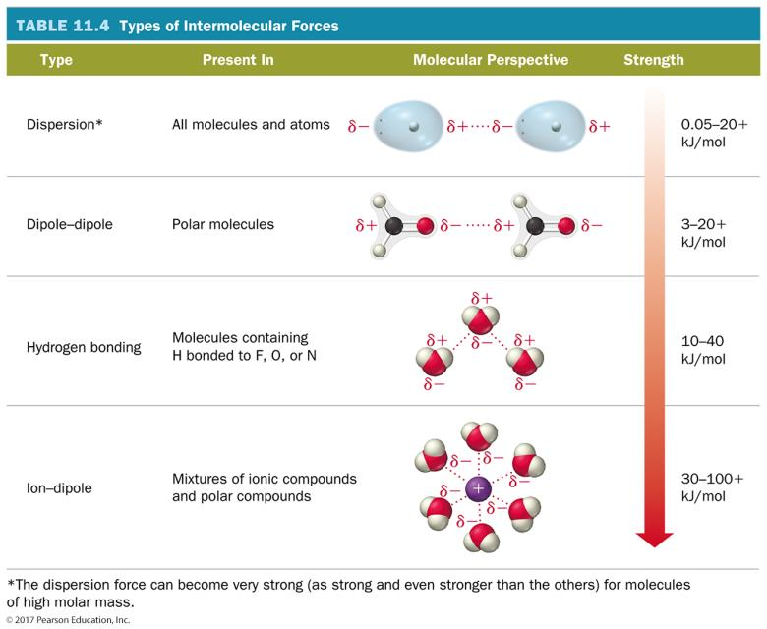

Slide 55
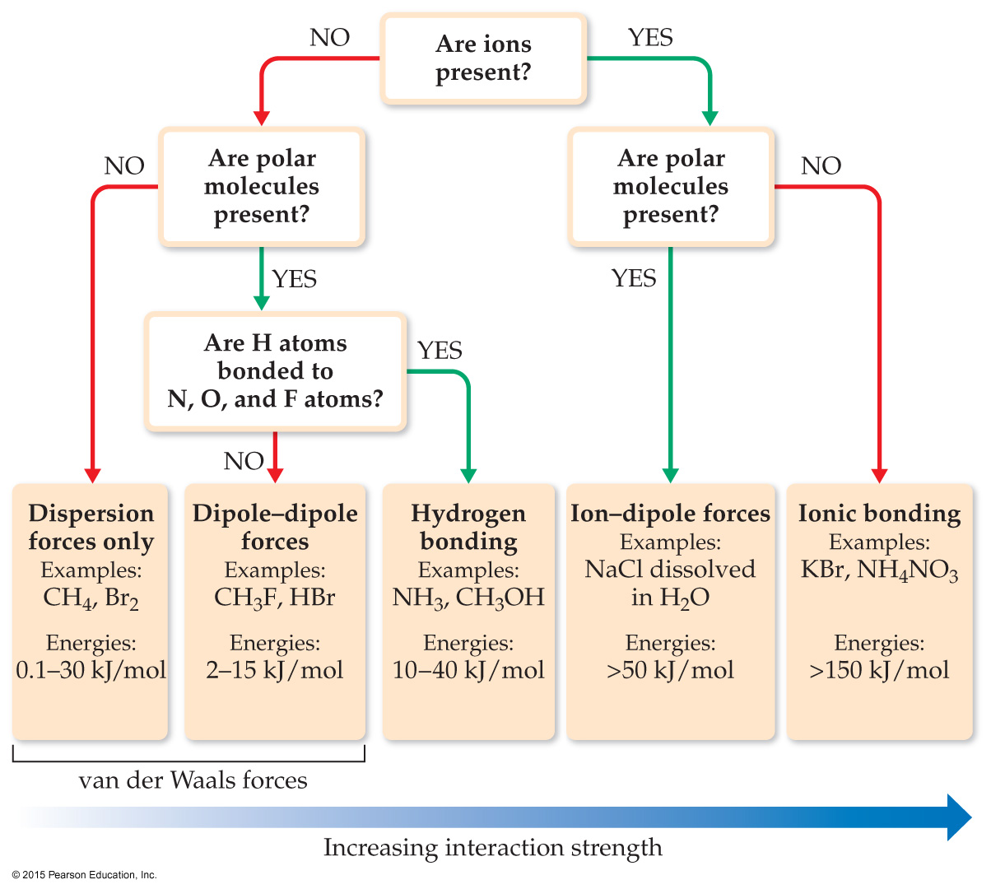
Summarizing Intermolecular Forces

Slide 56
Example
What types of intermolecular forces are present in nitrogen, N₂, chloroform, CHCl₃, carbon dioxide, CO₂, and ammonia, NH₃?
Strategy:
Write the Lewis structure for each molecule
Determine polarity. Polar molecules have dipole forces
Check for the presence of H–N, H–O, and H–F bonds. The presence of these bonds indicates hydrogen bonding
All molecules have dispersion forces

Slide 57
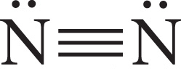
Example
Solution:
N₂
Lewis structure:
Polarity:
Nonpolar - No dipole forces present
H–N , H–O, and H–F bonds?
No. Hydrogen bonding not possible.
Intermolecular forces - dispersion forces

Slide 58
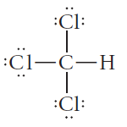
Example
CHCl₃
Lewis structure:
Polarity:
Polar - Dipole forces present
H–N, H–O, and H–F bonds?
No. Hydrogen bonding not possible.
Intermolecular forces - dispersion and dipole forces

Slide 59
Example
CO₂
Lewis structure:
Polarity:
Nonpolar - No dipole forces present
H–N, H–O, and H–F bonds?
No. Hydrogen bonding not possible
Intermolecular forces - dispersion forces

Slide 60
Example
NH₃
Lewis structure:
Polarity:
Polar - Dipole forces present
H–N, H–O, and H–F bonds?
Yes. Hydrogen bonding possible
Intermolecular forces - dispersion, hydrogen bonds, and dipole forces

Slide 61
Types of Solids
We will now look at solids in more detail. We will first identify the basic unit that makes up the solid and the forces between those units. We will then use this information to classify solids into one of four types: molecular solid, ionic solid, metallic solid, or covalent network solid.

Slide 62
Types of Solids
A molecular solid consists of atoms or molecules. It is held together by intermolecular forces.
A metallic solid consists of the positive cores of metal atoms. It is held together by metallic bonding, a “sea” of delocalized electrons.

Slide 63
Types of Solids
An ionic solid is composed of cations and anions. It is held together by ionic bonds, the electrical attractions between oppositely charged particles.
A covalent network solid consists of atoms. These atoms are held together in large chains or networks by covalent bonds.

Slide 64
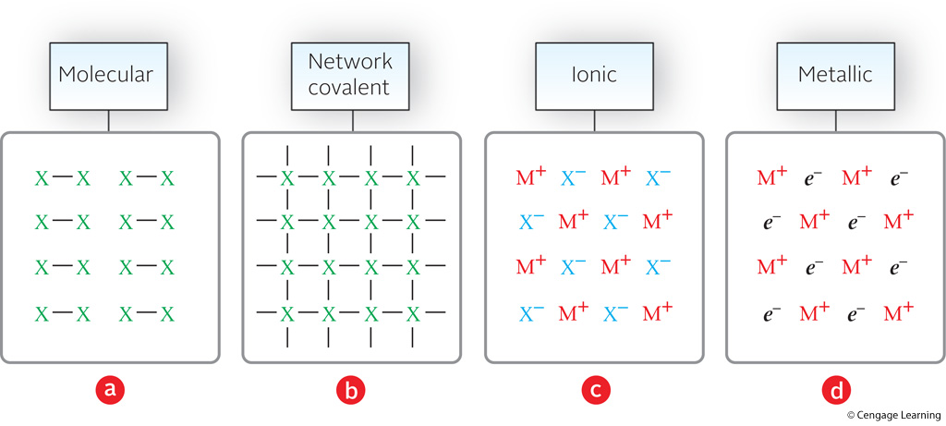
Diagrams of Four Types of Substances

Slide 65
Physical properties such as melting point, hardness, and electrical conductivity are related to solid structure.
Table 11.1 gives melting points and boiling points for various solids, indicating the solid structure of each.

Slide 66
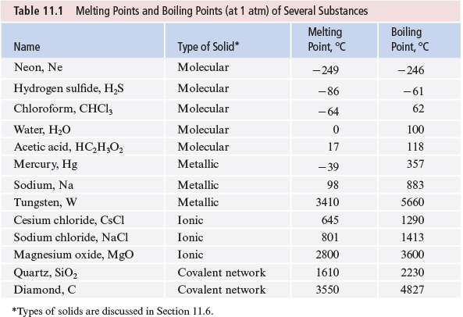

Slide 67
Physical Properties
In general, molecular solids have lower melting points, and covalent network solids and ionic solids have high melting points.
The melting points of ionic solids vary owing to differences in lattice energy which, in turn, depends on ionic charges.
The melting points of metals vary considerably.

Slide 68
Physical Properties
Hardness depends on how easily the structural units can be moved relative to one another.
Molecular solids tend to be soft. By contrast, three-dimensional covalent network solids, such as diamond, are very hard.

Slide 69
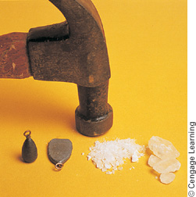
Physical Properties
Ionic compounds are brittle because they tend to fracture easily along crystal planes.
Metals are malleable, so that they can be easily shaped by hammering.

Slide 70
Physical Properties
Metals are good electrical conductors because of their delocalized valence electrons.
Ionic solids do not conduct electricity. When melted, however, they do conduct electricity.

Slide 71
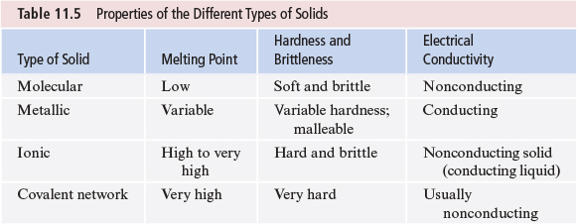

Slide 72
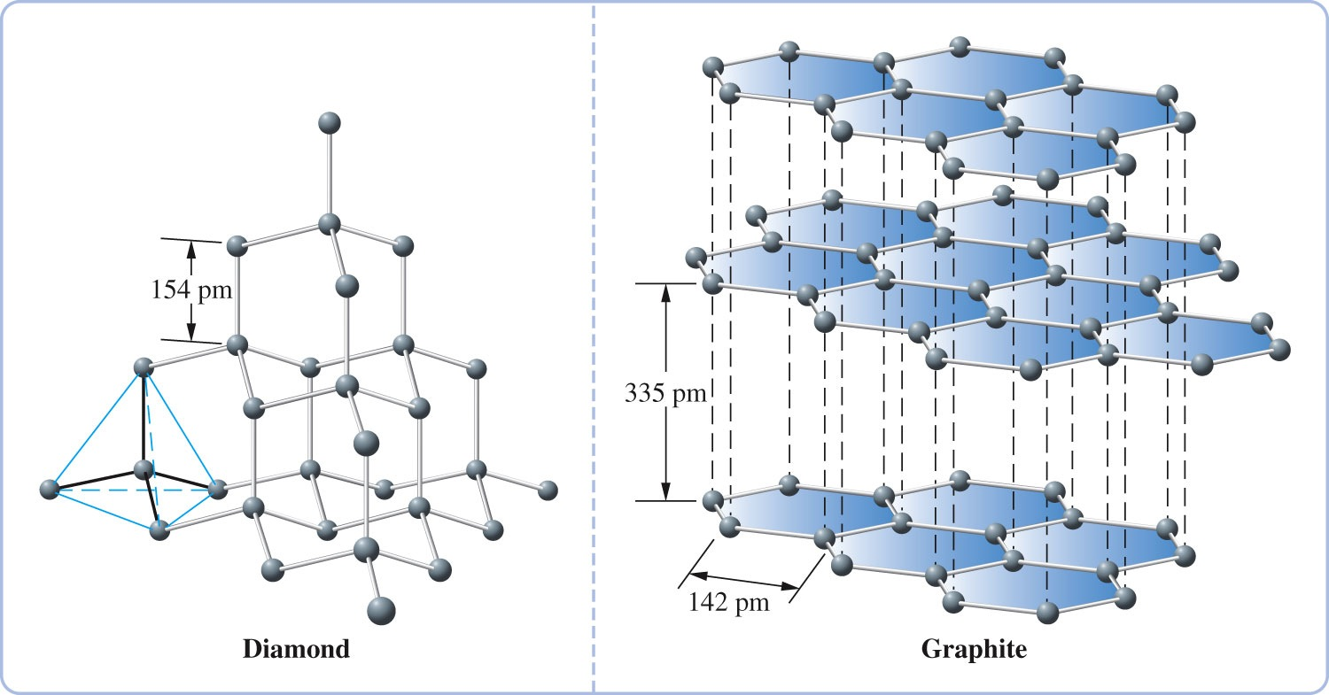
Carbon exists as a covalent network solid in both the graphite and diamond forms.

Slide 73
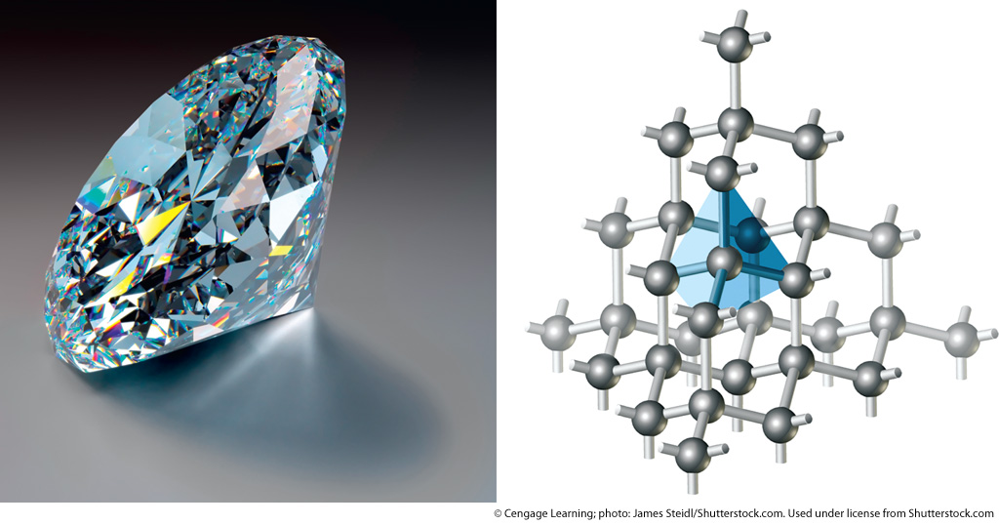
The Structure of a Diamond

Slide 74
The Structure of Graphite

Slide 75
Kinds of Solids
Covalent Network Solids: Particles are atoms linked together by covalent bonds into a giant, three-dimensional array. An example is quartz.

Slide 76
Crystal Structure of Quartz
Quartz
Common form of SiO₂
Major component of sand
Tetrahedral structure

Slide 77
Structures and Properties of Types of Substances

Slide 78
Example
For each species in column A, choose the description in column B that best applies
A | B
CO₂ | (a) ionic, high-melting
CuSO₄ | (b) liquid metal, good conductor
SiO₂ | (c) polar molecule, soluble in water
Hg | (d) ionic, insoluble in water
 | (e) network covalent, high-melting
 | (f) nonpolar molecule, gas at 25°C

Slide 79
Example
Strategy:
Characterize each species with respect to type, forces within and between particles, and if necessary, physical properties
Find the appropriate matches

Slide 80
Example
Solution:
(a) CO₂
Molecule, nonpolar
Only match is (f) even if you did not know that CO₂ is a gas at 25° C
(b) CuSO₄
Ionic, water soluble
Only match is (a) even if you did not know that CuSO₄ has a high melting point

Slide 81
Example
(c) SiO₂
Network covalent
Only match is (e)
(d) Hg
Metal, liquid at room temperature
Only match is (b)

