Slide 1
Molecular Weight (MW)
The sum of the atomic weights of all the atoms in a molecule of the substance.
Formula Weight (FW)
The sum of the atomic weights of all atoms in a formula unit of the compound, whether molecular or not.
©2017 Cengage Learning. All Rights Reserved. May not be copied, scanned, or duplicated, in whole or in part, except for use as permitted in a license distributed with a certain product or service or otherwise on a password-protected website for classroom use.

Slide 2
Formula Weight
Calculate the formula weight of the following compound using its atomic weight (AW).
Chloroform, (CHCl₃)
The answer rounded to three figures is 119 amu.

Slide 3
Molecular Weight (MW)
A molecular weight is the sum of the atomic weights of the atoms in a molecule.
For the molecule ethane, C₂H₆, the molecular weight would be
C: 2(12.011 amu)
+ H: 6(1.00794 amu)
30.070 amu

Slide 4
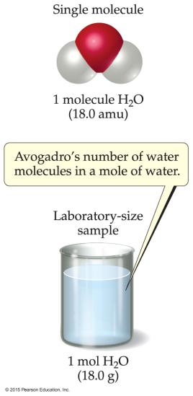
Avogadro’s Number
In a lab, we cannot work with individual molecules. They are too small.
6.02 × 10²³ atoms or molecules is an amount that brings us to lab size. It is ONE MOLE.
One mole of ¹²C has a mass of 12.000 g.

Slide 5
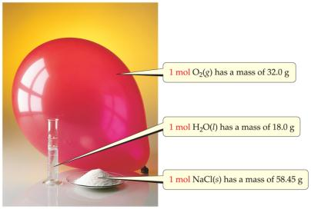
Molar Mass
A molar mass is the mass of 1 mol of a substance (i.e., g/mol).
The molar mass of an element is the atomic weight for the element from the periodic table. If it is diatomic, it is twice that atomic weight.
The formula weight (in amu’s) will be the same number as the molar mass (in g/mol).

Slide 6
Amount of Substance: The Mole
A counting unit – a familiar counting unit is a “dozen”:
1 dozen eggs = 12 eggs
1 dozen peas = 12 peas
1 mole (mol) = Number of atoms in 12 g of ¹²C
Latin for “heap” or “pile”
1 mol = 6.02214179 x 10²³ “units”
Avogadro’s number
ערימה
1 mole eggs = 6.02 x 10²³ eggs
1 mole peas = 6.02 x 10²³ peas

Slide 7
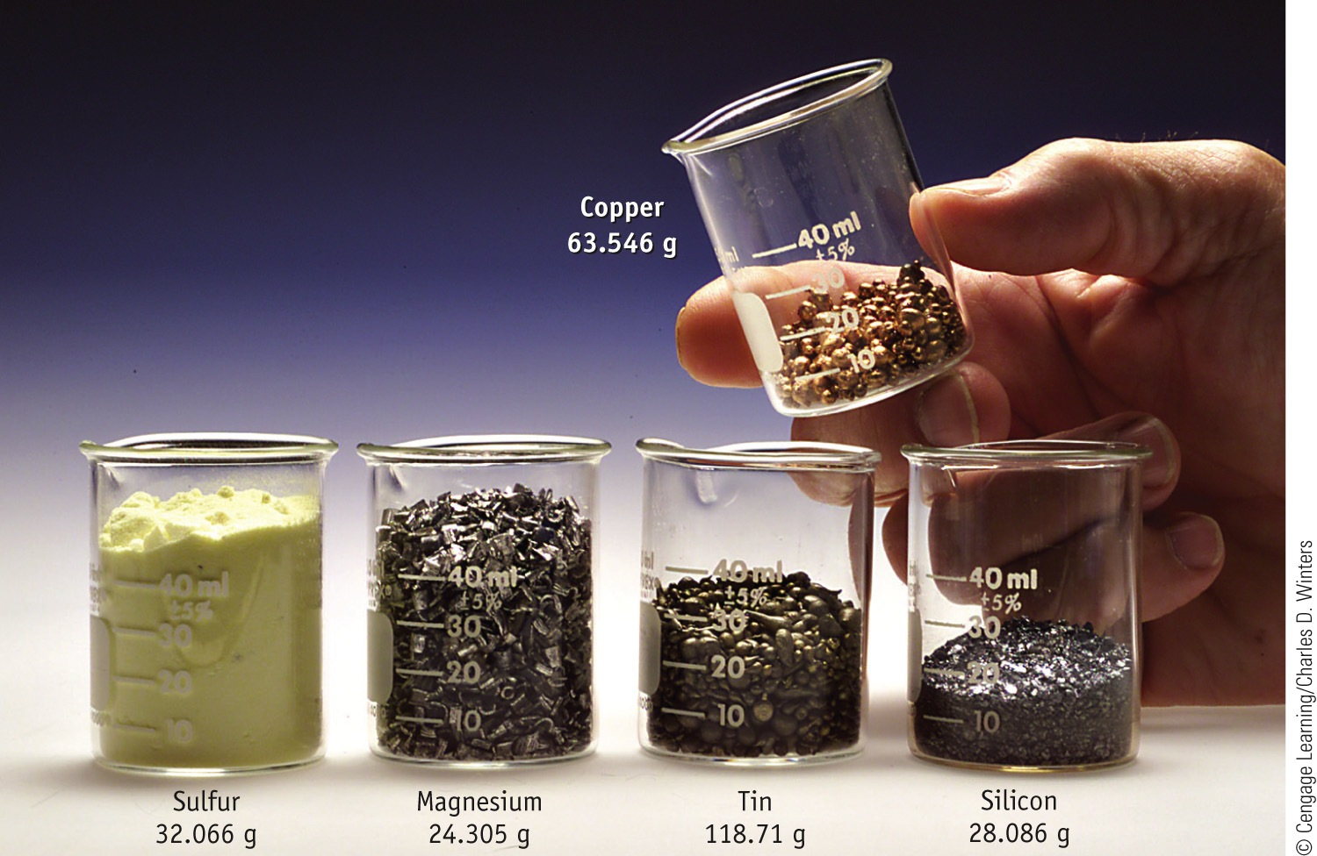
One-Mole Amounts
S₈
X 8 = 256.53 g

Slide 8
Molecular mass vs Molar mass
Molecular mass
mass of 1 molecule in amu
Molar mass
mass of 1 mole in grams

Slide 9
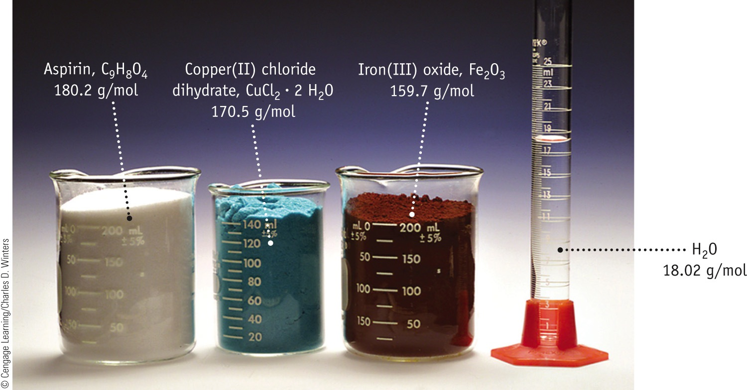
Molar Masses
Note that the mass of water is included in the molar mass of a compound.

Slide 10
Example
Acetylsalicylic acid (ASA), C₉H₈O₄, is the active ingredient of aspirin. What is the mass in grams of 0.509 moles of ASA?
Analysis:
Information given moles of ASA (0.509)
formula of ASA C₉H₈O₄
Information implied molar mass of ASA
Asked for mass of ASA
Strategy:
Substitute into the equation

Slide 11
Example
Solution:
MM of C₉H₈O₄
9(12.01) + 8(1.008) + 4(16.00) = 180.15 g/mol
Mass
חשב את מספר המולקולות של אספירין
מספר מולקולות = מספר מולים X מספר אבוגדרו
= 0.509 mol X 6.02X10²³ $\frac{molecules}{mol}$ = 3.06X10²³ molecules

Slide 12
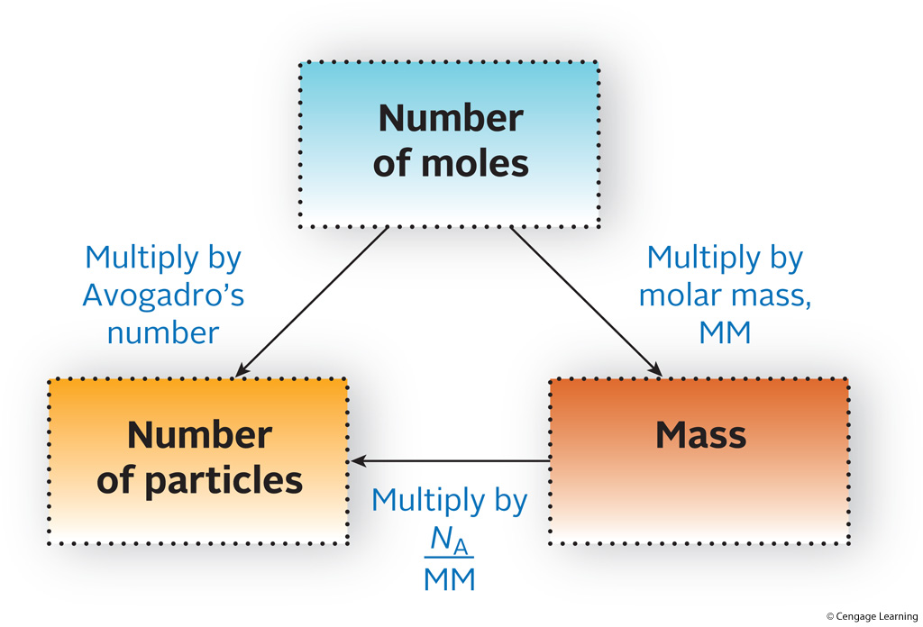
Flowchart for the Interconversion of Particles, Mass, and Moles

Slide 13
Percentage Composition
The mass percentage of each element in the compound. It helps determine the formula of new compounds.
Mass Percentage
Suppose that A is a part of something—that is, part of a whole.
The mass percentage of A in a substance is the parts of A per hundred parts of the total, by mass.
©2017 Cengage Learning. All Rights Reserved. May not be copied, scanned, or duplicated, in whole or in part, except for use as permitted in a license distributed with a certain product or service or otherwise on a password-protected website for classroom use.

Slide 14
Percentage Composition
Determine the grams of carbon present in 83.5 g CH₂O. Use the following data:
C = 40.0 %
H = 6.73 %
O = 53.3 %
Determining the mass of carbon in 83.5 g CH₂O,
©2017 Cengage Learning. All Rights Reserved. May not be copied, scanned, or duplicated, in whole or in part, except for use as permitted in a license distributed with a certain product or service or otherwise on a password-protected website for classroom use.

Slide 15
Example
Metallic iron is most often extracted from hematite ore, which consists of iron(III) oxide mixed with impurities such as silicon dioxide, SiO₂. What are the mass percents of iron and oxygen in iron(III) oxide?
Analysis:
Information given formula of the iron oxide (Fe₂O₃)
Information implied molar mass (MM) of Fe₂O₃
Asked for mass % of Fe and O in Fe₂O₃

Slide 16
Example
Strategy:
To find the mass percent of Fe follow the plan outlined below. Start with one mole of Fe₂O₃
Find the mass percent of oxygen by difference. Note that the compound is made up of only two elements, Fe and O

Slide 17
Example
Solution:
Mass % Fe
Mass % O
Mass % O = 100 % - mass % Fe = 100 % – 69.94 %
= 30.06 %

Slide 18
Empirical Formula (Simplest Formula)
The formula of a substance written with the smallest integer subscripts.
For example, The empirical formula for H₂O₂ is HO.
Compound Mol. formula Emp. formula
Hydrogen peroxide H₂O₂ HO
Borane (boron trihydride) BH₃ BH₃
Diborane (diboron hexahydride) B₂H₆ BH₃
Octene C₈H₁₆ CH₂
Butene C₄H₈ CH₂
©2017 Cengage Learning. All Rights Reserved. May not be copied, scanned, or duplicated, in whole or in part, except for use as permitted in a license distributed with a certain product or service or otherwise on a password-protected website for classroom use.

Slide 19
Determining the molecular formula requires:
The percentage composition
The molecular weight
Determining the empirical formula for a substance involves converting the masses of the elements to moles.
©2017 Cengage Learning. All Rights Reserved. May not be copied, scanned, or duplicated, in whole or in part, except for use as permitted in a license distributed with a certain product or service or otherwise on a password-protected website for classroom use.

Slide 20
A compound of nitrogen and oxygen is analyzed and a sample weighing 1.587 g is found to contain 0.483 g N and 1.104 g O. Determine the empirical formula of the compound.
©2017 Cengage Learning. All Rights Reserved. May not be copied, scanned, or duplicated, in whole or in part, except for use as permitted in a license distributed with a certain product or service or otherwise on a password-protected website for classroom use.

Slide 21
Converting masses to moles,
1.104 g x $\frac{1 mol O}{16.00 g O}$
Dividing the bigger mole number by the smaller one results in the smallest integers.
N = 1.00
O = 2.00
As the ratio of N to O is 1:2, the empirical formula is NO₂
©2017 Cengage Learning. All Rights Reserved. May not be copied, scanned, or duplicated, in whole or in part, except for use as permitted in a license distributed with a certain product or service or otherwise on a password-protected website for classroom use.

Slide 22
Determining molecular formula from empirical formula
For any molecular compound,
n is the number of empirical formula units in the molecule.
Multiplying the subscripts of the empirical formula by n gives the molecular formula.
©2017 Cengage Learning. All Rights Reserved. May not be copied, scanned, or duplicated, in whole or in part, except for use as permitted in a license distributed with a certain product or service or otherwise on a password-protected website for classroom use.

Slide 23
Determine the empirical formula and molecular formula of acetic acid using the following data.
Percentage composition of acetic acid:
C = 39.9%
H = 6.72%
O = 53.4%
Molecular weight of acetic acid = 60.0 amu
©2017 Cengage Learning. All Rights Reserved. May not be copied, scanned, or duplicated, in whole or in part, except for use as permitted in a license distributed with a certain product or service or otherwise on a password-protected website for classroom use.

Slide 24
100.0 g of acetic acid contains 39.9 g C, 6.72 g H, and 53. 4 g O.
Converting into moles gives:
C = 3.33 mol
H = 6.67 mol
O = 3.34 mol
Dividing the mole numbers by the smallest one gives:
C = 1.00
H = 2.00
O = 1.00
The empirical formula of acetic acid is CH₂O.
©2017 Cengage Learning. All Rights Reserved. May not be copied, scanned, or duplicated, in whole or in part, except for use as permitted in a license distributed with a certain product or service or otherwise on a password-protected website for classroom use.

Slide 25
Empirical formula weight of CH₂O is 30.0 amu.
Calculating the molecular formula of CH₂O,
The molecular formula of acetic acid is (CH₂O)₂ or C₂H₄O₂
©2017 Cengage Learning. All Rights Reserved. May not be copied, scanned, or duplicated, in whole or in part, except for use as permitted in a license distributed with a certain product or service or otherwise on a password-protected website for classroom use.

Slide 26
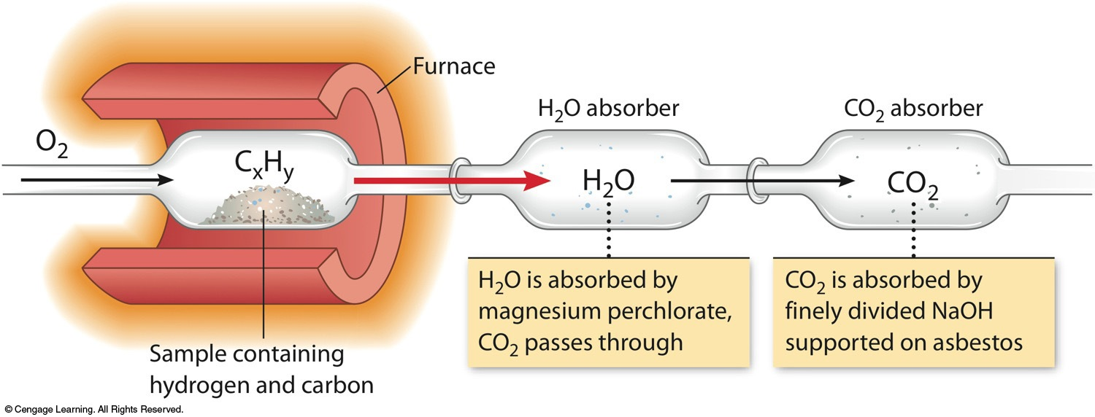
Determining the Formula of Hydrocarbon by Combustion
Combustion involves the addition oxygen to another element.
When hydrocarbon molecules burn completely, the products are always carbon dioxide gas and water.

Slide 27
Combustion Analysis Problem:
1.516 g of a compound containing carbon, hydrogen and oxygen (C_{X}H_{Y}O_{Z}) is subjected to combustion analysis.
The results show that 2.082 g of CO₂ and 1.705 g of H₂O were produced.
What is the empirical formula for the compound?
If the molecular weight of the compound is 160.2 g/mol, what is the molecular formula of the compound?

Slide 28
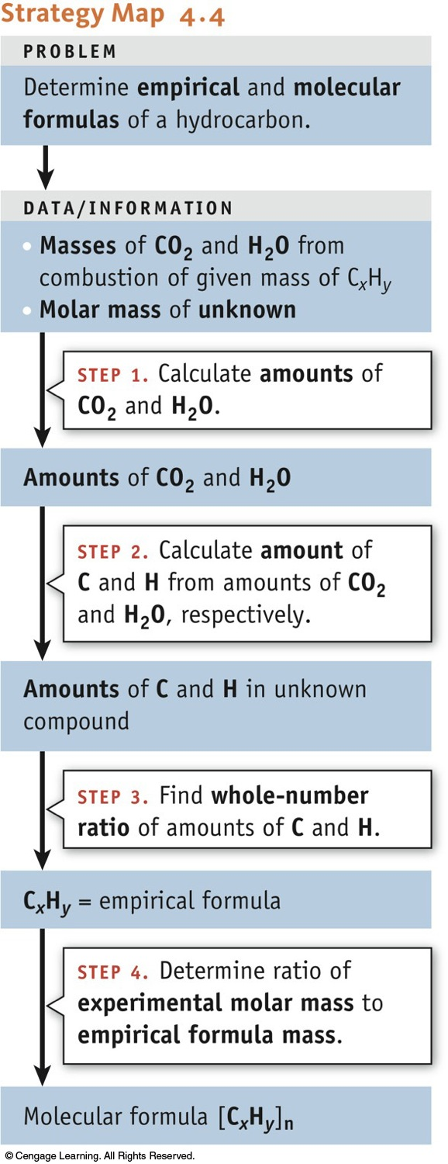
Strategy

Slide 29
Solution to the problem:
g CO₂
mol CO₂
mol C
Don’t forget the mole ratio…
g H₂O
mol H₂O
mol H

Slide 30
Combustion Analysis Problem
You can’t determine the oxygen in the sample from either CO₂ or H₂O…
Think about what is happening to the sample:
C_{x}H_{y}O_{z} + O₂(g) → CO₂(g) + H₂O (l)
The oxygen in the CO₂ and H₂O came from both the sample and the O₂ in the furnace!
Since there is no way to know how much of that oxygen came from the sample and the O₂, you cannot determine the oxygen in the sample directly!

Slide 31
Combustion Analysis Problem
original sample mass
mass of C and H in sample

Slide 32
Combustion Analysis Problem
Collecting the results:
yields
C_{X}H_{Y}O_{Z}
Both carbon and oxygen have the smallest numbers of mols: Divide each set of mols by 0.04731.
The empirical formula is: CH₄O

Slide 33
Combustion Analysis Problem
Determining the Molecular Formula
For some compounds, the molecular formula is a multiple of the empirical formula:
empirical formula
molecular formula
n x C_{X}H_{Y}O_{Z} = C_{nX}H_{nY}O_{nZ}
n = 2,3,4…
Since the molecular formula is a multiple is scaled by a factor “n”, the molecular and empirical molar masses must also scale by the same ratio.

Slide 34
Combustion Analysis Problem
From the combustion analysis it was found that the empirical formula for the unknown compound was CH₄O.
This yields an empirical molar mass or empirical weight of:
[12.01 + 4x(1.0079) +16.00] g/mol =
32.04 g/mol

Slide 35
Stoichiometry
The calculation of the quantities of reactants and products involved in a chemical reaction.
Interpreting a Chemical Equation
A chemical equation may be interpreted in terms of either:
Numbers of molecules (or ions or formula units)
or
(2) Numbers of moles
©2017 Cengage Learning. All Rights Reserved. May not be copied, scanned, or duplicated, in whole or in part, except for use as permitted in a license distributed with a certain product or service or otherwise on a password-protected website for classroom use.

Slide 36
Representing Chemistry on Different Levels
2H₂(g) + O₂(g)
2H₂O(l)
Microscopic:
2 molecules of hydrogen gas react with 1 molecule of oxygen gas to yield 2 molecules of liquid water.
Physical states are often listed:
(g) gas (s) solid
(ℓ) liquid (aq) aqueous (dissolved in water)

Slide 37
Why Do We Add Coefficients Instead of Changing Subscripts to Balance?
Hydrogen and oxygen can make water OR hydrogen peroxide:
2 H₂(g) + O₂(g) → 2 H₂O(l)
H₂(g) + O₂(g) → H₂O₂(l)

Slide 38
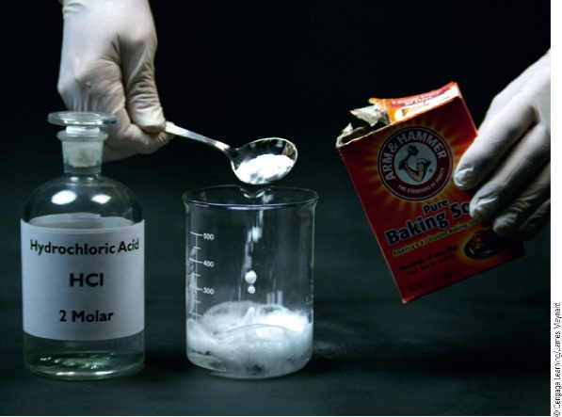
Chemical Equations
Any equation can be interpreted as referring to the nanoscale or macroscale:
NaHCO₃(s) + HCl(aq) → CO₂(g) + H₂O(ℓ) + NaCl(aq)
1 formula unit | + | 1 molecule | → | 1 molecule | + | 1 molecule | + | 1 form. unit
4 form. units | + | 4 molecules | → | 4 molecules | + | 4 molecules | + | 4 form. units
N_{A} form. units | + | N_{A} molecules | → | N_{A} molecules | + | N_{A} molecules | + | N_{A} form. units
1 mol | + | 1 mol | → | 1 mol | + | 1 mol | + | 1 mol

Slide 39
Steps in a stoichiometric calculation

Slide 40
Consider the following reaction and determine the grams of iron that can be produced from 1.00 kg of Fe₂O₃.

Slide 41
Determine the grams of HCl that react with 5.00 g of manganese dioxide according to the following reaction.

Slide 42
Limiting Reactant
The reactant that is entirely consumed when a reaction goes to completion.
Once one reactant has been completely consumed, the reaction stops.
The moles of product are always determined by the starting moles of the limiting reactant.
מגיב מגביל

Slide 43
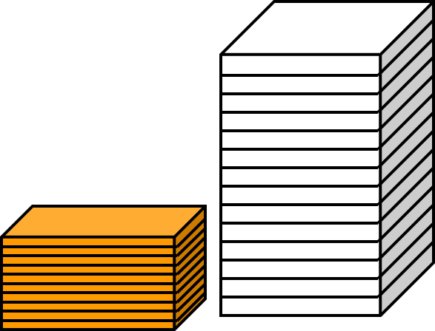
Limiting Reactant
Given 10 slices of cheese and 14 slices of bread. How many sandwiches can you make?
Balanced equation
1 cheese + 2 bread 1 sandwich
1 cheese ≡ 2 bread
1 cheese ≡ 1 sandwich
2 bread ≡ 1 sandwich

Slide 44
Limiting Reactant
Bread is limiting…
…base all other calculations on the limiting reactant.
Sandwiches made
1 sandwich
2 bread
14 bread x = 7 sandwiches
Cheese remaining
1 cheese
2 bread
14 bread x = 7 cheese used
Initially
Used
Excess cheese = 10 – 7 = 3 slices

Slide 45
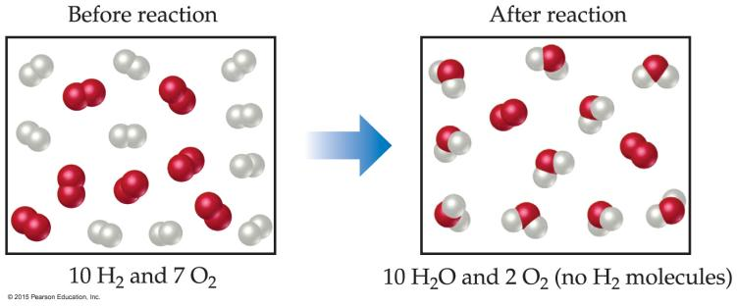
Limiting Reactants
The limiting reactant is the reactant present in the smallest stoichiometric amount.
In other words, it’s the reactant you’ll run out of first (in this case, the H₂).

Slide 46
Limiting Reactants
In the example below, the O₂ would be the excess reagent.
עודף

Slide 47
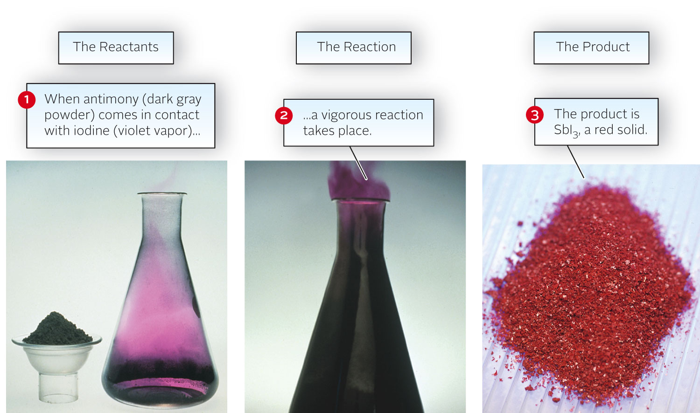
Limiting Reactant
2 Sb (s) + 3 I₂ (s) → 2 SbI₃ (s)

Slide 48
Example
Consider the reaction
What is the limiting reactant when 1.20 mol of Sb and 2.40 mol of I₂ are mixed?
Analysis:
Information given moles of each reactant: Sb (1.20), I₂ (2.40)
balanced equation
Asked for limiting reactant

Slide 49
Example
Strategy:
Find mol SbI₃ produced by first assuming Sb is limiting, and then assuming I₂ is limiting
mol Sb → mol SbI₃; mol I₂ → mol SbI₃
The reactant that gives the smaller amount of SbI₃ is limiting.

Slide 50
Example
Solution:
mol SbI₃
Limiting reactant
1.20 mol (Sb limiting) < 1.60 mol (I₂ limiting); the limiting reactant is Sb.

Slide 51
Limiting Reactant
Mole Ratio Method
Calculate the amount (mol) of two reactants and then their mole ratio. If:
actual < theoretical: numerator reactant is limiting.
actual > theoretical: numerator reactant is in excess.
Example
If 374 g of NH₃ and 768 g of O₂ are mixed, what mass of NO will form?
4 NH₃(g) + 5 O₂(g) → 4 NO(g) + 6 H₂O(g)

Slide 52
Limiting Reactant
374 g NH₃ + 768 g O₂, mass_{NO} formed? 4 NH₃ + 5 O₂ → 4 NO + 6 H₂O
Balanced? Yes
1 mol
17.03 g
n_{NH3} = 374 g = 21.96 mol
1 mol
32.00 g
n_{O2} = 768g = 24.00 mol
Mole ratio of reactants
24.00
21.96
5
4
actual = 1.093
theoretical = 1.25
actual < theo.
O₂ is limiting

Slide 53
Limiting Reactant
Mass of NO formed?
4 NH₃(g) + 5 O₂(g) → 4 NO(g) + 6 H₂O(g)
excess 24.00 mol ?
O₂ is limiting. Base all calculations on O₂.
4 NO
5 O₂
n_{NO} = 24.00 mol O₂ = 19.20 mol
30.01g
1 mol
mass_{NO} = 19.20 mol = 576 g

Slide 54
ניצולת
Theoretical Yield
The maximum amount of product that can be obtained by a reaction from given amounts of reactants.
This is a calculated amount.
©2017 Cengage Learning. All Rights Reserved. May not be copied, scanned, or duplicated, in whole or in part, except for use as permitted in a license distributed with a certain product or service or otherwise on a password-protected website for classroom use.

Slide 55
Actual Yield
The amount of product that is actually obtained.
This is a measured amount.
Percentage Yield
©2017 Cengage Learning. All Rights Reserved. May not be copied, scanned, or duplicated, in whole or in part, except for use as permitted in a license distributed with a certain product or service or otherwise on a password-protected website for classroom use.

Slide 56
Percent Yield
Few chemical reactions have 100% yield.
Possible reasons
Side reactions may produce undesired product(s).
Incomplete reaction due to poor mixing or reaching equilibrium…
Product loss during isolation and purification.
©2017 Cengage Learning. All Rights Reserved. May not be copied, scanned, or duplicated, in whole or in part, except for use as permitted in a license distributed with a certain product or service or otherwise on a password-protected website for classroom use.

Slide 57
Percent Yield
2.50 g of copper heated with an excess of sulfur made 2.53 g of copper(I) sulfide
16 Cu(s) + S₈(s) → 8 Cu₂S(s)
What was the percent yield for this reaction?
1 mol
63.55g
n_{Cu} used:
2.50 g
= 0.03934 mol Cu
Theoretical yield
16 Cu ≡ 8 Cu₂S
0.03934 mol Cu = 0.01967 mol Cu₂S
8 Cu₂S
16 Cu
©2017 Cengage Learning. All Rights Reserved. May not be copied, scanned, or duplicated, in whole or in part, except for use as permitted in a license distributed with a certain product or service or otherwise on a password-protected website for classroom use.

Slide 58
Percent Yield
2.50 g Cu + S₈ (excesss) made 2.53 g Cu₂S… What was the %-yield?
Theoretical yield (0.01967 mol Cu₂S)
159.2 g
1 mol
= 0.01967 mol Cu₂S = 3.131 g Cu₂S
Actual yield = 2.53 g Cu₂S (in problem)
2.53 g
3.131 g
Percent yield = x 100% = 80.8%
©2017 Cengage Learning. All Rights Reserved. May not be copied, scanned, or duplicated, in whole or in part, except for use as permitted in a license distributed with a certain product or service or otherwise on a password-protected website for classroom use.

